Slide 1
SS7G11 The student will explain the impact of location, climate, physical characteristics, distribution of natural resources, and population distribution on Southern and Eastern Asia.
a. Describe the impact climate and location has on population distribution in Southern and Eastern Asia.
b. Describe how the mountain, desert, and water features of Southern and Eastern Asia have affected the population in terms of where people live, the types of work they do, and how they travel.

Slide 2
What is population distribution?
Population distribution is basically where people live within a region.

Slide 3
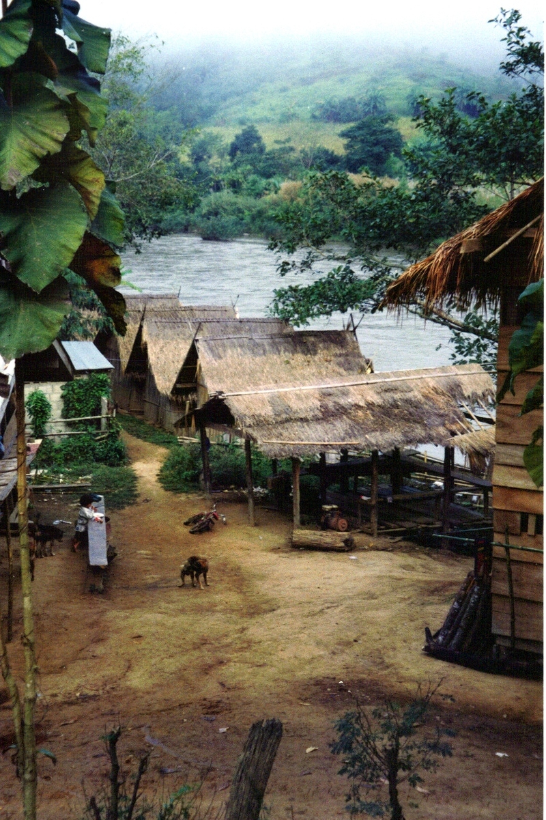
Why do people live where they live?
Climate
Location of country within a region
Physical features of a region

Slide 4
Climate
Climate is the average weather usually taken over a 30-year time period for a particular region and time period.
Climate is not the same as weather, but rather, it is the average pattern of weather for a particular region.

Slide 5
How does climate affect population distribution?
People are creatures of comfort.
Climate influences what we wear.
Climate influences what we eat.
Climate influences the types of houses in which we live.

Slide 6
Location
Where something is in relationship to other places in its region and the world.

Slide 7
How does location affect population distribution?
The location of a place in relationship to other areas will determine where people live.
The location of the physical features and natural resources will also influence population density.

Slide 8
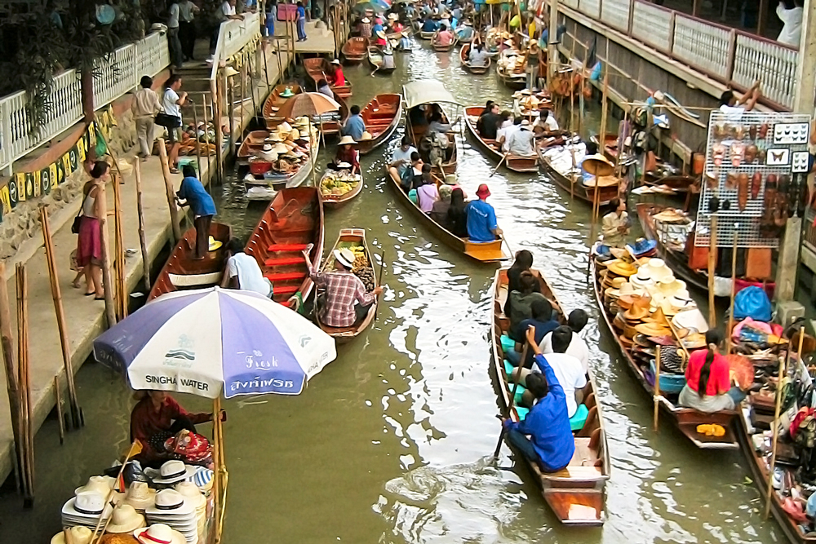
What impact do physical features have on us?
where we live
the types of work we do
how we travel

Slide 9
Mountains
The Himalayas
The ruggedness of the mountains keep many people from living in it’s range.
The rain-shadow effect of the mountains keeps most people out of western China.
People who travel through the mountains have to use vehicles capable of covering rough terrain.
People in the mountains perform more traditional work.

Slide 10
Deserts
The Gobi, Taklamakan and other desert areas
Most people avoid living in the western and northern portion of China.
Little to no water, sparse plant life.
Sandy, hot terrain makes life and travel difficult.
Inhabitants tend to be nomads (people who travel from place to place in search for food).

Slide 11
Water Features
Rivers, seas, oceans and wetlands
Fresh water, fertile soil, lots of plant and animal life.
Variety of work (farming to fishing to industrial).
Travel by boat.
Have to deal with flooding.

Slide 12
Sources
Slide 2: http://education.randmcnally.com/classroom/action/viewLargerMapImage.do?mapFileName=Asia_Population.png&imageTitle=Asia%20Population%20Density%20Map&skillLevel=Elem&oid=1073906999
Slide 3: http://www.orangesmile.com/travelguide/manila/; http://www.boldlygosolo.com/boldly_go_solo/asia/
Slide 4: http://www.weatherwizkids.com/weather-climate.htm; http://education.randmcnally.com/classroom/action/viewLargerMapImage.do?mapFileName=Asia_Climate.png%20&imageTitle=Asia%20Climate%20Map
Slide 5: http://stream.helixcharter.net/trevino/872315/matt%20vellone%27s%20gis%20portfolio/my%20map%20layout/4658ec32-08c7-4e40-b164-92f2d9b43642.html
Slide 6: http://room5worldhistory.blogspot.com/2011_11_01_archive.html
Slide 7: http://1.bp.blogspot.com/-rV1oRgaLusY/TrfJJ7c4JhI/AAAAAAAADfk/EwZ7rWOE64k/s1600/china-map-7.jpg
Slide 8: http://www.sacu.org/picshow.php?ind=11&picid=501; http://www.huffingtonpost.com/lacy-morris/transportation-around-the-world_b_3677994.html
Slide 9: http://cac-ib-geography.wikispaces.com/Population+Density+and+Distribution+of+China
Slide 10: http://www.diercke.de/bilder/omeda/800/18661E_1_China_Bev_dichte.jpg
Slide11: http://education.randmcnally.com/classroom/action/viewLargerMapImage.do?mapFileName=Asia_Population.png&imageTitle=Asia%20Population%20Density%20Map&skillLevel=Elem&oid=1073906999

