Slide 1
Quebec’s
Independence
Movement

Slide 2
Standards
SS6H5 The student will analyze important contemporary issues in Canada.
a. Describe Quebec’s independence movement.

Slide 3
Teachers
Print out the following slide for each student. They should complete the graphic organizer during the presentation.

Slide 4
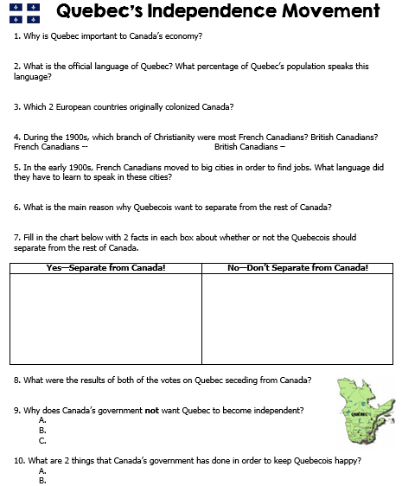

Slide 5
Quebec’s
Independence
Movement

Slide 6
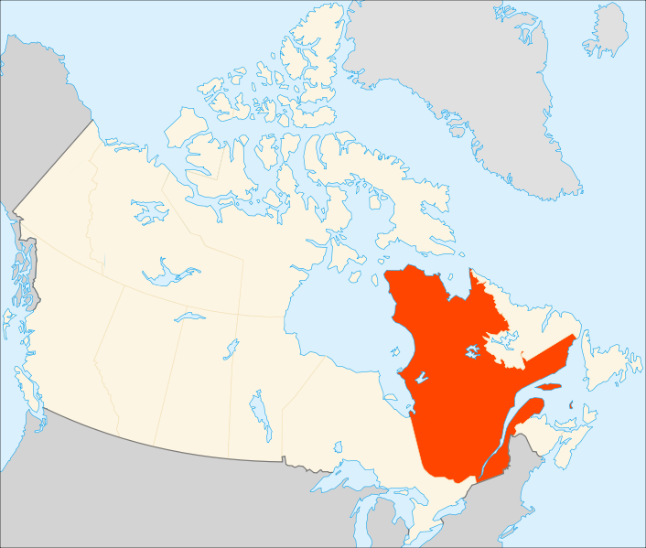

Slide 7
Province of Quebec
Quebec is located in eastern Canada.
A large part of Canadian industry is centered in Quebec.
Many electronics and computer factories are based here.
French is the official language of business and government in Quebec.
81% of the people speak French as their 1st language.

Slide 8
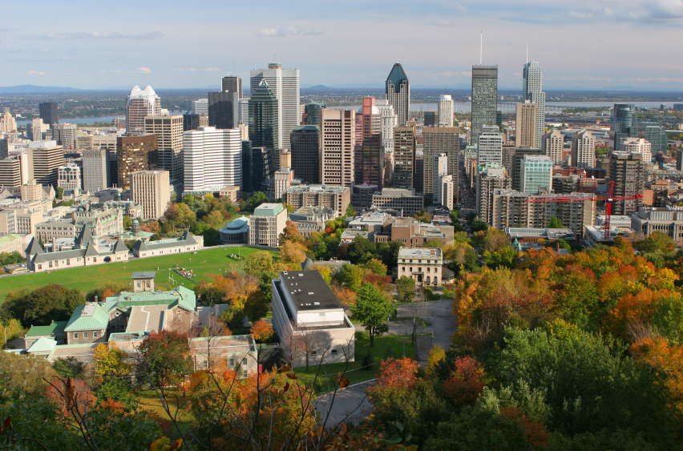

Slide 9
History Review
Canada was originally colonized by the French (fur trade).
Great Britain wanted part of the fur trade, so they fought & won the French and Indian War.
They divided Canada into Upper Canada (British) and Lower Canada (French).
“Lower Canada” is now called Quebec.
Canada was united in 1867 with the British North America Act.
Quebec is still predominately French.

Slide 10
Early 1900s
Most French Canadian families had been living in Quebec for hundreds of years.
They spoke French & had a different culture than English-speaking Canadians.
The majority lived on farms and rarely left their villages.
Most French Canadians were Catholic, while the majority of British Canadians were Protestant.

Slide 11
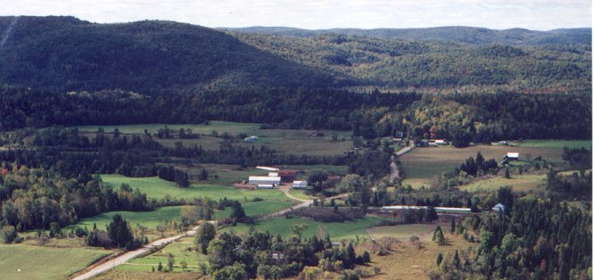

Slide 12
A Separate Quebec
The idea of a separate French Canada spread slowly.
At first, most French Canadians did not think that Quebec needed independence just to be French.
By the 1960s, however, thinking had changed…
Many French Canadians had become Quebec nationalists & thought of themselves as Quebecois, not Canadians.

Slide 13
A Separate Quebec
By this time, Quebec had changed in many ways…
Growing populations pushed into farmlands and rural people grew poor.
Many chose to leave farms and move to cities.
Their lives were very different now.
They stopped going to Catholic churches.
They no longer led a traditional lifestyle.
English was spoken in most cities, while French was not.

Slide 14
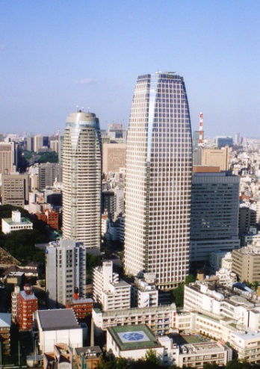

Slide 15
Independence
Many French Canadians felt that their language and culture might disappear.
French culture was overwhelmed by English.
They were tired of feeling like second-class citizens in their own country.
Most started to think that Quebec should secede from Canada (be independent).
Separatists--want Quebec to “separate” from Canada.

Slide 16
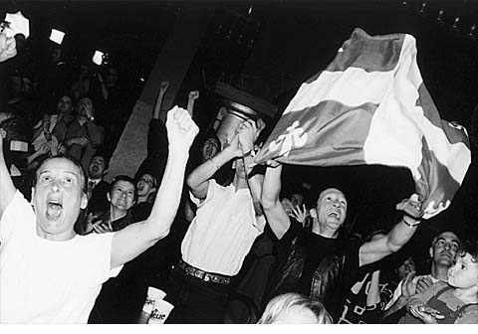

Slide 17
Separating - Pros
Those who support Quebec separatism want:
to protect French language and culture
to be treated as equals with English-speaking Canadians
other Canadians to respect French language and culture
to preserve French Canadian culture for future generations

Slide 18
Separating - Cons
Those who oppose Quebec separatism argue that separatism would:
result in economic disaster for Quebec,
Ruin national unity and pride, &
Make the rest of Canada lose all of Quebec’s natural resources.

Slide 19
Let the People Vote
In 1980 & 1995, the people of Quebec voted whether or not to secede.
Both votes were in favor of staying Canadian.
Last vote--49.4% voted to secede and 50.6% voted to stay Canadian…wow!
Close results showed that the relationship between Quebec and the rest of Canada will continue to be a controversial issue.

Slide 20
What Now?
Canada’s government does not want to allow Quebec to separate from Canada because Quebec:
Is a huge economic help to country,
Is rich in natural resources, &
Has access to many waterways (shipping & trade).
The government has made several reforms in an attempt to keep separatists happy.

Slide 21
Reforms
Canada’s government has passed several laws to help Quebec’s citizens preserve their language and culture.
In 1982, the Constitution Act made Canada bilingual.
1. Two official languages (English & French)
2. All government documents must be written in French & English

Slide 22
In Quebec Today…
French is the only official language.
English may be used in advertising, but it must be placed after the French words, and it must be smaller font.
Some people are happy with these changes, but other people still believe that Quebec should be independent from the rest of Canada.

Slide 23
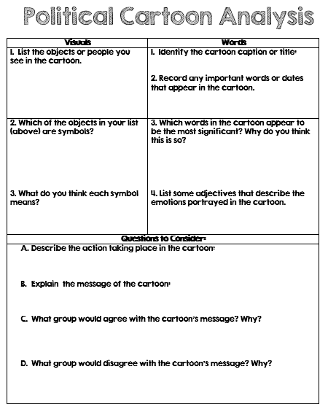

Slide 24
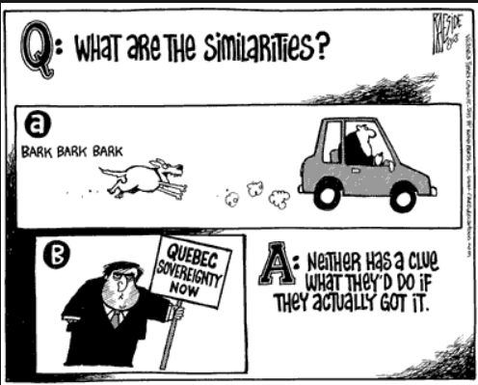

Slide 25
Two Viewpoints
On the left lens of the glasses, write two reasons why the Quebecois would want to separate from Canada and create their own country. *Include an illustration that represents this viewpoint.
2. On the right lens of the glasses, write two reasons why the Quebecois would NOT want to separate from Canada. *Include an illustration that represents this viewpoint.
3. Color your glasses. Please do not leave any white space on your paper!
4. Cut out your glasses and turn them in. ☺

Slide 27
Teachers
Thank you for downloading this file. I hope you enjoy using it with your students, and I can’t wait to read your feedback in my TPT store! ☺
For more social studies materials, please visit my store: http://www.teacherspayteachers.com/Store/Brain-Wrinkles
I teach Language Arts and Social Studies in Georgia, so my products are aligned with Common Core (LA) and Georgia Performance Standards (SS).
© Copyright 2013. Brain Wrinkles. All rights reserved. Permission is granted to copy pages specifically designed for student or teacher use by the original purchaser or licensee. The reproduction of any other part of this product is strictly prohibited. Copying any part of this product and placing it on the Internet in any form (even a personal/classroom website) is strictly forbidden. Doing so makes it possible for an Internet search to make the document available on the Internet, free of charge, and is a violation of the Digital Millennium Copyright Act (DMCA).

Slide 28
Credits:
All photos were found via Creative Commons and labeled for reuse.
Fonts:
Backgrounds & Graphics:

