Slide 1
Unit Conversions Using Equivalent Ratios

Slide 2
Warm Up
OBJECTIVE SWBAT convert a measurement from one unit to another using equivalent ratios.
LANGUAGE OBJECTIVE: SWBAT learn & use unit conversion vocabulary.
Directions: Make equivalent ratios.
x 3.5
x 2¼
x 2.5
1.)
3.5
2.)
3.)
12.5
9
x 3.5
x 2¼
x 2.5
Agenda

Slide 3
Launch - Vocabulary
How many inches is 2 feet?
2 feet is 24 inches.
Hint: There are 12 inches in 1 foot.
1 foot = 12 inches
2 feet = 24 inches
Agenda

Slide 4
Launch - Vocabulary
How many inches is 2 feet?
2 feet is 24 inches.
You have just made a unit conversion.
Feet and inches are the
units of measure.
1 foot = 12 inches
this is your conversion factor
Today we will learn how to convert units with ratios.
Agenda

Slide 5
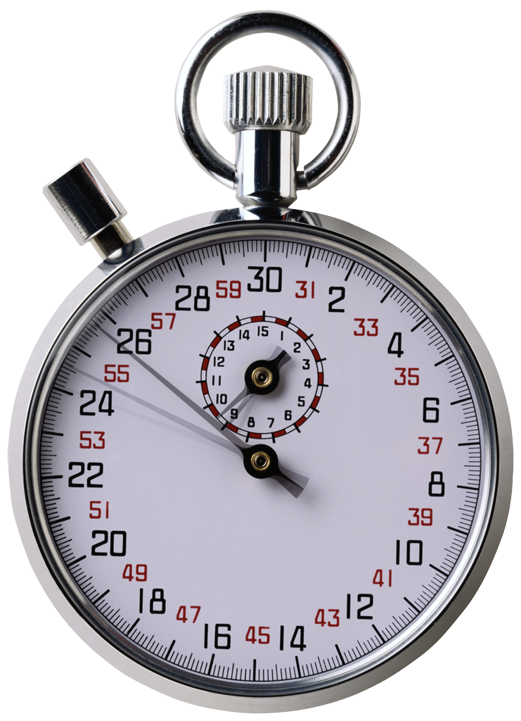
Launch - Vocabulary
One minute: Write the definitions of these terms on your worksheet.
Conversion
Units (of measure)
Conversion Factor
The act of changing from one thing to another
A standard quantity used to measure. Example: inches, cm
The ratio of a measurement in one unit to the equivalent numerical value in another unit. (ex. 12 inches/1 foot = 12/1 or 12)
Agenda

Slide 6
Launch – Think, Write, Pair, Share
1 min
1 min
1 min
Think: What are some units for measuring in each category below?
Pair: Talk to your elbow partner. Share units. Write Write down any units that you didn’t have before.
Share: Students will be selected at random to share 3 units from each category.
Write: Write at least two different units for measuring in each category on your worksheet.
1 min
Length | Volume | Weight
Agenda

Slide 7
Launch – Think, Write, Pair, Share
1 min
Share: Students will be selected at random to share 3 units from each category.
Length | Volume | Weight
Inch Foot Yard Mile Centimeter Millimeter Meter Kilometer | Cup Fluid ounce Quart Pint Gallon Liter Milliliter | Pound Ounce Ton Gram Kilogram Metric ton
Agenda

Slide 8
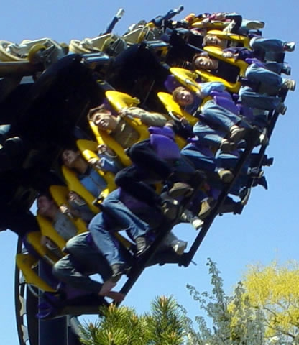
Explore
Emily, Lilo, and Henry are going to go to Six Flags on a field trip. They all want to go on the Batman roller coaster ride, but they have to make sure they are each tall enough to go on the ride.
Agenda

Slide 9
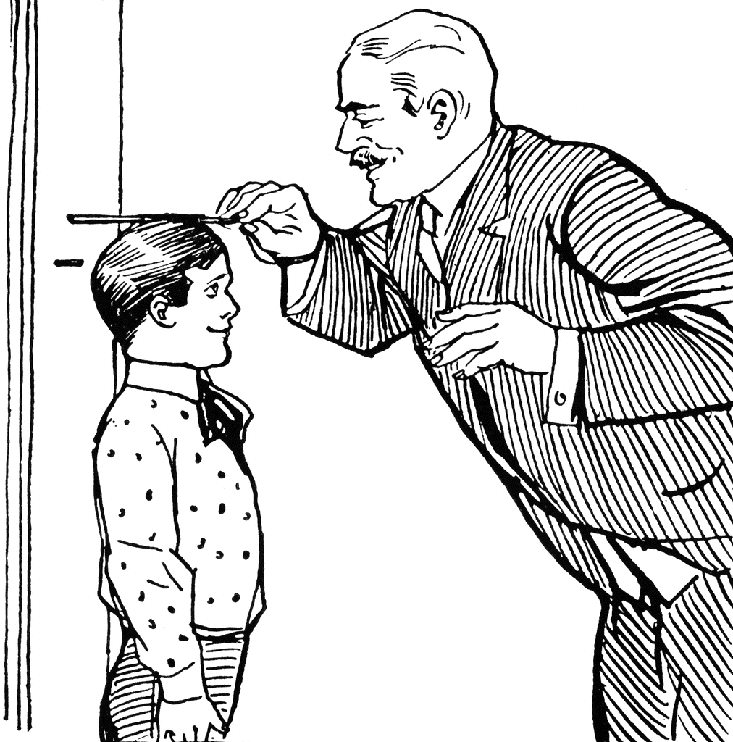
Explore
Their teacher looks up the height requirement and it is 54 inches. The students know their heights in feet but not in inches. Help them to figure out if they are each tall enough to ride the Batman roller coaster.
Agenda

Slide 10
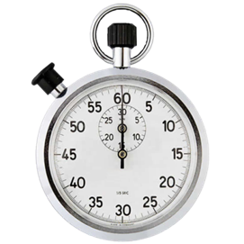
Explore
Emily | Lilo | Henry
4 feet, 4 inches | 4 ½ feet | 4 ¾ feet
You must be 54 inches tall to ride the Batman roller coaster. Who can and who cannot go on this ride?
Take 5 minutes to work on this problem on your own.
Agenda

Slide 11
Explore
Emily | Lilo | Henry
4 feet, 4 inches | 4 ½ feet | 4 ¾ feet
You must be 54 inches tall to ride the Batman roller coaster. Who can and who cannot go on this ride?
Think, Write, Pair, Share: What makes this problem difficult?
Write your thoughts on your worksheet. Then share with your partner.
Share: How could we make this problem easier to do?
Agenda

Slide 12
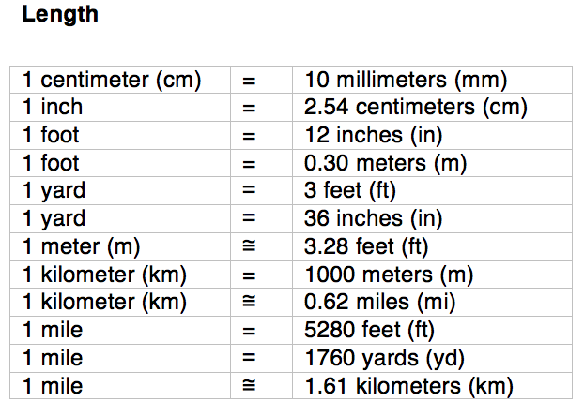
New Skill – Unit Conversion Using Ratios
Vocabulary
We need to
convert units!
Let’s change the 54 inches to feet.
First we need the unit conversion rate. Let’s look on a unit conversion table to find the information.
1
Agenda

Slide 13
Mini-Lesson: Unit Conversion Using Ratios
A rate is a ratio
showing the relationship of 2 different measurement units.
Vocabulary
Let’s change the 54 inches to feet.
1
First we need the unit conversion rate.
Put your finger on the unit conversion rate.
Agenda

Slide 14
Mini-Lesson: Unit Conversion Using Ratios
Next we will write the conversion rate as a ratio in fraction form:
2
Does it matter if I write the ratio with 1 foot on the top or the bottom?
or
What do you think?
This is a unit rate because it is 12 inches per 1 foot.
Vocabulary
A unit rate is a
rate where one measurement has a value of 1.
Agenda

Slide 15
Launch
Vocabulary
convert
means change
3
To convert 54 inches into feet
we will make an equivalent ratio. We write the unit
=
conversion ratio as a rate in fraction form and set it equal to another ratio.
Vocabulary
Agenda

Slide 16
Launch
We write the unit conversion ratio as a rate in fraction form and set it equal to another ratio.
3
=
You could also write:
=
The important thing to remember is that the units on top must match. And the units on the bottom must match.
Agenda

Slide 17
Launch
4
Next we put in the number we are converting into the second ratio. We are
converting 54 inches into feet. Should we put 54 on the top or the bottom of the ratio?
=
Agenda

Slide 18
Launch
5
Now, to find the feet, we need to find the factor we multiply by to make these two
ratios equivalent.
That is,
What do I multiply 12 by to get 54?
Put your hand up when you think you know.
=
x ?
Where have we done this before in this lesson?
Vocabulary
Equivalent means
equal value.
Agenda

Slide 19
Launch
Next, to find the feet, we need to find the factor we multiply by to make these 2 ratios equivalent.
5
12 x ___ = 54
so…
54 ÷ 12 = ___
4.5
=
x ?
Agenda

Slide 20
Launch
I use the same factor top and bottom to make an equivalent ratio.
6
x 4.5
So,
54 inches = 4.5 feet
=
4.5
Now we can solve the problem!
x 4.5
Vocabulary
4.5 is your
conversion factor.
Agenda

Slide 21
Launch
Emily is 4 feet 4 inches
Lilo is 4½ feet tall
Henry is 4¾ feet tall
You must be 54 inches or 4.5 feet to ride the coaster.
Remember that
1 foot is 12 inches
so 0.5 feet is 6 inches.
So who can and who cannot ride Batman?
Take a few minutes to find the answer to this question. Write it on your worksheet.
Agenda

Slide 22
Launch
Time to Discuss It!
Emily is 4 feet 4 inches
Lilo is 4½ feet tall
Henry is 4¾ feet tall
You must be 54 inches or 4.5 feet to ride the coaster.
Cannot go
Can go
Can go
Lefty tell Righty: Explain how to use equivalent ratios to convert 54 inches to 4.5 feet.
So who can and who cannot ride Batman?
Righty tell Lefty: Explain how to use the 4.5 feet to solve the problem.
Agenda

Slide 23
Practice
Let’s practice setting up equivalent ratios to solve unit conversion problems.
Practice Problem #1
2.5 yards = ____ feet
First, find the conversion rate.
Vocabulary
Check your worksheet if
you forget your vocabulary.
Then, set up the conversion rate as a ratio in fraction form.
Agenda

Slide 24
Practice
Let’s practice setting up equivalent ratios to solve unit conversion problems.
Practice Problem #1
2.5 yards = ____ feet
First, find the conversion factor.
Then, set up the conversion factor as a rate in fraction form.
Agenda

Slide 25
Practice
Let’s practice setting up equivalent ratios to solve unit conversion problems.
Practice Problem #1
2.5 yards = ____ feet
Now make another equivalent ratio. Units must be the same across the top and the bottom.
=
Agenda

Slide 26
Practice
Let’s practice setting up equivalent ratios to solve unit conversion problems.
Practice Problem #1
2.5 yards = ____ feet
Then put the information from the problem into the second ratio.
=
2.5
Agenda

Slide 27
Practice
Let’s practice setting up equivalent ratios to solve unit conversion problems.
Practice Problem #1
2.5 yards = ____ feet
Find the conversion factor that we multiply or divide by to move from left to right.
=
2.5
1 x ___ = 2.5
x 2.5
x ?
Agenda

Slide 28
Practice
Let’s practice setting up equivalent ratios to solve unit conversion problems.
Practice Problem #1
2.5 yards = ____ feet
7.5
x 2.5
Multiply by the same factor top and bottom to make an equivalent ratio.
7.5
=
2.5
x 2.5
Agenda

Slide 29
Practice
Practice Problem #2
28 fluid ounces = ____ cups
Practice Problem #3
2¼ pounds = ____ ounces
3.5
36
x 2¼
x 3.5
x ?
3.5
2¼
=
=
28
36
x 3.5
x ?
x 2¼
Agenda

Slide 30
Practice
Practice Problem #4
13.2 feet = ____ meters
Practice Problem #5
5 pounds = ____ kg
4
2.25
x 5
x 4
x ?
4
5
=
=
13.2
2.25
x ?
x 4
x 5
Agenda

Slide 31
Practice
5
Practice Problem #6 10 quarts = ____ liters
x 2.5
x ?
x 2.5
2.5
2.5
=
=
10
5
x 2.5
x 2.5
x ?
Agenda

Slide 32
Summary
Today we learned how to convert units using equivalent fractions. Fill in the vocabulary words to complete the explanation of how to do it.
1.) Write the ____________ _________ as a ratio in fraction form.
2
x ?
2
2.) Make an ___________ _______ by setting it equal to another ratio.
=
24
3.) We put the number we know into the 2nd ratio & find the ___________
___________.
x 2
Word Bank:
convert ratio conversion rate
equivalent ratio conversion factor
4.) Then _________ the units by multiplying by the conversion factor.
Agenda

Slide 33
Summary
Today we learned how to convert units using equivalent fractions. Fill in the vocabulary words to complete the explanation of how to do it.
conversion
1.) Write the ____________ _________ as a ratio in fraction form.
2
?
rate
x ?
2
2.) Make an ___________ _______ by setting it equal to another ratio.
=
equivalent ratio
24
3.) We put the number we know into the 2nd ratio & find the ___________
___________.
x 2
conversion
factor
Word Bank:
convert ratio conversion rate
equivalent ratio conversion factor
convert
4.) Then _________ the units by multiplying by the conversion factor.
Agenda

Slide 34
Exit Ticket
Solve the problem. Put your thumb up when you are done.
90 inches = _____ yards
Choose the best answer from the four given below.
Write it down next to your work.
When you hear the answer you chose, put your hand up.
1½ yards
2½ yards
30 yards
270 yards
Agenda

