Slide 1
Distribution of Power
Unitary, Confederation, & Federal

Slide 2


Governments
So why do we need governments anyways?
Turn and discuss this question with your
elbow partner.

Slide 3

Governments
All countries require governments to function.
Governments provide laws, structure, public services,
and national defense.
There are different types of governments:
  democracies
  republics
  monarchies
  dictatorships

Slide 4



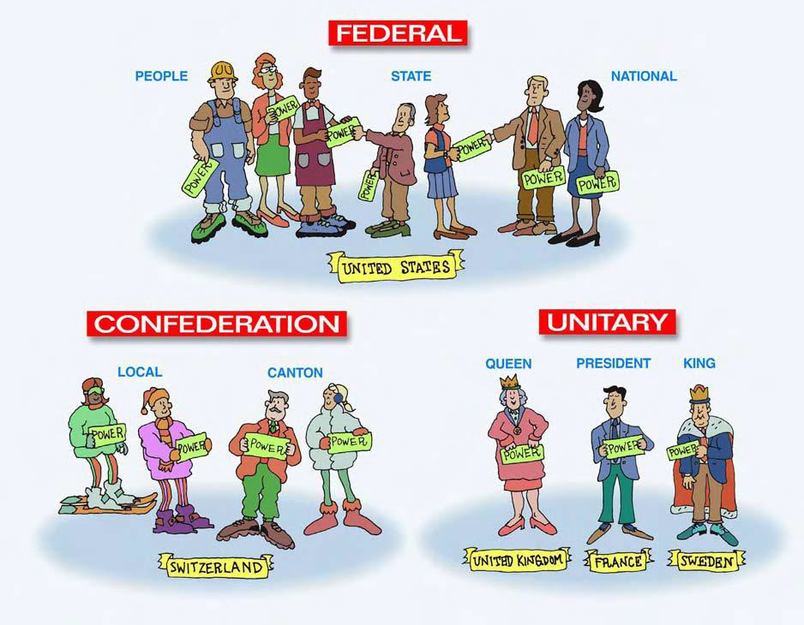
How is Power Shared?

Slide 5






Federal System

Slide 6


Federal System
In a federal system, power is shared by a powerful central
government and the state or local governments.
States or provinces are given considerable self-rule, usually through their own legislatures.

Slide 7
Federal System
In a federal form of government, power is divided between a
central government & small divisions, such as states.
A document (such as a constitution) may describe the rights, responsibilities, and duties of the central government & the states.
Central government can be powerful, but does not have the
ability to dissolve states or choose state leaders.

Slide 8

Federal Government- power of the Central government is separate from State Government
The Federal Constitution Laws Rule Both Central and State
Central Government
State/Local Government

Slide 9


Federal Countries
Many countries use this form of distributing government
power.
  Western hemisphere: Brazil, Canada, Mexico, US, Venezuela, etc.
  Europe: Russia, Germany, etc.
A federal system does not mean that there is more or less personal freedom for the people. It explains how power is distributed.

Slide 10
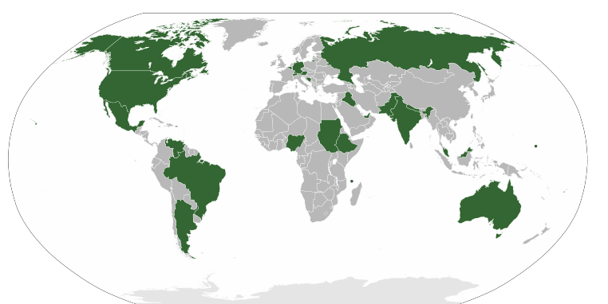
Federal Governments

Slide 11


Let’s Review
How does a federal system of government divide
power?
What defines the rights, responsibilities, & duties of
the central & state governments?

Slide 12
Let’s Review
1. How does a federal system of government divide
power?
Between the central government and smaller units
such as states
What defines the rights, responsibilities, & duties of the central & state governments?
  A constitution

Slide 13




Unitary System

Slide 14


Unitary System
• In a unitary system, the power is held by one central authority.
• All power is given to one branch of
government.

Slide 15


Unitary System
In a unitary government, the central government has most of the authority and decision-making power.
  Local government offices are part of the central government.
  The central government maintains all power over the local
governments.
Unitary governments may not be less democratic (when ordinary citizens get to vote) than other forms--it all depends on who is in charge!

Slide 16
Unitary Government
Central
Government has all the power
The Local Governments
are not separate,
but are smaller parts
of the Central government
Local Government
Same as Central
Local
Government
Same as Central
Local Government
Same as Central

Slide 17


Unitary Countries
Many countries in the world are run this
way.
  Western hemisphere: Cuba & Bolivia
  Europe: United Kingdom, Sweden, Spain, &
France

Slide 18
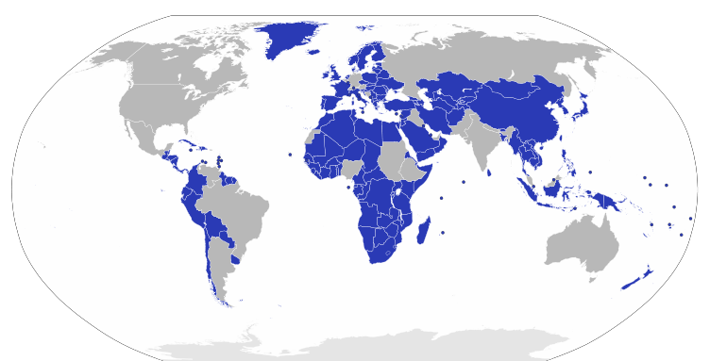
Unitary Governments

Slide 19


Let’s Review
1. How is power distributed in a unitary government?
True or False: In a unitary government, the national government could remove the governor of a state and pick a new one.
France, UK, Bolivia, and Cuba--what do these countries
have in common?

Slide 20
Let’s Review
A central government assigns power and duties to smaller
units of government within the country.
True or False: In a unitary government, the national government could remove the governor of a state and pick a new one.
  True
All have unitary government systems

Slide 21
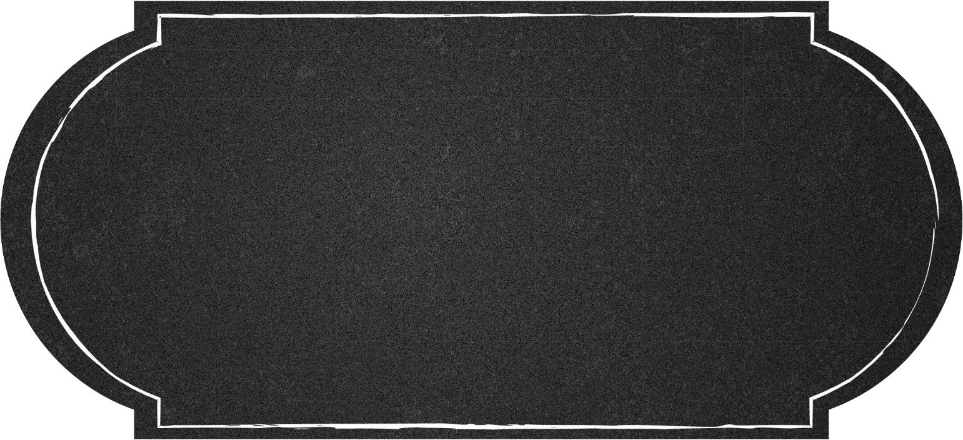


Confederation

Slide 22


Confederation
A confederation is a system in which power is shared
by an alliance of independent states (countries).
  They voluntarily work together for some common purpose and agree to certain limits on their freedom of action.
Examples: European Union, OPEC

Slide 23
Confederation
Some countries agree that they would be better able to
solve problems or provide help if they worked together.
They might sign a treaty or a constitution under which the countries agree to defend each other, trade with each other, use a common currency, etc.
Membership is usually voluntary & a country can decide to leave at any time.

Slide 24
Confederation
Not commonly found among governments in the 21st century
because there are several problems with them:
  Often have little power because a high percentage of members must agree to decisions made,
  Individual countries can veto decisions, &
  Changes in the constitution requires all members to agree.
Confederations generally have a weak central government.

Slide 25


Let’s Review
What is one problem with a confederation
government?
In a confederation, government power lies with
the .

Slide 26
Let’s Review
What is one problem with a confederation
government?
  The central government can create laws but
might not be able to enforce them
In a confederation, government power lies with
the .
  Governments of the member countries/states

Slide 27


Show What You Know
Let’s get in groups of three. Number yourselves one, two, and
three.
  Ones explain to the twos and threes how a unitary government system distributes power.
  Twos explain to the ones and threes how a confederation
government system distributes power.
  Threes explain to the ones and twos how a federal government system distributes power.

Slide 28


Stop & Think
Turn to your elbow neighbor and tell them which form of government power you like best.
o Don’t forget to tell them WHY
this is your opinion!

Slide 29
ONE
Since its 1 988 constitution, Brazil has divided its country
into twenty-six states and a central government district. The states are then broken into over 5,500 municipalities, which are like counties. All these political units have a local government that has its own laws and taxes. Brazilians vote for representatives at each level. The central government will not allow any states or municipalities to be independent or break away from the country’s national
government.

Slide 30
TWO
For only three years beginning in 1836, the countries of Bolivia, North Peru, and South Peru attempted a government system in which the three countries created a loose union that shared power as well as ruled themselves.
Neighboring countries, including Argentina and Chile, were alarmed about this new government and a war followed that ended this shared government system between Bolivia and Peru.
.

Slide 31
THREE
Established in 1993, the European Union (EU) is an economic and political union of twenty-seven independent countries, or member states, which has a foundation from the European Economic Community. The EU has allowed a single free trade market where all member states are guaranteed freedom of movement of people, goods, services, and capital. Most EU countries have adopted a common currency, called the euro. While it is governed by the EU Commission and Parliament over the union’s common interests, each country still controls its independently-run government.

Slide 32
FOUR
Costa Rica is a peaceful, democratic republic where power is only given by the central government, based in San Jose, the capital city. The seven provinces have leaders, but the laws and taxes of the central government have full control over the regional division.

Slide 33
FIVE
Since its 1917 constitution, Mexico has had a central government based in its capital, Mexico City, and thirty-one states that also have their own state governments. Citizens vote for their representatives on three government levels: the central, state, and municipal governments.

Slide 34
SIX
Fidel Castro took power as dictator over Cuba and
made it communist in 1 9 59 after leading the Cuban Revolution. Under this government system, only one political party was in control and only one person, Castro, made all decisions for the citizens. The laws he established from Havana, the capital, were to be followed by the entire country.

