Slide 1
How do you position a group of numbers that include decimals, fractions and integers on a number line?

Slide 2
In this lesson you will learn about locating positive rational numbers by using a number line.

Slide 3
9.25 9 9.2
9.25
9.
9.2
00
0
9 9.2 9.25

Slide 4
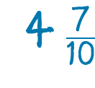
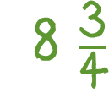
4.7 =
= 8.75

Slide 5
Not realizing that fractions and decimals describe the same point on a line

Slide 6
3 Strategies to Position on a number line

Slide 7
Change to Decimals
4.3, 4.2, 4.8, 4.75

Slide 8
4.3, 4.2, 4.8, 4.75
4.3
4.75
l l l l l l l l l l l
4
4.2
4.8
5
4.2, 4.3, 4.75, 4.8

Slide 9
Change to Fractions

Slide 10
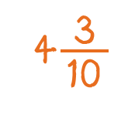
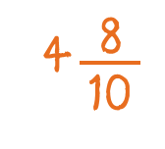
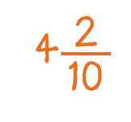
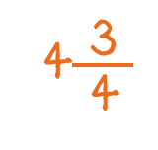
l l l l l l l l l l l
4
5

Slide 11
Just position on the number line without changing

Slide 12
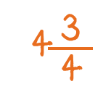
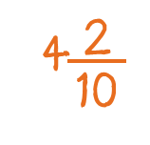
l l l l l l l l l l l
4
4.3
4.8
5

Slide 13
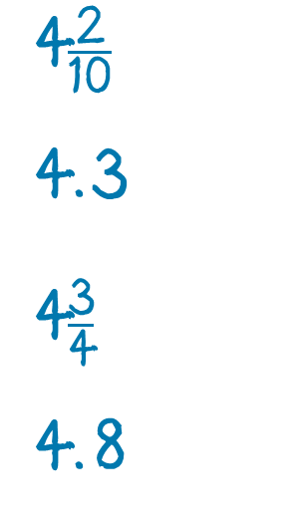
4.8
l l l l l l l l l l
4
5
4.3

Slide 14
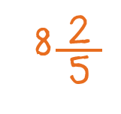
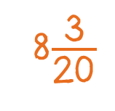
8.95
8
8.7
9

Slide 15
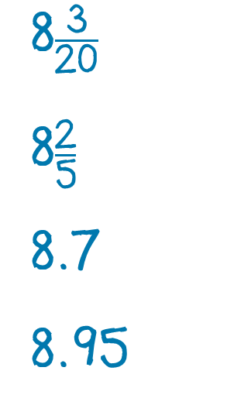
9
8.95
8.7
8

Slide 16
In this lesson you have learned about locating positive rational numbers by using a number line.

Slide 17
2 1/4
2 4/5
l l l l l l l l l l l
2
2.35
2.6
3

Slide 18
3 1/10
3.5
l l l l l l l l l l l
3
3 2/5
3.8
4

Slide 20
l l l l l l l l l l l
9
10

Slide 21
Take a number line and put some marks on it. Challenge your partner to come up with a decimal number for the point while you come up with a fraction. Take turns trading off who does the decimal and who does the fraction.

