Slide 1
Asia’s
Population
Distribution
The Impact of Climate, Location,
Physical Characteristics, & Natural Resources

Slide 2
Standards
SS7G11 The student will explain the impact of location, climate, physical characteristics, distribution of natural resources, and population distribution on Southern and Eastern Asia.
a. Describe the impact climate and location has on population distribution in Southern and Eastern Asia.
b. Describe how the mountain, desert, and water features of Southern and Eastern Asia have affected the population in terms of where people live, the types of work they do, and how they travel.

Slide 3
Teachers
Print off the following page for each student. Have the students brainstorm what they already know about each country (“Ahhh” section) before the discussion. After the discussion, go back and have the students fill in new things that they learned (“Haaa” section).

Slide 4
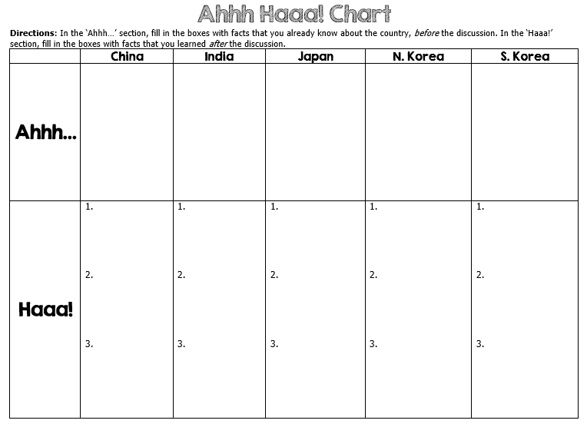

Slide 5
Teachers
Print off the following page for each student. The students should complete the CLOZE notes while discussing the presentation.

Slide 6
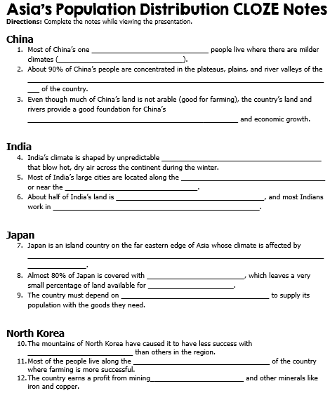

Slide 7
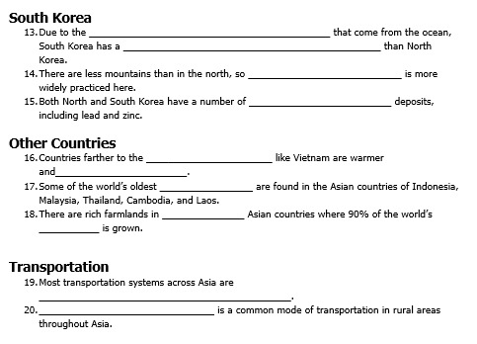

Slide 8
Asia’s
Population
Distribution
The Impact of Climate, Location,
Physical Characteristics, & Natural Resources

Slide 9
China
Population: 1,349,585,838

Slide 10
Climate
Because of China’s great size, it has a variety of climates.
High mountain ranges to the south cut off moisture from the Indian ocean, making the Gobi and Taklimakan desert regions in the country’s center harsh and dry.
Northern China is semi-arid, while areas to the east and south are humid and tropical.
Most of China’s one billion people live where there are milder climates (northeast).

Slide 11
Location
Two great deserts are located in Northern China.
Few people live here besides nomads and animal herders.
Other parts of northern and western China have more moderate climates so farming is possible.
About 90% of China’s people are concentrated in the plateaus, plains, and river valleys of the eastern third of the country.
The northeast, around the Huang He River, is China’s most populated region.
Here, in Chinese cities like Beijing and Shanghai, the population can exceed almost 6,000 people per square mile.

Slide 12
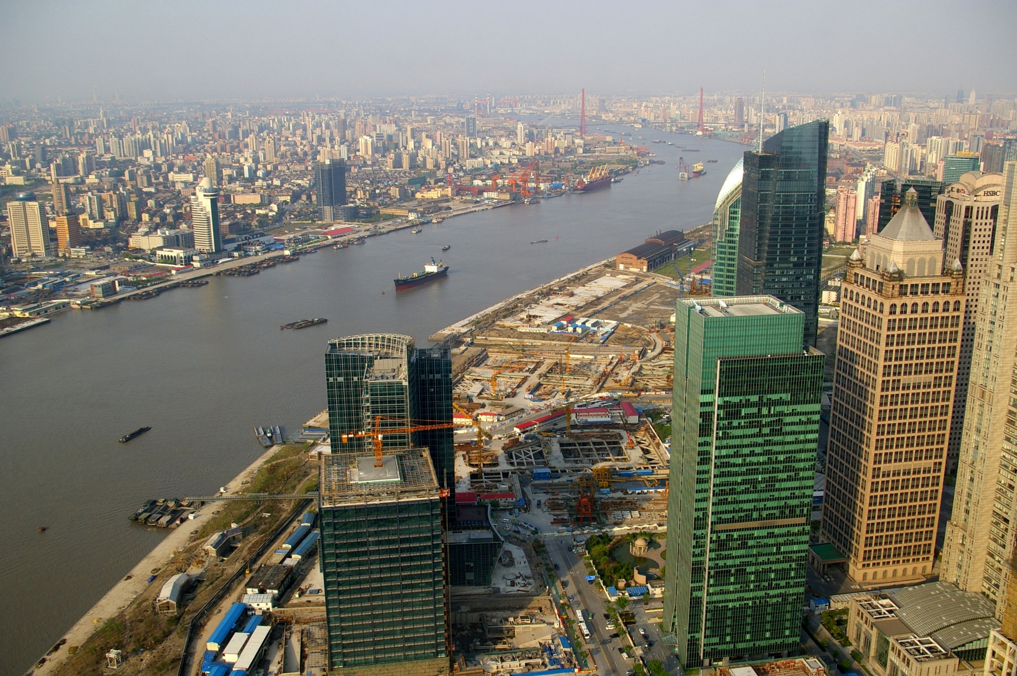
Shanghai

Slide 13
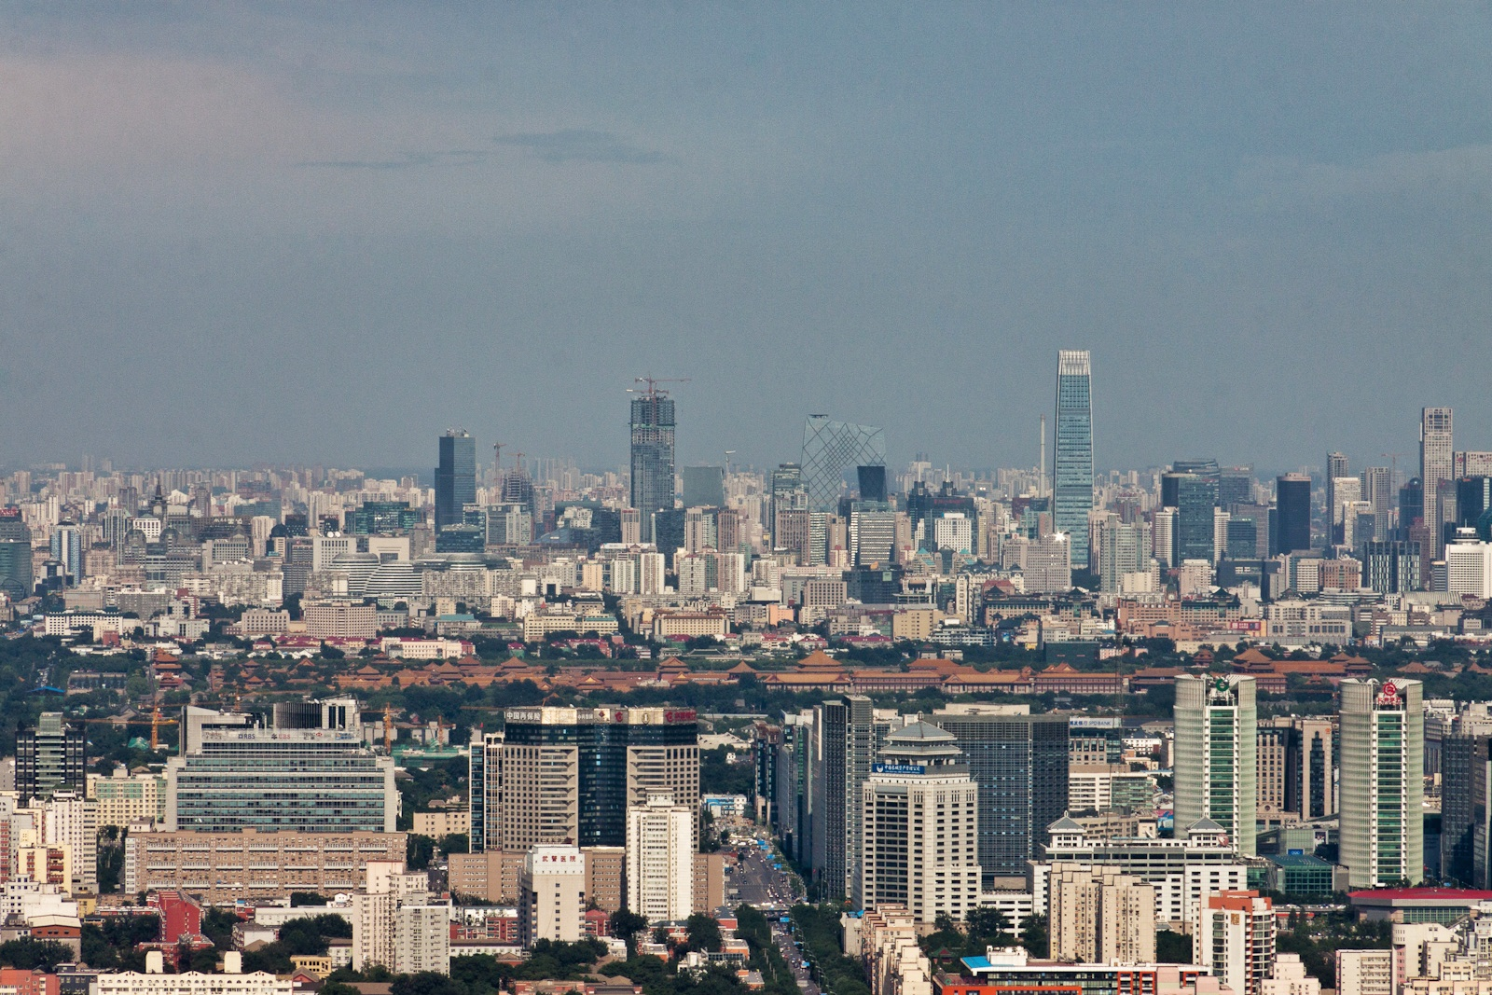
Beijing

Slide 14
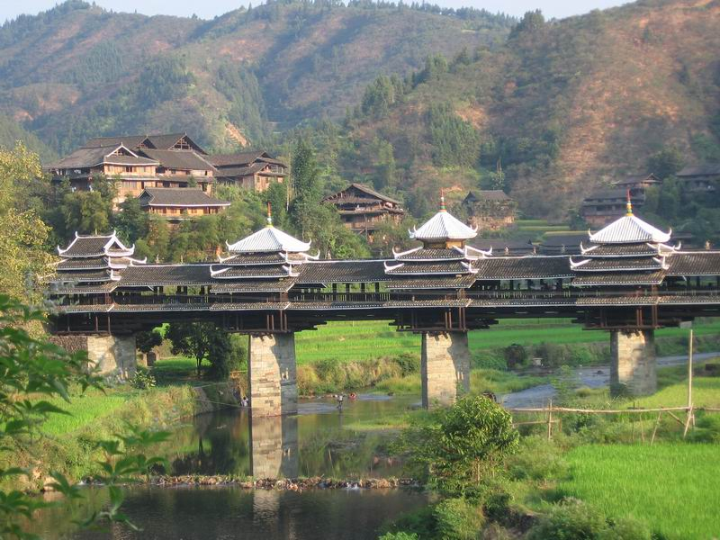
Village in Rural China

Slide 15
Natural Resources
The massive country of China has an abundance of natural resources.
What are China’s major natural resources?
coal, iron ore, petroleum, natural gas, mercury, tin, tungsten, antimony, manganese, molybdenum, vanadium, magnetite, aluminum, lead, zinc, rare earth elements, uranium, hydropower potential (world's largest)
Even though much of China’s land is not arable (good for farming), the country’s land and rivers provide a good foundation for China’s industry and economic growth.

Slide 16
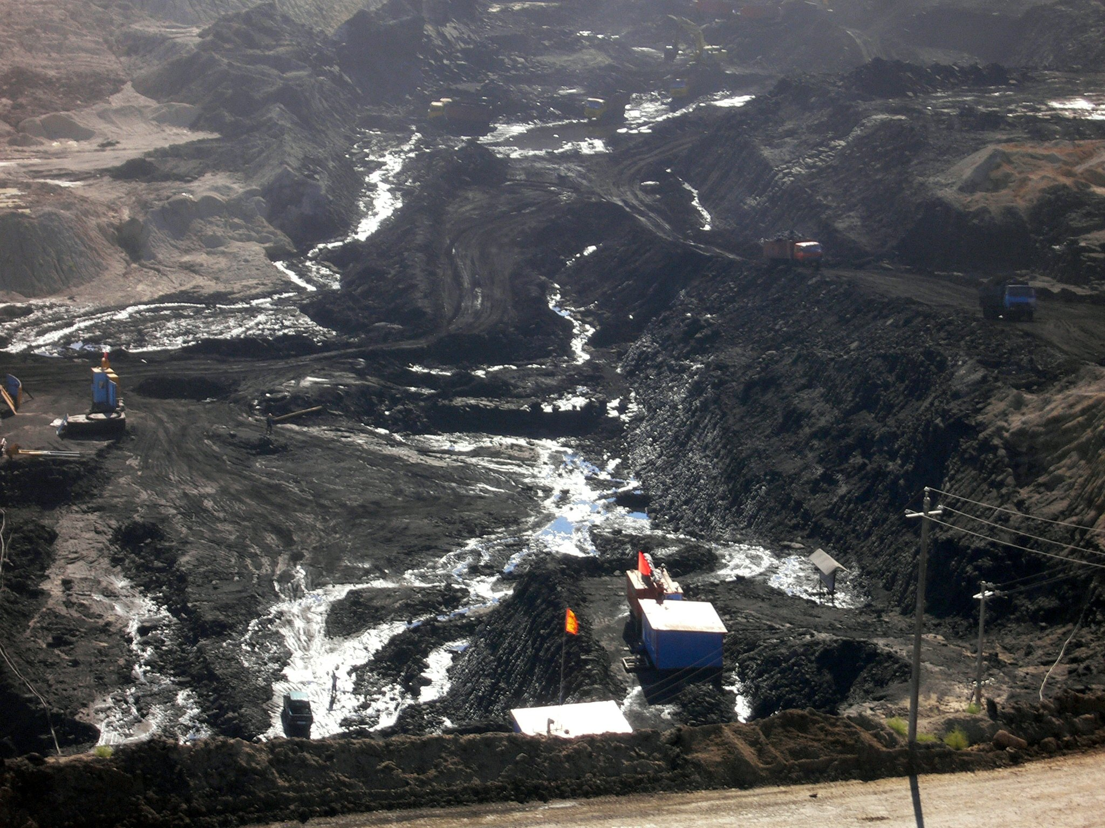
Coal Mine

Slide 17
India
Population: 1,220,800,359

Slide 18
Climate
India has many types of climates.
Snow and ice cover the mountains in the north.
A large desert area borders Pakistan.
The Ganges Plain is humid and almost tropical.
The Deccan Plateau in the higher center of the country is more moderate.
There is a subtropical coastal plain along the Indian Ocean.
India’s climate is shaped by unpredictable monsoons that blow hot, dry air across the continent during the winter.
During spring and summer, the winds bring heavy rains from the ocean.

Slide 19
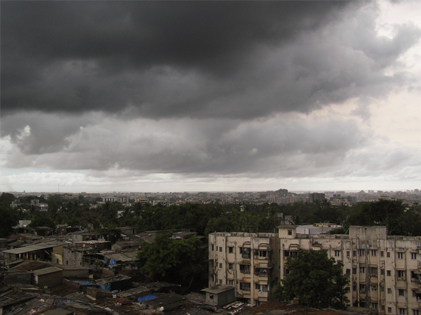
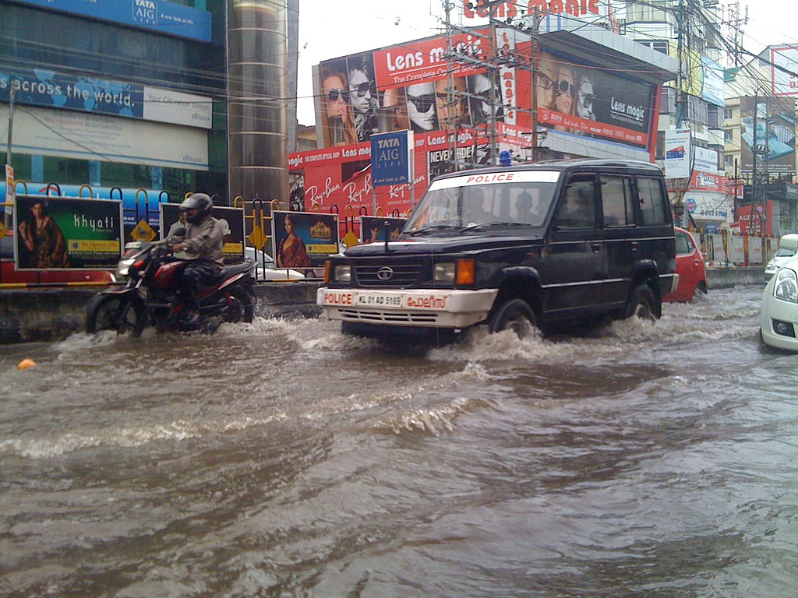
Monsoon - Mumbai

Slide 20
Location
India is separated from the rest of Asia by three mountain ranges.
South of the mountains, most of India is a broad plain between the Indus and Ganges rivers.
The land here is very fertile, which is good because most of India’s people rely on farming and other agricultural work.
Most of India’s large cities are located along the Ganges River or near the coast.
Fewer people live in the high center of the country on the Deccan plateau.

Slide 21
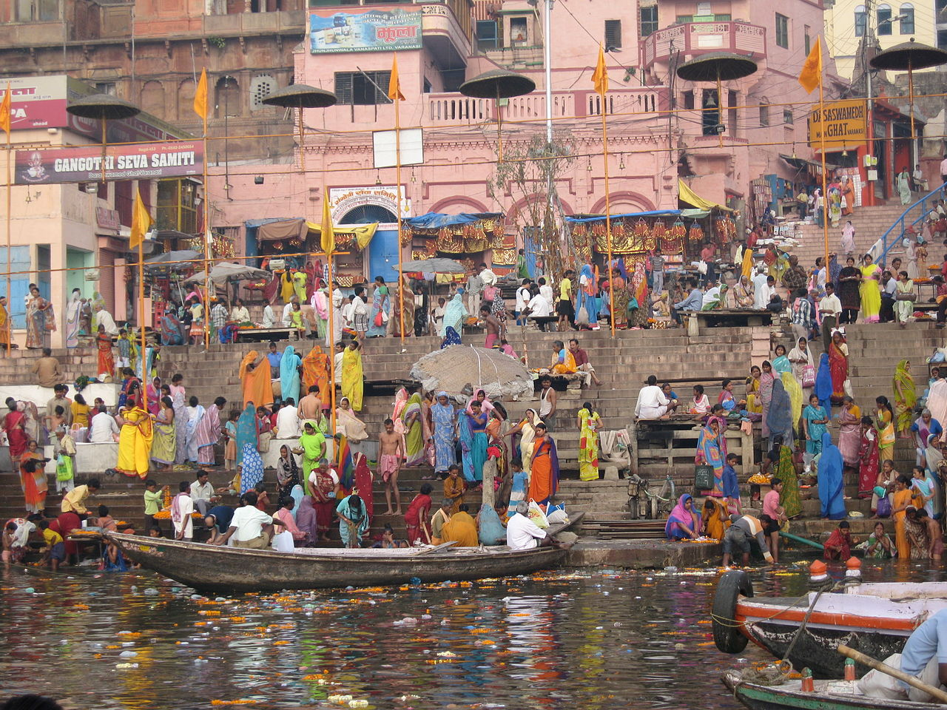
Ganges River at Varanasi, India

Slide 22
Natural Resources
About half of India’s land is arable, and most Indians work in agriculture.
India’s fertile land and ample water supply are its most valuable resources.
India has the fourth-largest coal reserves in the world.

Slide 23
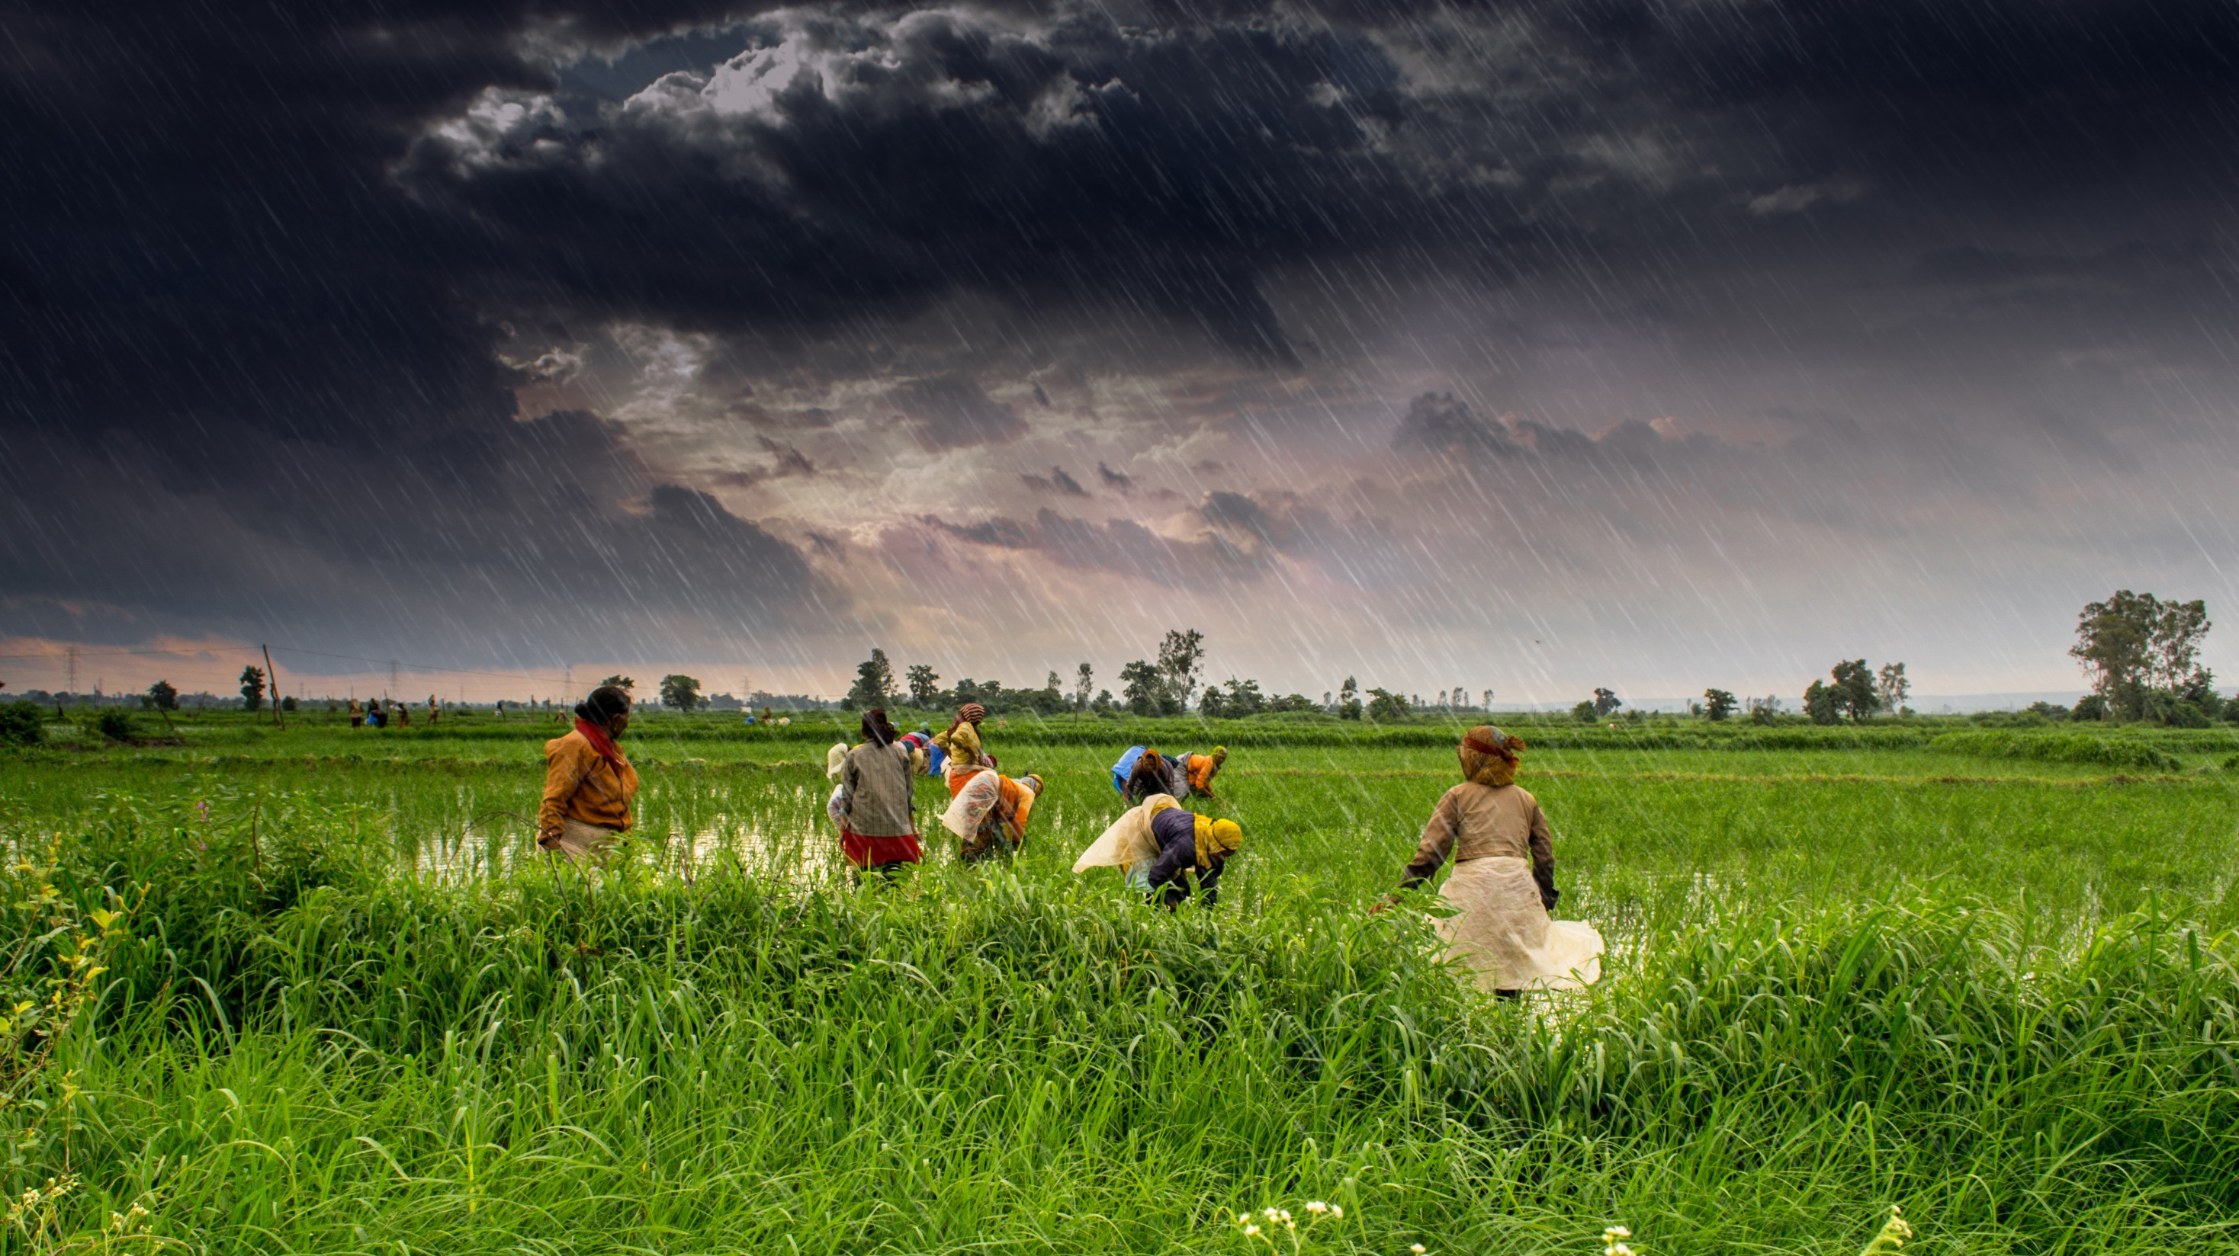
Farming in India during Monsoon Season

Slide 24
Japan
Population: 127,253,075

Slide 25
Climate
Japan is an island country on the far eastern edge of Asia whose climate is affected by ocean currents.
The Japan Current brings warm water to the southern and eastern coasts, while the Oyashio Current cools the northern coast.
The warmer parts of Japan have longer growing seasons for farming, and the cooler north is good for fishing.
Japan experiences monsoons and typhoons.

Slide 26
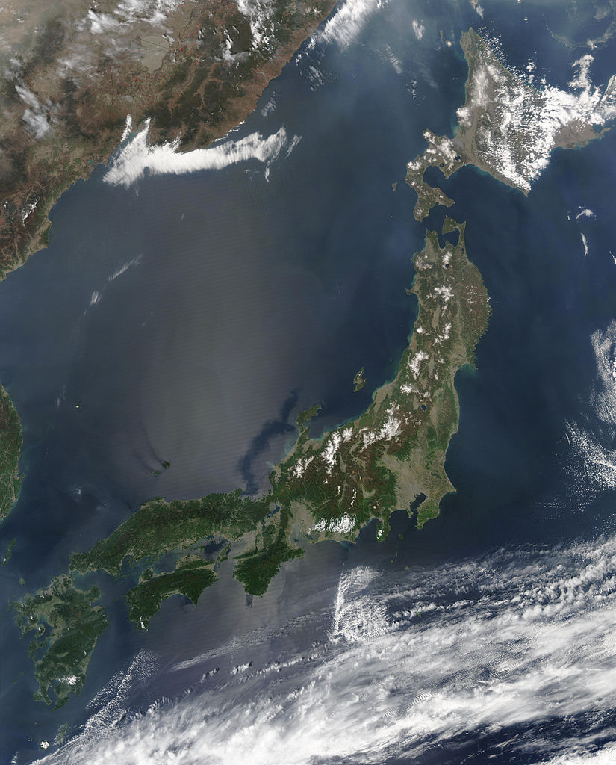
Satellite View of Japan

Slide 27
Location
Almost 80% of Japan is covered with mountains, which leaves a very small percentage of land available for farming.
There are many volcanoes in Japan, which often cause earthquakes.
Some parts of the country have developed hot springs around the volcanic areas, and others use the heat to warm water for people to use.
Much of Japan’s population is crowded into cities.
Tokyo is the most crowded urban area in the world.

Slide 28
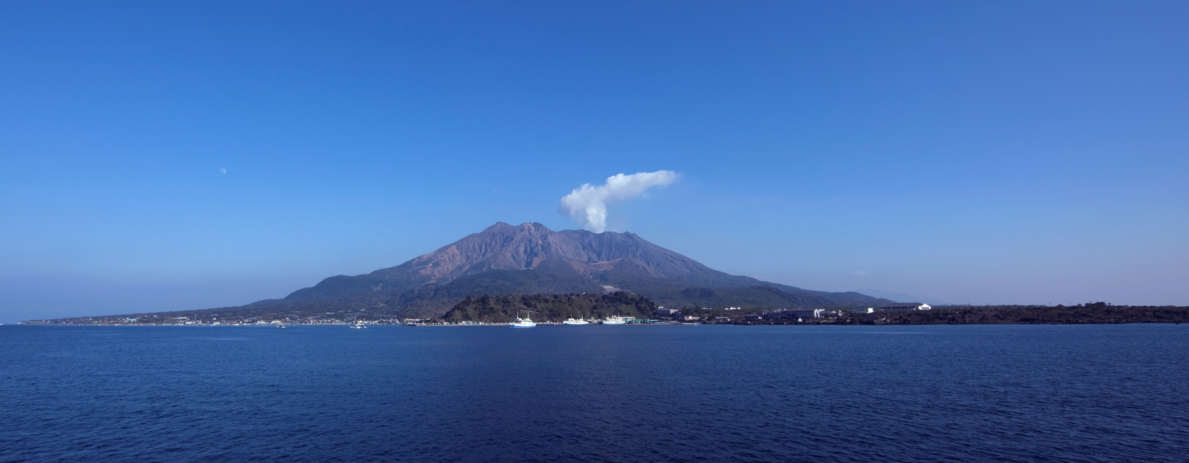
Sakurajima – Most Recent Eruption August 2013

Slide 29
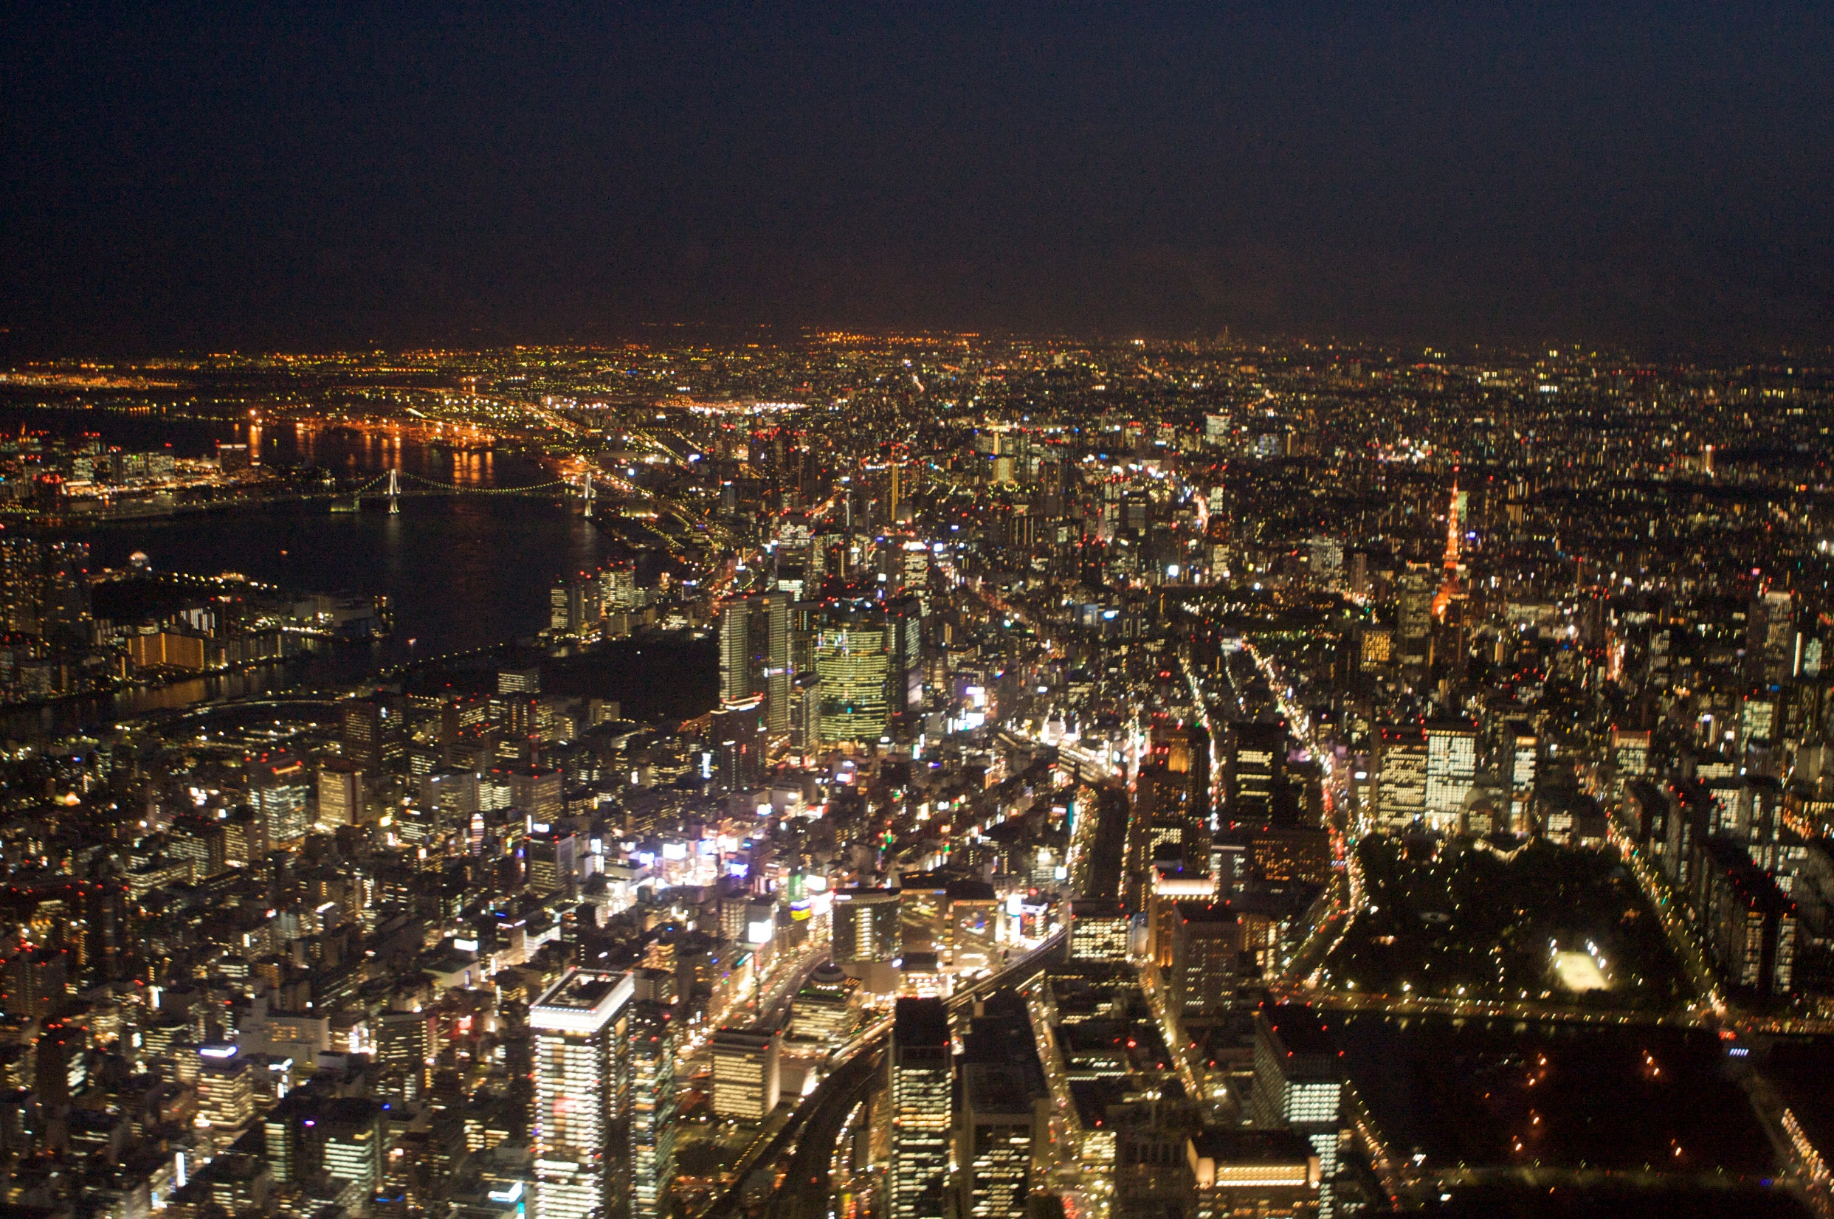
Tokyo – World’s Largest Megacity

Slide 30
Natural Resources
Japan has practically no natural resources.
Much of the land is not arable, so the majority of Japan’s food must be imported.
The country must depend on industry and trade to supply its population with the goods they need.
Japan does, however, have a strong fishing industry.
It is actually the world’s top fishing country, with China in second.

Slide 31
North
Korea
Population: 24,720,407

Slide 32
Climate & Location
North Korea has short summers and long, cold winters.
The land is mountainous and is not as heavily populated as South Korea.
The mountains of North Korea have caused it to have less success with agriculture than others in the region.
Most of the people live along the western half of the country where farming is more successful.

Slide 33
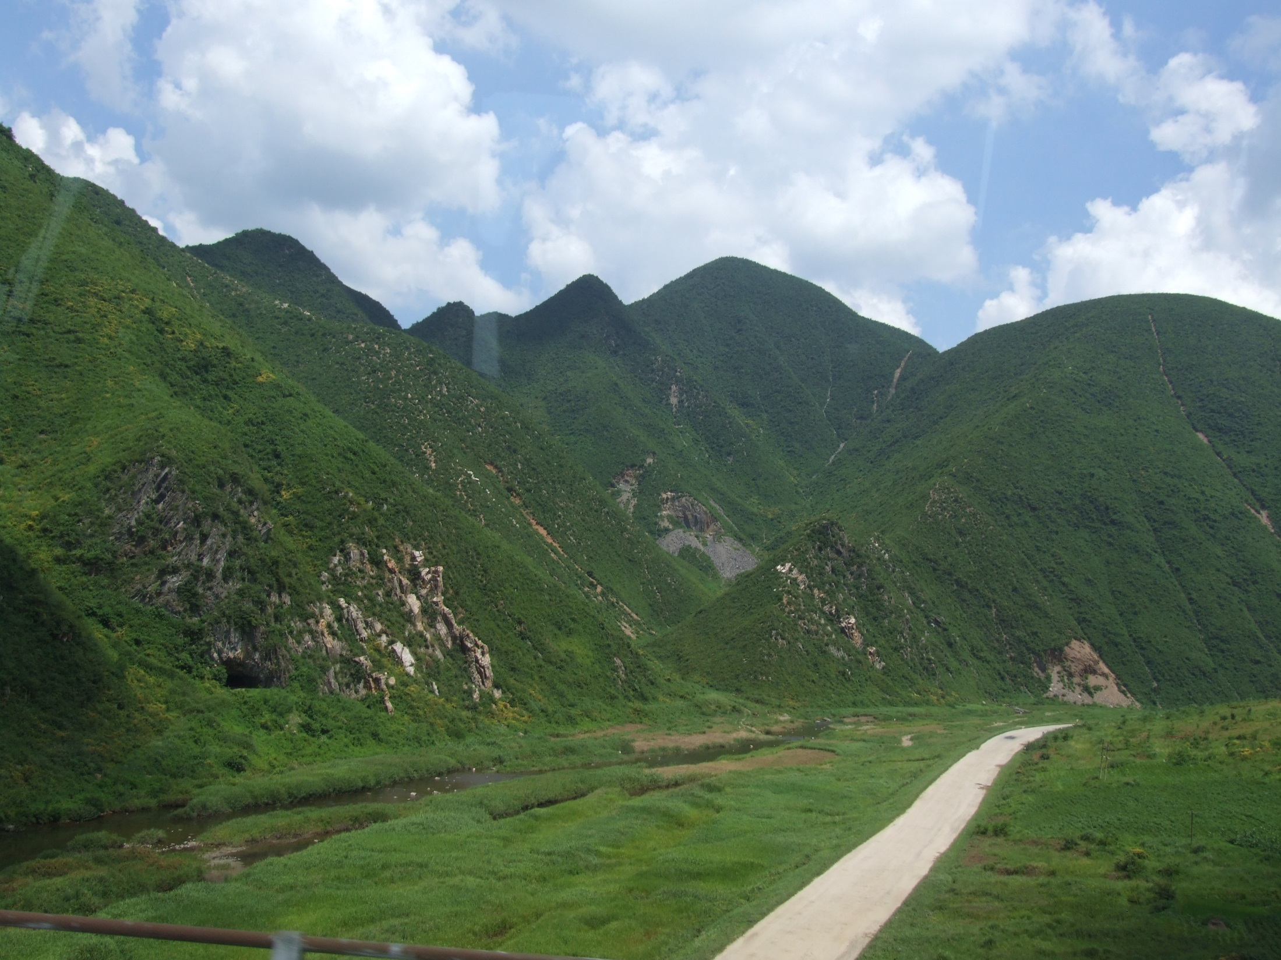
North Korea

Slide 34
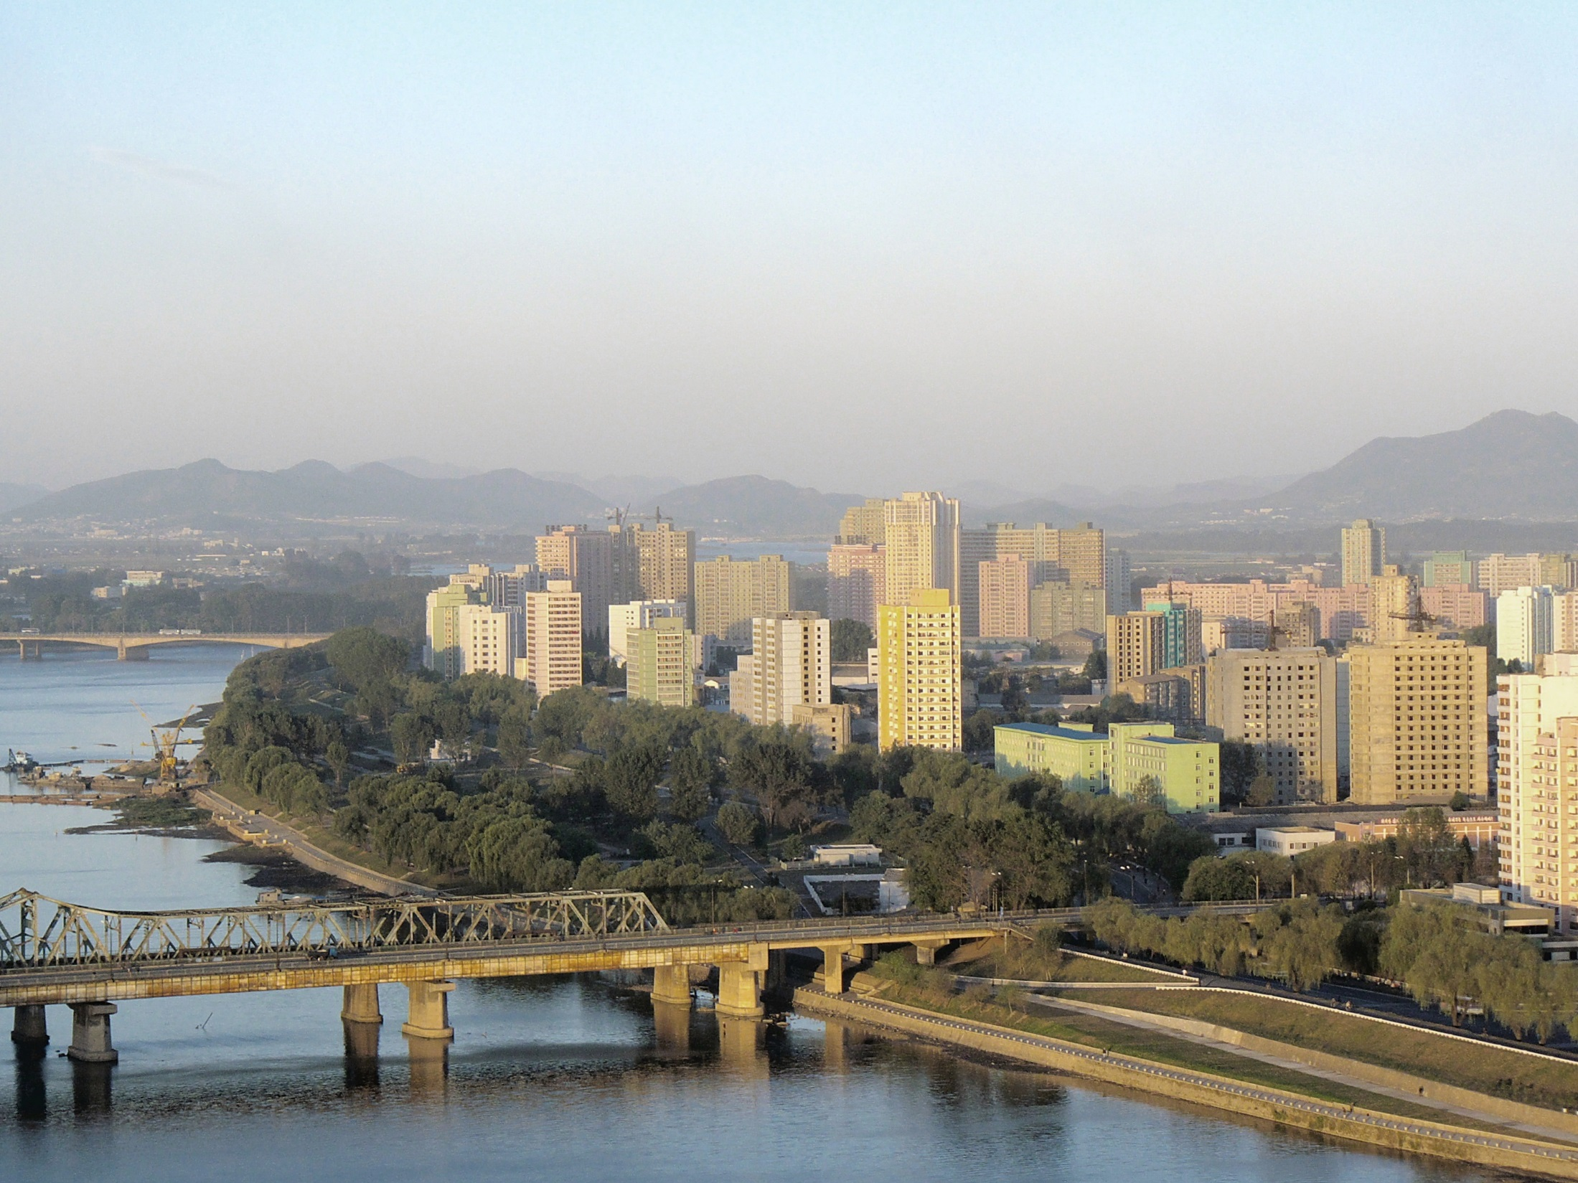
Pyongyang, North Korea’s Capital

Slide 35
Natural Resources
There are fast-flowing rivers in the mountains where North Koreans have developed hydroelectric power plants.
The country earns a profit from mining coal and other minerals like iron and copper.

Slide 36
South
Korea
Population: 48,955,203

Slide 37
Climate & Location
Due to the warm winds that come from the ocean, South Korea has a milder climate than North Korea.
South Korea has a larger population than North Korea, with about 25% of the people living in the capital city, Seoul.
There are less mountains than in the north, so farming is more widely practiced here.

Slide 38
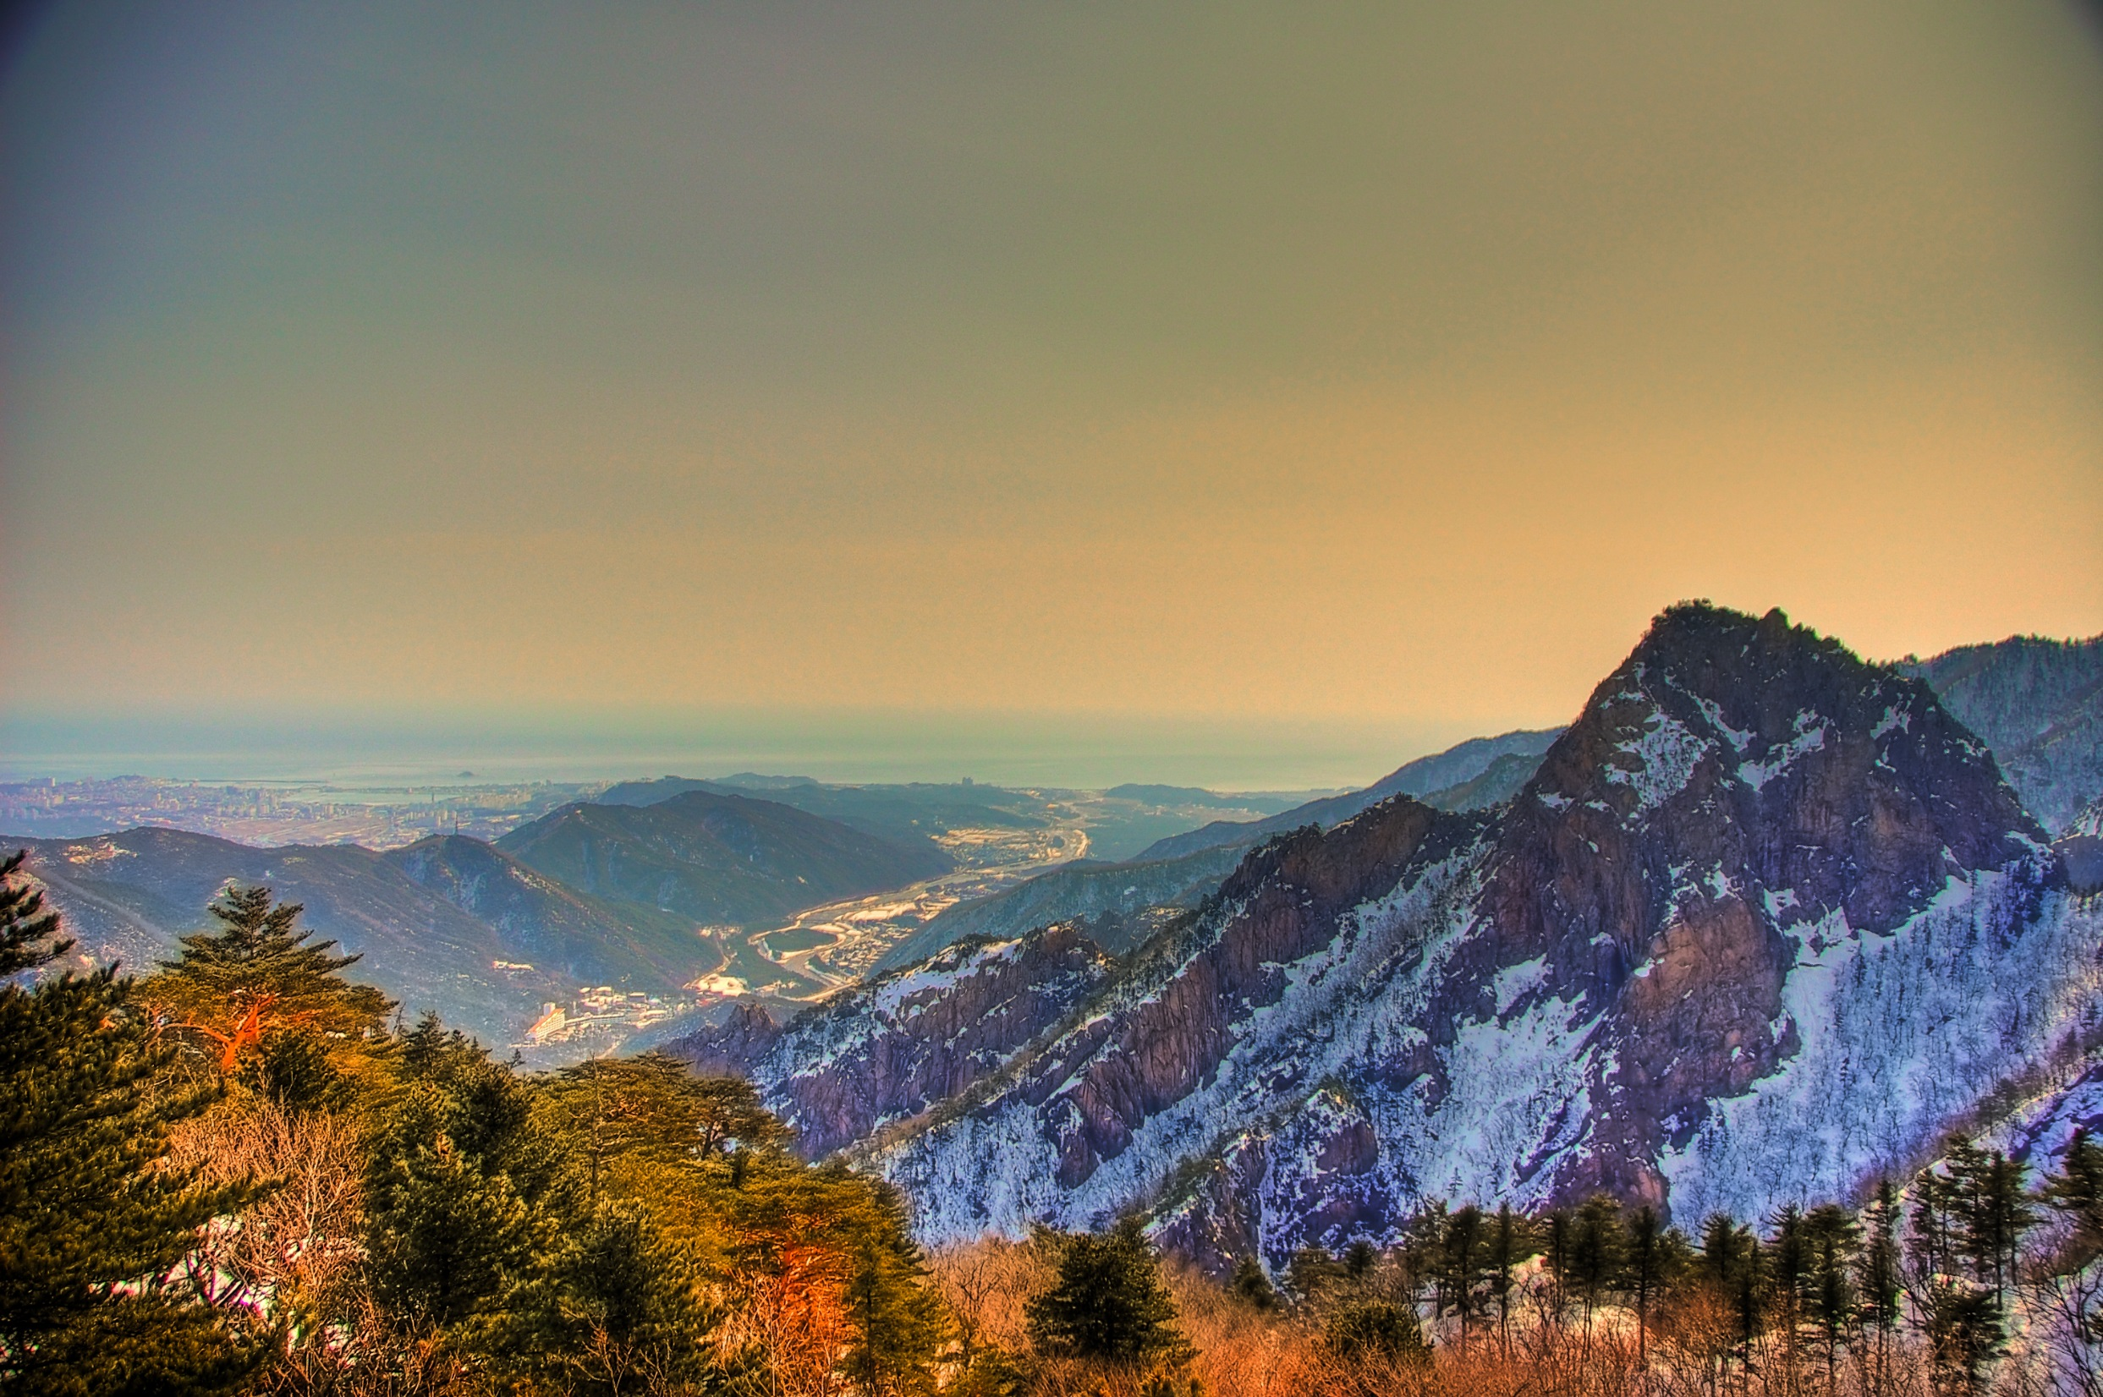
South Korea

Slide 39
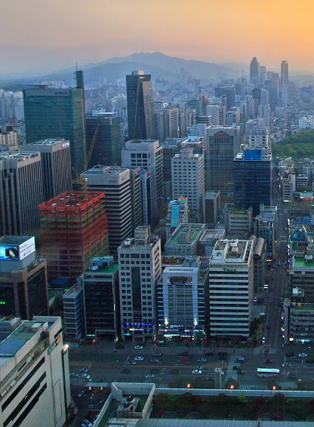
Gangnam District Seoul,
South Korea

Slide 40
Natural Resources
Both North and South Korea have a number of mineral deposits, including lead and zinc.

Slide 41
Other
Countries

Slide 42
Climate & Location
Countries farther to the southeast like Vietnam are warmer and tropical.
Some of the world’s oldest rainforests are found in the Asian countries of Indonesia, Malaysia, Thailand, Cambodia, and Laos.
Few people live in the rainforests, but they are rapidly disappearing because of deforestation.

Slide 43
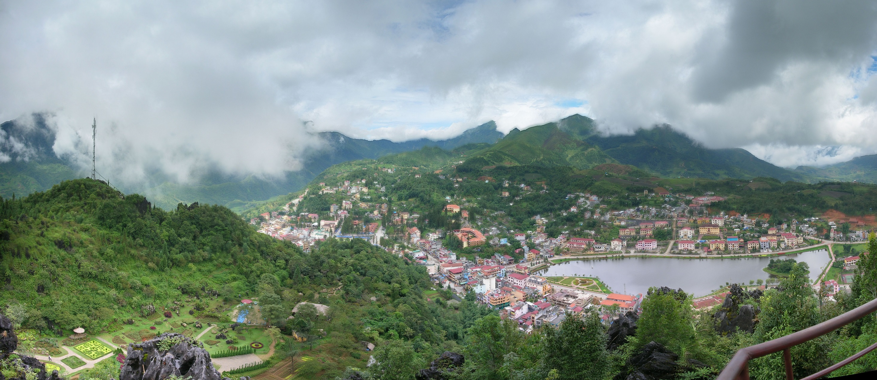
Rainforest – Sa Pa, Vietnam

Slide 44
Natural Resources
There are rich farmlands in southeast Asian countries where 90% of the world’s rice is grown.
About half of Vietnam’s people are farmers, living in the fertile deltas of the Mekong and Red rivers.
In Thailand, people also live in fertile river areas where they grow rice and other crops.
Vietnam is also able to mine phosphates for export, as well as drill for oil.

Slide 45
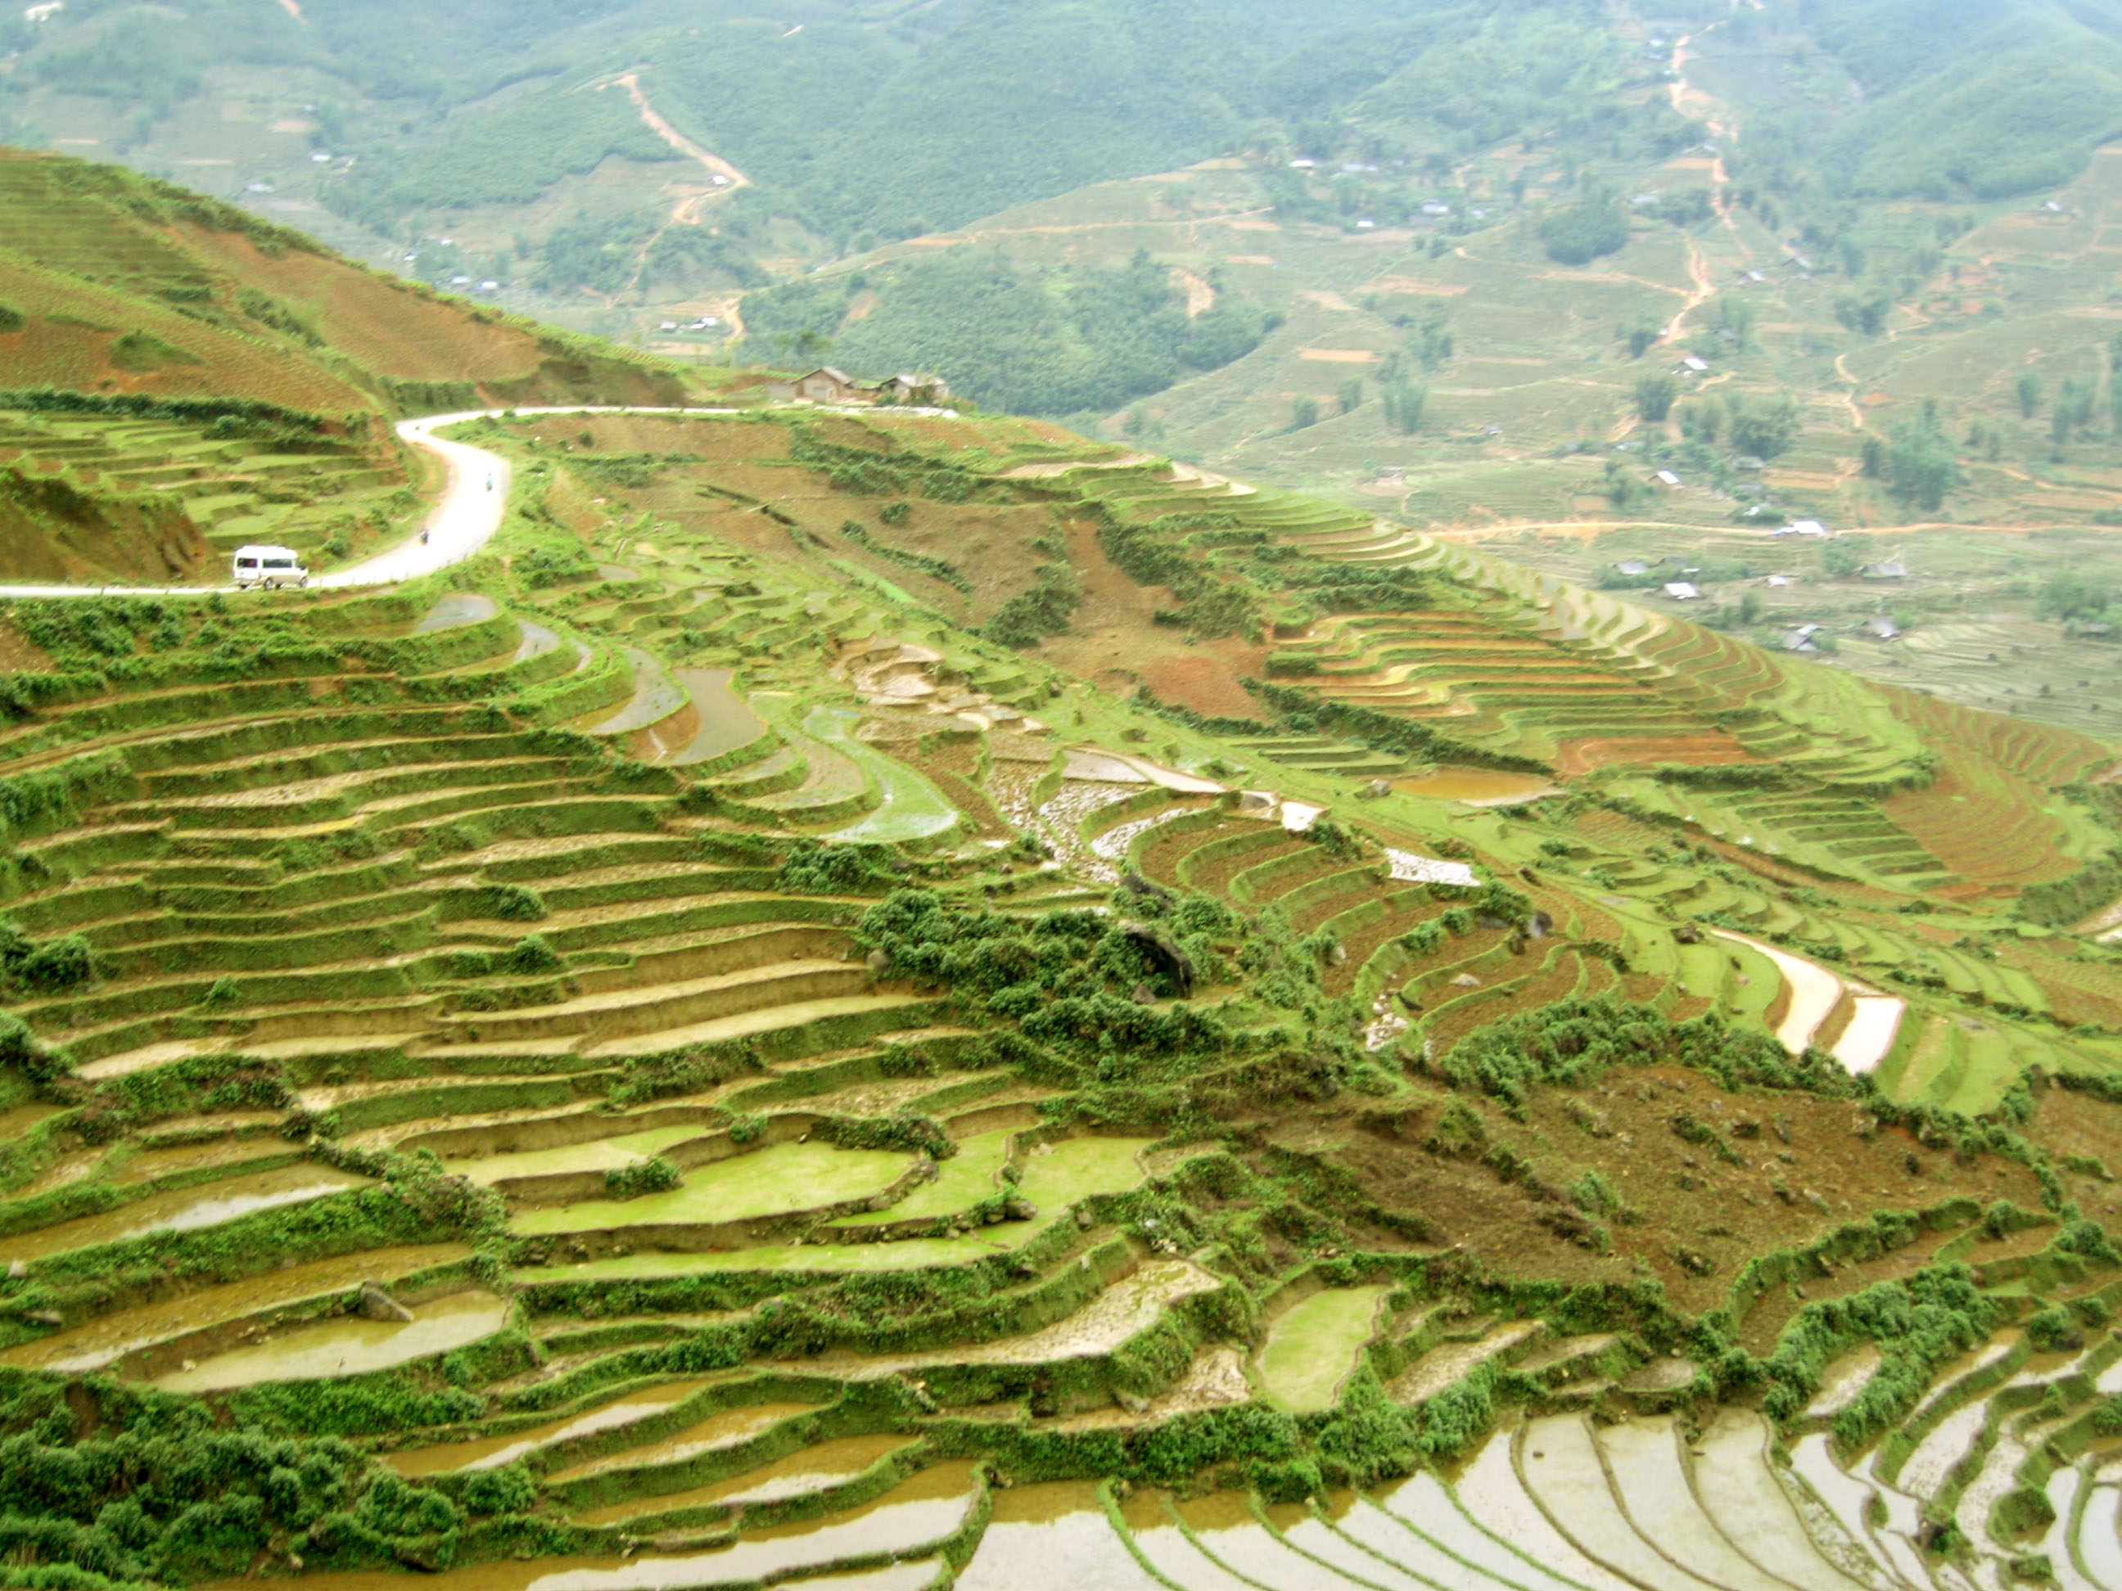
Vietnamese Rice Fields

Slide 46
Transportation

Slide 47
Transportation
Most transportation systems across Asia are underdeveloped.
Road systems are not well developed and links between countries are often close because of disagreements.
Most of Asian travel (between countries) happens by sea or air.
Walking is a common mode of transportation in rural areas throughout Asia.

Slide 48
Transportation
Japan has a high-speed rail system where trains travel up to 199 miles per hour!
Many people in China’s cities can afford cars but the roads are highly congested.
Public bus and subway systems are available, and people also use bicycles or walk.
Roads are also congested in India’s cities and the same modes of transportation are available.

Slide 49
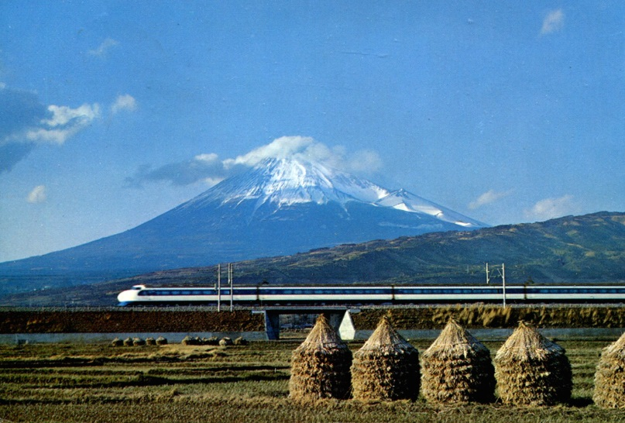
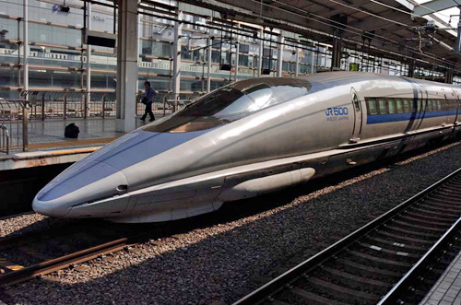
Japanese Bullet Train

Slide 50
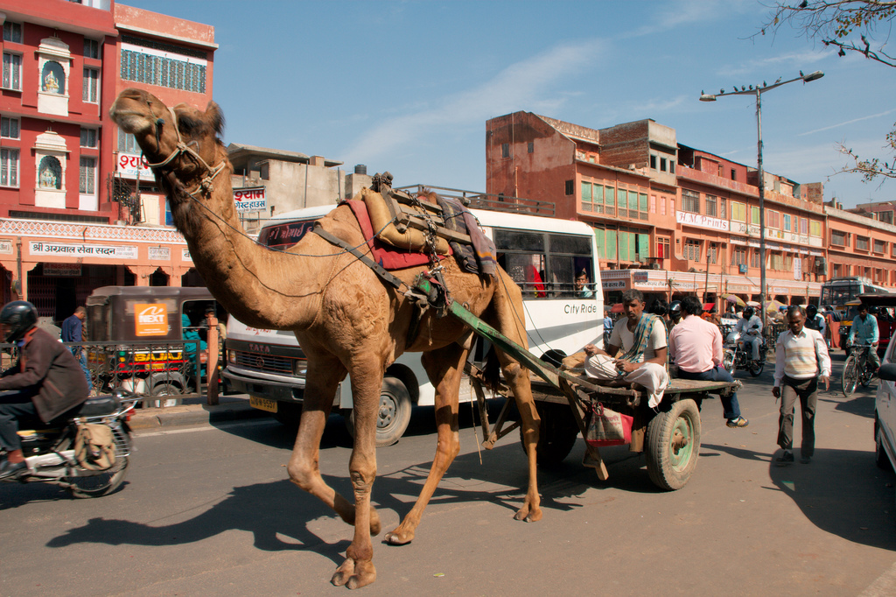
Jaipur, India

Slide 51
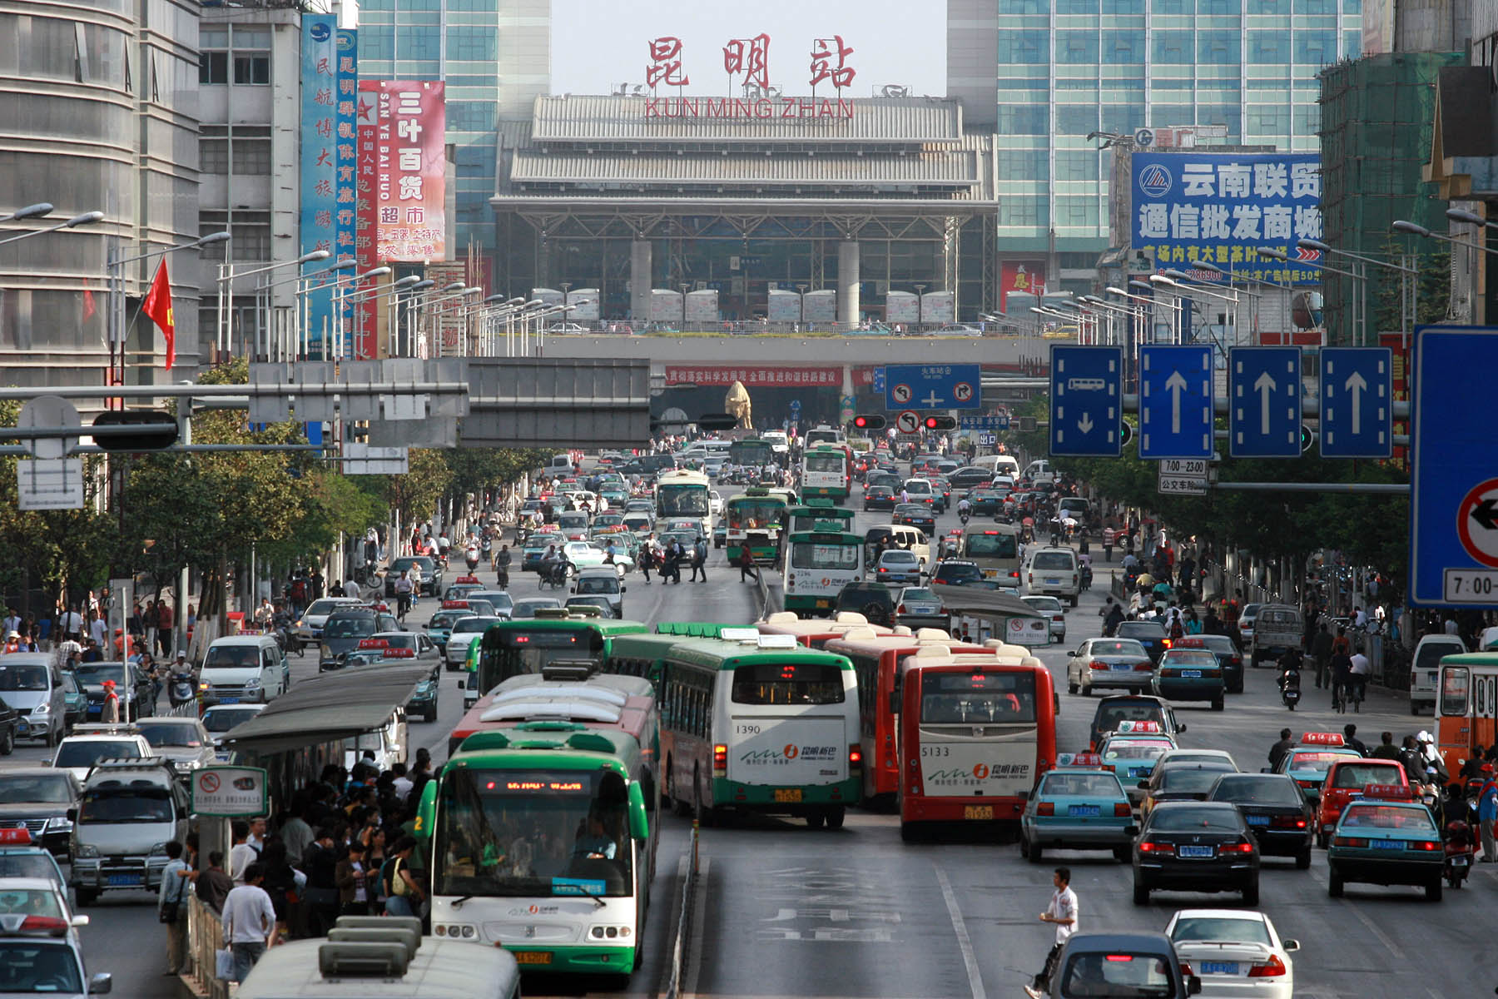
Yunnan, China

Slide 53
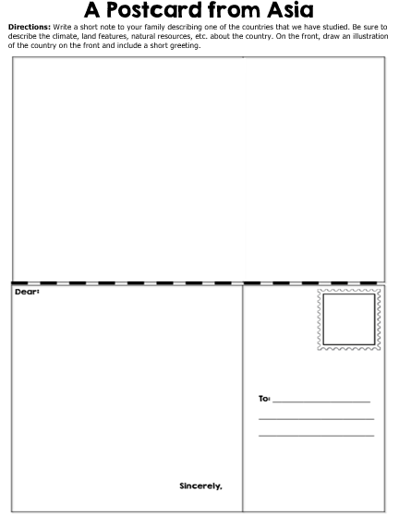

Slide 54
Fieldtrip Wish List
Fieldtrip Wish List
Wouldn’t it be awesome to take a fieldtrip to one of the countries that we are studying? Write your teacher a note to try and convince her to take your class to this country. Include at least THREE reasons why we should go there. Also, draw an illustration to go with your note.
Wouldn’t it be awesome to take a fieldtrip to one of the countries that we are studying? Write your teacher a note to try and convince her to take your class to this country. Include at least THREE reasons why we should go there. Also, draw an illustration to go with your note.
From the Desk of…
From the Desk of…

Slide 55
Teachers
Thank you for downloading this file. I hope you enjoy using it with your students, and I can’t wait to read your feedback in my TPT store! ☺
For more social studies materials, please visit my store: http://www.teacherspayteachers.com/Store/Brain-Wrinkles
I teach Language Arts and Social Studies in Georgia, so my products are aligned with Common Core (LA) and Georgia Performance Standards (SS).
© Copyright 2013. Brain Wrinkles. All rights reserved. Permission is granted to copy pages specifically designed for student or teacher use by the original purchaser or licensee. The reproduction of any other part of this product is strictly prohibited. Copying any part of this product and placing it on the Internet in any form (even a personal/classroom website) is strictly forbidden. Doing so makes it possible for an Internet search to make the document available on the Internet, free of charge, and is a violation of the Digital Millennium Copyright Act (DMCA).

Slide 56
Credits:
All photos were found via Creative Commons and labeled for reuse.
Fonts:
Backgrounds & Graphics:
*The graphics used in this item are copyrighted and may not be used for your own commercial projects or given away to anyone else.

