Slide 1
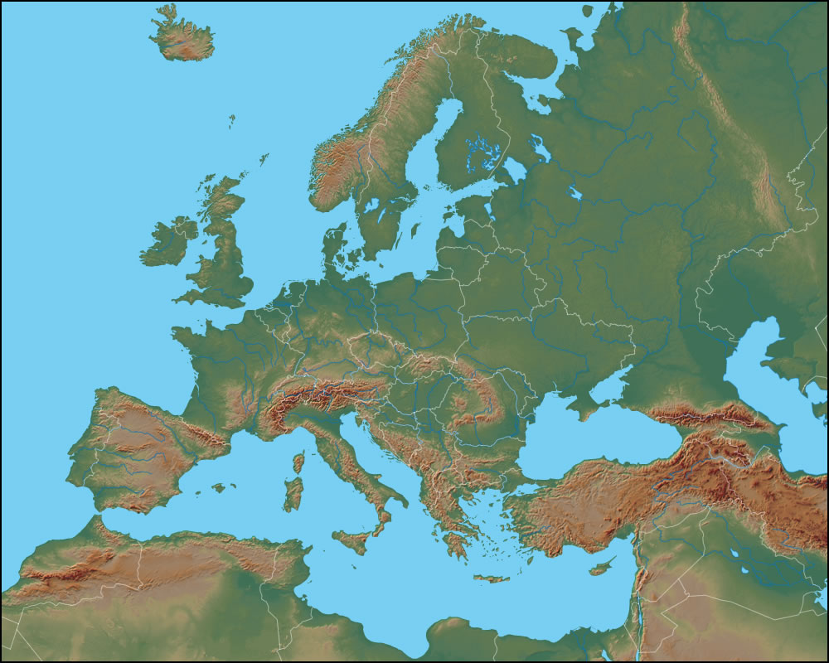
Physical Map of Europe
1
Ural Mountains

Slide 2
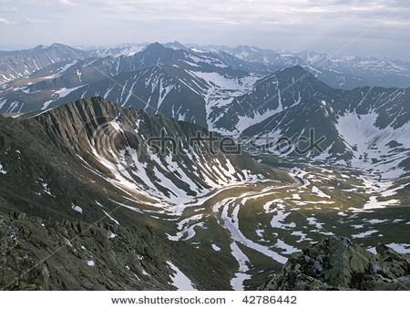
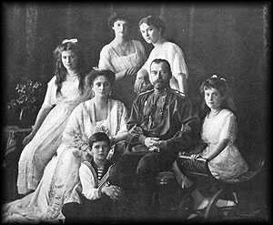
Physical Map of Europe
Ural Mountains

Slide 3
Physical Map of Europe
2
Scandinavian Peninsula

Slide 4
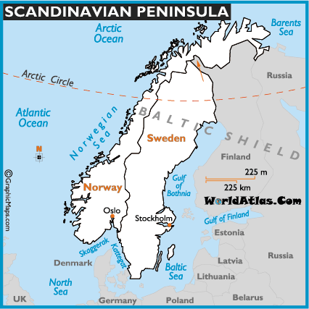
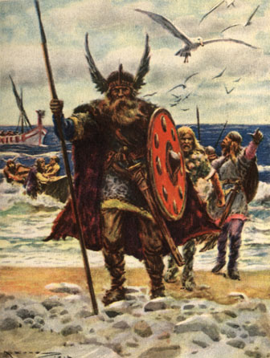
Physical Map of Europe
Scandinavian Peninsula

Slide 5
Physical Map of Europe
3
Pyrenees

Slide 6
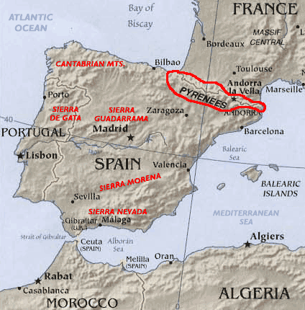
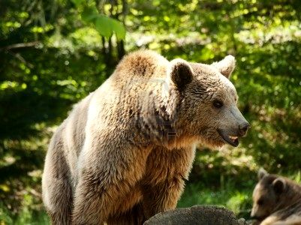
Physical Map of Europe
Pyrenees

Slide 7
Physical Map of Europe
4
European Plain

Slide 8
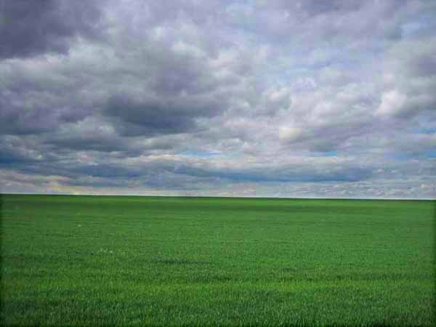
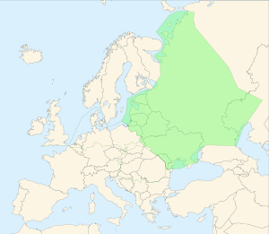
Physical Map of Europe
European Plain

Slide 9
Physical Map of Europe
5
Rhine River

Slide 10
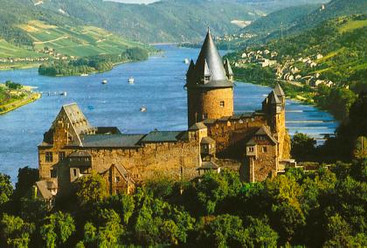
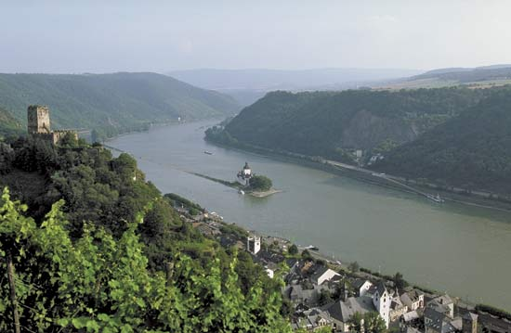
Physical Map of Europe
Rhine River

Slide 11
Physical Map of Europe
6
Danube

Slide 12
Physical Map of Europe
Danube

Slide 13
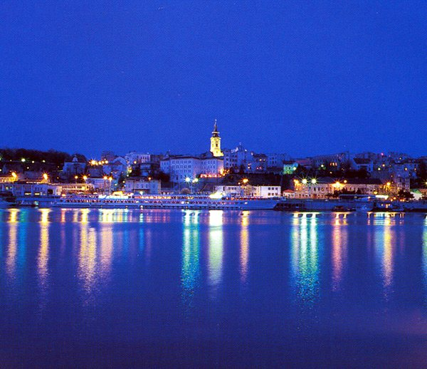
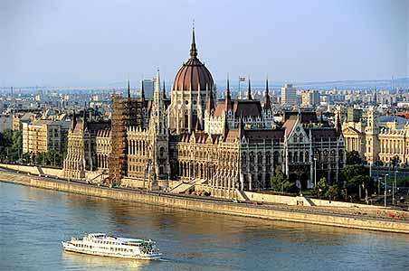
Physical Map of Europe
Danube

Slide 14
Physical Map of Europe
7
Alps

Slide 15
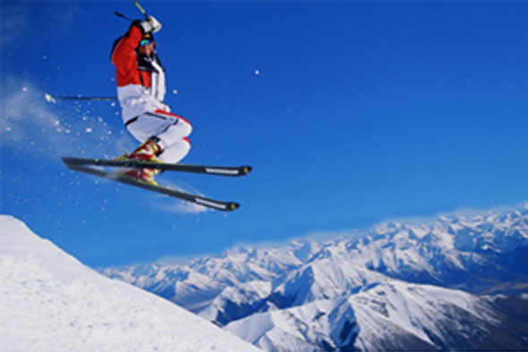
Physical Map of Europe
Alps

Slide 16
Physical Map of Europe
8
Mediterranean Sea

Slide 17
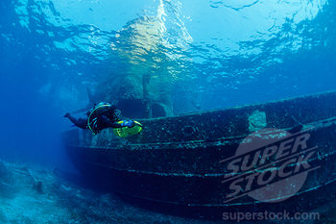
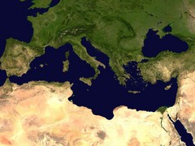
Physical Map of Europe
Mediterranean Sea

Slide 18
Physical Map of Europe
9
Iberian Peninsula

Slide 19
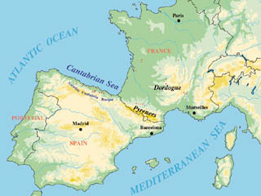
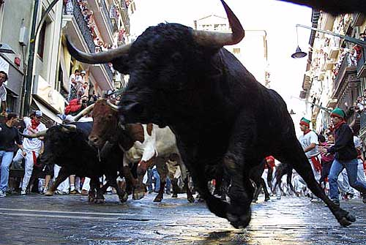
Physical Map of Europe
Iberian Peninsula

Slide 20
Physical Map of Europe
10
English Channel

Slide 21
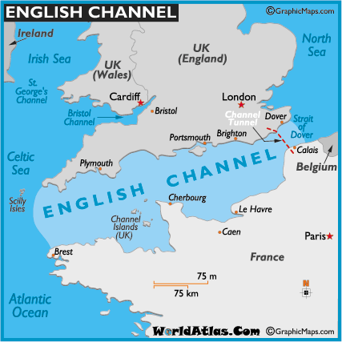
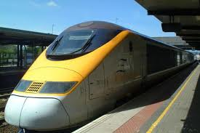
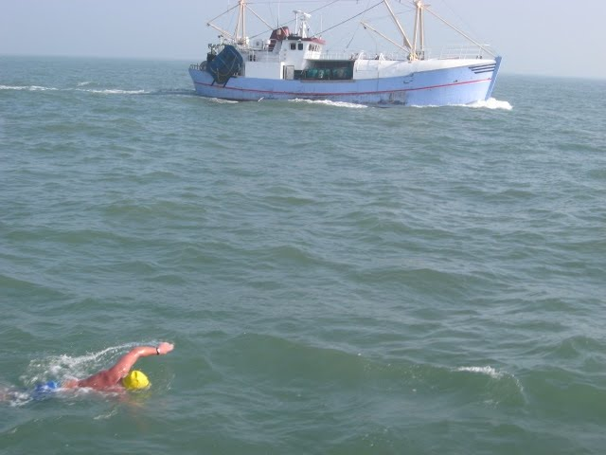
Physical Map of Europe
English Channel

Slide 22
European Plain
2. Pyrenees Mountains
English Channel
4. Ural Mountains
5. Mediterranean Sea
6. Danube River
7. Rhine River
8. Iberian Peninsula
9. Scandinavian Peninsula
10. Alps

