Slide 1
History of
Canada
From European Contact to
Canadian Independence

Slide 2
First Nations
The First Nations are the native peoples of Canada.
They came from Asia over 12,000 years ago.
They crossed the Bering Land Bridge that joined Russia to Alaska.
There were 12 tribes that made up the First Nations.

Slide 3
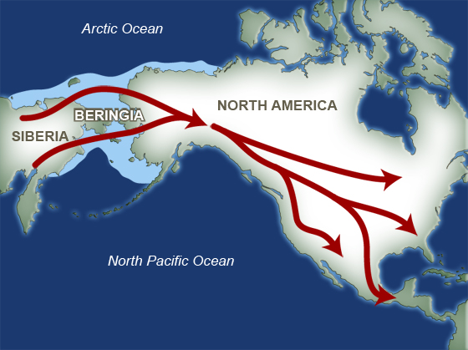

Slide 4
Inuit
The Inuit are one of the First Nation tribes.
They still live in Canada today.
In 1999, Canada’s government gave the Inuit Nunavut Territory in northeast Canada.

Slide 5
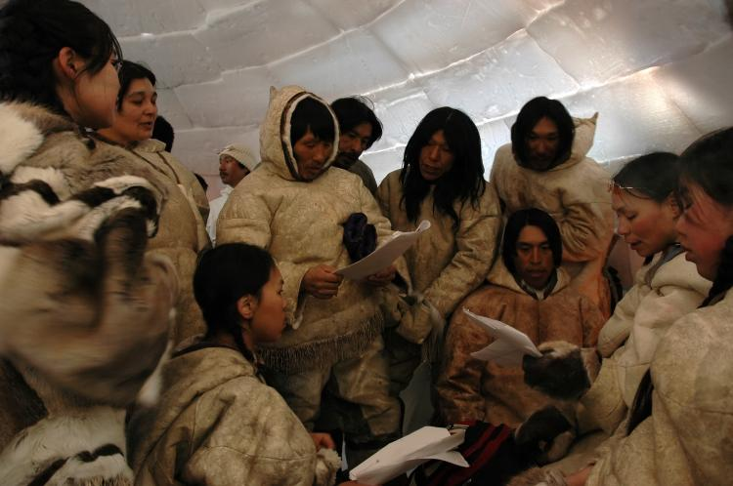
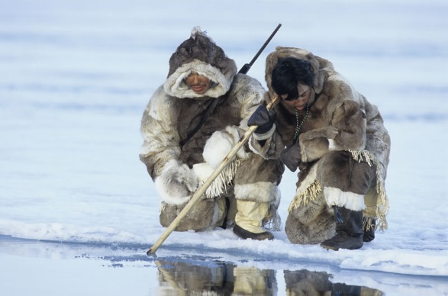

Slide 6
Early Europeans
The first explorers to settle Canada were Norse invaders from the Scandinavian Peninsula.
In 1000 CE, they built a town on the northeast coast of Canada and established a trading relationship with the Inuit.
The Norse deserted the settlement for unknown reasons.
Europeans did not return to Canada until almost 500 years later…

Slide 7
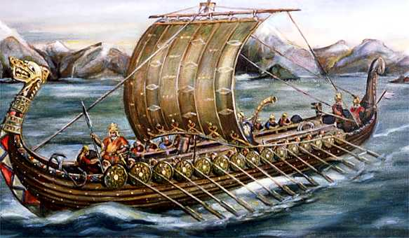
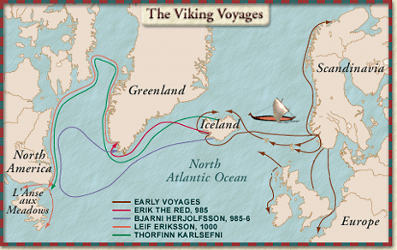

Slide 8
Newfoundland
The Italian explorer, John Cabot, sailed to Canada’s east coast in 1497.
Cabot claimed an area of land for England (his sponsor) and named it “Newfoundland”.

Slide 9
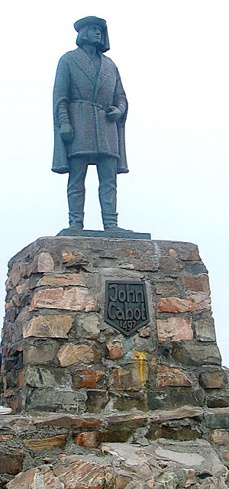
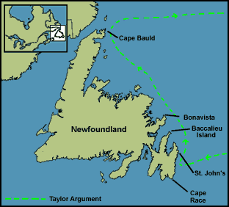

Slide 10
New France
Jacques Cartier sailed up the St. Lawrence River in 1534.
He claimed the land for France.
French colonists named the area “New France”.

Slide 11
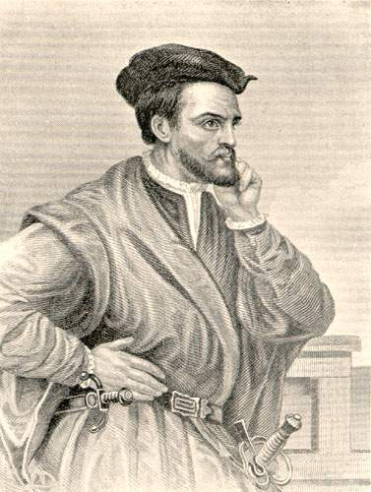
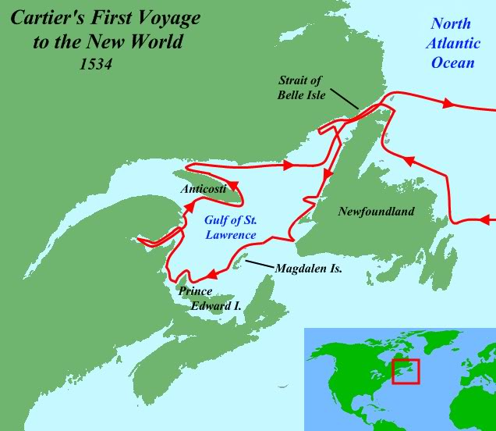

Slide 12
New France (Quebec)
In 1608, Samuel de Champlain built the first permanent French settlement in New France—called Quebec.
The population grew slowly.
Many people moved inland to trap animals.
Hats made of beaver fur were in high demand in Europe.

Slide 13
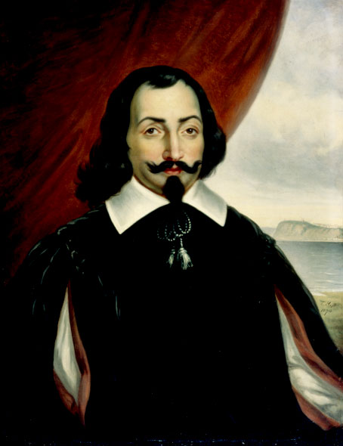

Slide 14
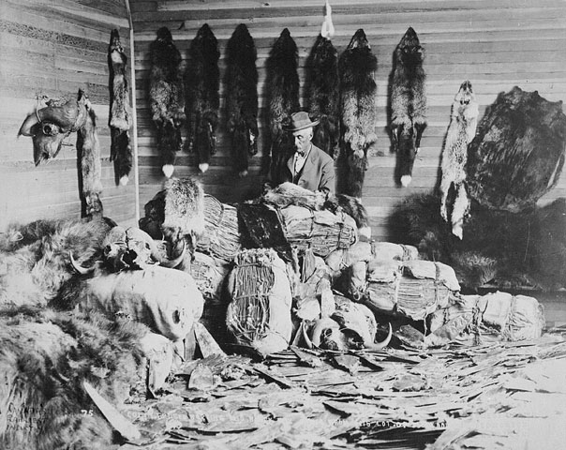
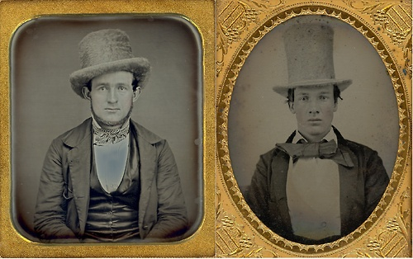

Slide 15
New France (Quebec)
European fur traders were joined by French farmers, merchants, and missionaries from the Catholic Church.
They brought with them French laws, traditions, & religion.
France wouldn’t let anyone move to New France who was not Catholic.

Slide 16
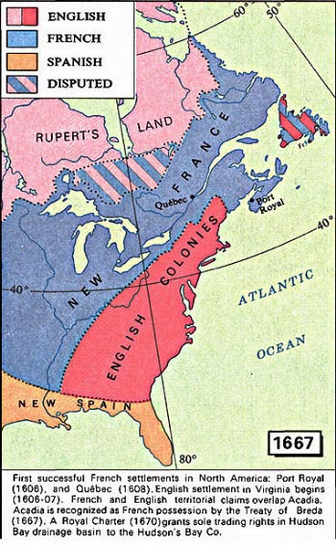

Slide 17
The British in Canada
The British colonized the region south of New France.
They saw New France’s success in fur trapping and wanted to take control of the fur trade.
This led to the French and Indian War in 1754.

Slide 18
French & Indian War
Great Britain fought for control of Canadian territory and the fur trade.
It was Great Britain and the Iroquois Indians versus France and the Huron Indians.
Great Britain conquered Quebec in 1754 and forced France to sign the Treaty of Paris in 1763.

Slide 19
Treaty of Paris
This gave Britain control of all lands east of the Mississippi River, except for 2 islands off the coast of Newfoundland.
The British forced Nova Scotia’s French-speaking people to leave.
Nova Scotia’s French went to another French colony – Louisiana.
Descendants of these people are the Cajuns.

Slide 20
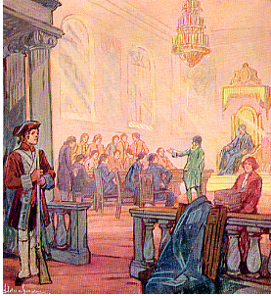

Slide 21
American Revolution
In 1776, Americans gained independence from Great Britain.
This initiated a huge cultural change in Canada.
Americans who did not believe in independence left America and moved to Quebec.
These people were called “Loyalists” because they were loyal to Great Britain.
As a result, Quebec began to have people who spoke English as well as French.

Slide 22
Quebec Act
Many Loyalists did not want to live among French-speaking Canadians.
Cultural difference between the English speakers & French speakers sparked many conflicts.
In 1774, British government passed the Quebec Act.

Slide 23
Quebec Act
The British allowed the French to stay in Quebec, but continued to control the region.
The Quebec Act guaranteed the French the right to maintain their culture (language, religion, traditions).

Slide 24
Results
It gave French Canadians in Quebec the right to continue practicing the Catholic religion and allowed French civil law.
Loyalists were irritated with the new political & cultural power of the French.
They could not own land or have representation in Quebec’s government.
The differences among the two groups eventually led to a re-division of the country.

Slide 25
Division of Canada
Most English speaking citizens lived in Upper Canada (Ontario).
Most French speaking citizens lived in Lower Canada (Quebec).

Slide 26
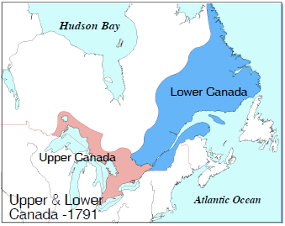

Slide 27
War of 1812
During this war, the French and British worked together against the United States, who tried to invade Canada.
War resulted in a draw, but it defined the US-Canadian border & increased a sense of Canadian nationalism.
Both French Canadians & English Canadians joined to protect their land—they were more united than ever before.

Slide 28
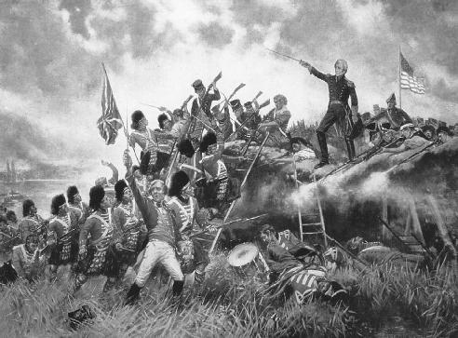

Slide 29
War of 1812 - After
French Canadians and British Canadians realized that they hated being under British rule.
They thought that Great Britain was too far away to understand their economic & political needs.

Slide 30
Province of Canada
In 1837, Canadians began to rebel against British control.
Britain sent a government reformer to examine the Canadian problem.
As a result of the inquiry, Britain discovered an economic need to unify the 2 Canadian provinces.
In 1841, Upper & Lower Canada were united, establishing the “Province of Canada”.

Slide 31
British North America Act
During the 1860s, Canadian leaders discussed the confederation of all British North American Colonies.
In 1867, the British North America Act created a federation union of Canada.
It joined four colonies (Quebec, Ontario, New Brunswick, & Nova Scotia).
The four colonies became provinces joined by a unifying constitution.
Britain accepted the agreement because they were glad to be rid of the responsibility of protecting the colonies (too expensive).

Slide 33
Transcontinental Railroad
The British North America Act allowed each region to sell goods more easily to one another.
This improved trade helped the economy.
Soon there was enough money to build a railroad across the country.
The Transcontinental Railroad was built in 1886.
People could now easily travel from the Atlantic Ocean to Pacific Ocean.

Slide 34
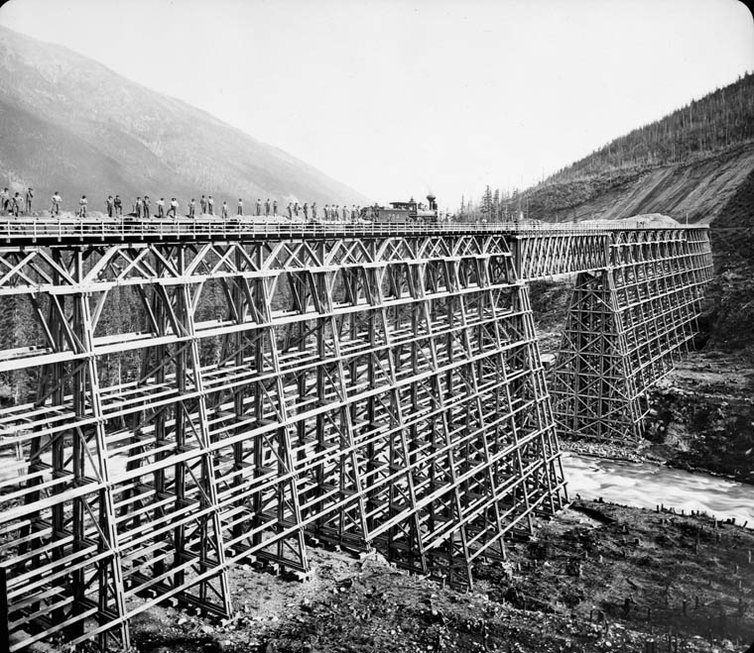
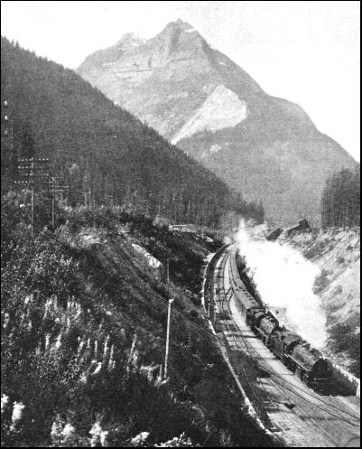

Slide 35
Expanding Canada
When Canada became a confederation in 1867, there were only 4 provinces.
Leaders desired to expand the new country from the Atlantic to the Pacific.
They bought land from the Hudson’s Bay Company.
They thought the purchase would be a simple process, but problems occurred with the native peoples.

Slide 36
Expanding Canada
Eventually the First Nations (Inuit) agreed to relocate to reservations (now Nunavut).
Transcontinental Railroad was built on this land.
Soon, 3 new provinces and 1 territory were created: Manitoba, British Columbia, Prince Edward Island, and the Northwest Territories.

Slide 38
Railroad’s Results
The railroad increased the shipment of goods across Canada.
It increased travel from coast to coast.
It caused the creation of new provinces and territories.
The railroad was also the birth of Canadian nationalism.
Before the railroad, most people only thought of themselves as belonging to their province; after, they felt as if they were part of one country.

Slide 39
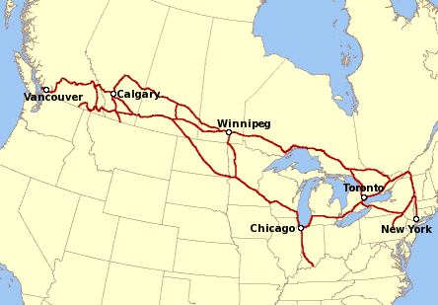

Slide 40
Yukon Gold
Gold was discovered along the western coast of Canada in 1896.
Canada’s government created Yukon territory in 1898 to meet the needs of the area’s growing population.

Slide 41
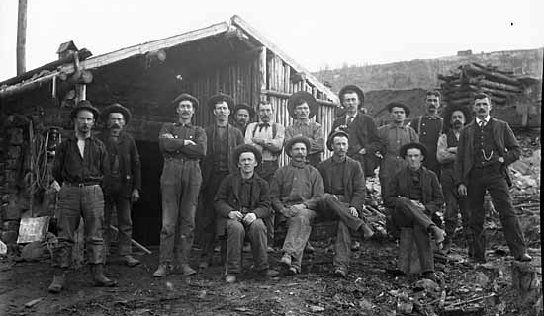
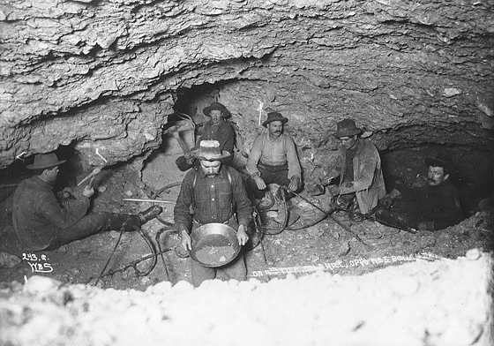

Slide 43
Saskatchewan & Alberta
1905
This land was originally part of Northwest Territories, but by early 1900s, many people wanted this to change.
Reason 1: The economy had shifted from fur trade to farming, mining, logging & railway.
Reason 2: The population grew quickly because of the new industries.
Reason 3: The area could not afford everything people needed (like schools).
By forming new provinces, they could collect taxes to pay for these things.

Slide 44
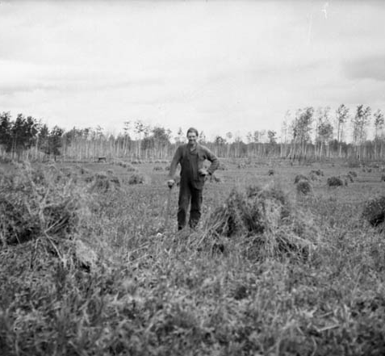
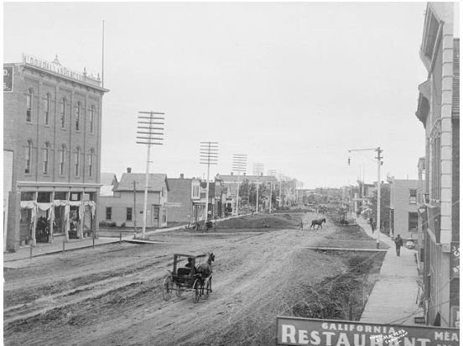

Slide 45
Canada in WWI
Canada still had close ties with Britain and felt they should contribute in the fight against Germany.
They sent military forces, raw materials, & food to Europe.
Canada’s contribution changed the way the world viewed the country.
Canada was now a union that was able to compete with world powers.
WWI also increased Canadian nationalism.

Slide 46
Newfoundland - 1949
Newfoundland joined the country of Canada because:
Canada promised to help them by building many things such as railroads and roads.
Britain didn’t want the cost of supporting Newfoundland anymore.

Slide 47
Nunavut - 1999
In the 1970s, the Inuit wanted to create a territory called Nunavut.
They wanted their own territory so that they could start making decisions for themselves.
They needed their own government.
They wanted control of their land.
For many years Canada had used the resources of the Arctic without asking the Inuit.
Inuit still live the same way that their ancestors did—they use traditional methods for survival.

Slide 49
