Slide 1
Geography
of Canada
Physical Features, Where People Live, & How They Trade

Slide 3
Physical
Features

Slide 4
Great Lakes
5 large freshwater lakes in central North America
HOMES (Huron, Ontario, Michigan, Erie, Superior)
Serve as the “industrial heartland” of the continent because of all of the factories
One of the world’s busiest shipping areas
Most of Canada’s population lives in this region

Slide 7
St Lawrence River
Major source of overseas and US/Canada shipping & trade
Shortcut that connects the Great Lakes to the Atlantic Ocean
Huge producer of hydroelectricity

Slide 8
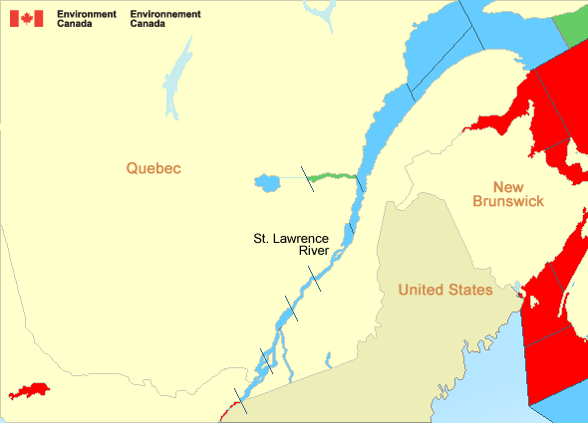

Slide 9
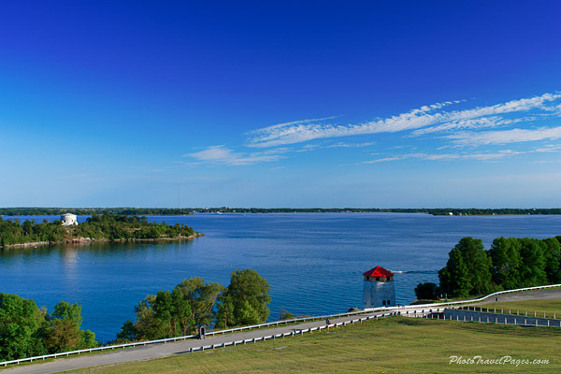

Slide 10
St Lawrence Seaway
A canal completed in 1959 at the eastern end of the Great Lakes
Connects the Great Lakes with the St. Lawrence River (which flows to the Atlantic Ocean)
Major source of overseas and US/Canada shipping & trade
Closed from November to April (frozen)
Seaway has made cities in Eastern Canada home to many successful manufacturing companies

Slide 11
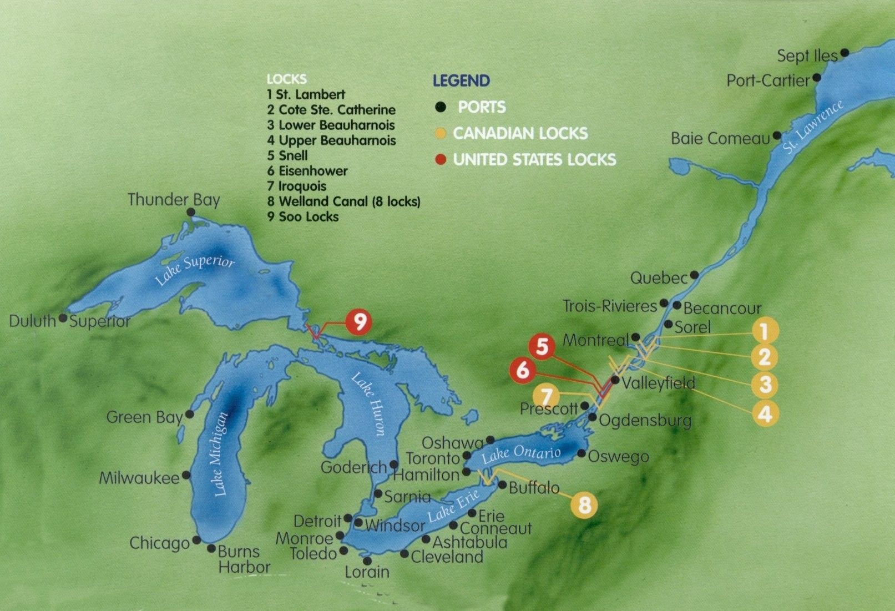

Slide 12
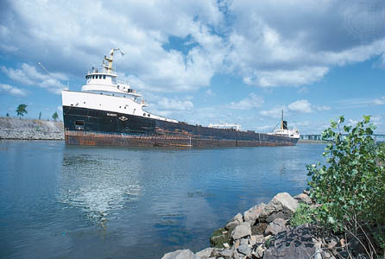

Slide 13
Hudson Bay
HUGE inland sea in east central Canada
“an arm” of the Atlantic Ocean
Grain from Alberta & Saskatchewan is shipped from Hudson Bay out to the Atlantic and on to other countries
Only navigable from July to October

Slide 14
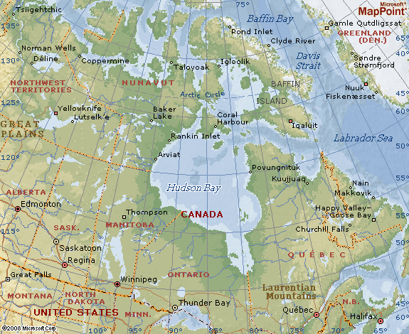

Slide 15
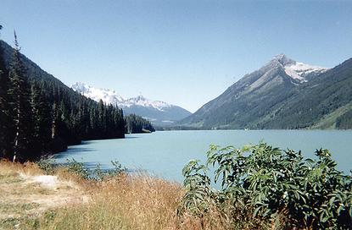

Slide 16
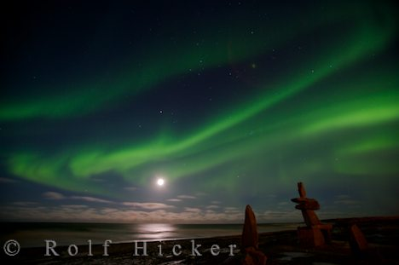

Slide 17
Atlantic Ocean
This is the 2nd largest of the earth’s 5 oceans.
It’s also the most heavily traveled ocean.
It forms the eastern border of Canada.
It’s a major shipping route to Europe & Africa.

Slide 18
Pacific Ocean
Largest & deepest of the world’s 5 oceans
Covers 1/3 of the earth’s surface!
Western border of Canada
Major shipping route to Asia

Slide 19
Canadian Shield
Stretches from Great Lakes to Arctic Ocean; covers half of Canada!
Horseshoe region around Hudson Bay
Region of mostly thin soil lying on top of rock, with many bare outcrops of rock & thousands of lakes
Major source of natural resources: timber, minerals, & water
Region is sparsely populated.

Slide 20
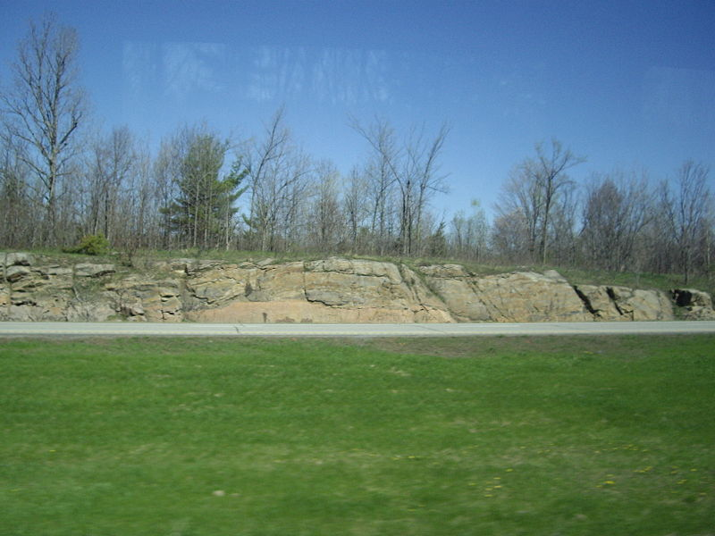

Slide 21
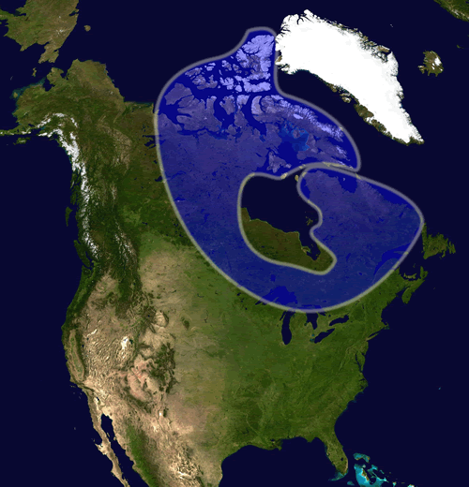

Slide 22
Rocky Mountains
Mountains located in Western Canada
Includes western Alberta and eastern British Columbia
Stretch a distance of 2,000 miles!
Mining is the biggest industry in the region, followed closely by logging.
Major minerals include: iron ore, copper, coal, gold.
Sparsely populated & contain few cities

Slide 23
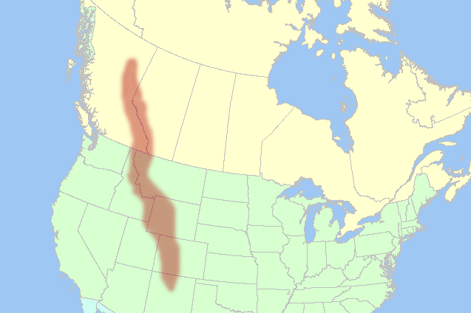

Slide 24
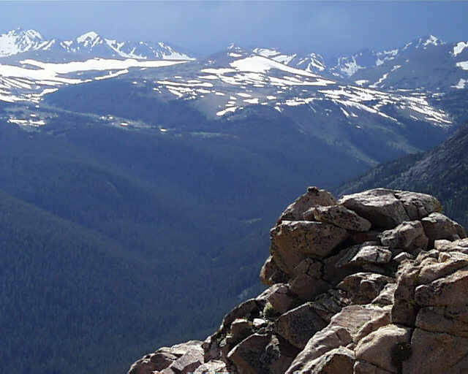

Slide 25
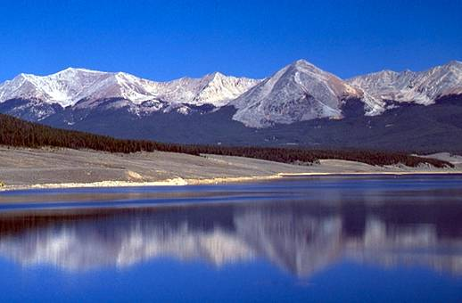

Slide 26
Where People Live
&
How They Trade

Slide 27
Let’s Review:
Physical Features

Slide 28
Location
2nd largest country in the world (Russia is larger)
Surrounded by three oceans: Atlantic, Arctic, & Pacific
Southern border is the US
Alaska also forms part of the western border.
Population is 33 million, which is small compared to its size (US population is 9 times larger!)
90 percent of population lives within 100 miles of the US-Canadian border…WHY?

Slide 29
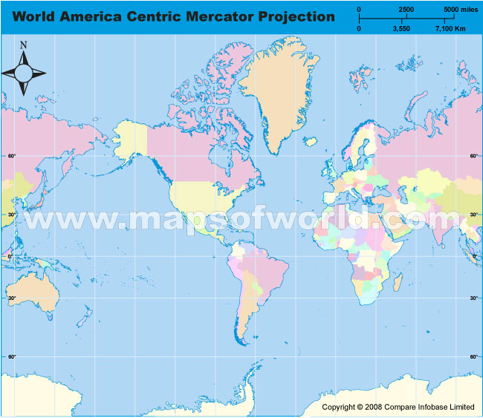

Slide 30
Location & Trade
Canada’s location in the world helps it to be a leader in world trade:
It’s uniquely located on 3 oceans, so it has opportunities to trade with Europe & Asia.
Great Lakes and the St. Lawrence Seaway allow goods to be shipped to and from central Canada and the Atlantic Ocean
A major benefit for Canada is its border with the US (#1 trading partner).
Share over 3,000 miles of border & trade is relatively easy
80% of Canada’s exports come to US

Slide 31
Climate
Southeastern part of Canada has a MUCH warmer climate than the rest of the country.
Warm to hot summers & cold winters
Allows for a long growing season
Pacific coast has a temperate climate.
Pacific ocean cools the region in summer and warms it in winter.
Over 100 inches of precipitation per year
Northern Canada is COLD!
Few people live here – temperatures can be below freezing even in summer!

Slide 32
Climate & Trade
Canada’s location in the world helps it to be a leader in world trade:
It’s uniquely located on 3 oceans, so it has opportunities to trade with Europe & Asia.
Great Lakes and the St. Lawrence Seaway allow goods to be shipped to and from central Canada and the Atlantic Ocean
A major benefit for Canada is its border with the US (#1 trading partner).
Share over 3,000 miles of border & trade is relatively easy
80% of Canada’s exports come to US

Slide 33
Natural Resources
Rich in natural resources:
coal, oil, natural gas, iron ore, nickel, zinc, copper, gold, lead, molybdenum, potash, diamonds, & silver
Rivers and lakes have an abundance of fish, fresh water, & hydroelectric power.
Good soil allows farmers to grow crops for Canadians--with enough left over to trade with other countries
Timber is also a major natural resource.

Slide 34
N.R. & Trade
Sells oil and natural gas, fish, agricultural products, & timber to other countries
Hydroelectricity is used in Canada and also sold to the US.
5% of the land in Canada is arable (actually a large amount because there is so much land).
Rich soil produces valuable crops that are consumed in Canada and traded to other countries.

