Slide 1
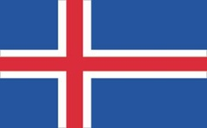
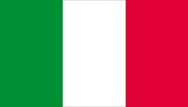
The Geography
of Europe
Adapted from Ms. Susan M. Pojer
Horace Greeley High School
Chappaqua, NY

Slide 2
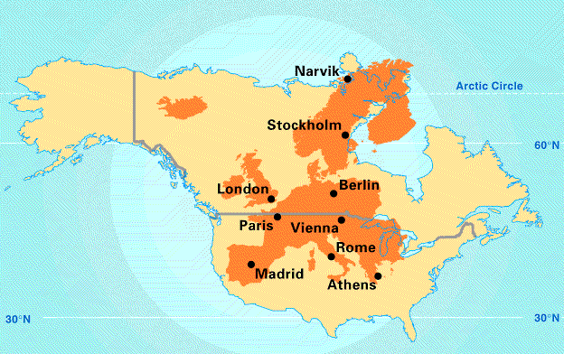
Europe’s Latitude v. U.S.
The U.S. is not directly west of Europe, Canada is directly west of Europe

Slide 3
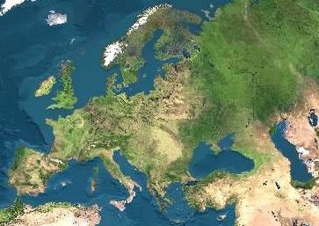
Satellite View of Europe

Slide 4
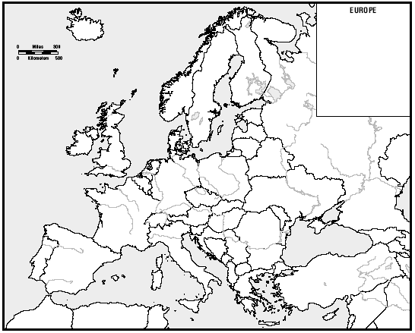
B o d i e s
of
W a t e r
Arctic Ocean
Atlantic Ocean
North Sea
Baltic Sea
English Channel
Caspian Sea
Bay of Biscay
Black Sea
Dardanelles Strait
Adriatic Sea
Strait of Gibraltar
Tyrrhenian Sea
AegeanSea
Mediterranean Sea

Slide 5
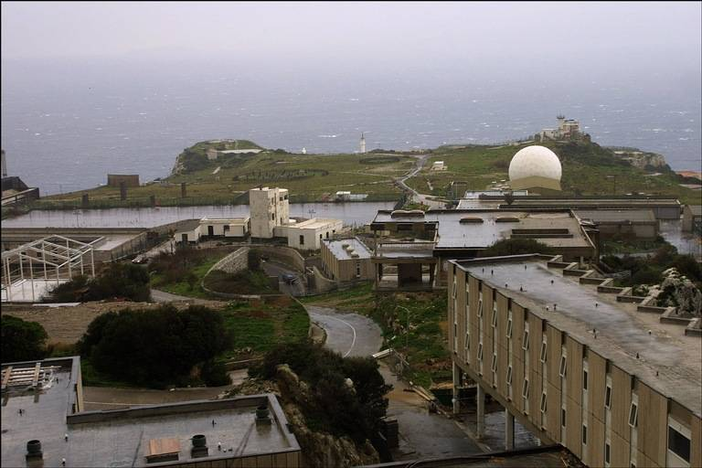
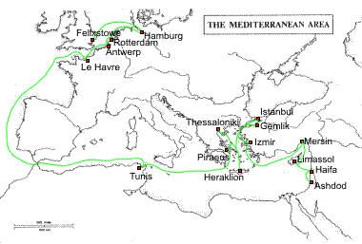
The Mediterranean Sea
Strait of Gibraltar & the “Pillars of Hercules”
2,400 miles long & 1,000 miles wide
“Crossroads of 3 Continents”

Slide 6
You do not need to know all the bodies of water, rivers, plains or mountains of Europe, you just need to know that Europe is made up of a diverse terrain!

Slide 7
R i v e r s
Volga R.
Don R.
Thames R.
Elbe R.
Vistula R.
Rhine R.
Oder R.
Seine R.
Dnieper R.
Loire R.
Po R.
Danube R.
Tagus R.
Tiber R.
Ebro R.

Slide 8
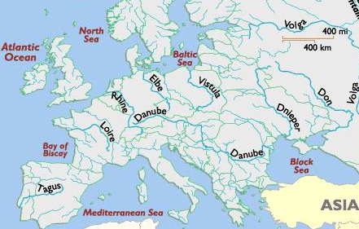
The Danube River
1770 miles

Slide 9
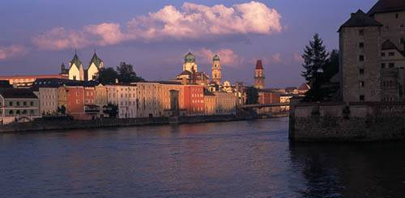
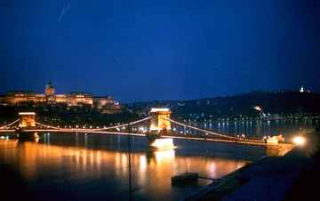
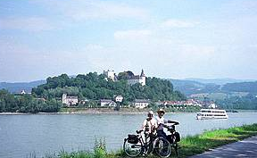
The Danube River
Where Buda & Pest Meet
Biking along the Danube
Flows through the 12 countries of Germany, Austria, Slovakia, Hungary, Serbia, Croatia, Bosnia and Herzegovina, Slovenia, Bulgaria, Romania, and the Ukraine.

Slide 10
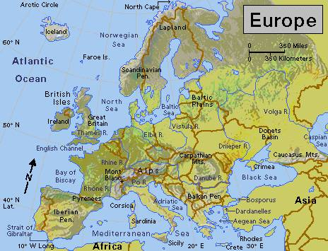
The Volga River
It’s the longest river in Europe --> 2,300 miles.

Slide 11
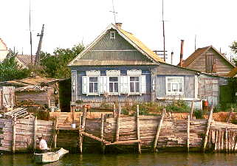
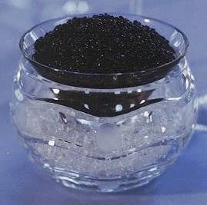
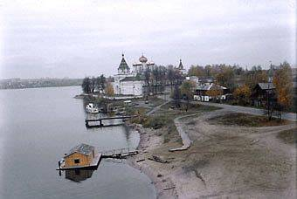
The Volga River
The river is so polluted that the sturgeon catch has been decreased by 60%.

Slide 12
Why are most of the capitals of Europe on major rivers?

Slide 13
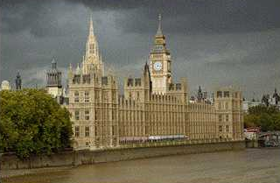
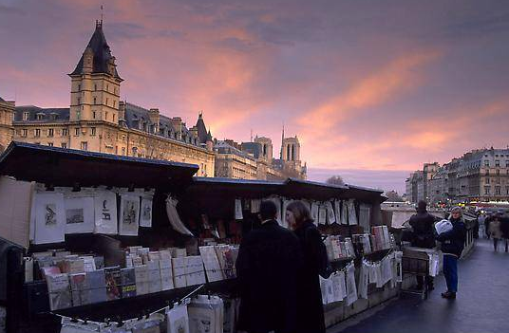
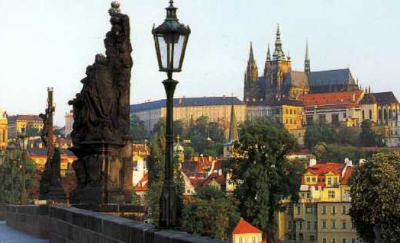
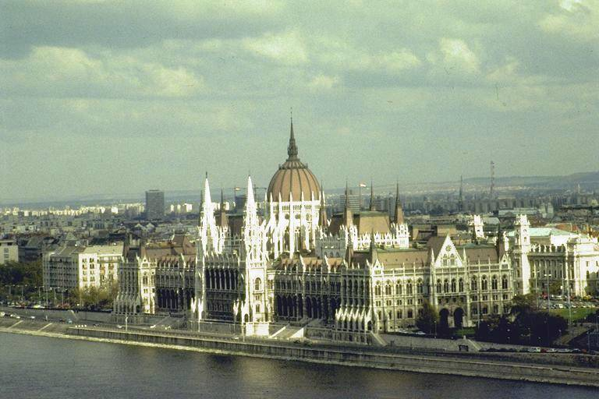
Capitals on the Rivers
London on the Thames
Paris, right bank of the Seine
Prague on the Vltava
Budapest on the Danube

Slide 14
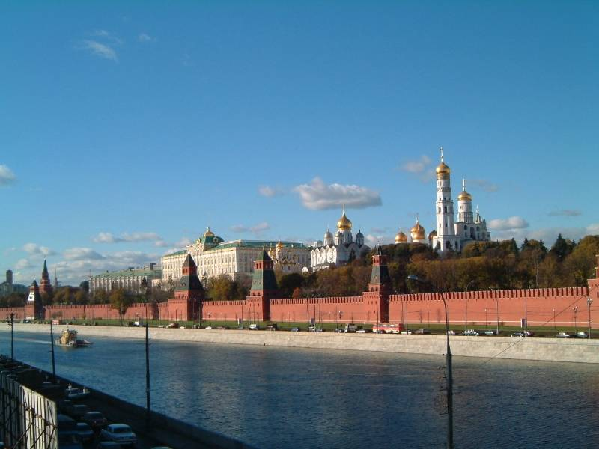
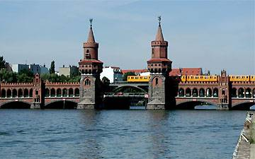
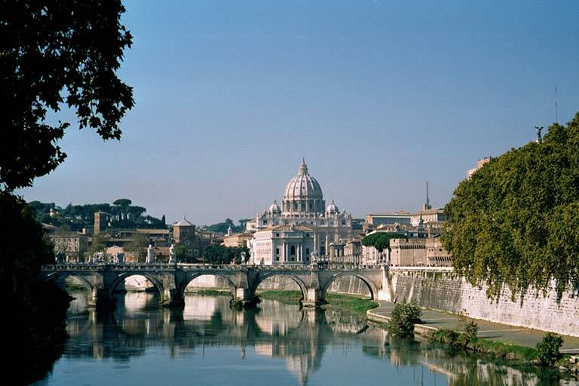
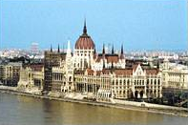
Capitals on the Rivers
Moscow on the Moscow River
Berlin on the Spree
Rome on the Tiber
Vienna on the Danube

Slide 15
What’s the answer??

Slide 16
Answer:
They are Europe’s lifeline!

Slide 17
M o u t a i n s & P e a k s
Ural Mts.
Carpathian Mts.
Caucasus Mts.
Alps Mts.
Pyrennes Mts.
Dinaric Alps
Apennines Mts.
Mt. Vesuvius ^
Mt. Olympus ^
Mt. Etna ^

Slide 18
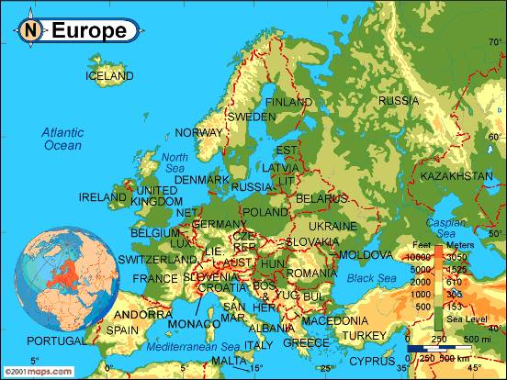
Elevation
Urals
Caucasus
Pyrennes
Carpathians
Alps
Apennines

Slide 19
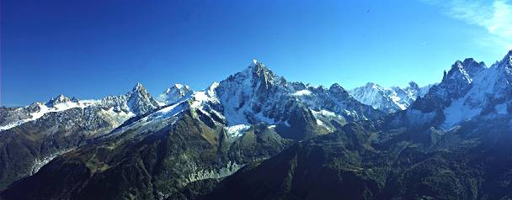
The Alps
The Alps cover most of Switzerland, Austria, and parts of Italy and France.

Slide 20
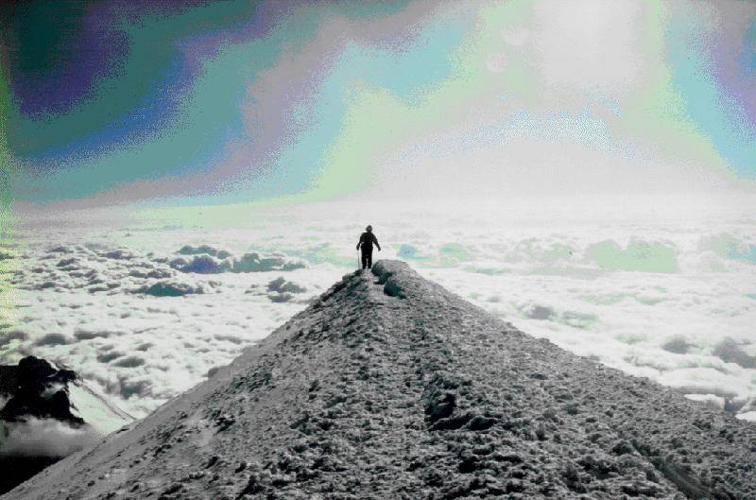
Mt. Blanc in the Alps
It’s the highest mountain in the Alps: 15,771 feet.

Slide 21
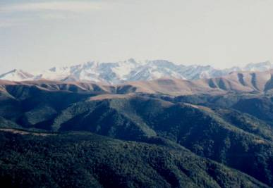
The Caucasus Mountains
The origin of the word Caucasian.

Slide 22
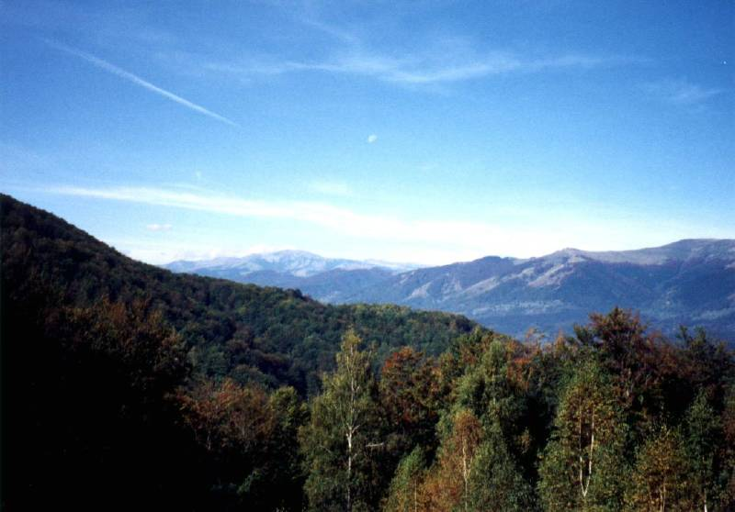
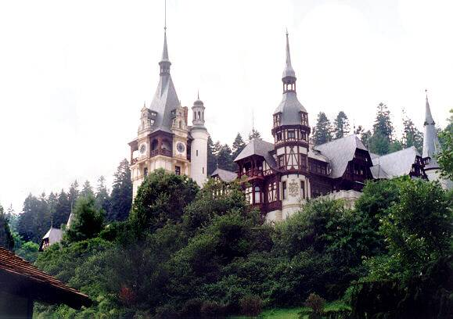
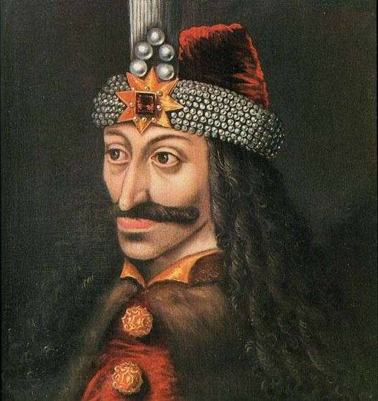
Transylvania in the Carpathian Mountains
Home of Vlad Tepeš, the Drakul (“Count Dracula”)

Slide 23
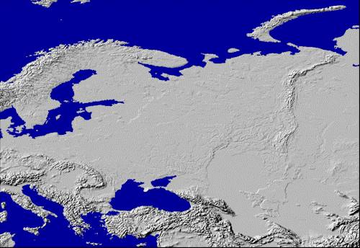
Ural Mountains: “The Great Divide”
1500 miles
It divides the European and Asian sections of Russia.

Slide 24
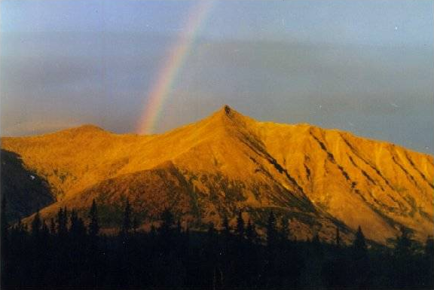
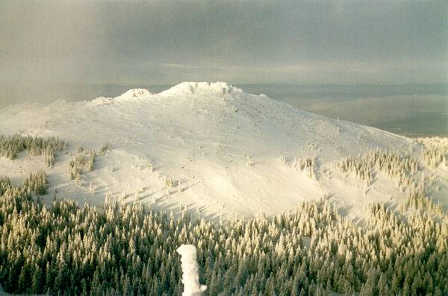
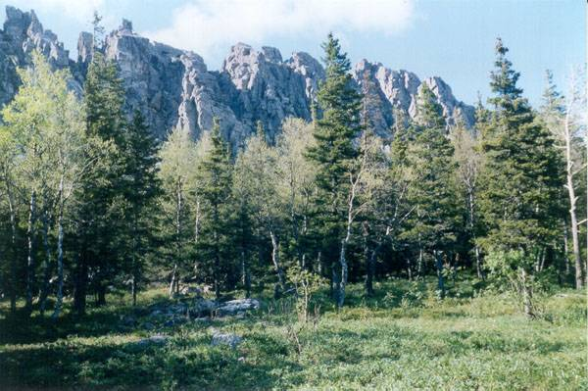
The Ural Mountains

Slide 25
Siberian Lowlands
P l a i n s
Northern European Plain
Steppes

Slide 26
Climate

Slide 27
Europe’s Latitude v. US

Slide 28
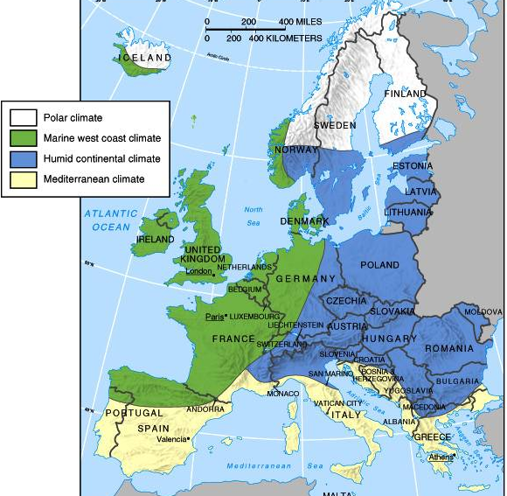
Climate

Slide 29
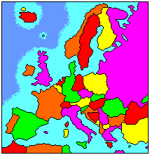
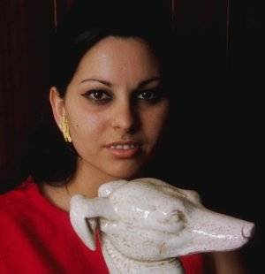
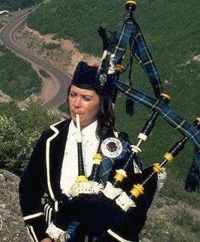
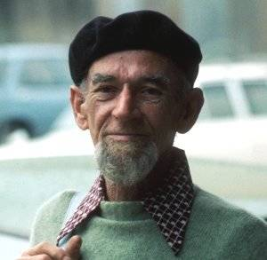
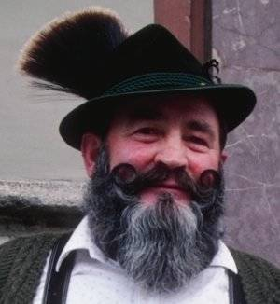
Arrivederci!
Good Bye!
Au Revoir!
Adios!
Auf Wiedersehen!
Cairete!
Do Svidaniya!

