Slide 1
Evaluating Expression

Slide 2
Warm Up
OBJECTIVE: SWBAT evaluate algebraic expressions.
Language Objective: SWBAT describe the steps to evaluating expressions.
A magic store is selling exploding pens for $3 each plus $1 for tax.
Kyle thinks you can figure out the cost of 10 pens with the below.
numerical expression
Quick Discussion:
Algebraic Expression?
Do you agree or disagree?
Explain.
3p+1
Click to reveal next part
Agenda
Notes:
(Time on this slide - 4 min) Time passed 4 min
In-Class Notes
Read slide as it appears.
Click to reveal a quick discussion how this can be written as an algebraic expression.
Preparation Notes
The purpose of this warm up is to review numerical expressions and algebraic expressions, and to make a quick connection between the two. Be sure to make the connection that the variable, p, took the place of the 10. Since students will be evaluating expressions in this unit, this is quick way to prompt students for lesson.

Slide 3



Launch- Shopping with Marvin
Marvin the Math Magician has a problem for you.
He wants to buy some magic wands
and some magician hats.
The wands cost $8 each and $5 for each hat.
How much will Marvin have to pay for 12 wands and 7 hats?
Agenda
Notes:
(Time on this slide - 2 min) Time passed 7 min
In-Class Notes
Read the slide as it appears.
Click to advance.
Have students do a ‘turn and talk’ to come up with the answer.
Preparation Notes
The purpose of the launch is to familiarize students with problems they already know how to solve. Then for them to start to see the connection to algebraic expressions and evaluating them. This problem is meant to be quick- no more than five minutes. The next slide is where time is provided to discuss students’ answers and thought process. As students are discussing their answer to the problem, ask them to think about the operations they are using and the order in which they are using them. This will help with the upcoming slides.

Slide 4

Launch- Shopping with Marvin
How did you get your answer?
The wands cost $8 each and $5 for each hat.
How much will Marvin have to pay for 12 wands and 7 hats?
How can we write a to show our answer of 131?
numerical expression
Click to reveal next part
Agenda
Notes:
(Time on this slide - 4 min) Time passed 11 min
In-Class Notes
Read slide as it appears
Emphasize the fact that this expression is a numerical expression versus an algebraic expression.
Preparation Notes
You can show this slide in two ways, depending on the level of your students. If your students need guided practice in writing a numerical expression for this problem, give time for students to share their results and put them on the board before advancing the slide. Questions may needed to be prompted to help students derive at the expression. For example: What operation did you use first? What as the last operation you used? How can write the math you did as one numerical expression without using an equal sign? (Advancing the slide will have the numerical expression appear). If you circulate the room and observe your students were able to write the expression, you can advance this slide as quickly as you want.
A discussion should take place that there are different ways to write the expression. For example 12(8) + 7(5) is the same expression.

Slide 5
Explore 1- Evaluating with Marvin
How much will Marvin have to pay for 6 wands and 3 hats?
Write an numerical expression to
find the answer.
Remember: the wands cost $8 each and $5 for each hat.
Click to reveal next part
Agenda
Notes:
(Time on this slide - 4 min) Time passed 15 min
In-Class Notes
Read slide as it appears
Preparation Notes
Based on the Launch, this slide is designed to give students individual practice to write a numerical expression without any guidance. Encourage students to find the answer by writing a numerical expressions as shown in the Launch. Again, students may write the expression differently than the one shown, and should be discussed. Be sure to point out the fact that equal signs were not used at all to derive the answer.

Slide 6
Explore 1- Evaluating with Marvin
The wands cost $8 each and $5 for each hat.
Numerical Expression
7
12
7
12
12 wands
7 hats
3
6
3
6
6 wands
3 hats
What changed in the two examples?
Sometimes it helps to represent a problem as an
algebraic expression.
w= # of wands
8w+5h
h= # of hats
Click to reveal next part
Agenda
Notes:
(Time on this slide – 3 min) Time passed 18 min
In-Class Notes
Read the slide as it appears
Be sure students understand why the numbers change from the two expressions. Make the connection that wands and hats are the variables since they changed in both problems.
When the prompt appears for the algebraic expression, remind students what an algebraic expression is.
Explain quantities that keep changing (variables), they are assigned a letter, which will become the variable in the expression.
Before advancing the slide where the algebraic expression will appear, ask students what they think the algebraic expression is.
Preparation Notes
This slide is where students will make the connections between the two problems. The problem from the Launch and the Explore. As the slide advances, remind the students that the first expression came from when the expression was evaluated with 12 wands and 7 hats. The second expression was evaluated with 6 wands and 3 hats. Ask the students what changed in both expressions. Do not continue with the slide until students understand what changed from the first problem compared to the second problem. Advance the slide to prompt the class that we are going to use an algebraic expression that models this situation. Ask the class, what is meant by algebraic expression? Emphasize again that the number of wands and hats kept changing. Then as the variables appear to represent the wands and hats, explain why we chose the letters w and h. In this unit, students have not been exposed to this, so be sure to discuss naming variables. Give students a few minutes to see if they can derive the algebraic expression before advancing the slide.

Slide 7
Explore 1- Evaluating with Marvin
How much will Marvin have to pay for 10 wands and 2 hats?
w = 10
h = 2
Algebraic
Expression
This is called substitution!!
w
h
10
2
We just evaluated the expression.
Click to reveal next part
evaluate
Agenda
Notes:
(Time on this slide – 4 min) Time passed 22 min
In-Class Notes
Read slide as it appears
Scaffold this problem with the students.
Have them copy down the expression before they start figuring out the answer.
Prompt with questions asking what step should take place next.
Continue this process until the expression has been evaluated.
Be sure to read the prompt that appear at the right of the screen.
Click on the word evaluate at the bottom of the screen for the definition to appear.
Preparation Notes
The goal here is to scaffold the process of evaluating expressions. Students can copy this problem into their notebooks or you can just have a discussion with them. (There is another problem for them to work on without any guidance). Ask students how they would solve this problem using the algebraic expression. If students are struggling, remind students the w and h keeps changing as seen in the previous problems. Have a quick discussion on why the first step is called substitution. Once the numbers are substituted in, make the connection that the students are familiar with the rest of the process because they just have to use the order of operations. Make sure they understand why this process is called evaluating expressions. Click on the word evaluate at the bottom of the screen for the definition to appear. Again, be sure to point out the fact that equal signs were not used at all to derive the answer.

Slide 8
Explore 1- Evaluating with Marvin
How much will Marvin have to pay for 10 wands and 2 hats?
w = 10
h = 2
Algebraic
Expression
This is called substitution!!
10
2
We just evaluated the expression.
Evaluate: to calculate the value of a numerical or algebraic expression.
Click to reveal next part
evaluate
Agenda
Notes:
(Time on this slide - min) Time passed
This is a hidden slide.

Slide 9
Explore 1- Evaluating with Marvin
Find the cost of buying 9 wands and 7 hats.
9
Steps:
1. Copy the expression.
w=
7
h=
h
w
7
9
2. Substitute the value in for the variable.
3. Evaluate using the order of operations.
Click to reveal next part
Agenda
Notes:
(Time on this slide - 5 min) Time passed 27 min
In-Class Notes
Read the slide as it appears
Prompt students with questions as the slide advances.
This slide is for students to have a set of steps to follow.
Teacher discretion to have students copy the steps in their notebook.
Preparation Notes
The goal of this slide is for students to have a concrete strategy to evaluating expressions and to attempt the problem on their own. Ask what number should take the place of the w? For the h? At this point give students about 2 minutes to evaluate the expression. Ask students what answered they obtained. Then advance the slide to show the process and have the steps appear. The teacher can use their discretion if they want the students to copy them into their notebook. This is designed to scaffold the process of evaluating expressions, therefore, it is recommend to have students copy steps so they have a process to follow when students are working individually. Again, point out the fact that equal signs were not used to derive the answer.

Slide 10
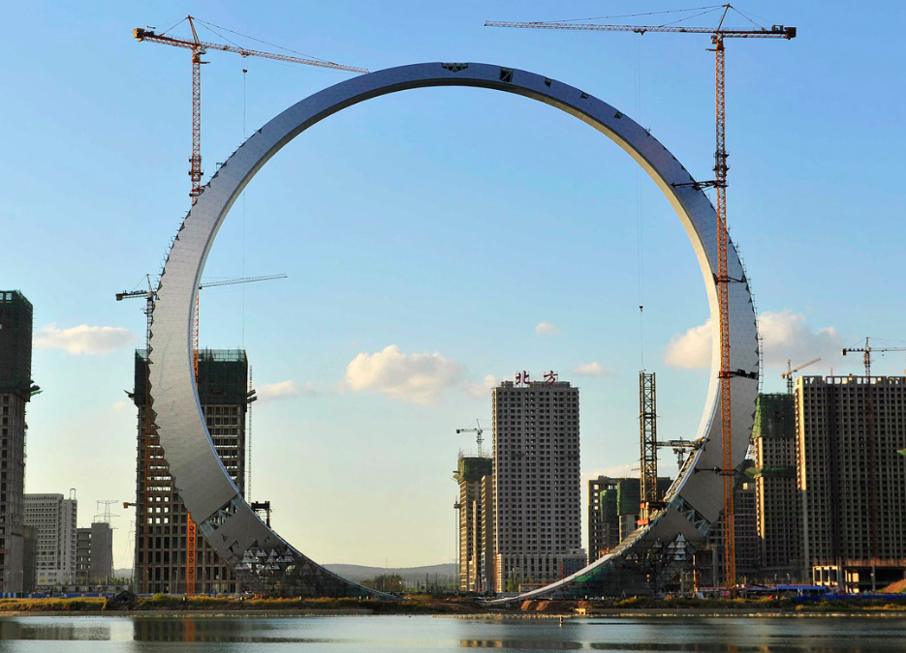
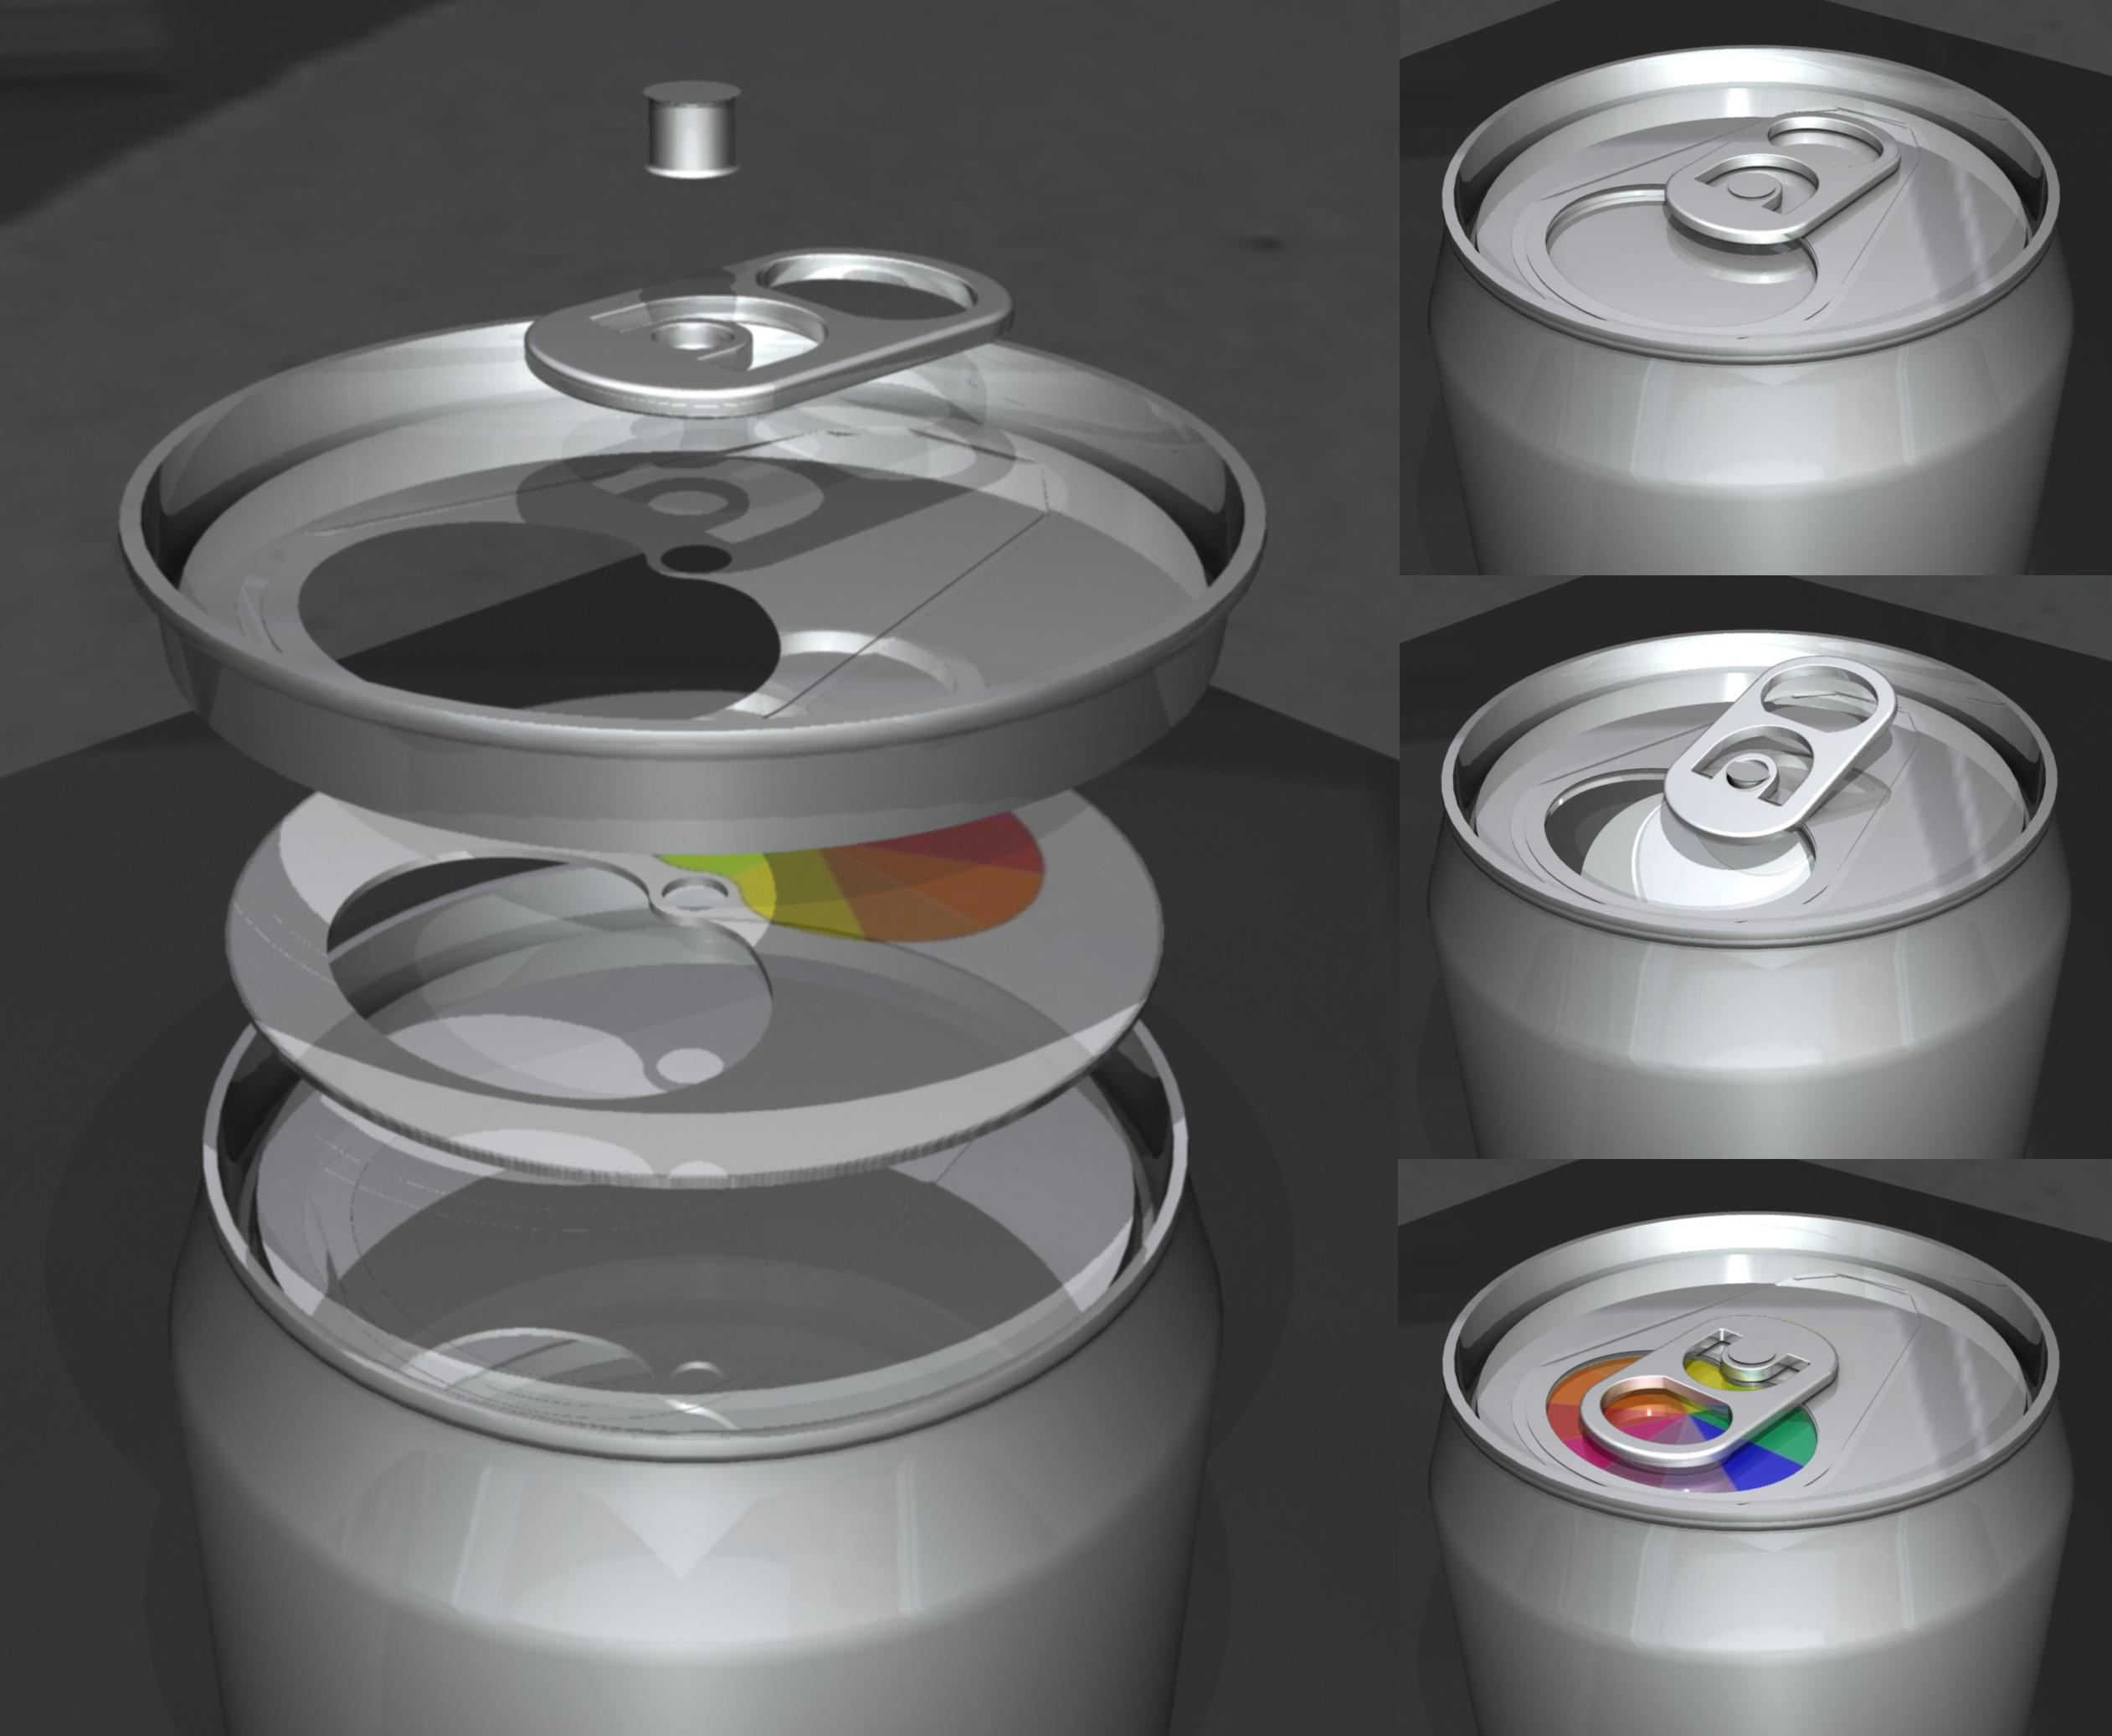
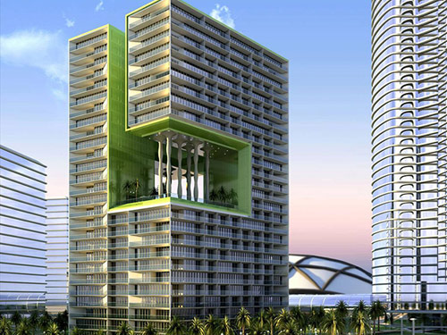
Explore 2- Formulas
Flashback…
Objective: evaluate algebraic expressions.
We can use the process of evaluating to solve problems in the real world.
For example: engineers, architects and builders use geometric formulas every day.
Circumference
Surface Area
Cylinder
Volume Rectangular Prism
Click to reveal next part
Agenda
Notes:
(Time on this slide -1 min) Time passed 30 min
In-Class Notes
Read the objective again to the class.
Continue to read the slide as it appears.
Make the connection that students can evaluate geometric formulas (students may or may not have seen before) using the same process they just learned.
Quickly discuss the shapes that appear and mention the formulas provided.
Preparation Notes
This slide is designed to be discussed quickly. The goal of the slide is to transition into the next two slides since students will be asked to evaluate two problems involving geometric formulas. These are just random examples of formulas connected to the shapes provided. If time is not an issue, you can take this discussion to a deeper level discussing other formulas related with these shapes. Read the slide as it appears making sure to make the connection that formulas can be easily evaluated just as expressions using the same process.
NOTE: When presented with the next two slides, the formulas provided are written as expressions versus equations. This was done to keep the focus of the lesson using only expressions.

Slide 11
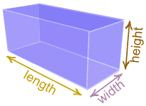
Explore 2- Formulas
Volume is the amount of space a shape takes up. The expression for calculating the volume of the rectangular
prism is below.
5ft
or
Find the volume
9ft
4ft
9
4
5
Steps:
1. Copy the expression.
2. Substitute the value in for the variable.
3. Evaluate using the order of operations.
Click to reveal next part
Agenda
Notes:
(Time on this slide - 3 min) Time passed 30 min
In-Class Notes
In class practice.
Can be done individually or with a partner.
Encourage students to follow the steps to evaluate the expression.
Give students about 5 minutes to complete.
Depending on the level of your students, an explanation of more than one variable next to each other means to multiply.
Advance the slide to show the process in obtaining the answer.
Students may need reassurance that formulas can be evaluated as well following the steps/process.
Preparation Notes
The practice is designed for students to work individually or with a partner. There are two problems provided. These are optional problems depending on the level of your students. A group work assignment is provided for students after these problems.
If these slides are chosen to be used, reassure the students that formulas are expressions that are evaluated. If they have not been exposed to these formulas yet, explain that in their upcoming units, a complete understanding of the formulas will take place. Otherwise, make the connection that they have seen these formulas before. An explanation of more than one variable next to each other means to multiply. Point out the dimensions of the prism leading the students to decided which number takes the place of which variable.
These types of problems were chosen because the standards reference formulas. Give students about 5 minutes to work on the problems. Depending on the level of your students, an explanation of more than one variable next to each other means to multiply. Advancing the slide will show the process to obtaining the answer.

Slide 12
Explore 2- Formulas
Surface Area is the total of the area of all sides. The expression for calculating the surface area of a rectangular
prism is below.
5ft
Find the volume.
9ft
4ft
Steps:
1. Copy the expression.
9
4
9
5
4
5
2. Substitute the value in for the variable.
3. Evaluate using the order of operations.
Click to reveal next part
Agenda
Notes:
(Time on this slide - 3 min) Time passed 33 min
In-Class Notes
This is another problem for students to practice with.
Can be done individually or with a partner.
Encourage students to follow the steps to evaluate the expression.
Give students about 5 minutes to complete.
Advance the slide to show the process in obtaining the answer.
Students may need reassurance that formulas can be evaluated as well following the steps/process.
Preparation Notes
The practice is designed for students to work individually or with a partner. This is the last of guided practice problems. These are optional problems depending on the level of your students. A group work assignment is provided for students after these problems.
If these slides are chosen to be used, reassure the students that formulas are expressions that are evaluated. If they have not been exposed to these formulas yet, explain that in their upcoming units, a complete understanding of the formulas will take place. Otherwise, make the connection that they have seen these formulas before. Remind students again, that more than one variable next to each other means to multiply. Point out the dimensions of the prism leading the students to decided which number takes the place of which variable.
These types of problems were chosen because the standards reference formulas. Give students about 5 minutes to work on the problems. Advancing the slide will show the process to obtaining the answer.

Slide 13
Exit Slip
Kiara was asked to evaluate the expression . Her answer was 14.
Did she substitute 11, 13, or 15? How do you know?
Answer : 13
27 – 13
14
Agenda
Notes:
(Time on this slide - 3 min) Time passed 60
In-Class Notes
Have students individually answer the following question.
Either go over the question or just collect before students leave for the period.
Preparation Notes
This exit slip is designed to quickly assess students individually to see if they have gained an understanding from the lesson. The answer is provided if decide to go over as a whole class or can just collect as students leave.

