Slide 1






Slide 2

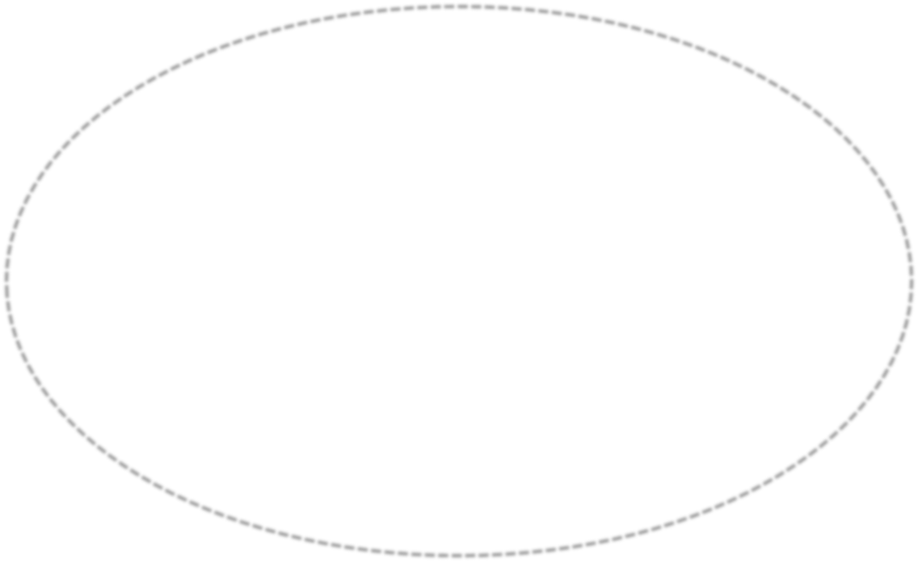








Slide 3



Which European countries established
1
extensive empires in Asia, Africa, and the
Americas?
France, Belgium, Spain, Portugal
France, United Kingdom, Spain, Portugal
Germany, France, United Kingdom, Spain
Italy, France, Portugal, Spain

Slide 4



Which religion did the early European
2
explorers hope to spread to Asia,
Africa, & the Americas?
Islam
Hinduism
Judaism
Christianity

Slide 5

Who was the leader of the Nazi party
in Germany during World War II?
3
Adolf Hitler
Vladimir Lenin
Wilhelm II
Woodrow Wilson

Slide 6


4
Why was Prince Henry nicknamed “the
Navigator”?
He was the Prince of Portugal.
He discovered a trade route around the
Americas to Asia.
He funded many voyages and set up the first
school of navigation.
He funded the first voyage around the world.

Slide 7


Which of the following European
5
countries DID NOT have any colonies
in the Americas?
Spain
France
Portugal
Germany

Slide 8


What war was a result of militarism
6
and nationalism in the late nineteenth
and early twentieth centuries?
Civil War
Revolutionary War
World War I
Cold War

Slide 9
Which was a CAUSE of the Russian
7
Revolution?
The czar was executed.
There were food shortages in Russia
and the serfs were starving.
The Germans showed signs of surrender.
Soldiers did not know how to use their
weapons.

Slide 10
Which person did the actions below?
8
•Did not protect the Russian royal family
•Changed Russia’s name to the Soviet Union
•Set up a communist government in Russia
Vladimir Lenin
Czar Nicholas II
Emperor Wilhelm II
Woodrow Wilson

Slide 11
9
The Treaty of Versailles ended World War I, but some of the terms of the treaty contributed to the beginning of World War II. Which was one of the terms of the treaty?
Germany was forced to pay reparations to the Allied countries.
Germany could develop a strong army and navy.
It divided Germany into East and West.
It made Germany a world power.

Slide 12


10
What was a goal of the Treaty of Versailles?
to help Germany rebuild its industry
to build better roads and factories in
Germany
To make sure Germany did not invade
France in the future
To give Great Britain and the United States credit for their help in WWI

Slide 13

11
After World War I, how did the Allied countries hope to keep Germany from becoming too powerful again?
United States took over German military bases.
Germany was not allowed to have a large army or
navy.
Germany was allowed to keep its colonies.
Germany did not have to pay any war debts to the
Allied countries.

Slide 14


Which country was divided during the
Cold War:
12
France
Ukraine
Russia
Germany

Slide 15

What happened to people who spoke out
against Hitler?
13
A They were sent to Siberia.
B They were allowed to leave Germany. C Some were put in prison; others were murdered.
D Nothing; freedom of speech was
allowed.

Slide 16


14
Which statement explains what these sentences are about?
•Hitler promised to rebuild Germany’s military.
•The Treaty of Versailles angered Germans.
•Hitler said he would get back Germany’s lost land.
events that led to World War I
feelings Germans had about other countries
ways that German leaders tried to rebuild their
countries
reasons why Hitler and the Nazis came to power in
Germany

Slide 17


The Holocaust is associated with
which conflict?
15
World War I
World War II
The Cold War
Russian Revolution

Slide 18

The time of tension without direct
warfare from 1945 to 1991 is called:
16
World War II
Nazism
Cold War
Holocaust

Slide 19

After World War II, which two
17
superpowers engaged in the Cold
War?
United States and the Soviet Union
Germany and Italy
United States and Germany
Soviet Union and Germany

Slide 20
The Berlin Wall was built in this
country in 1961:
18
France
Ukraine
Russia
Germany

Slide 21
Which country was the first to begin exploring the west coast of Africa, looking for a route to Asia? (Prince Henry the Navigator is also from this country.)
19
France
Portugal
Spain
United Kingdom

Slide 22



20
Which country did not help rebuild West Germany’s government after World War II?
United States
Soviet Union
France
United Kingdom

