Slide 1




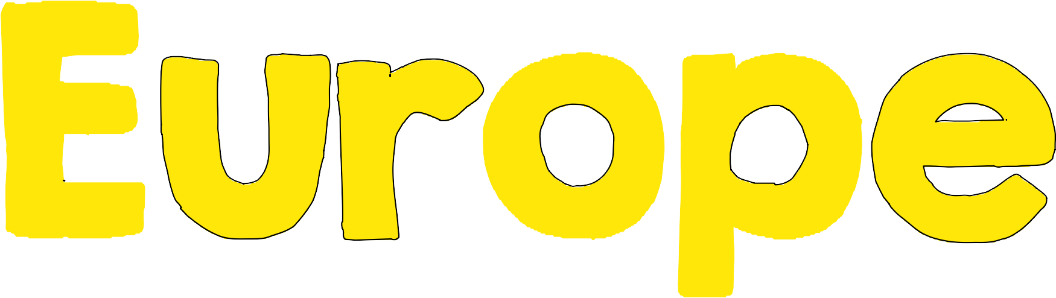

Slide 2

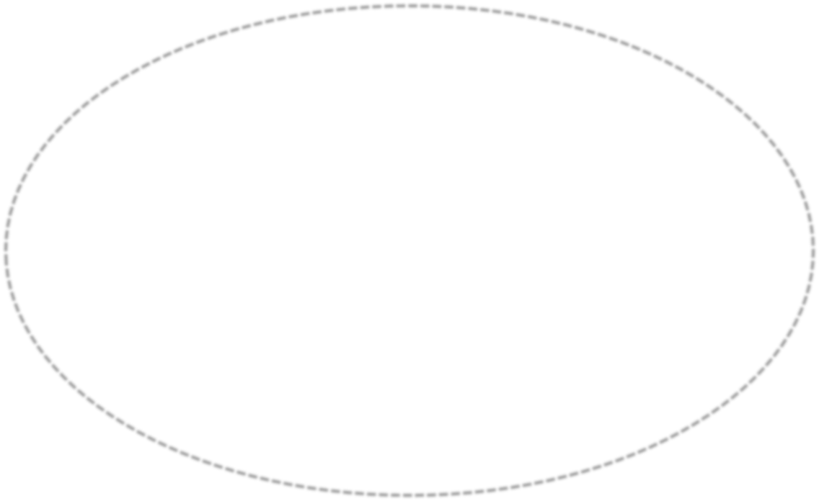








Slide 3



1
The natural border between France
and Spain are the .
Ural Mountains
Alps
Pyrenees Mountains
Carpathian Mountains

Slide 4



Russian is an example of a __
language.
2
Romance
Slavic
Germanic
Greek

Slide 5

What do German and English have in
3
common?
They are both Romance languages.
They are both primarily spoken in Russia.
They are both Germanic languages.
They are the primary languages
spoken in Italy.

Slide 6


Which is NOT one of the four regions
of the United Kingdom?
4
Northern Ireland
Belgium
Wales
Scotland

Slide 7


Where did Judaism, Christianity, and
Islam all originate?
5
Southwest Asia
Eastern Europe
Northwest Asia
Southern Africa

Slide 8


Acid rain is destroying the Black
6
Forest. This is a major problem for
what country?
Italy
United Kingdom
Russia
Germany

Slide 9
The United Kingdom has set forth
7
government regulations for emissions released from cars. They are working hard to reduce .
air pollution.
water pollution.
erosion.
flooding.

Slide 10
8
The 2nd largest river in Europe (that
runs through 12 countries) is the
__ river.
Rhine
Danube
Seine
Thames

Slide 11
What is the name of the mountain
9
range that divides the continents of
Europe and Asia?
Alps
Ural Mountains
Pyrenees Mountains
Andes Mountains

Slide 12


Which European peninsula is closest to
the Arctic Circle?
10
Scandinavian
Iberian
Italian
Balkan

Slide 13

11
More than half of Europe is covered by
a landform called the .
Central Uplands.
Alpine Mountain System.
European Plain.
Northwestern Highlands.

Slide 14


Which situation is an effect of acid
rain?
12
cleaner rivers
destroyed forests
buildings and statues that look new
increased automobile
manufacturing

Slide 15

What is the main cause of air pollution
in the United Kingdom?
13
nuclear reactor explosion
London smog
use of fossil fuels
automobile exhaust & emissions

Slide 16


Which was an effect of the nuclear
disaster at Chernobyl, Ukraine?
14
People and animals did not get sick.
Drinking water was unsafe for a long time.
Forests got healthier than they had been.
All the nuclear power plants in the world were closed.

Slide 17


Which area of Russia has the greatest
population?
15
Siberia
Asian Russia
European Russia
Russia’s population is spread out
evenly across the country.

Slide 18

Which condition keeps Russia’s natural
resources from being used?
16
harsh climate and rough terrain
lack of workers
no market for the resources
no government funding

Slide 19

What physical feature makes it
17
difficult for Italian merchants to trade
with countries north of Italy?
The Alps
Mediterranean Sea
European Plain
Pyrenees Mountains

Slide 20
In what way are the French and Italian
18
languages alike?
The countries of France and Italy are close to
each other.
They are both Romance languages that derived from Latin.
They are both the official language of the United
Nations.
French and Italian share the roots of the Germanic
languages.

Slide 21
Which is the oldest of the three main
religions of Europe?
19
Christianity
Islam
Judaism
Roman Catholic

Slide 22


How are the three religions alike?
20
They each worship several gods.
They each worship only one god.
Each of the three religions is
getting smaller.
They each use a sacred text known
as the Bible.

