Slide 2
United Kingdom

Slide 3
Economic System
UK has a Mixed economic system.
It’s actually closer to a Market economy than any other European country.
UK is economically strong; it’s one of the world’s leading industrial powers.

Slide 4
Natural Resources
What’s available?
Coal, petroleum, natural gas, iron ore, lead, zinc, gold, tin, limestone, salt, clay, chalk, gypsum, potash, silica sand, slate, arable land

Slide 5
Land Use
What percentage of the land is arable (capable of being farmed)?
23%
What are the major agricultural products?
Cereals, oilseed, potatoes, vegetables, cattle, sheep, poultry, & fish

Slide 6
Industries
What’s being produced in the factories?
Machine tools, electric power equipment, automation equipment, railroad equipment, shipbuilding, aircraft, motor vehicles, communications devices, metals, chemicals, coal, petroleum, paper, textiles, food processing, clothing, & other consumer goods

Slide 7
Literacy Rate
What percentage of people over the age of 15 can read and write?
99%
How long are students required to stay in school?
16 years

Slide 8
Unemployment Rate
What percentage of people do not have jobs?
8%
What percentage of people live in poverty?
14%

Slide 9
GDP
$2.441 trillion
9th in the world
GDP Per Capita--What is the value of goods and services produced per person?
$37,500

Slide 10
Economic Struggles
Unemployment
Over depletion of natural resources (pollution)
Improving public services (which forces the country to raise taxes)

Slide 11
Germany

Slide 12
Economic System
Germany has a Mixed economic system
After reunification in 1990, East Germany had to move away from a Command economic system and slowly towards a Market System.

Slide 13
Natural Resources
What’s available?
Coal, lignite, natural gas, iron ore, copper, nickel, uranium, potash, salt, construction materials, timber, arable land

Slide 14
Land Use
What percentage of the land is arable (capable of being farmed)?
33%
What are the major agricultural products?
Potatoes, wheat, barley, sugar beets, fruit, cabbages, cattle, pigs, poultry

Slide 15
Industries
What’s being produced in the factories?
Among the world’s largest and most technologically advanced producers of iron, steel, coal, cement, chemicals, machinery, vehicles, machine tools, electronics, food & beverages, shipbuilding, & textiles

Slide 16
Literacy Rate
What percentage of people over the age of 15 can read and write?
99%
How long are students required to stay in school?
16 years

Slide 17
Unemployment Rate
What percentage of people do not have jobs?
5.5%
What percentage of people live in poverty?
15.5%

Slide 18
GDP
$3.401 trillion
5th largest in the world
GDP Per Capita--What is the value of goods and services produced per person?
$37,500

Slide 19
Economic Struggles
Modernizing the former East German economy (annual transfers from west to east of $80 billion)
The former East Germany’s decayed economy continues to be a burden on the country
Unemployment
Over depletion of natural resources (pollution)
Improving public services (which forces the country to raise taxes)

Slide 20
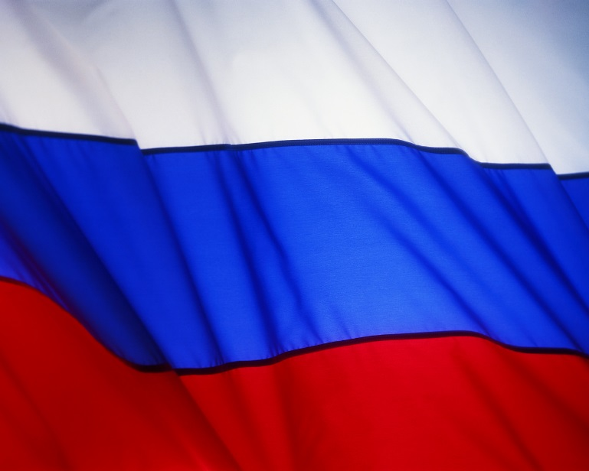
Russia

Slide 21
Economic System
Russia has a Mixed economic system
Russia’s economy has been moving away from a Command economy and more towards a free Market economy since the fall of the Soviet Union in 1991…not there yet (Mixed)

Slide 22
Natural Resources
What’s available?
Wide natural resource base including major deposits of oil, natural gas, coal, many minerals, timber
Russia leads the world in oil production (2012)
Obstacles such as harsh climate, terrain, distance, & size hinder Russia’s exploitation (use) of natural resources

Slide 23
Land Use
What percentage of the land is arable (capable of being farmed)?
7% (permafrost over Siberia is a major problem for growing crops!)
What are the major agricultural products?
Grain, sugar beets, sunflower seed, vegetables, fruits, beef, milk

Slide 24
Industries
What’s being produced in the factories?
Coal, oil, gas, chemicals, metals, machines, aircrafts, space vehicles, shipbuilding, communication devices, tractors, construction equipment, medical & scientific instruments, textiles

Slide 25
Literacy Rate
What percentage of people over the age of 15 can read and write?
99.6%
How long are students required to stay in school?
14 years

Slide 26
Unemployment Rate
What percentage of people do not have jobs?
5.7%
What percentage of people live in poverty?
12.7%

Slide 27
GDP
$2.022trillion
7thlargest in the world
GDP Per Capita--What is the value of goods and services produced per person?
$18,000

Slide 28
Economic Struggles
Natural resources are difficult to use because of the harsh climate, size and few navigable rivers
Moving away from the former Command economy of the Soviet Union (where the government made all of the decisions), and letting the public have a greater influence on the economy
Unemployment

Slide 29
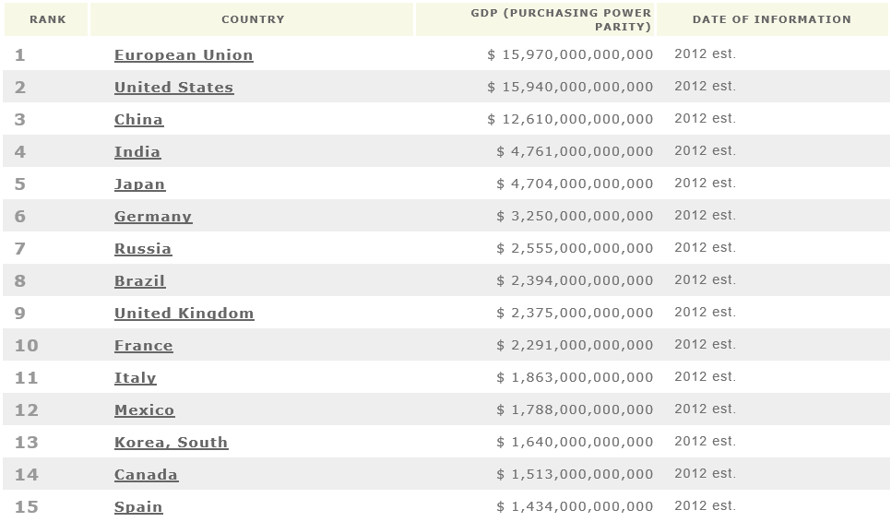
Top GDP Leaders

Slide 30
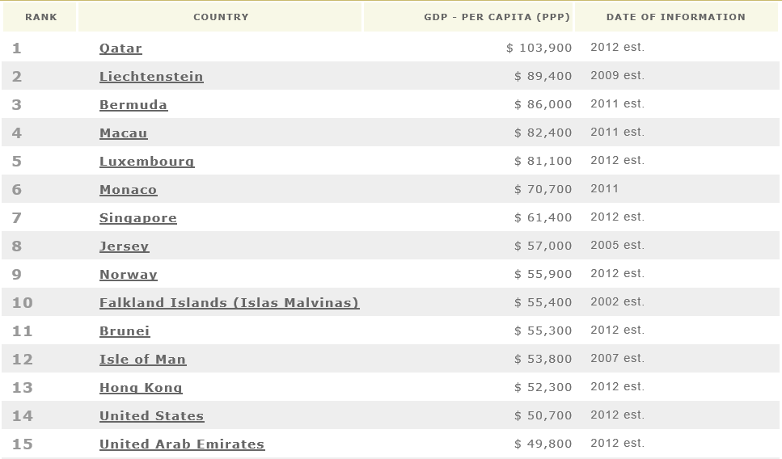
Top GDP Per Capita Leaders

Slide 31
What’s Your Opinion?
Which country do you think has the best economy? Why? Write THREE sentences that explain your choice.

