Slide 1
Canada’s
Government
A Constitutional Monarchy, Parliamentary Democracy, & Federation

Slide 2
Let’s Review
Government Systems – Who has the power?
Unitary--power is held by one central authority
Confederation--association of independent states that agree to certain limitations on their freedoms by joining together
Federal--power is divided between central authority & several regional authorities
Which system does Canada have?

Slide 3
Let’s Review
Government Types – how do citizens participate?
Autocracy-- 1 person possesses unlimited power & citizens have limited role in government
Oligarchy-- small group exercises control & citizens have limited role in government
Democracy--supreme power is vested in the people & exercised by them directly or indirectly through a system of representation involving free elections
Which type does Canada have?

Slide 4
Let’s Review
Two Types of Democratic Governments:
Parliamentary– citizens elect members of Parliament, and then the members select the leader
Leader works with or through the legislature
Presidential--system of government in which the leader is constitutionally independent of the legislature; citizens directly elect leader
Leader works separate from legislature
Which type does Canada have?

Slide 5
Canada’s Government
Federation (federal system)
Parliamentary Democracy
Constitutional Monarchy

Slide 6
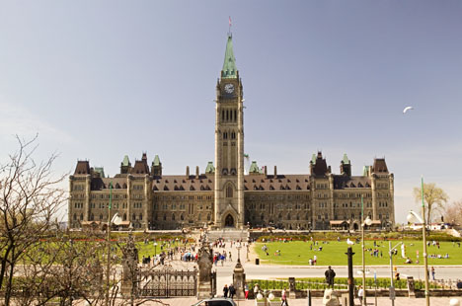
Parliament Hill, in Ottawa, Ontario, is home to Canada’s government.

Slide 7
Federal System
Canada has a federal system, which means that the national government and the provincial & territorial governments SHARE power.
There are 10 provinces and 3 territories in Canada.

Slide 8
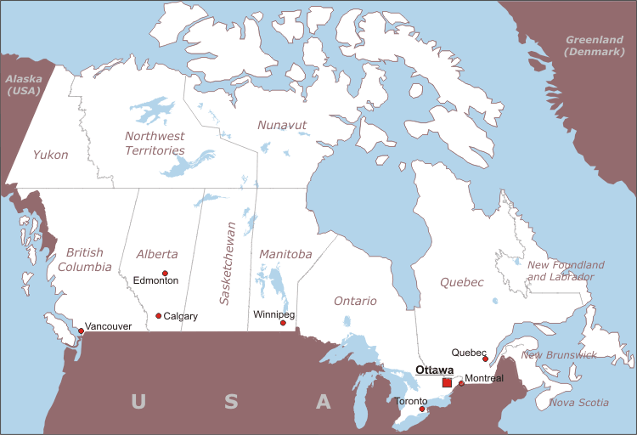

Slide 9
Constitutional Monarchy
Constitutional Monarchy- A monarch inherits the right to rule but is limited by laws and a law-making body elected by the people.
Canada’s constitution lists the powers of the government.
The British monarchy, a king or queen, is the head of state. However, since the monarchy does not live in Canada, he or she chooses a governor-general to act in his or her place…

Slide 10
Leadership
1. Head of State: Monarch of the United Kingdom (presently, Queen Elizabeth II); little political power
2. Governor General: stands in for the monarch
3. Prime Minister: holds the most political power; works closely with the legislature

Slide 11
Her Majesty
Queen Elizabeth II

Slide 12
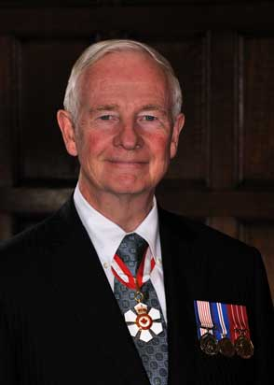
His Excellency
The Right Honorable
David Johnston
Governor General

Slide 13
The Right Honorable
Stephen Harper
Prime Minister

Slide 14
How Leaders are Chosen
Governor General: appointed by the monarch on the advice of the Prime Minister; serves a 5-year term
Prime Minister: is the leader of the majority party in the House of Commons; indirectly elected by the people

Slide 15
Legislature
Legislature = the central authority of a government
Canada’s legislature is called Parliament.
The Citizens of Canada vote for members of Parliament.
Members of Parliament belong to many different Political Parties.

Slide 16
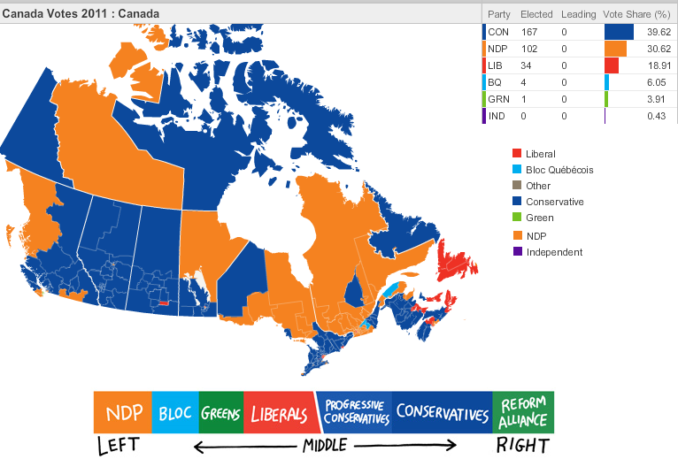
Political Parties in Canada’s Government

Slide 17
Canada’s Parliament
Senate (105 seats): members are appointed by the governor general with advice from the Prime Minister
not elected by the people; can serve until they are 75 years old
House of Commons (308 seats): members are directly elected by the people
serve 5-year terms
largest political party in the House elects the Prime Minister

Slide 18
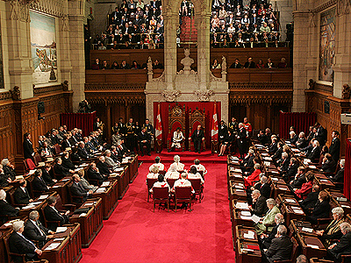
Canadian Senate

Slide 19
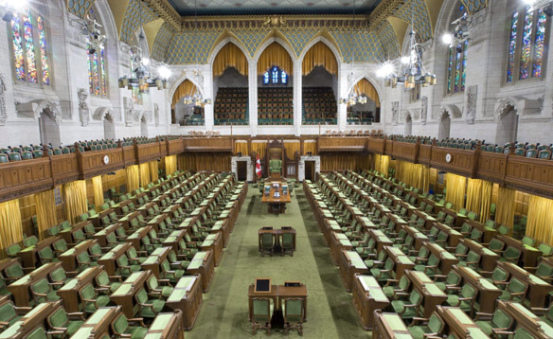
Canadian House of Commons

Slide 20
Parliamentary Democracy
Whichever political party has the most members in the legislature selects the Prime Minister.
This is the major difference between a Presidential Democracy and a Parliamentary Democracy!
Parliamentary Democracy – legislature (Parliament) chooses Head of Government (Executive Leader)
Citizens vote for members of Parliament, members choose the Prime Minister.

Slide 21
Role of the Citizen
Citizens must be 18 to vote, but voting is not required by law.
As a democracy, its citizens must participate in voting and elections:
They elect members of Parliament.
They elect regional government officials (provincial governors).
They also vote on issues like whether or not Quebec should be an independent country.
Separatists are people who want Quebec to be its own country.

Slide 22
Branches of Government
Canada has 3 Branches of Government just like any other Democratic Country.
Executive Branch – this is the Prime Minister
Legislative Branch – this is Parliament. Parliament is made up of two groups: the House of Commons and the Senate
Judicial Branch – made up of all the courts in Canada

Slide 24
