Slide 1
Location, Climate, & Natural Resources
Australia
Where People Live & How They Trade

Slide 2
Location
Australia is both a continent & a country.
It lies about 2,000 miles southeast of Asia.
Surrounded but the Pacific Ocean on the east and the Indian Ocean on the west.
It’s in the southern hemisphere.
Literally the “land down under”!

Slide 5
Climate
Climate varies across the continent.
Australia is south of the equator, so it’s climate is opposite that of North America:
Summer: December through March
Winter: June through September

Slide 6
Mount Hotham, Victoria

Slide 7
Climate
The northern part of Australia is closest to the equator.
It has a tropical climate and is warm-to-hot all year round.
It gets more rain than any other part of the country.
Winter: wet and cool
Summer: hot and dry

Slide 8
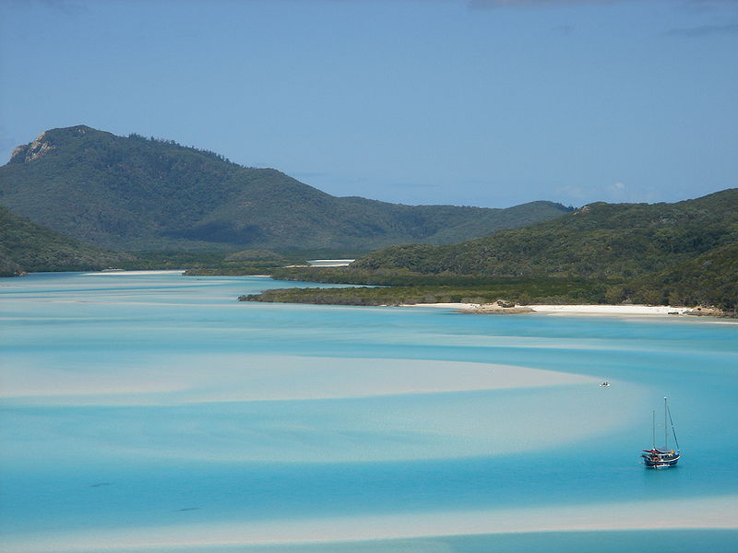
Whitsunday Island, Queensland

Slide 9
Climate
Central Australia is mostly desert.
This is the largest part of Australia.
Very little rain falls here.
Most of this area gets less than 10 inches of rain per year!

Slide 10
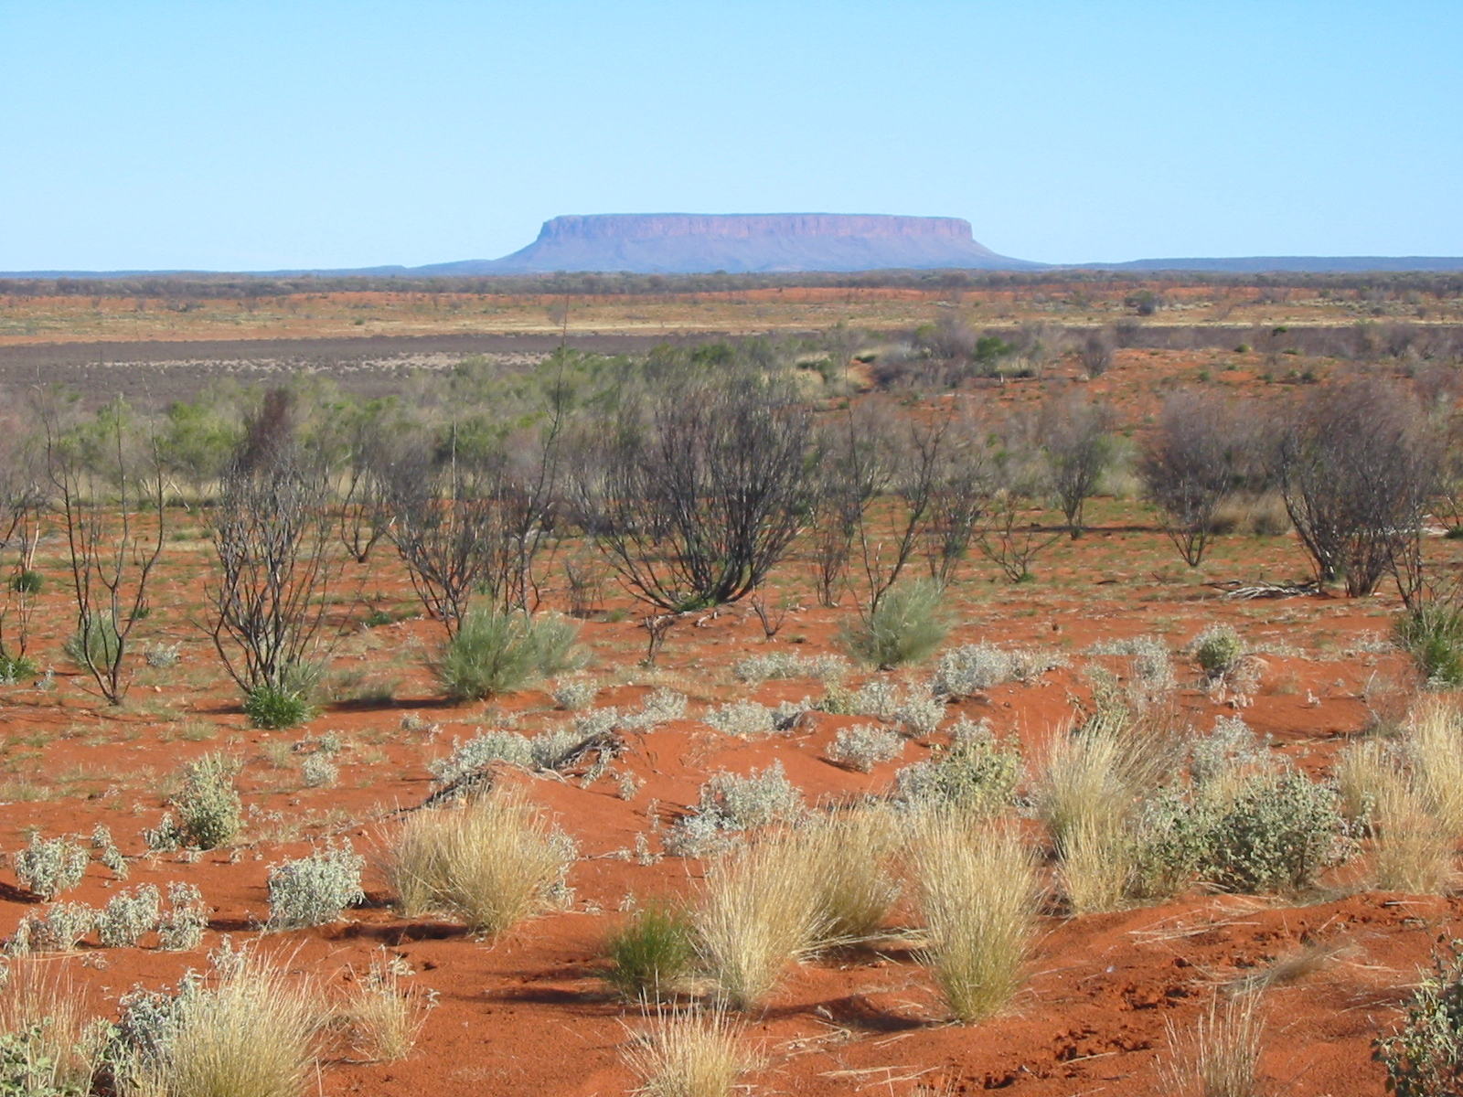
Outback (Ayers Rock)

Slide 13
Climate
Only the southeast and southwest corners along the coasts have a temperate climate.
Summers aren’t too hot & winters aren’t too cold.
The climate in these regions is the one that most Australians prefer.
Most Australians live along southeastern coast.

Slide 15
Tourism
Tourists from the northern hemisphere visit Australia’s warm beaches when it is winter in their country.
Tourists usually wait until spring or fall to visit the rural areas & the outback.
It’s not too hot then.

Slide 16
Gold Coast, Queensland

Slide 17
Natural Resources
Outback refers to the dry interior of Australia.
It’s mainly open countryside, including vast expanses of grazing land.
There are only a few widely scattered settlements in the Outback.
Many of them grew up around mining operations.

Slide 18
Boulia, Queensland

Slide 19
Natural Resources
Across much of Australia, the ground is barren & not ideal for farming (outback).
Many minerals are found here: gold, silver, uranium, coal, copper, & iron ore
Australia has exported nearly $400 billion worth of metals, minerals, & fuels in the past 20 years.
Natural resources account for 1/3 of the country’s economy!

Slide 20
Broken Hill Township – Mining Town in New South Wales

Slide 21
Natural Resources
Australia exports more coal & iron ore than any other country.
It leads the world in mining bauxite, titanium, & diamonds.
No other country has more reserves of lead, cadmium, or nickel.

Slide 22
Natural Resources
Natural resources have always been important to Australian trade.
In the mid-1800s, Australia had a gold rush in the southern region.
Thousands of immigrants moved to Australia to find gold.
Many came from England, Ireland, Germany, & China.

Slide 23
Super Pit – World’s Largest Gold Mine

Slide 24
Natural Resources
In the non-desert regions, Australians grow many grains.
Grains are grown in inland regions of the coastal states (not too hot/dry here).
Grains include a wide range of different crops:
Wheat, barley, sorghum, rye, rice, chickpeas, lentils, & oilseeds

Slide 25
Farmland in Queensland

Slide 26
Where People Live
The coastal areas are the most populated.
Most people live along the east coast.
The most populated city is Sydney, in New South Wales.
Another populated city is Brisbane, Queensland.

Slide 27
Sydney, New South Wales

Slide 28
Brisbane, Queensland

Slide 29
Where People Live
Nearly 80% of Australians live in urban areas.
Australia is one of the world’s most urbanized countries.
70% of all Australians live in cities of more than 100,000 people.
Sydney has 3.5 million people.
Melbourne has about 3 million people.

Slide 30
Sydney, New South Wales

Slide 31
Gold Coast, Queensland

Slide 32
Trade
Australia’s top trading partners for exports are: China (29.5%), Japan (19.3%), South Korea (8%), & India (4.9%).
Australia’s top trading partners for imports are: China (18.2%), US (11.6%), Japan (7.8%), Singapore (5.9%), Germany (4.6%), Thailand (4.2%), & South Korea (4%).
Australia exports tons of natural resources to China.
50% of iron ore exports go to China.
In return, China provides Australia with affordable finished goods (cars, kitchen appliances, etc.).

Slide 33
Tourism
Foreign tourists create only 1/4 of Australia’s $81 billion tourist industry.
Australia’s location makes it expensive for people to visit from other countries.
Australians do the majority of tourism within their own country.
Its remote location in the Southern Hemisphere makes it expensive for Australians to leave & visit other countries.

