Slide 1
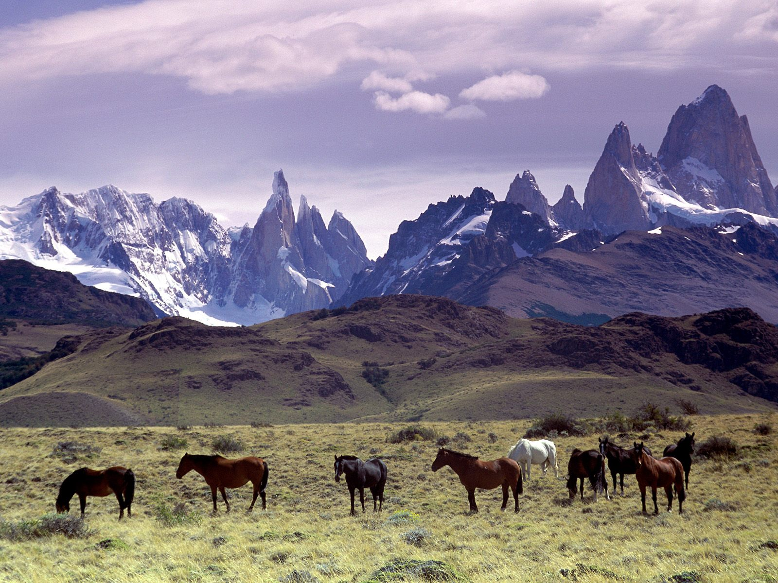
Latin America
Physical Geography

Slide 2
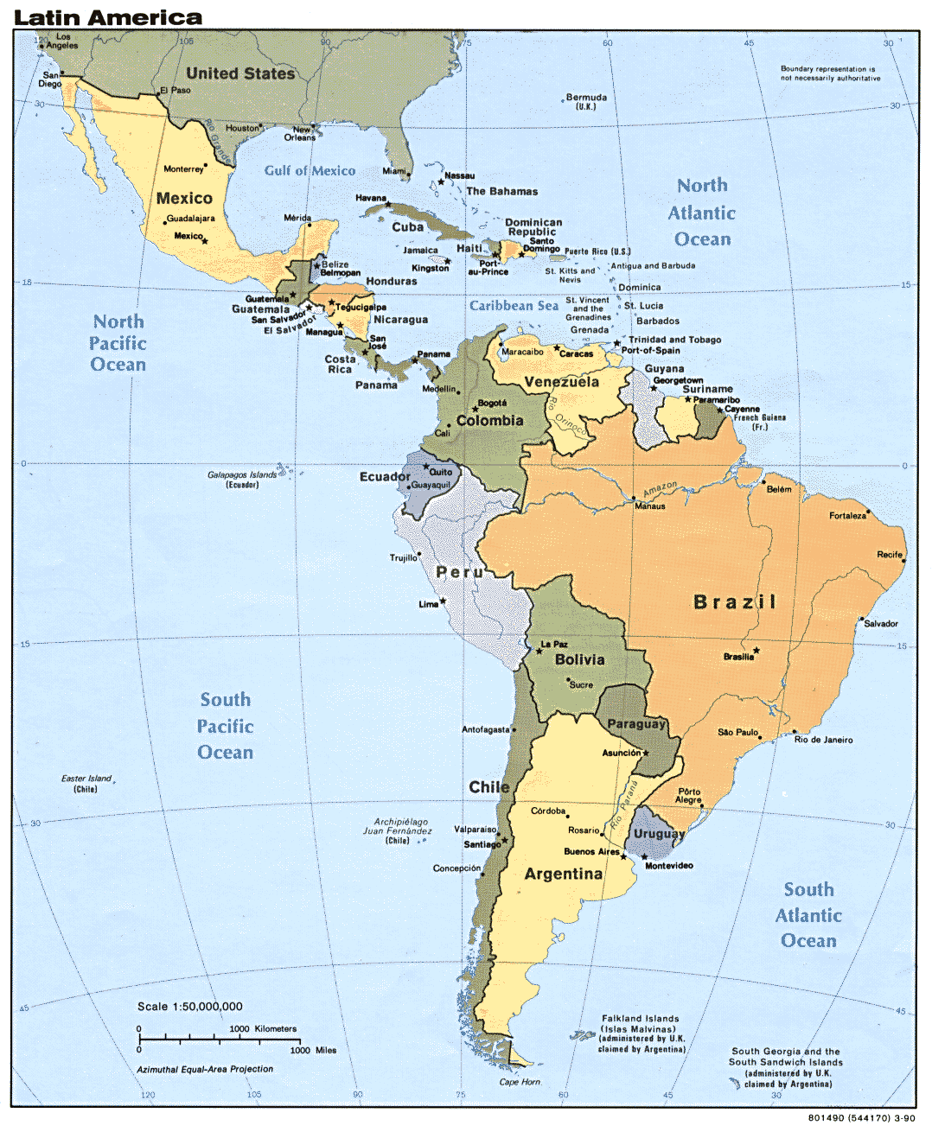
This is Latin America.
Latin America is NOT a continent.
Latin America is NOT a country.
Latin America IS a cultural region.

Slide 3
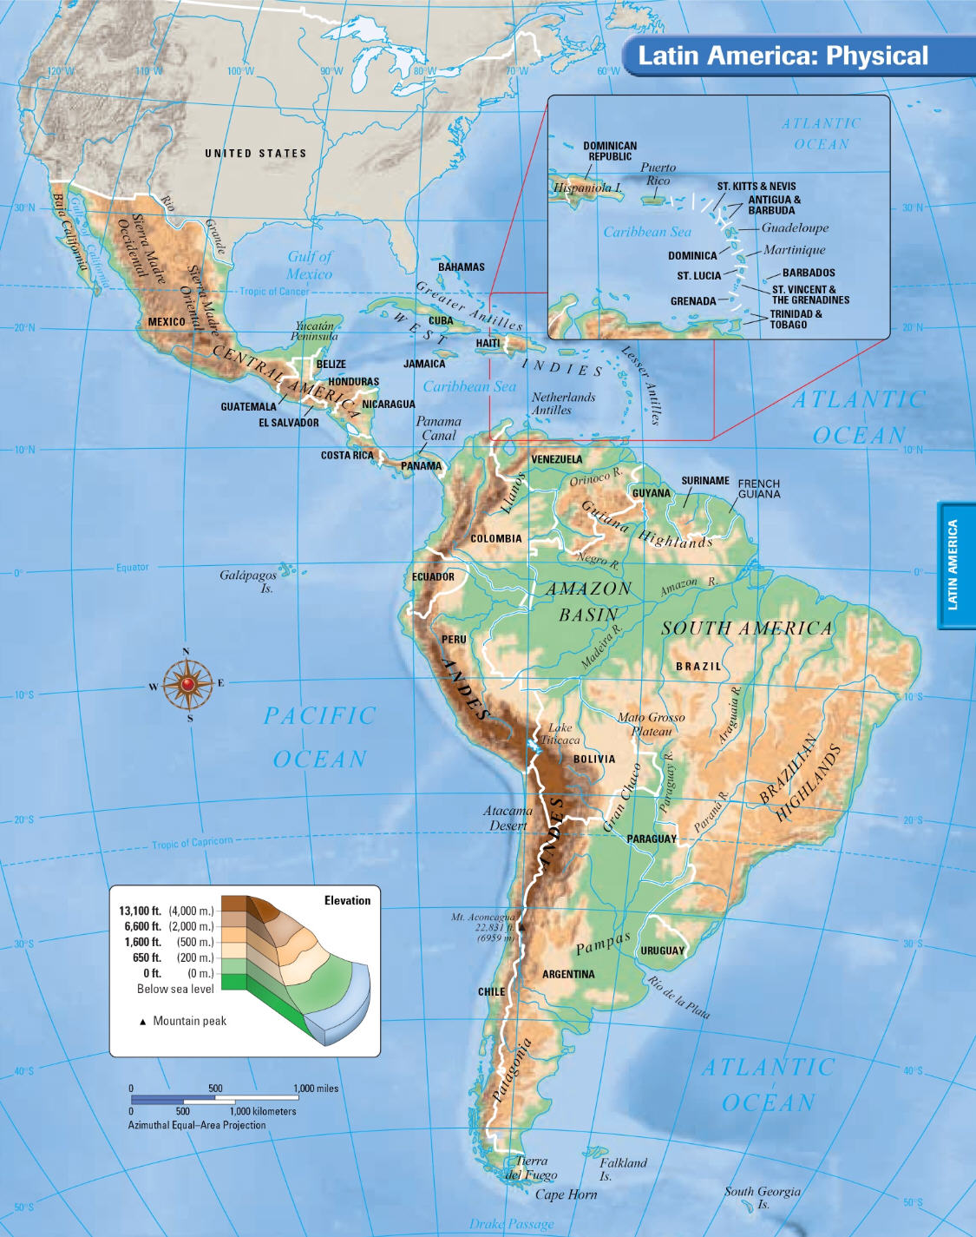
Latin America stretches for 5,500 miles from the Rio Grande River in Mexico to Cape Horn at the southern end of South America.

Slide 4
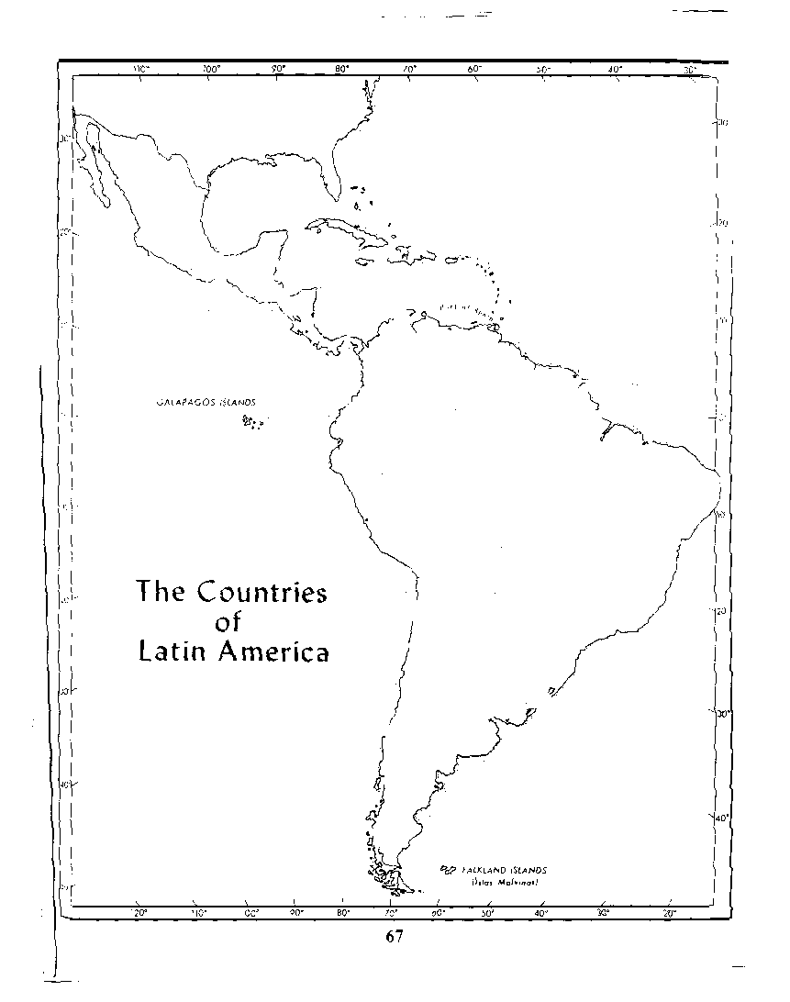
Subregions
There are two sub-regions of Latin America.
“MIDDLE AMERICA”
-Mexico
-Central America countries
-Island nations in the Caribbean
SOUTH AMERICA
-12 countries
-2 foreign ruled territories

Slide 5
Physical Features of Latin America and the Caribbean
Latin America includes Mexico, Central America, and South America
The islands of the Caribbean are also considered to be part of Latin American
The region is called Latin America because the languages spoken there (mostly Spanish & Portuguese) developed from the Latin language.
It has an area of 8 million square miles which is nearly 16 percent of the Earth’s surface.

Slide 6
Most of the Latin America is made up of mountains or highlands.
HIGHLANDS –
A mountainous or hilly section of a country
MOUNTAINS –
land that is at least 2000 ft. high

Slide 7
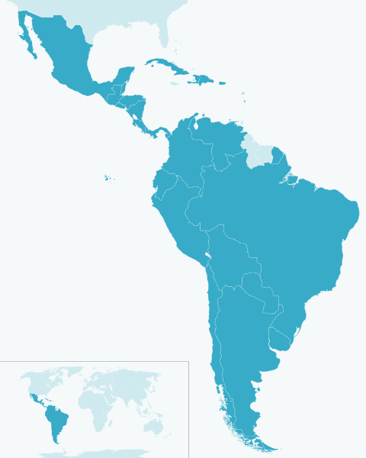
Latin America lies between the Pacific and Atlantic oceans. Both oceans are important trade routes for Latin America. The Caribbean Sea is another important body of water in Latin America.
CARIBBEAN SEA
ATLANTIC OCEAN
PACIFIC OCEAN
Label on your map:
4. Caribbean Sea
Pacific Ocean
Atlantic Ocean

Slide 8
The Caribbean Sea
An arm of the Atlantic Ocean
Located between Cuba and South America
Islands in the Caribbean Sea are popular tourist destinations because of their beautiful beaches and mild tropical climate.

Slide 9
Caribbean Sea

Slide 10
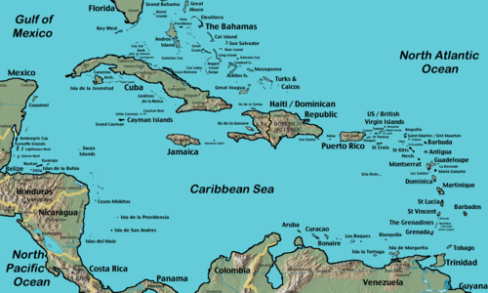
Caribbean Islands
How were the Caribbean Islands formed? What are they?
They were formed by volcanic activity. They are peaks of volcanoes and some are active.
Can be a hazardous place to live.

Slide 11
Countries of the Caribbean
Cuba
Haiti
Dominican Republic
Jamaica and
Puerto Rico (US)

Slide 12
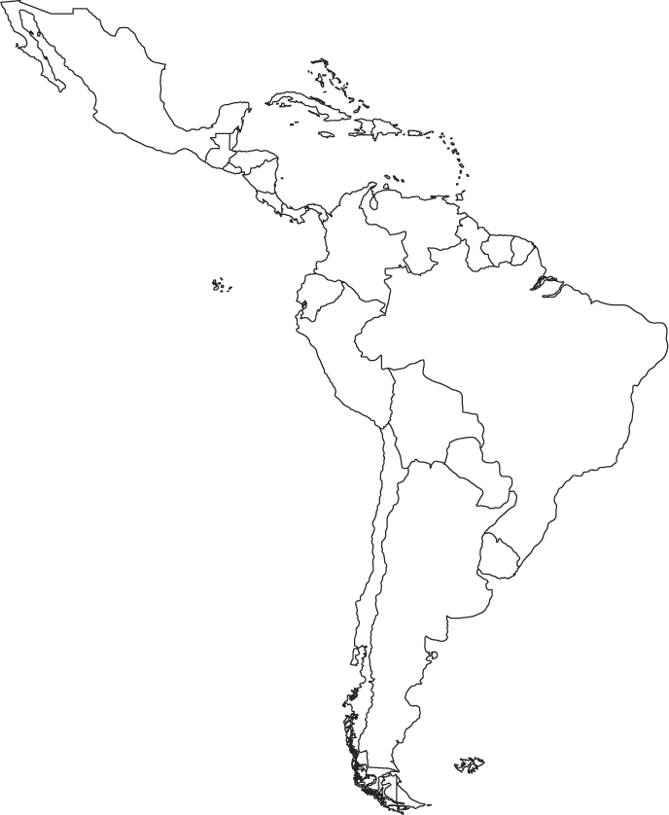
Cuba
Label #2
Cuba
on your map.

Slide 13
Haiti
Label # 3 Haiti
on your map.

Slide 14
Gulf of Mexico
Another arm of the Atlantic Ocean
Cradled by Mexico and the south U.S. coastline from Texas to Florida
The Mississippi River and Rio Grande are two major rivers that empty into the gulf.
Label # 1 The Gulf of Mexico
on your map.

Slide 15
Mexico
Label # 14 Mexico
on your map.

Slide 16
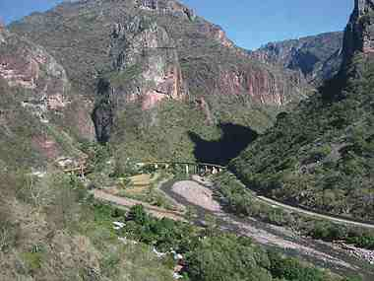
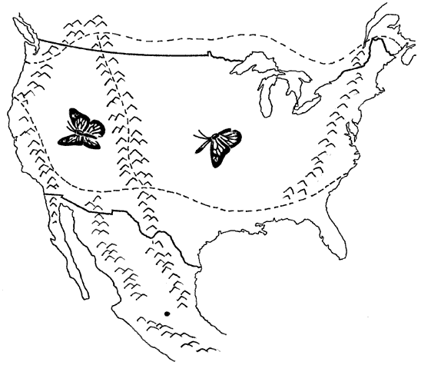
SIERRA MADRES
Label # 15 The Sierra Madres
on your map.
In Mexico the Sierra Madres mountains split into the Sierra Madre West and Sierra Madre East.
SIERRA MADRES EAST
SIERRA MADRES WEST

Slide 17
Sierra Madres

Slide 18
Sierra rocky cliffs

Slide 19
Green slopes

Slide 20
Looking across the range

Slide 21
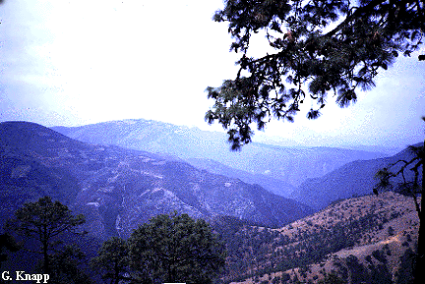
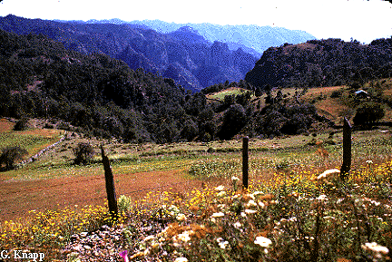
The Sierra Madres, Mexico

Slide 22
Countries of Central America
Belize, Guatemala, El Salvador, Honduras, Nicaragua, Costa Rica, Panama

Slide 23
Costa Rica
Label # 13 Costa Rica
on your map.

Slide 24
Panama
Label # 12 Panama
on your map.

Slide 25
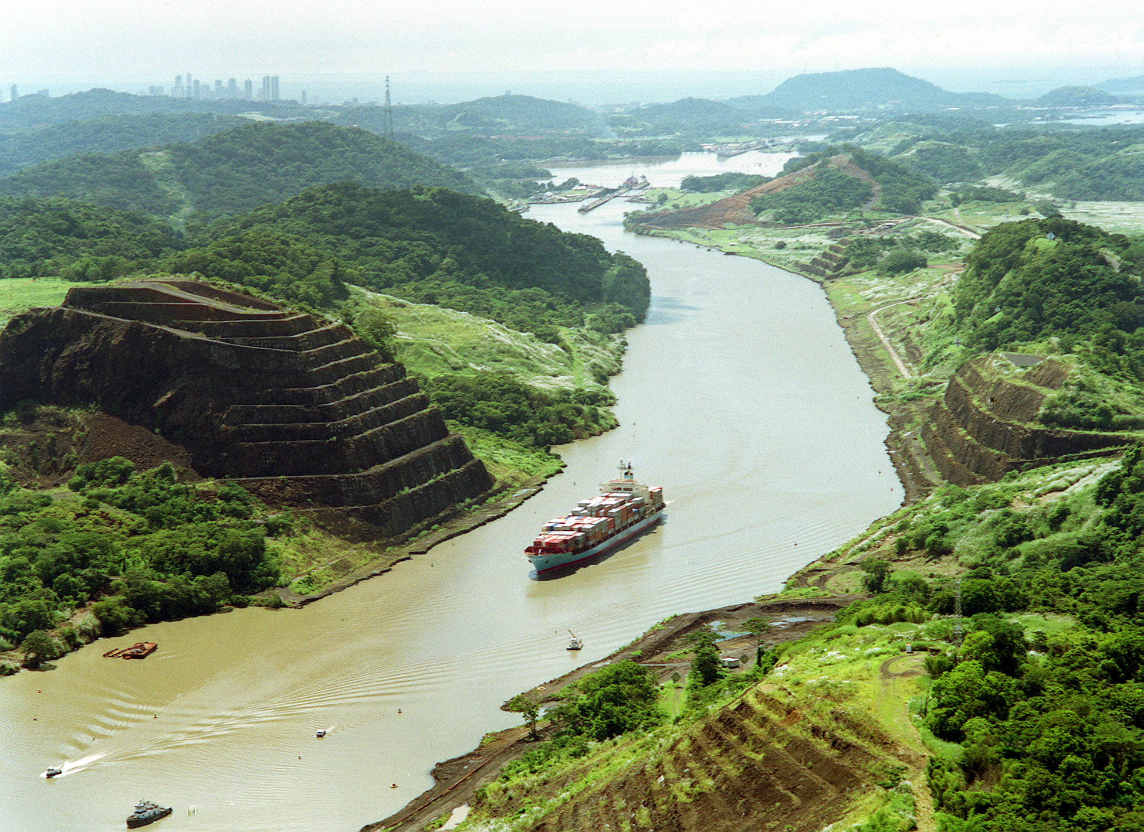
The Panama Canal

Slide 26
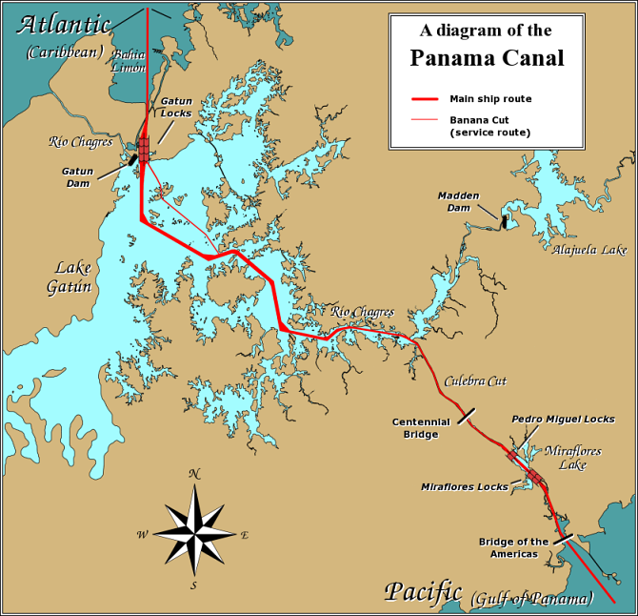
What is the purpose of the Panama Canal?
Allows ships to travel between the Atlantic and Pacific Ocean without sailing around the Southern tip of South America

Slide 27
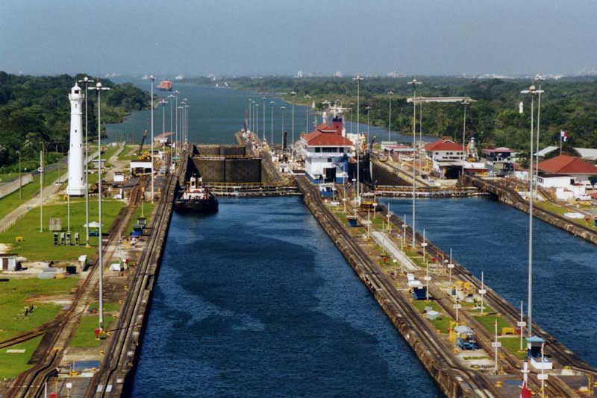

Slide 28
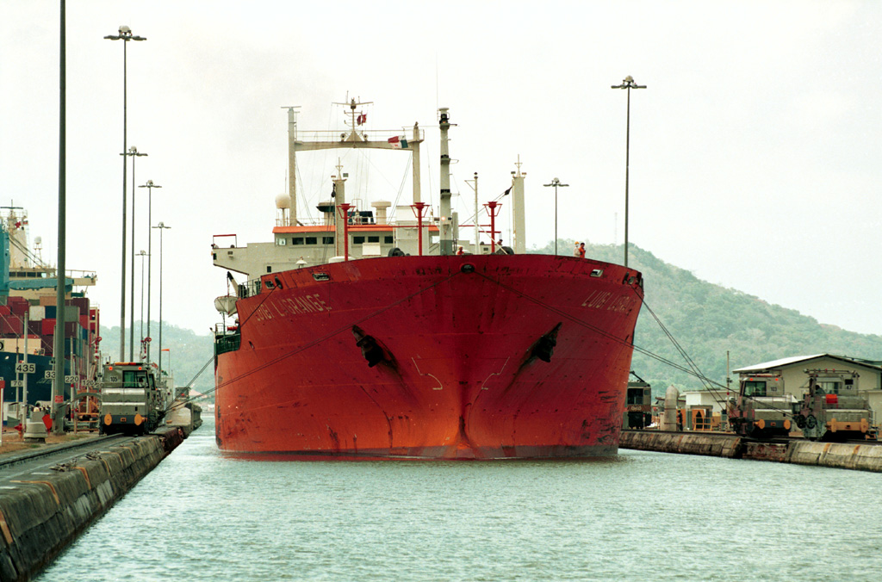
Going Through the Panama Canal

Slide 29
https://www.youtube.com/watch?v=-vi19z4LEi0&src_vid=fA-pnN54uPw&feature=iv&annotation_id=annotation_322604

Slide 30
Equator
Draw the equator on your map.

Slide 31
Countries of South America
Colombia, Venezuela, Guyana, Suriname, French Guiana, Ecuador, Peru, Bolivia, Brazil, Paraguay, Argentina, Chile, Uruguay

Slide 32
Colombia
Label # 11 Colombia
on your map.

Slide 33
Venezuela
Label # 5
on your map.

Slide 34
Brazil
Label # 7
Brazil
on your map.

Slide 35
Bolivia
Label # 8
Bolivia
on your map.

Slide 36
Elevation and the Andes
The major mountain range of Latin America begins in The United States
as the Rocky Mountains,
continues through Mexico
where it is known as the Sierra Madres
and Central America
where it is called Central Highlands
and down through South America
where the mountain range is called
The Andes.

Slide 37
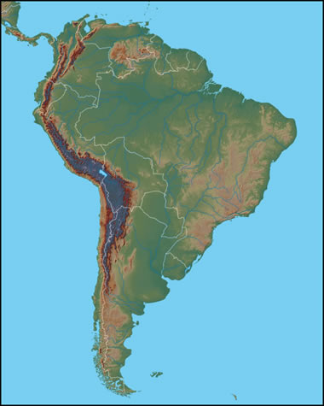
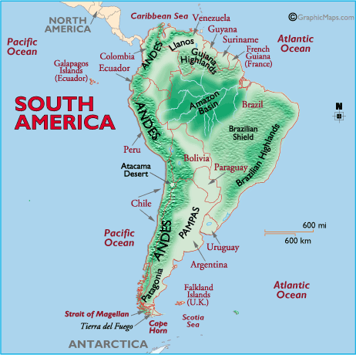
The Andes are the longest mountain range in the world and the 2nd highest mountains in the world.
ANDES MOUNTAINS
Label # 10 The Andes Mountains
on your map.

Slide 38
The ANDES Mountains
Stretch for 4,500 miles along the western edge of South America.
They are the world’s longest mountain chain, with peaks of more than 20,000 feet.
A unique feature is the cordilleras, several ranges that run parallel to one another.

Slide 39
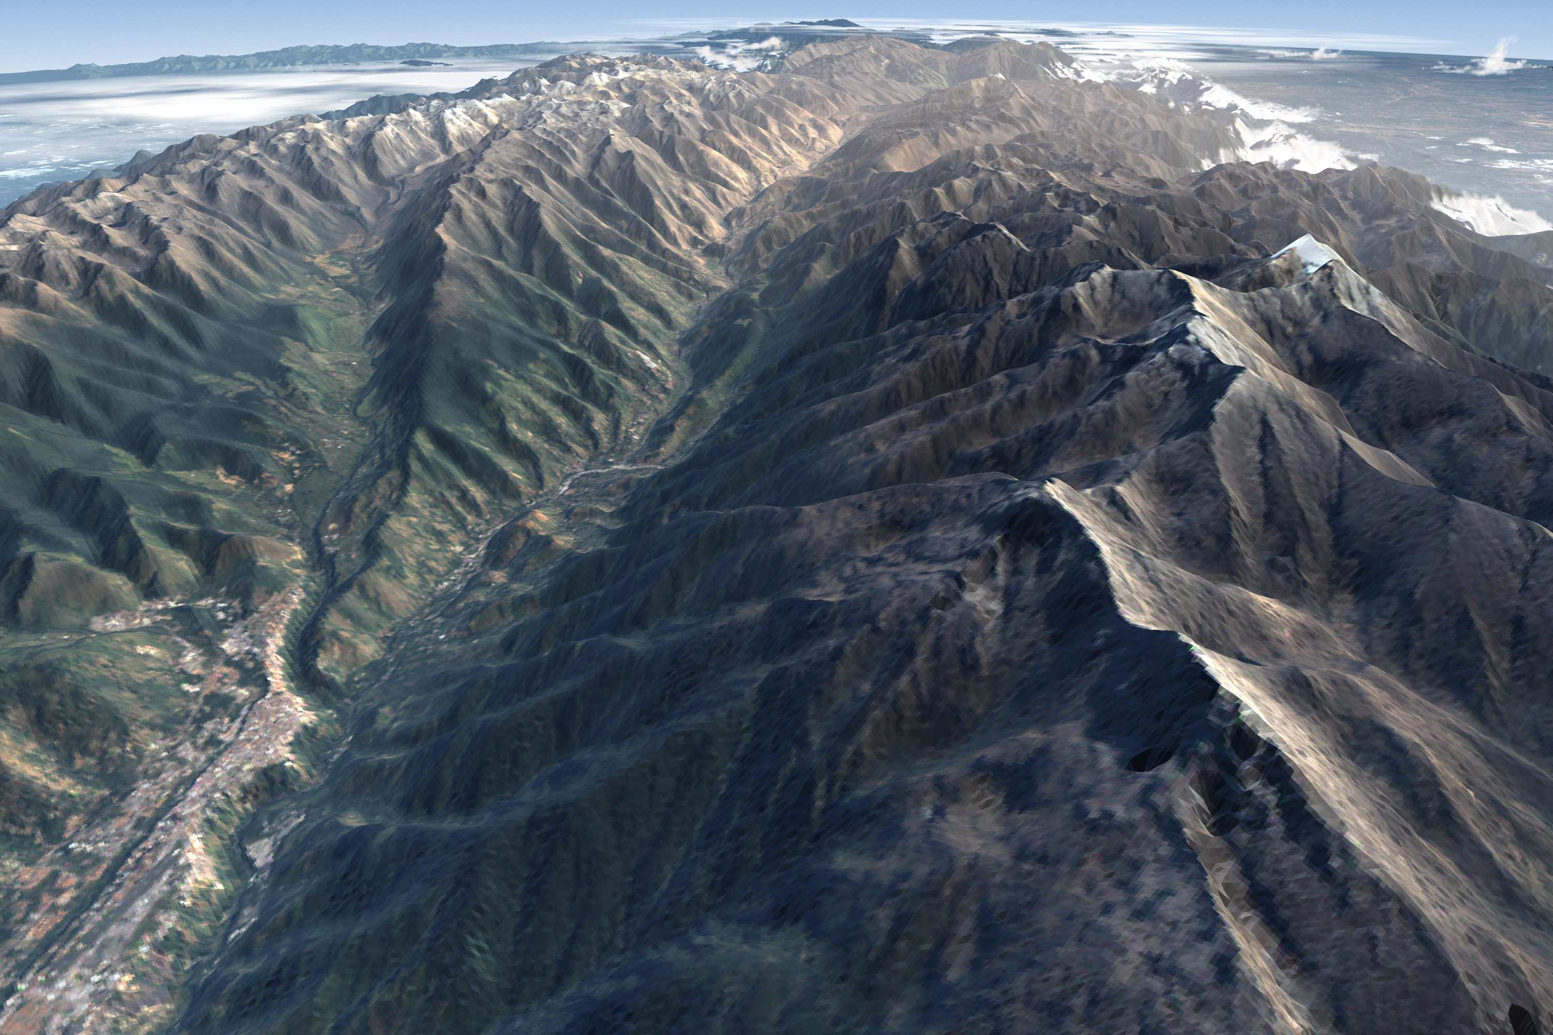

Slide 40
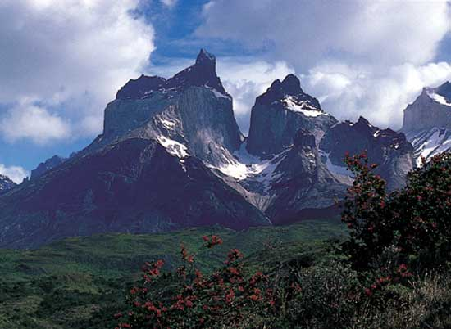

Slide 41
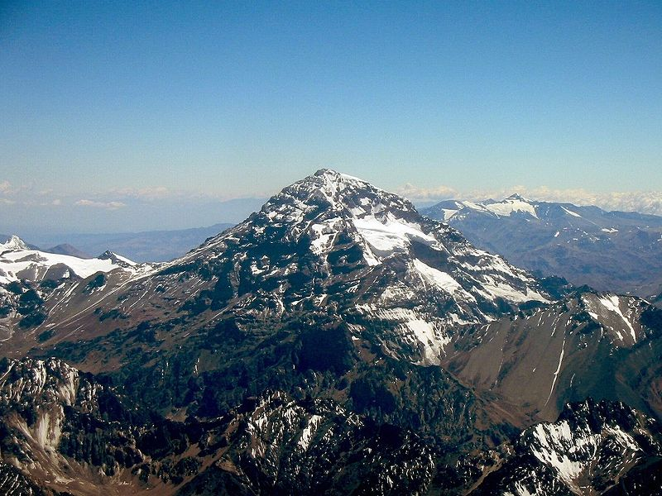
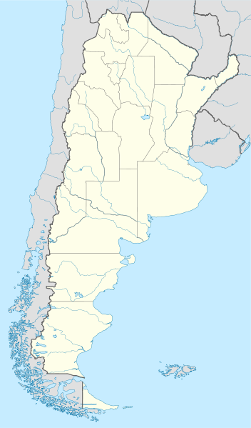
Aconcagua (South America): 6,962 m (22,841 ft)
Located in Argentina, right along it’s border with Chile, tallest peak outside of Asia

Slide 42
ANDES

Slide 43
Peaks in the ANDES

Slide 44
Looking up

Slide 45
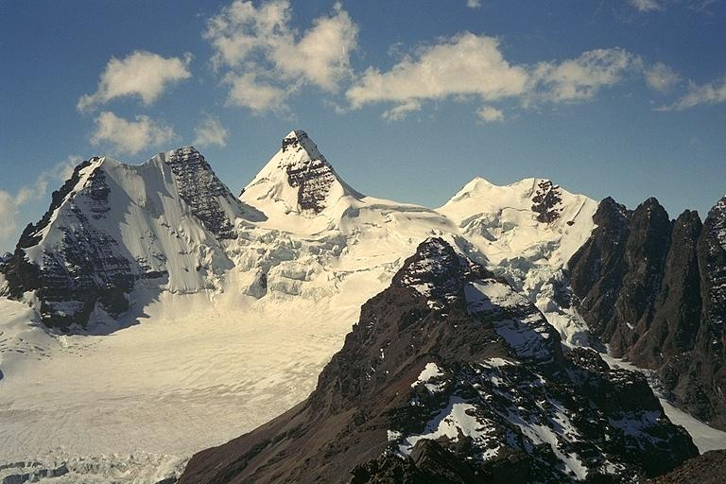
Andes Mountains (Peru)

Slide 46
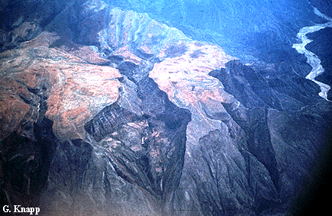
The Eastern Flank of the Andes

Slide 47
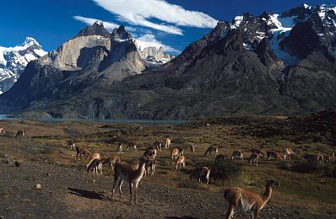
Llamas in the Andes

Slide 48
Population in the Andes
Why do people live in the mountains and plateaus of Latin America?
Cooler climates, rich natural resources (water, volcanic soil, timber and minerals)

Slide 49
http://app.discoveryeducation.com/player/view/assetGuid/D2813CC3-79E2-4777-92EA-2C899103C4FD

Slide 50
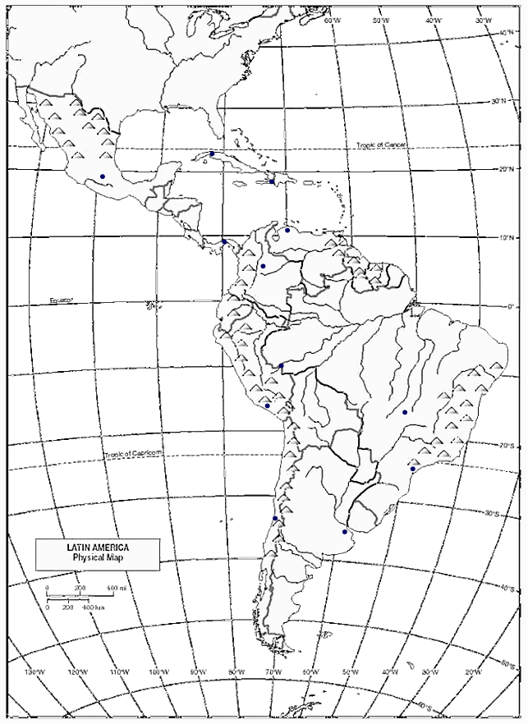
Deserts
In South America is the driest desert in the world.
It is sheltered from the rainforest by the Andes
Atacama Desert
Label # 9 The Atacama Desert
on your map.

Slide 51
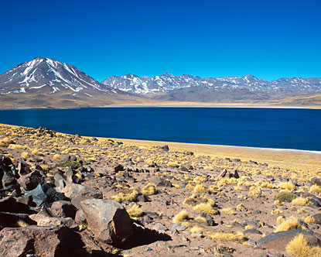
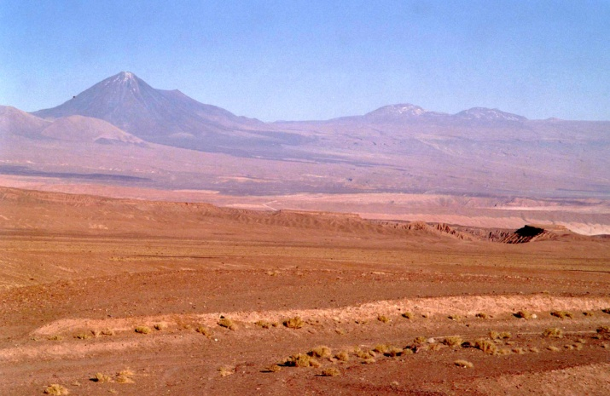
Atacama Desert, Chile
The Atacama is one of the driest places on Earth. In some parts no rain has fallen for 400 years.

Slide 52
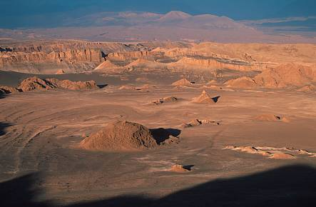
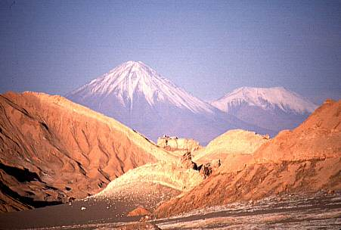
Atacama Desert

Slide 53
Atacama

Slide 54
http://app.discoveryeducation.com/player/view/assetGuid/58DF6611-4F51-4E32-ABDF-01CB76278212

Slide 55
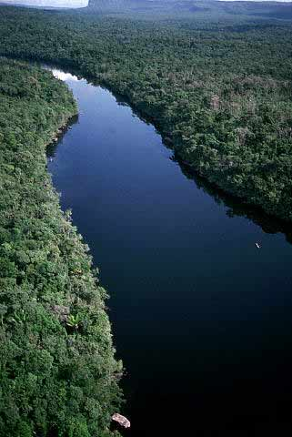
The Amazon River
Flows from the Peruvian Andes to the Atlantic coast of Brazil.
4,000 miles long and the longest river in the Western Hemisphere (world’s 2nd longest)
10 times the water volume of the Mississippi.

Slide 56
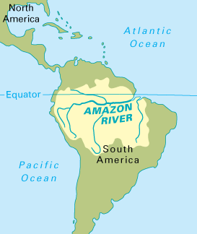
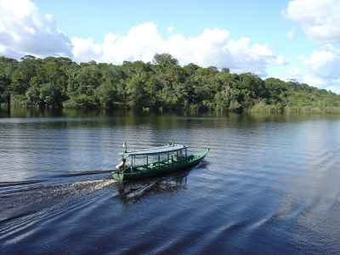
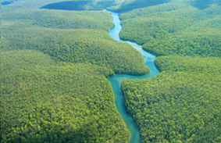
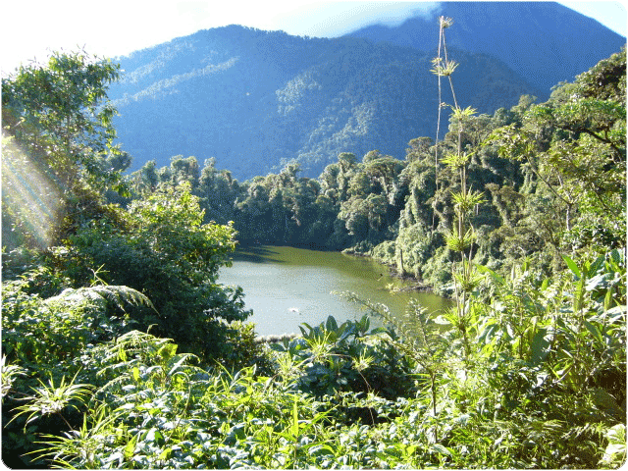
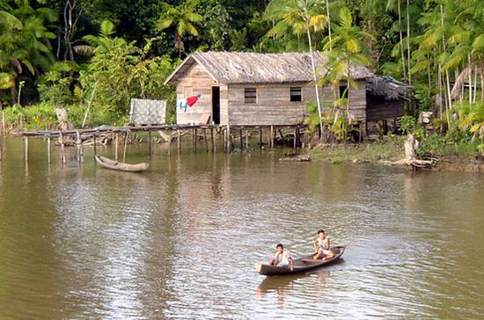
AMAZON RIVER
The Amazon is the largest river in the world. It begins in the Andes Mountains in Peru and flows east across Brazil.

Slide 57
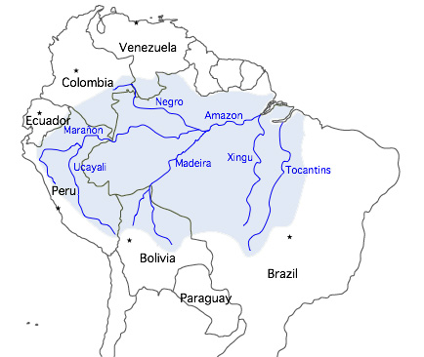
Label # 6 – The Amazon River
on your map.

Slide 58
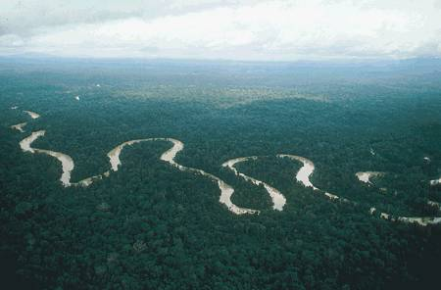

Slide 59
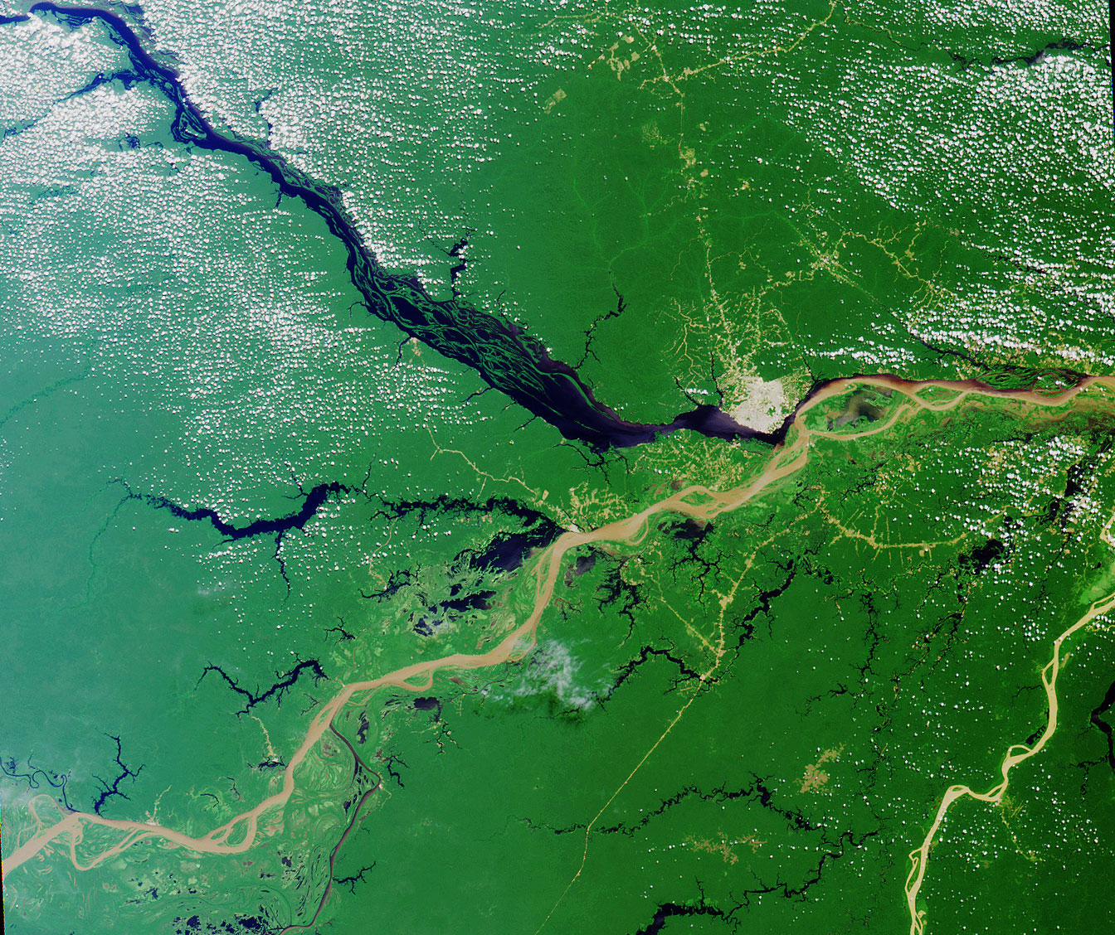

Slide 60
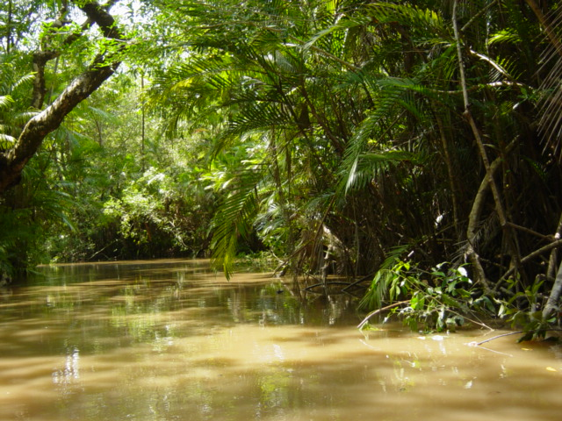

Slide 61
Amazon flowing through the rainforest.

Slide 62
http://app.discoveryeducation.com/player/view/assetGuid/561B4DB3-58A2-457A-9FDA-D676D753EC4E

Slide 63
Grasslands
Pampas
In Argentina
Used for grazing and farming
Llanos
In Venezuela
Used for grazing and farming

Slide 64
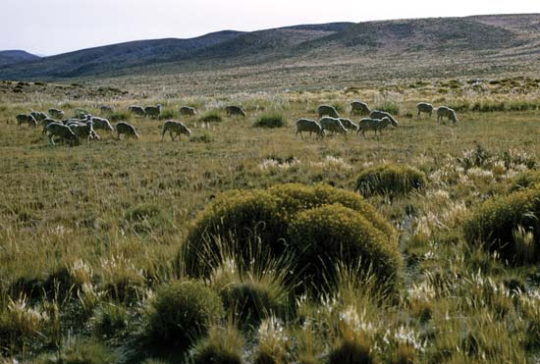
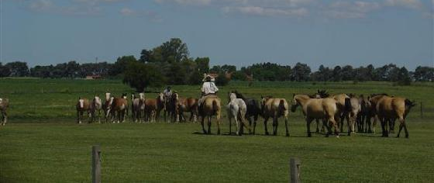
LOWLANDS
PAMPAS
One kind of lowland area in Latin America is pampas. The pampas are grassy plains that stretch from Argentina into Uruguay. The pampas are a
productive farming region.

Slide 65
Cattle on the Pampas

Slide 66
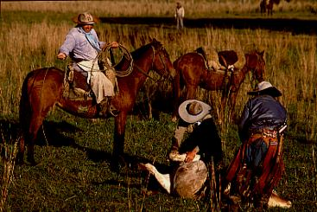
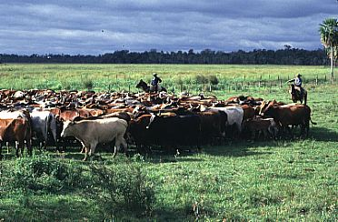
Cattle Ranching on the Pampas

Slide 67
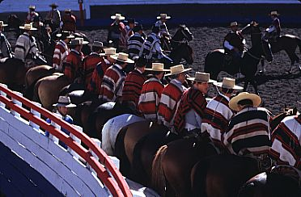
Gauchos of the Pampas, Argentina

Slide 68
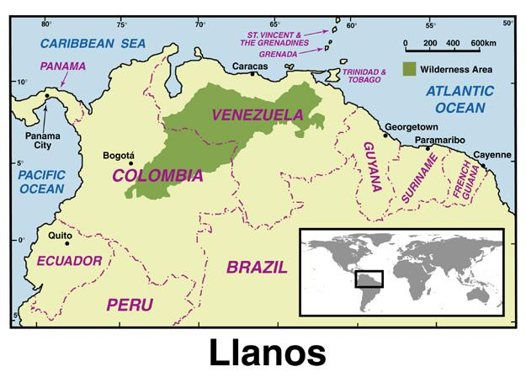

Slide 69
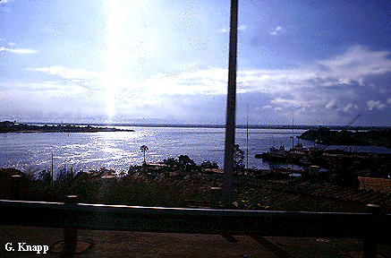
Orinoco Lowlands, the Llanos

Slide 70
Shade trees on the llanos

Slide 71
A small pond on the llanos

Slide 72
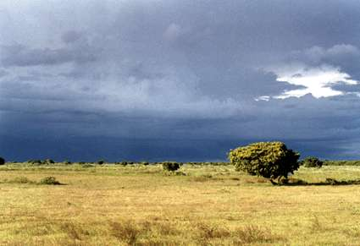
Lllanos and Pampas
Where are the llanos and pampas? What are the regions used for?
They are inland grasslands.
Llanos-Colombia and Venezuela
Pampas- Argentina and Uruguay
Used for grazing cattle.

Slide 73
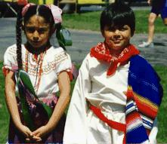
WHY is it called Latin America?
Latin is a language
The two widely spoken languages are Latin-based
And Spanish just about everywhere else!!!
Portuguese is spoken in Brazil
www.skokienet.org/ festival/cultures.html

Slide 74
Adios!

