Slide 1


Environmental Issues of Latin America
Mrs. Beck
6th grade
2013

Slide 2
MAINTENANCE ACTIVITY
Today's Warm Up:
3-2-1
3 bodies of water in Latin America
2 mountain ranges in Latin America
1 desert in South America

Slide 3
Our Learning Target
I can explain the air pollution environmental issue in Mexico City, Mexico,

Slide 4

VOCABULARY PREVIEW
What does it look like?
Vocabulary Graphic Organizer
Smog -Air Pollution
Deforestation
Oil Spill

Slide 5
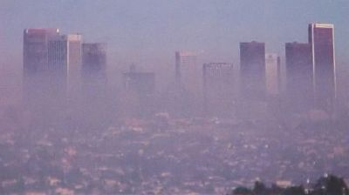
What is smog?
Smog is basically derived from the merging of two words; smoke and fog. The atmospheric pollutants or gases that form smog are released in the air when fuels are burnt. When sunlight and its heat react with these gases and fine particles in the atmosphere, smog is formed.

Slide 6
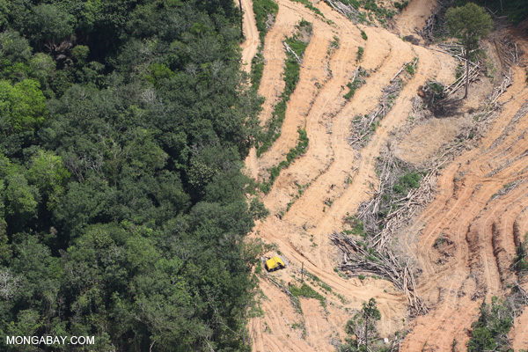
What is Deforestation?
Deforestation refers to the cutting, clearing, and removal of rainforest or related ecosystems into less bio-diverse ecosystems such as pasture, cropland, or plantations.

Slide 7
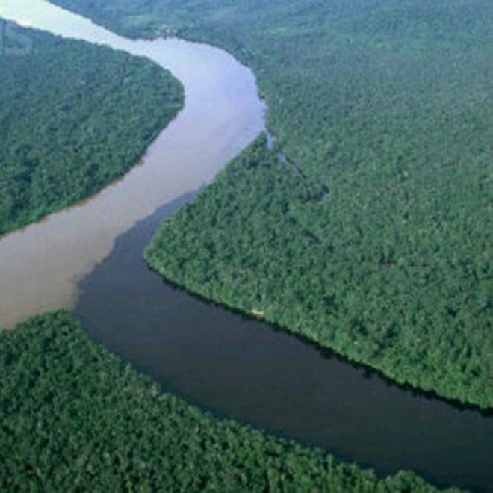
An oil spill is a release of a liquid petroleum hydrocarbon into the environment due to human activity, and is a form of pollution.
This oil spill happened on February 4 in the eastern Monagas estate, Venezuela when a main oil pipe cracked open releasing the
equivalent to 60,000
barrels of oil into the
Guarapiche River. It is
said the crude moves
about 25 miles every
24 hours.

Slide 8

Make two Graphic Organizers as pictured.
We will label them on the next slide.

Slide 9

MEXICO CITY Graphic Organizers
T-Chart and Tables
EARLY 2OTH CENTURY MEXICO
MEXICO CITY TODAY
SOURCES OF POLLUTION PROBLEMS IN MEXICO CITY
1.
2.
3.
4.
LIST AT LEAST THREE WAYS THAT MEXICO CITY’S GEOGRAPHY CONTRIBUTES TO ITS SMOG PROBLEM.
1.
2.
3.

Slide 10
As countries grow in population and add more factories and businesses, they often face serious challenges to their environment.
One of the most important issues facing Latin American countries today is how to maintain a clean, healthy environment amidst rapid growth.

Slide 11
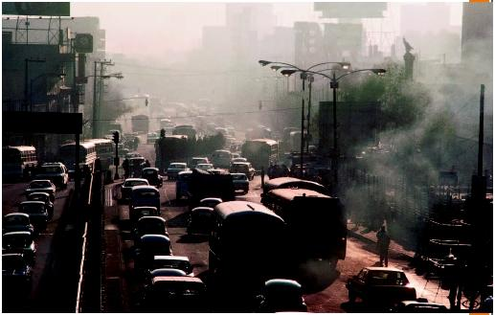
In the early 20th Century, Mexico City was known for its clear skies, and view of distant snowcapped mountains. Today, however, Mexico City is one of the world’s worst areas of air pollution. On most days, the hazy, polluted sky blocks the view to the mountains.

Slide 12
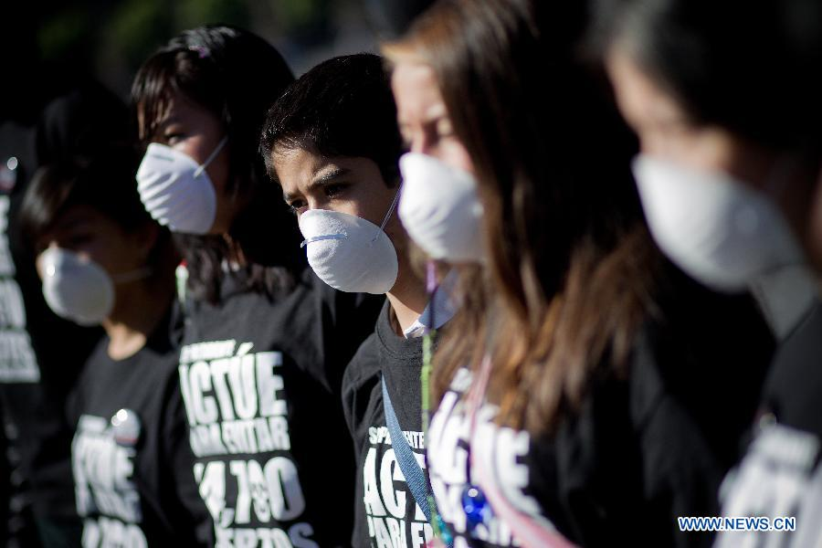
In 1992, the United Nations described the city's air as the most polluted on the planet. Six years later, that air earned Mexico the reputation of "the most dangerous city in the world for children." The air was so bad that children were more likely to have breathing problems and develop lung disease when they grew up.

Slide 13
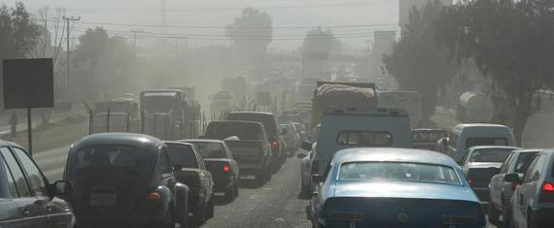
Many factors have contributed to this situation:
industrial growth- factories send pollution such as lead, sulfur dioxide, and carbon monoxide into the air.
a population boom (from 3 million in 1950 to some 20 million today),
and the proliferation of vehicles. More than 3.5 million vehicles -- 30% of them more than 20 years old -- now ply the city streets.

Slide 14
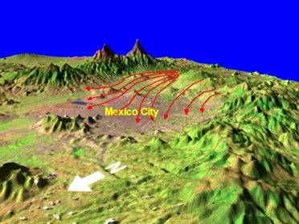

Geography conspires with human activity to produce this poisonous scenario, too. Located in the crater of an extinct volcano, Mexico City is about 2,240 meters above sea level. The high elevation means that the air is thin, and exhaust from cars and factories get trapped in the valley. The intense sunlight helps to push smog even higher.

Slide 15
SOLUTIONS
The government of Mexico is working on solutions to this problem.
First drivers must leave their cars at home one day per week.
Citizens are encourage to ride buses, trains or carpool to work.
Cars are inspected more often. Those with very bad exhaust problems must be repaired.
On days of the highest pollution levels, certain factories may be closed.

Slide 16
Mexico City –
On the Road to Cleaner Air
http://www.theguardian.com/global-development/video/2012/oct/04/mexico-city-cleaner-air-video

Slide 17
Mexico City –
Building Eats Smog!
http://money.cnn.com/video/news/2013/07/22/n-mexico-city-building-eat-smog.cnnmoney/index.html

Slide 18
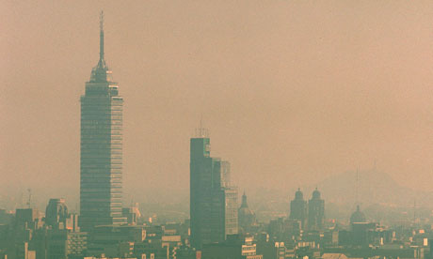
This is a reputation Mexico has been working hard to improve. But despite more than a decade of stringent pollution-control measures, a dull haze hangs over the city most days, obscuring the stunning snow-capped mountains that frame the city and endangering the health of its inhabitants.

Slide 19
Exit Ticket…
  Why is air pollution so bad in Mexico City?

Slide 20
AIR POLLUTION IN MEXICO CITY ASSESSMENT QUESTIONS
1. What are the main sources of air pollution in Mexico City?
  A. intense sunlight
  B. the high altitude
  C. factories and cars
  D. cars that produce little or no air pollution.

Slide 21
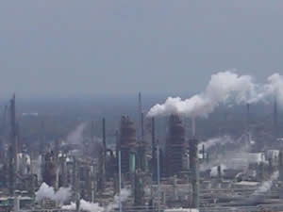
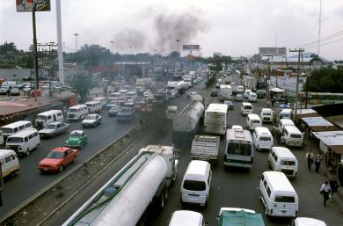
What are the main sources of air pollution in Mexico City?
C. factories and
cars

Slide 22
AIR POLLUTION IN MEXICO CITY ASSESSMENT QUESTIONS
2. How does geography play a role in Mexico City’s air pollution problem?
  A. It is one of the world’s largest cities.
  B. The city has views of distant snow capped mountains.
  C. It lies in a bowl-shaped valley that traps air pollutants.
  D. The cars and factories send pollution such as lead, sulfur and carbon monoxide into the air.

Slide 23
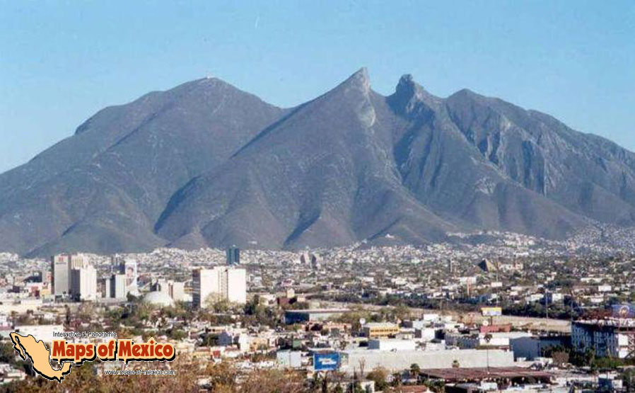
How does geography play a role in Mexico City’s air pollution problem?
C. It lies in a bowl-shaped valley that traps air pollutants.

Slide 24
Which solution is a way that the government is trying to reduce pollution in Mexico City?
A. ignoring cars with exhaust problems
B. reducing the number of buses and trains
C. making sure the pollution continues to grow
D. increasing the number of cars that produce little or no air pollution

Slide 25

Which solution is a way that the government is trying to reduce pollution in Mexico City?
D. increasing the number of cars that produce little or no air pollution

Slide 26
Which solution to Mexico City’s air pollution problem would be most challenging to businesses?
A. closing factories one day a week
B. using fuels that produce less pollution
C. having employees ride trains or buses to work.
D. asking citizens to leave their cars at home one day a week

Slide 27
Which solution to Mexico City’s air pollution problem would be most challenging to businesses?
A. Closing factories one day a week
Why?

Slide 28
Warm- up
Share response to exit ticket…
Brainstorm in pairs…facts about the Amazon Rainforest.
List one fact on a post-it and place it on class chart.

Slide 29
The Amazon Rainforest

Slide 30

Use graphic organizer as we explore the
Amazon
Rainforest.

Slide 31
What are rainforests?
Dense forests found in the tropical areas with heavy rainfall.

Slide 32
Where are rainforests located?

Slide 33
Why are rainforests important?
Rainforests provide a home to many plants and animals.

Slide 34
Why are rainforests important?
Rainforests produce 20% of the oxygen we breathe.

Slide 35
Why are rainforests important?
Rainforests are a source of medicines and foods.

Slide 36
Why are rainforests important?
Rainforests protect against flood, drought, and erosion

Slide 37
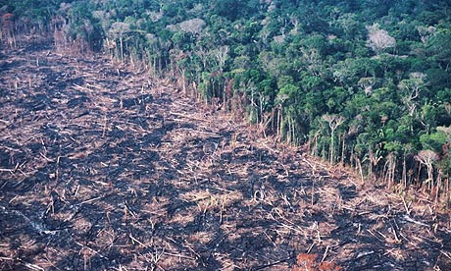
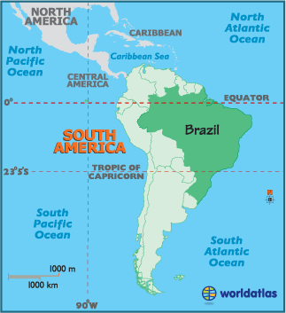
The Rainforest of Brazil
Deforestation

Slide 38
Why are rainforests being destroyed?
Wood for
timber and wood
for making fires
(LOGGING)

Slide 39


Why are rainforests being destroyed?
Agriculture for both small and large farms

Slide 40
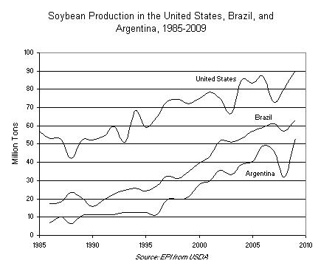
In the last few years, soy production has become a major force in the destruction of rainforests and other critical ecosystems, most notably in Brazil.
The US imports little soy from Brazil, since the US is a major soy producer. But other industrialized countries, such as those in the Europe, as well as Asia, are major importers of soy products from Brazil.
One of the ironies of the destruction of rainforests for soy production is that soy was seen by many as an alternative product to reduce the beef production that was responsible for so much rainforest clearing in recent times.
Soy production has grown so quickly in Brazil that it has now become a major threat to rainforests and soy farms are expanding into undemarcated indigenous lands, threatening tribal people.
Soybean Production

Slide 41
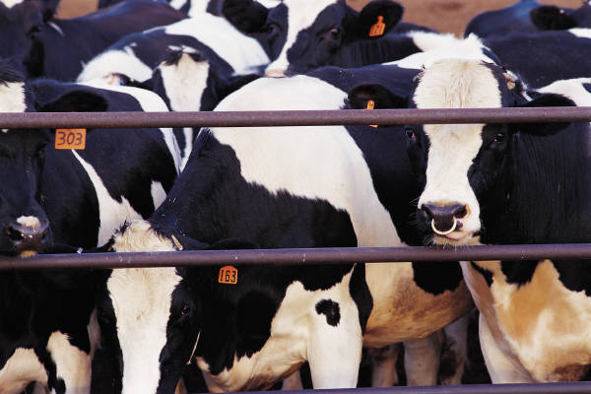
Why are rainforests being destroyed?
Grazing land for cattle

Slide 42
Cattle Ranching
Cattle are
Cattle is raised only for the purpose to be killed and sold for its meat

Slide 43
Cattle Ranching
Ranchers slash and burn rainforests to grow grass pasture for cattle. Once the cattle have grazed sufficiently, they are slaughtered and exported to industrialized countries, including the United States, to be made into fast food hamburgers and frozen meat products. It has been estimated that for every quarter pound hamburger made from rainforest cattle, fifty-five square feet of rainforest was cleared—an area equal to the size of a small kitchen.

Slide 44
Why are rainforests being destroyed?
Road construction

Slide 45
Deforestation of Brazil’s Rainforest
http://www.teachertube.com/viewVideo.php?video_id=226836

Slide 46
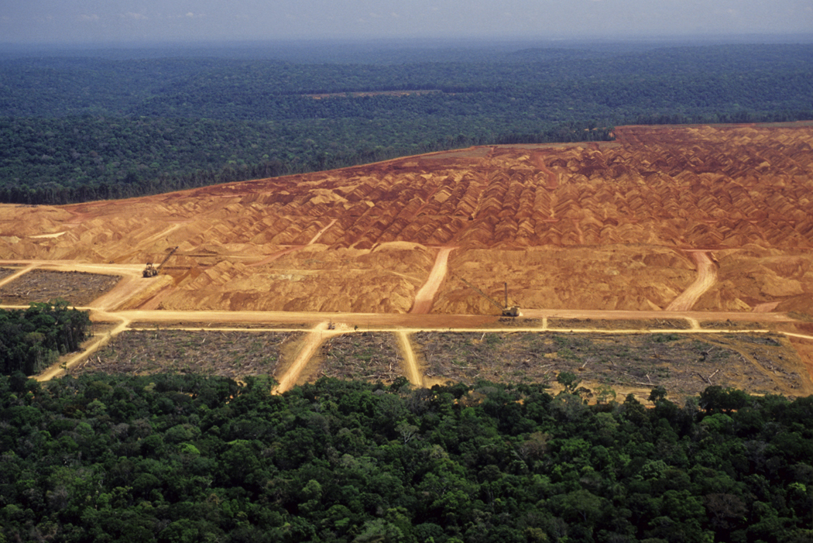
Why are Rainforest being destroyed?
Deforestation
The removal of trees from an areas of land

Slide 47
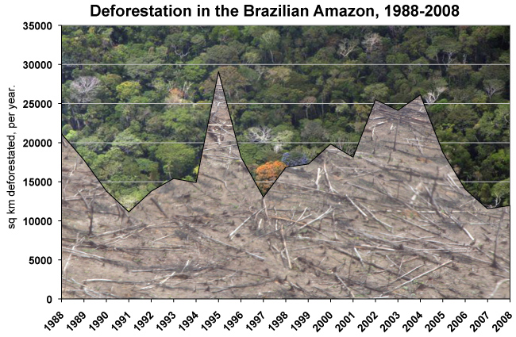

Slide 48
Exit Ticket
Students work in pairs to come up with answers to the following question…
Which of these is NOT a reason why rainforests are important to Brazil’s economy?
Three answers must be incorrect (but one close)
One answer correct.

Slide 49
Which is a problem associated with deforestation?
A. More oxygen is available on the planet.
B. Poor people earn money from selling trees.
C. Native people have too much forest for their needs.
D. There is less forest to produce goods that humans need.

Slide 50
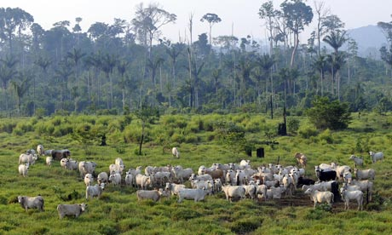
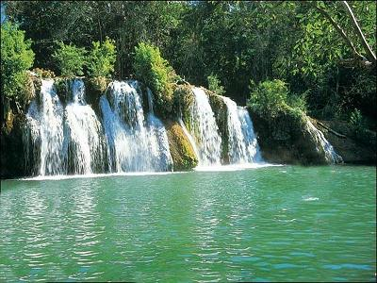
Which is a problem associated with deforestation?
D. There is less forest to produce goods that humans need.

Slide 51
Why does deforestation increase when the value of crops and cattle go up?
A. The value of timber goes up.
B. Laws to protect the rain forest are not enforced.
C. People think they can make more profit selling cattle and crops.
D. Environmental groups work with the government only when prices are down.

Slide 52
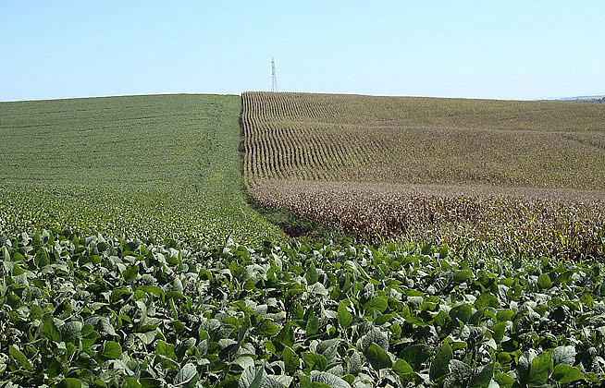
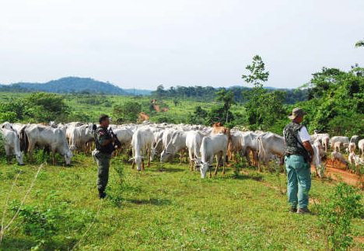
Why does deforestation increase when the value of crops and cattle go up.
C. People think they can make more profit selling cattle and crops.

Slide 53
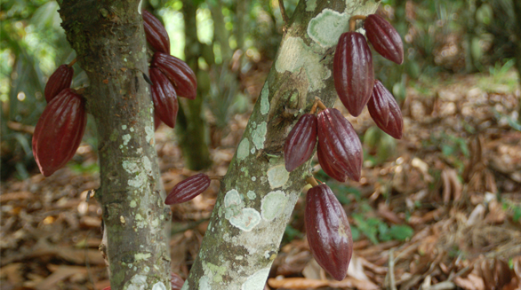
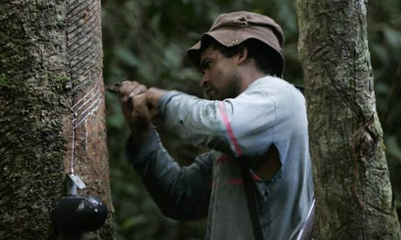
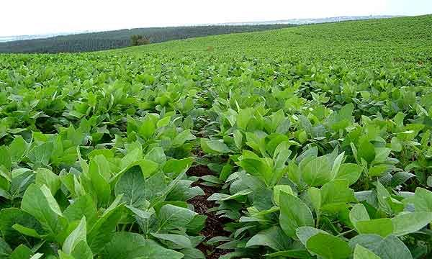
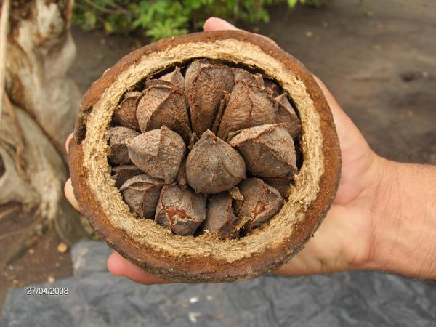
What is the main crop grown in areas of deforestation?
A. Cocoa
B. rubber
C. soybeans
D. Brazil nuts

Slide 54
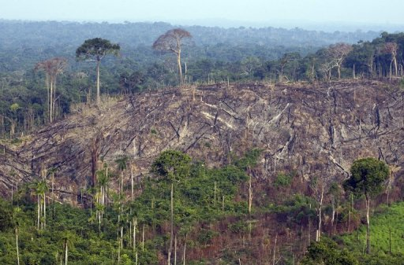
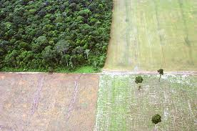
What is the main crop grown in areas of deforestation?
C. soybeans

Slide 55
The world gets 20 percent of which resource from the Amazon rain forest?
A. medicine
B. oxygen
C. rubber
D. soybeans

Slide 56
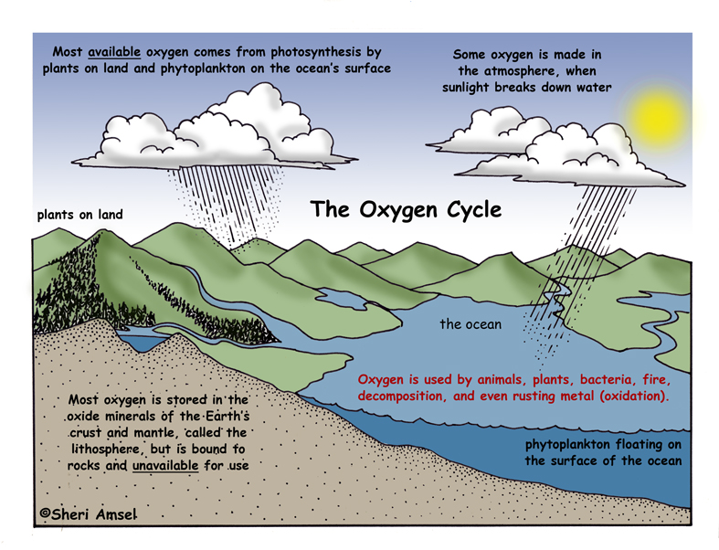
The world gets 20 percent of which resource from the Amazon rain forest?
B. Oxygen

Slide 57
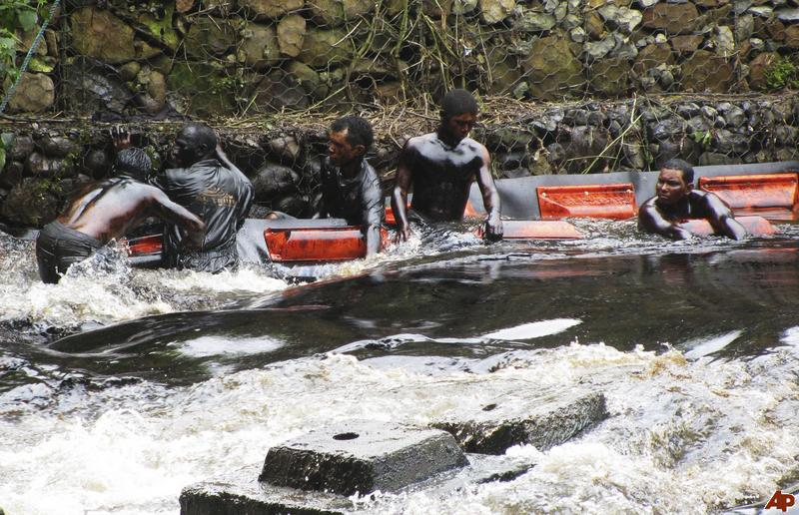
Oil-Related Pollution in Venezuela

Slide 58
Warm-up
http://www.youtube.com/watch?v=pKZ7R2GOd_k
(4:40)

Slide 59
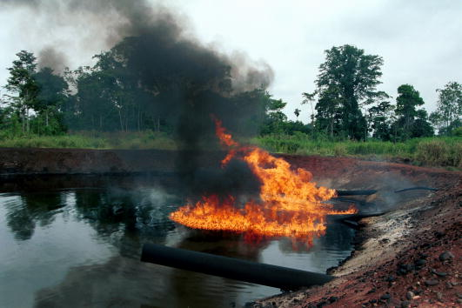
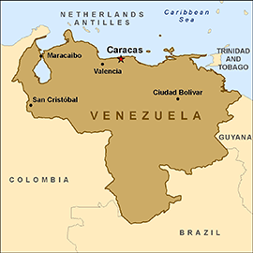
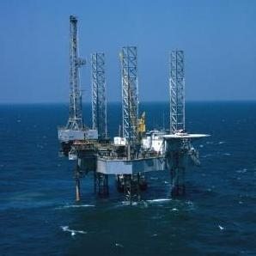
Venezuela’s Oil-Related Pollution

Slide 60
http://prezi.com/pir38erxehi2/copy-of-oil-drilling-in-venezuela/

Slide 61
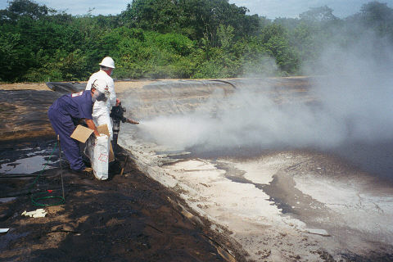
Venezuela is one of the world’s largest producers of oil and natural gas.
It is one of the top suppliers for the USA.
About half of the country’s revenues comes from oil sales.

Slide 62
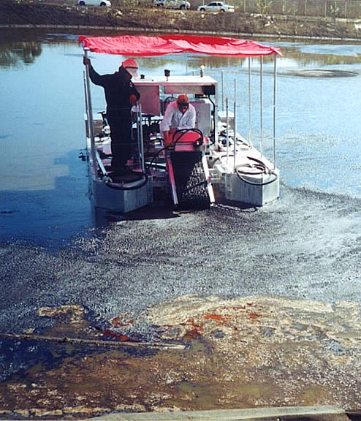
Oil Related Pollution Issues
Oil spills and tanker leaks damage the Caribbean Sea and area lakes. This creates environmental problems as well as making it harder for fishermen to make a living.
The oil rigs face the threat of hurricane damage as well.
Oil pits leak and allow seepage into water sources
Tourism suffers

Slide 63
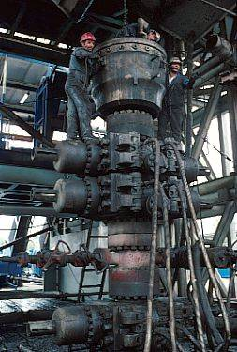
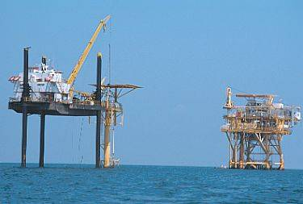
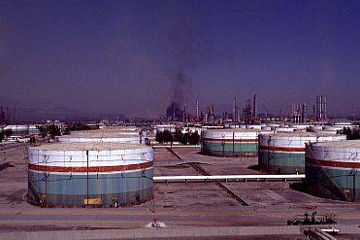
Oil Drilling in the Gulf of Mexico

Slide 64
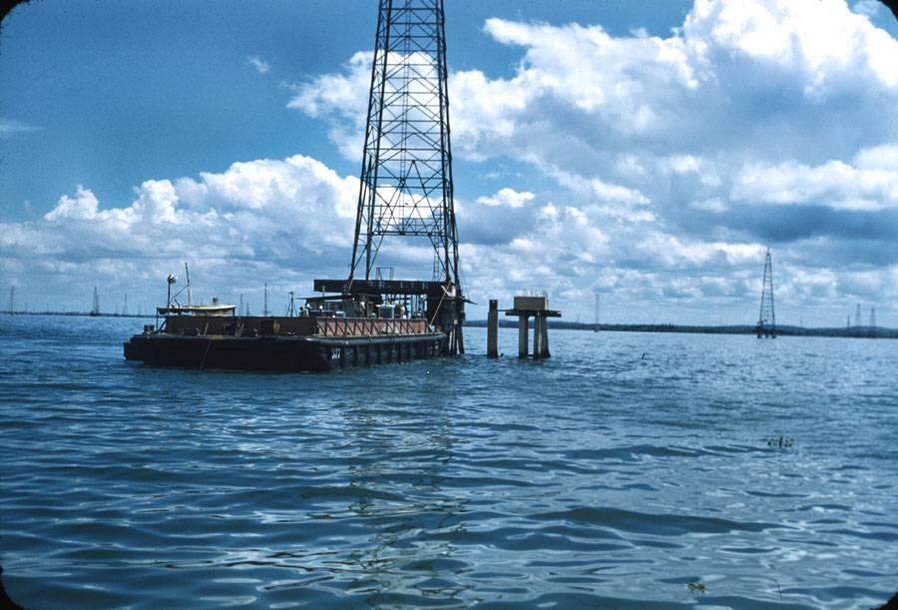
Government Cleanups
The government is setting new environmental policies.
The government is cleaning up the oil pits

Slide 65
What problem has been caused by oil production in Venezuela?
A. About 15 percent of U.S. oil comes from Venezuela.
B. The coast along the Caribbean Sea has been polluted with oil.
C. Lake Maracaibo has been the largest lake in South America.
D. Venezuela is more polluted than other South American countries.

Slide 66
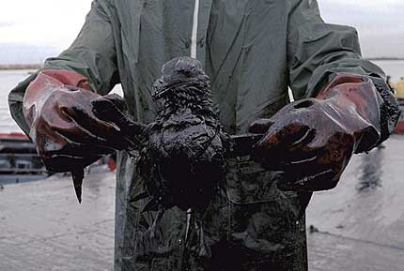
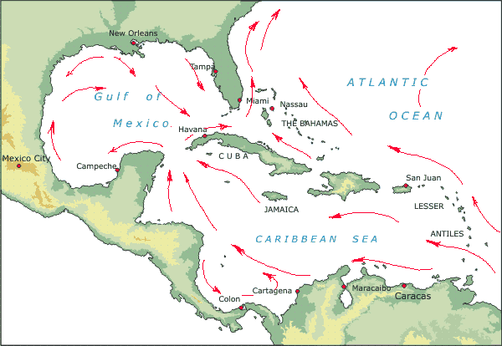
What problem has been caused by oil production in Venezuela?
B. The coast along the Caribbean Sea has been polluted with oil.

Slide 67
Why might the Venezuelan government NOT want to stop oil production in the country, even though it causes a lot of pollution?
A. The government gets about half of its money from the oil business.
B. The government does not care about the damage to the environment.
C. People living in Venezuela are know protected from flooding.
D. People in Venezuela do not care about the environment.

Slide 68
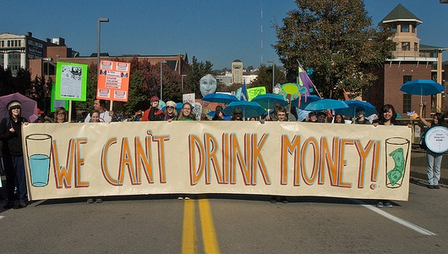
Why might the Venezuelan government NOT want to stop oil production in the country, even though it causes a lot of pollution?
A. The government gets about half of its money from the oil business.

Slide 69
Who is affected first by carbon dioxide pollution?
A. healthy adults
B. children and the elderly
C. farmers
D. fisherman along the Caribbean coast

Slide 70
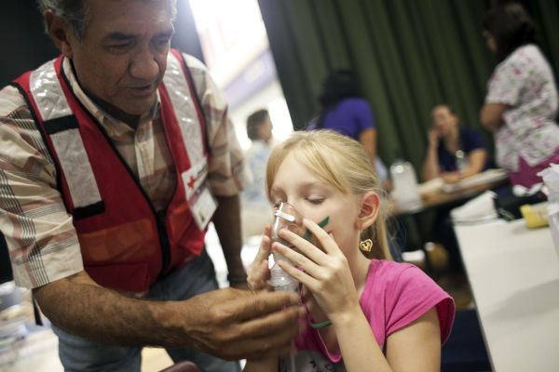

Who is affected first by carbon dioxide pollution?
B. Children and the Elderly

Slide 71
Which problem is associated with too much carbon in the air?
A. algal bloom
B. breathing problems
C. cooler air trapped at the Earth’s surface
D. oil slicks on the Caribbean sea

Slide 72
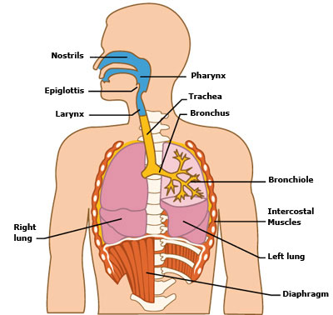
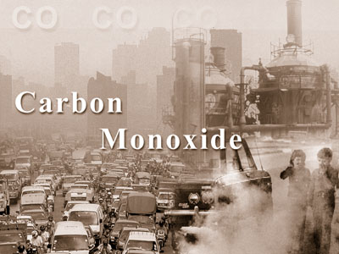
Which problem is associated with too much carbon in the air?
B. breathing problems

Slide 73
Important Facts: Oil Pollution in Venezuela
Venezuela is one of the largest producers of oil and natural gas in the world.
The country is the fifth-largest producer of oil in the world.
It has been producing oil for about a hundred years.
It is now one of the top four sources of oil for the United States.
In fact, about 15 percent of the oil sold in the United States comes from Venezuela.
The money from oil sales accounts for about half the money received by the government of Venezuela.
Along the Caribbean Sea, Venezuela’s coast has become polluted with oil.
Oil spills and tanker leaks have damaged the environment in the region.

