Slide 1
The Geography of Europe

Slide 2
STANDARD
SS6G8
The student will locate selected features of Europe

Slide 3
ESSENTIAL QUESTION
How does the locations of select countries and physical features in Europe impact climate, natural resources, where people live and how they make a living and trade?

Slide 4
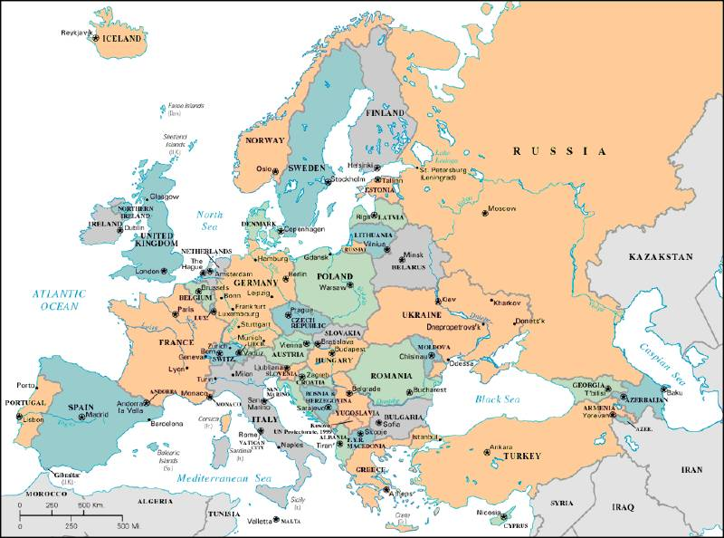
3,800 square miles

Slide 5
Continents by Size (sq. km.)
Asia | 44,579,000
Africa | 30,065,000
North America | 24,256,000
South America | 17,819,000
Antarctica | 13,209,000
Europe | 9,938,000
Oceania (incl. Australia) | 7,687,000

Slide 6
Rhine River
The Rhine River originates in the Swiss Alps mountain range and flows northwest to the North Sea. Throughout history, Europeans have depended on the Rhine to ship goods throughout the continent. The river had a major influence on the history and economy of Europe.

Slide 7
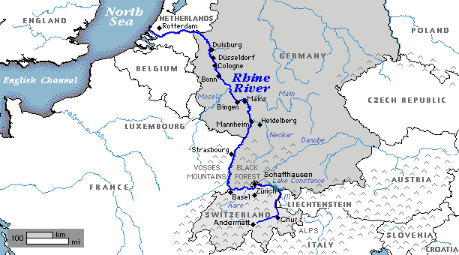

Slide 8
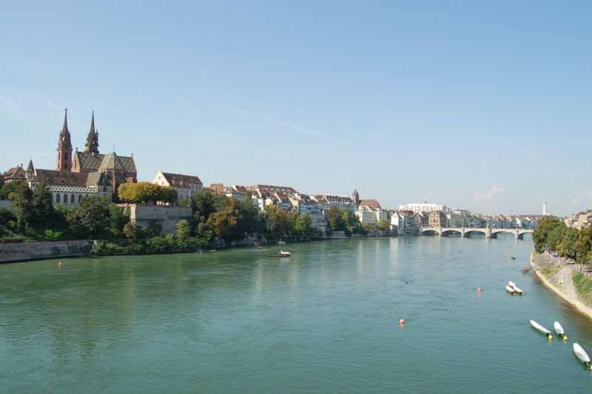

Slide 9
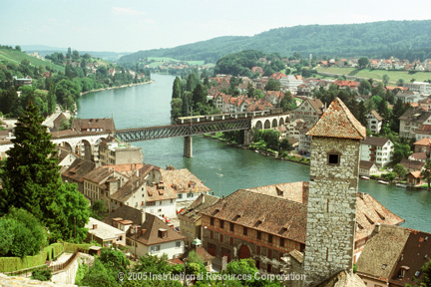

Slide 10
http://www.youtube.com/watch?v=8J2zm-70qgw
Video of the Rhine River

Slide 11
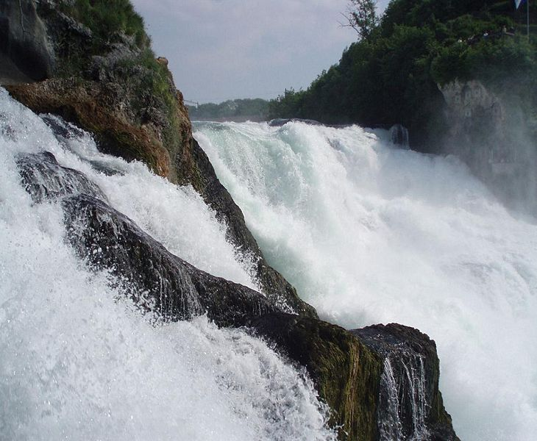

Slide 12
Danube River
The Danube River is the second largest river in Europe and an important shipping route across the continent. The Danube flows from west to east from Germany to the Black Sea. It either flows through or forms the border of ten countries.

Slide 14
The Danube River
http://www.youtube.com/watch?v=MW-CejCB57Y

Slide 16
The Alps
The Alps are a magnificent mountain range in south-central Europe stretching from eastern France and northern Italy through Switzerland and Austria. Snowmelt from the Alps pours into many of Europe’s rivers.

Slide 17
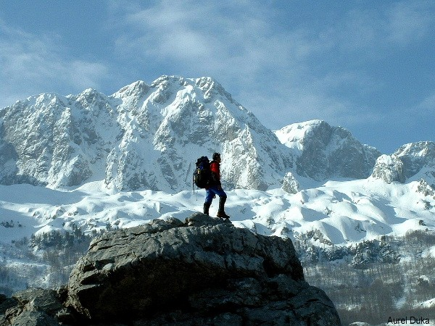

Slide 18
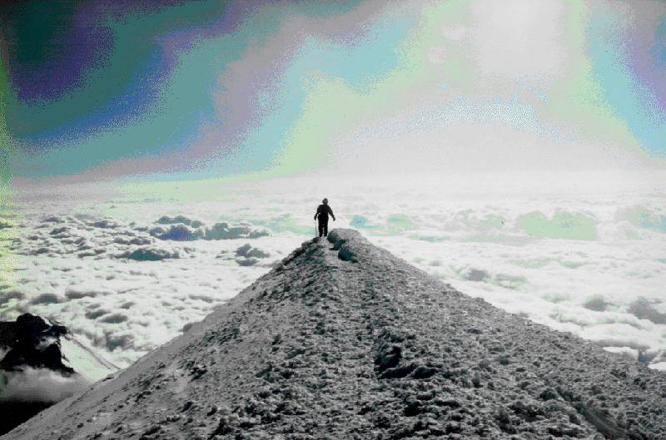
Mt. Blanc in the Alps
It’s the highest mountain in the Alps: 15,771 feet.

Slide 19
The alps
http://app.discoveryeducation.com/search?Ntt=the+alps

Slide 20
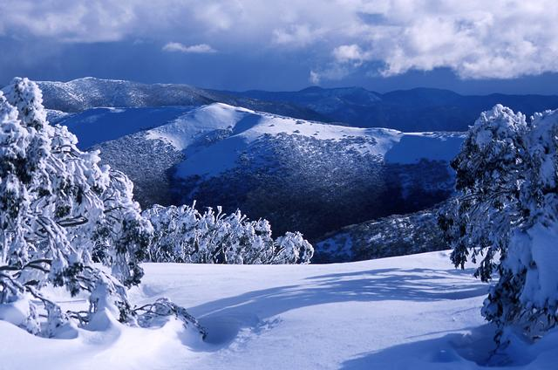

Slide 21
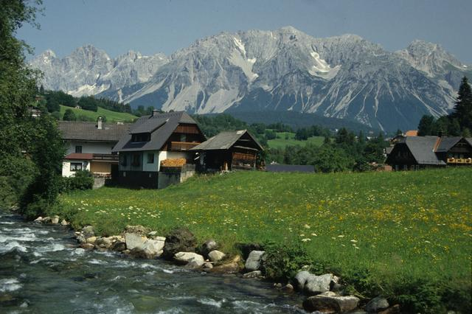

Slide 22
Pyrenees Mountains
The Pyrenees mountain range extends along the border between France and Spain. Most of the Pyrenees are in Spain.

Slide 23
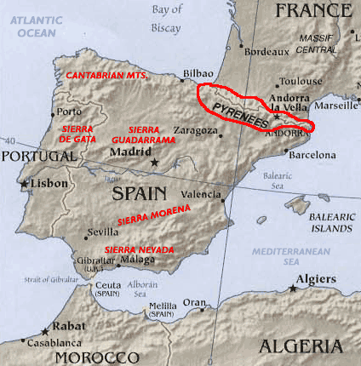

Slide 24
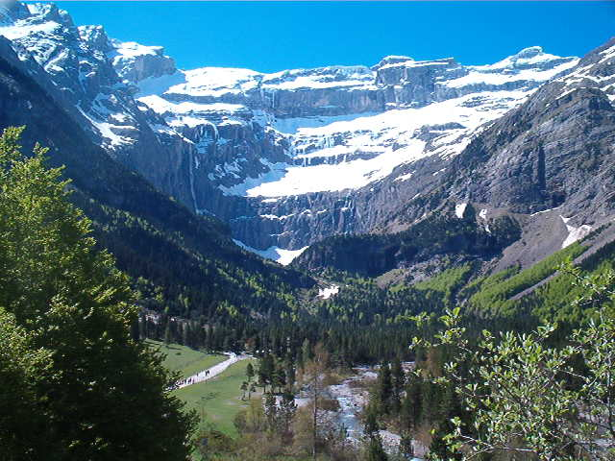

Slide 25
The pyrenees mountains
http://vimeo.com/48282976

Slide 26
Ural Mountains
The Ural Mountains in western Russia form the boundary between Europe and Asia.

Slide 27
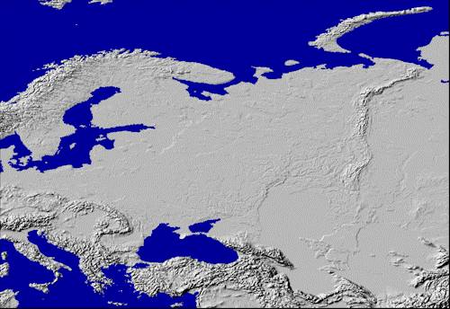
Ural Mountains: “The Great Divide”
1500 miles
It divides the European and Asian sections of Russia.

Slide 28
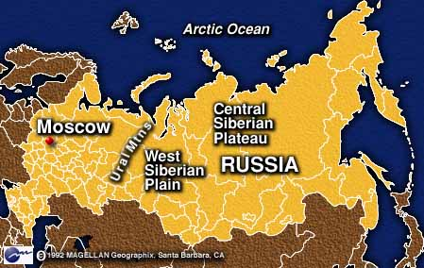

Slide 29
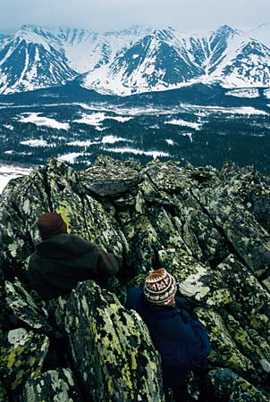

Slide 30
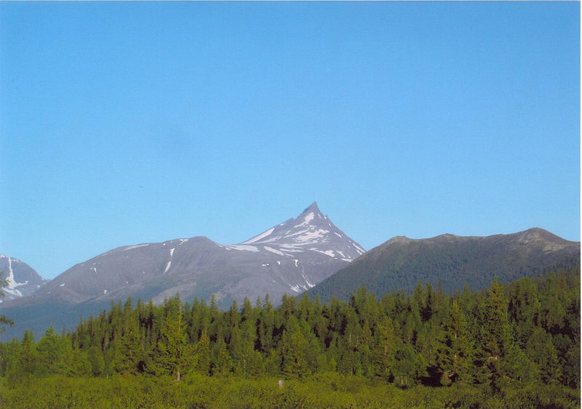

Slide 31
The English Channel
The English Channel is a narrow sea between Great Britain and France. In 1994, and underground rail tunnel called the “chunnel” was opened for transportation under the channel.

Slide 32
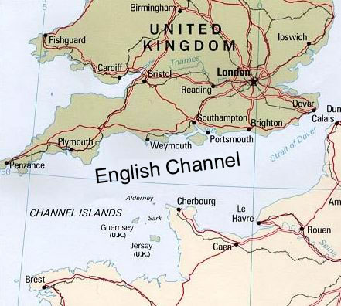

Slide 33
The english channel
http://www.youtube.com/watch?v=vGBnjM72WsA

Slide 34
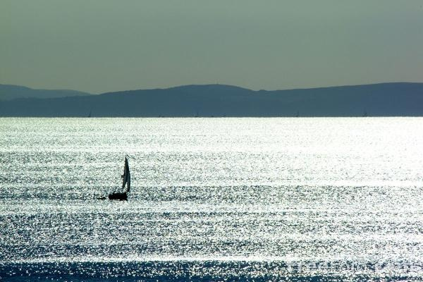

Slide 35
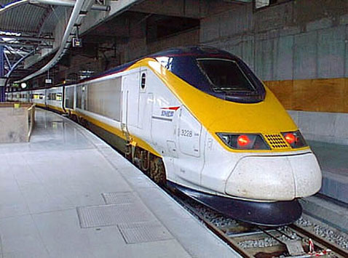

Slide 36
The english channel
http://www.youtube.com/watch?v=p8EUKn8hTcI

Slide 37
Iberian Peninsula
The Iberian Peninsula in southwest Europe contains Spain and Portugal. It is separated from the rest of Europe by the Pyrenees Mountains.

Slide 38
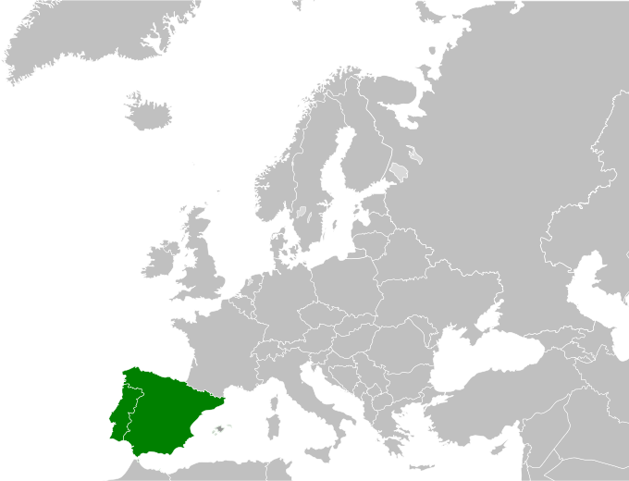

Slide 39
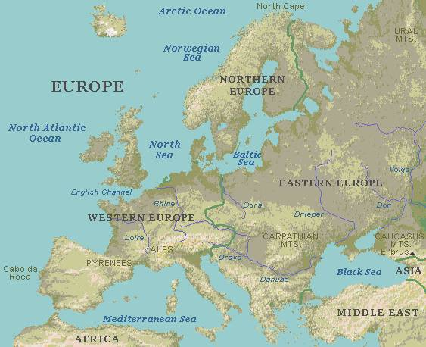
Southern Peninsulas
Crimean Peninsula
Iberian Peninsula
Italian Peninsula
Balkan Peninsula

Slide 40
Scandinavian Peninsula
The Scandinavian Peninsula in northern Europe is occupied by Norway and Sweden. This mountainous region is bordered on the north by the Barents Sea.

Slide 41
Scandinavian Peninsula

Slide 42
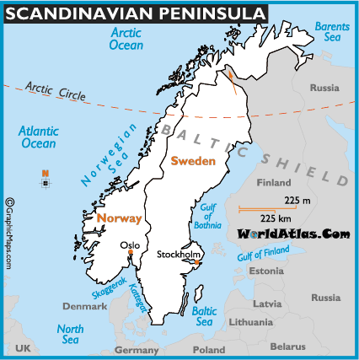
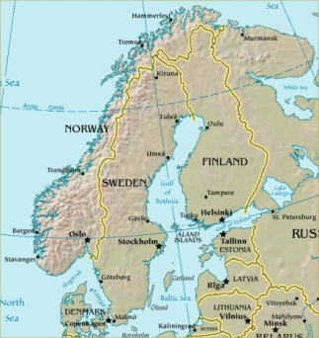

Slide 43
Mediterranean Sea
The Mediterranean Sea is the world’s largest inland sea, located between Europe, Africa, and Asia. The region around it has a dry, warm climate.

Slide 44
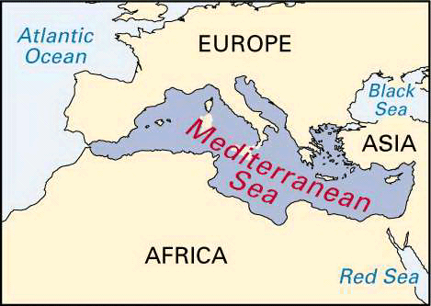

Slide 45
The mediterranean sea
http://video.nationalgeographic.com/video/places/parks-and-nature-places/oceans/oceans-mediterranean/

Slide 46
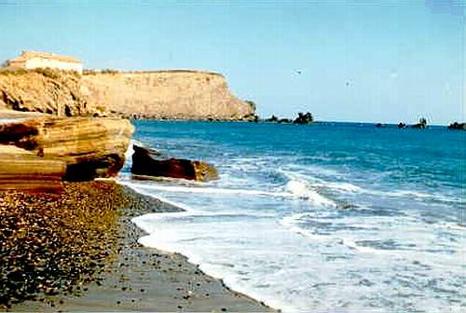

Slide 47
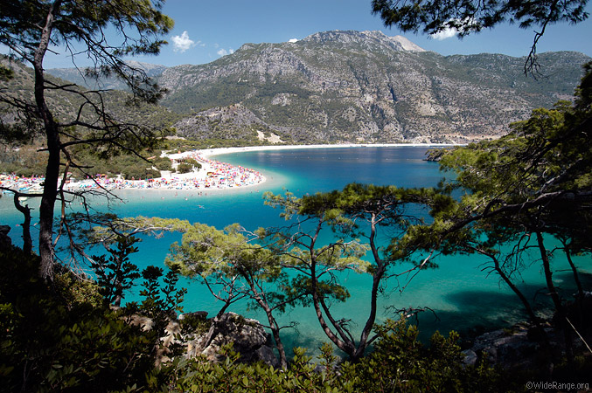

Slide 48
The European Plain
The European Plain is a vast, flat area that stretches across the northern part of Europe. This region has a rich farmland and some of the largest cities in Europe, like Paris, Berlin, and Moscow.

Slide 49
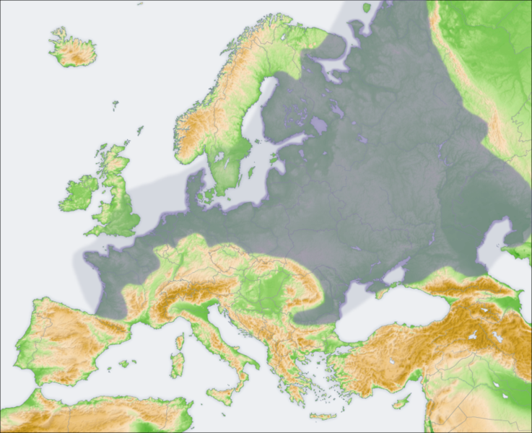
European Plain

Slide 50
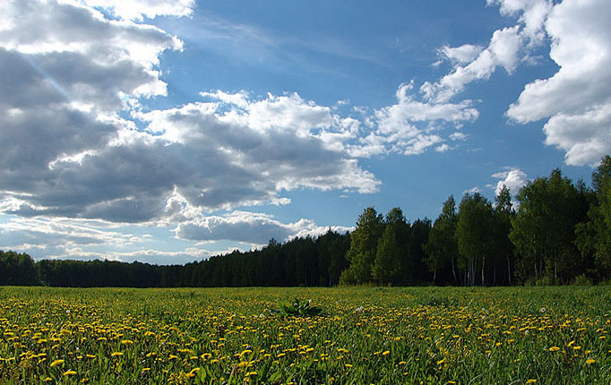

Slide 51
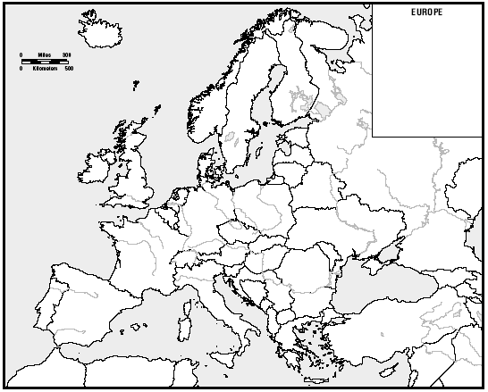
Northern European Plain

Slide 52
QUICK QUIZ
What mountain range separates Europe from Asia? __________________________
What peninsula is occupied by Spain and Portugal? __________________________
What body of water is between Europe, Africa, and Asia? _____________________
What river originating in the Alps has had a major influence on European history
and economics? ___________________________
5. What mountain range separates Spain and France? ___________________________
6. What peninsula contains Norway and Sweden? ______________________________
7. What body of water separates England from France? _________________________
8. What region of rich farmland stretches across the northern part of Europe? ________________________
Ural Mountains
Iberian Peninsula
Mediterranean Sea
Rhine River
Pyrenees
Scandinavian Peninsula
English Channel
European Plain

