Slide 1
Geography
Review:
Political &
Physical Features
Europe, Canada,
Latin America, & Australia

Slide 2
Standards
EUROPE
SS6G8 The student will locate selected features of Europe.
a. Locate on a world and regional political- physical map: the Danube River, Rhine River, English Channel, Mediterranean Sea, European Plain, the Alps, Pyrenees, Ural Mountains, Iberian Peninsula, and Scandinavian Peninsula.
b. Locate on a world and regional political-physical map the countries of Belgium, France, Germany, Italy, Poland, Russia, Spain, Ukraine, and United Kingdom.
CANADA
SS6G5 The student will locate selected features of Canada.
a. Locate on a world and regional political-physical map: the St. Lawrence River, Hudson Bay, Atlantic Ocean, Pacific Ocean, the Great Lakes, Canadian Shield, and Rocky Mountains.
LATIN AMERICA
SS6G1 The student will locate selected features of Latin America and the Caribbean.
a. Locate on a world and regional political-physical map: Amazon River, Caribbean Sea, Gulf of Mexico, Pacific Ocean, Panama Canal, Andes Mountains, Sierra Madre Mountains, and Atacama Desert.
b. Locate on a world and regional political-physical map the countries of Bolivia, Brazil, Colombia, Cuba, Haiti, Mexico, Panama, and Venezuela.
AUSTRALIA
SS6G12 The student will be able to locate selected features of Australia.
a. Locate on a world and regional political-physical map: the Great Barrier Reef, Coral Sea, Ayers Rock, and Great Victoria Desert.

Slide 3
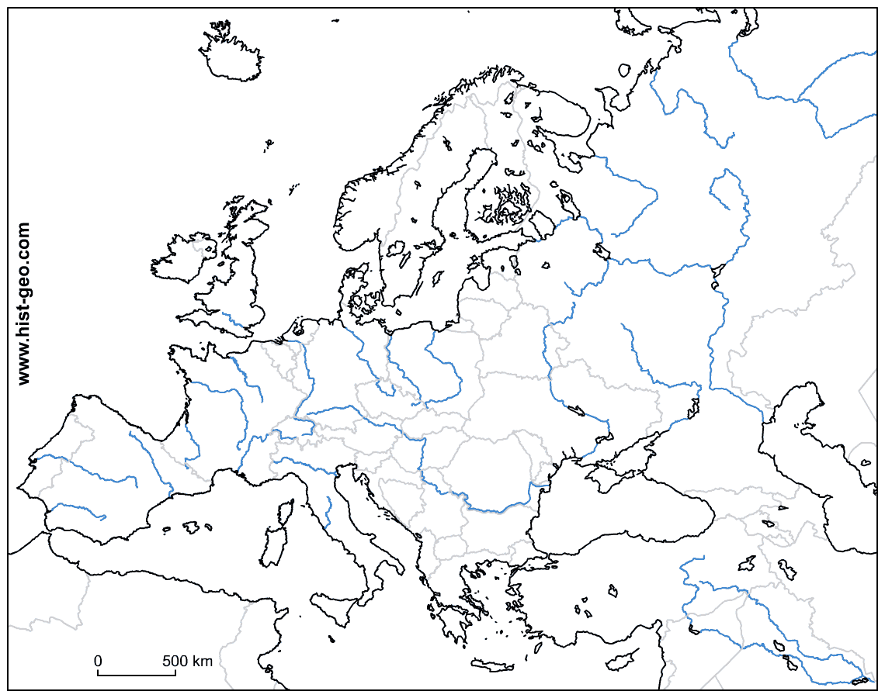
Europe
Your Task: Label the physical features that are numbered on the map of Europe below.
6
2
5
8
9
7
3
1
10
4

Slide 4
Europe
Your Task: Label the physical features that are numbered on the map of Europe below.
6
2
5
8
9
7
3
1
10
4
Alps
English Channel
Pyrenees
Mediterranean Sea
Ural Mountains
Scandinavian Peninsula
Iberian Peninsula
Rhine River
European Plain
Danube River

Slide 5
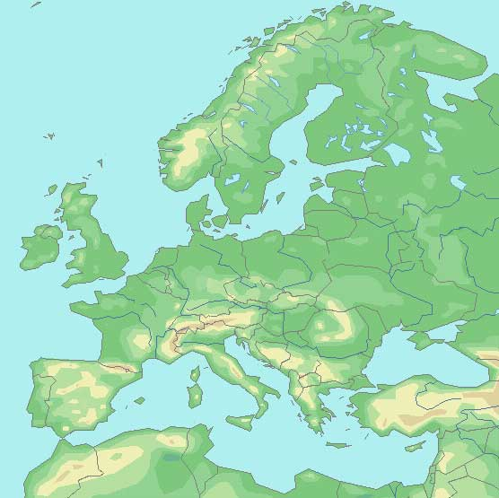
Europe
Your Task: Label the physical features that are numbered on the map of Europe below.
6
2
5
8
9
10
3
1
7
4

Slide 6
Europe
Your Task: Label the physical features that are numbered on the map of Europe below.
6
2
5
8
9
1
10
3
7
4
Alps
English Channel
Pyrenees
Mediterranean Sea
Ural Mountains
Scandinavian Peninsula
Iberian Peninsula
Rhine River
European Plain
Danube River

Slide 7
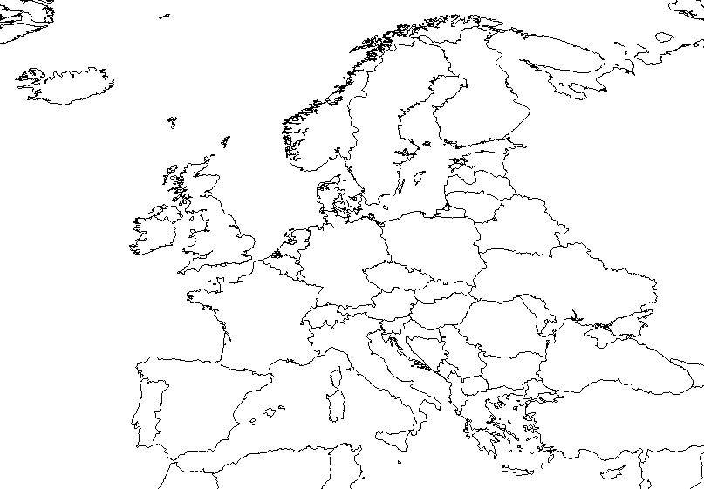
Europe
Your Task: Label the political features that are numbered on the map of Europe below.
6
2
3
9
8
5
1
7
4

Slide 8
Europe
Your Task: Label the political features that are numbered on the map of Europe below.
6
2
3
9
8
5
1
7
4
France
United Kingdom
Germany
Spain
Ukraine
Russia
Italy
Belgium
Poland

Slide 9
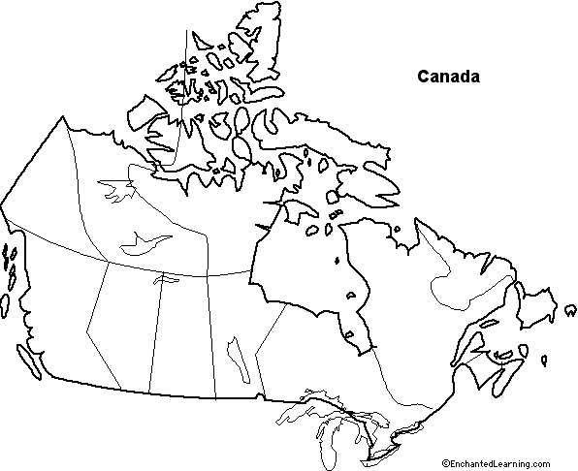
Canada
Your Task: Label the physical features that are numbered on the map of Canada below.
3
1
5
6
4
7
2

Slide 10
Canada
Your Task: Label the physical features that are numbered on the map of Canada below.
3
1
5
6
4
7
2
Rocky Mountains
Great Lakes
Hudson Bay
St. Lawrence River
Canadian Shield
Pacific Ocean
Atlantic Ocean

Slide 11
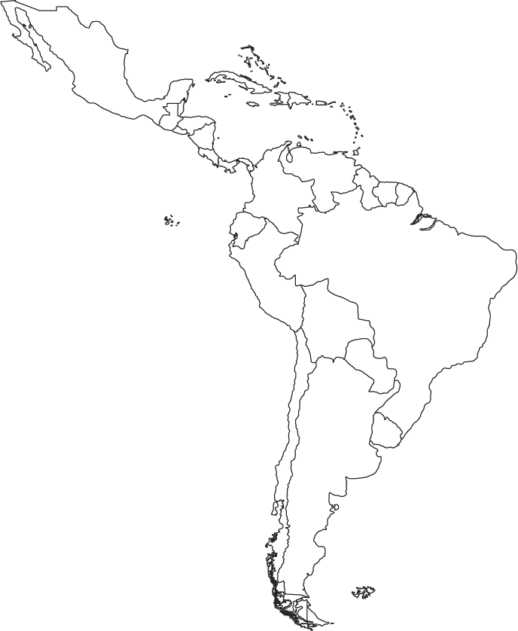
Latin America
Your Task: Label the countries that are numbered on the political map of Latin America below.
1
2
3
4
6
5
7
8

Slide 12
Latin America
Your Task: Label the countries that are numbered on the political map of Latin America below.
1
2
3
4
6
5
7
Mexico
Cuba
Haiti
Panama
Colombia
Venezuela
Brazil
Bolivia
8

Slide 13
Latin America
Your Task: Label the physical features that are numbered on the physical map of Latin America below.
2
1
3
4
6
5
7
8

Slide 14
Latin America
Your Task: Label the physical features that are numbered on the map of Latin America below.
2
1
3
4
6
5
7
8
Sierra Madre Mountains
Gulf of Mexico
Caribbean Sea
Panama Canal
Pacific Ocean
Amazon Rainforest
Andes Mountains
Atacama Desert

Slide 15
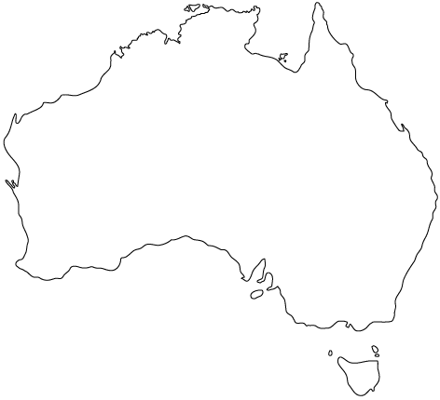
Australia
Your Task: Label the physical features that are numbered on the map of Australia below.
3
4
2
1

Slide 16
Australia
Your Task: Label the physical features that are numbered on the map of Australia below.
3
4
2
1
Great Victoria Desert
Ayers Rock
Coral Sea
Great Barrier Reef

Slide 17
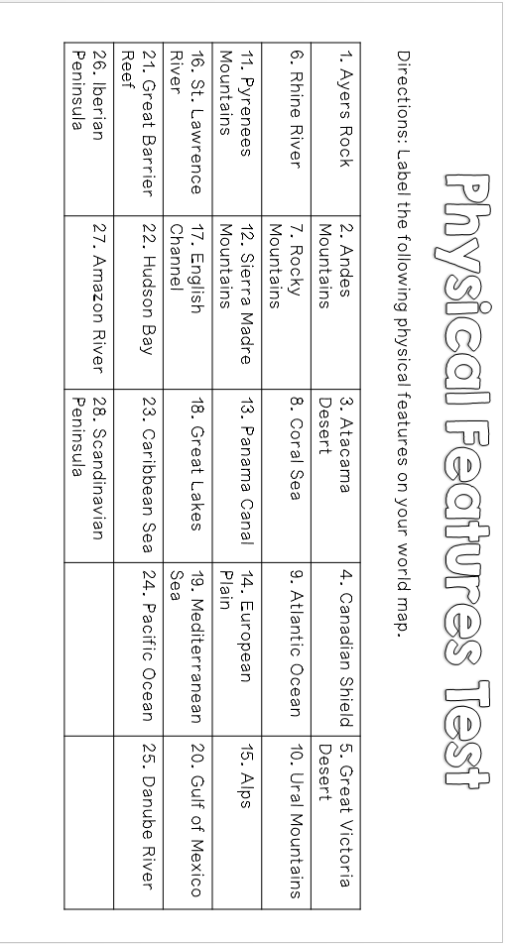

Slide 18
