Slide 1
Building Algebraic Expressions Day 1

Slide 2
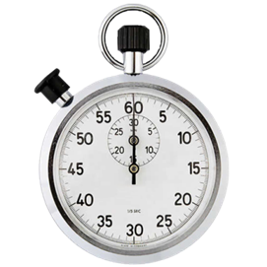
Warm Up
OBJECTIVE: We will identify independent & dependent variables and use them to write algebraic expressions for real-world scenarios. LANGAUGE OBJECTIVE: We will express verbally and in writing key vocabulary pertaining to variable expressions such as independent variable, dependent variable, and equation/expression.
At Billy’s Bowling Center, it costs $3.50 to rent a pair of bowling shoes, and $5 per game for each person. a) Copy and complete the table below to show the total cost for one person to rent shoes and play up to 3 games: b) Using words, numbers, and/or symbols, write a rule describing how to find the cost for any number of games played.
Answers
Agenda
Notes:
(5 min) 5 minutes
In-Class Notes
Allow students to complete this warm up according to your regular “do now” routine. Click the stopwatch if you want to project the time limit for students.
Recommended: teacher/student reads the scenario and questions aloud. Clarify and student questions on the directions, but instruct students to try it out giving minimal guidance.
Once students are ready, click “SOLUTION” at lower right of slide.
Preparation Notes
Note that, while writing tables to match scenarios is not the focus of this lesson, it is a habit that is encouraged and practiced across many of the EE strand lessons (and beyond). Feel free to give the appropriate level of guidance to your students in regard to creating/using tables.

Slide 3
Warm Up REVIEW
At Billy’s Bowling Center, it costs $3.50 to rent a pair of bowling shoes, and $5 per game for each person.
b) Possible “Rule” for finding Total Cost:
$8.50
$13.50
$18.50
shoes paid for first = $3.50 + 1 game x $5 per game = $5.00 TOTAL $8.50
shoes paid for first = $3.50 + 2 games x $5 per game = $10.00 TOTAL $13.50
shoes paid for first = $3.50 + 0 games x $5 per game = $0 TOTAL $3.50
shoes paid for first = $3.50 + 3 games x $5 per game = $15.00 TOTAL $18.50
“$3.50 plus $5 times the number of games played” or “Multiply $5 by the number of games you play, and add $3.50 for the shoes.”
5 • (# of games) + 3.50 = Total Cost
T = $3.50 + 5g
Agenda
Notes:
(5 min) 10 minutes
In-Class Notes
Before clicking to reveal answers, ask for student volunteers to show their work on the board! Your class may engage in a better discussion through these means than through just clicking to review answers.
For part (b), follow same process; allow for a few different student answers and dialogue among the class on a rules that work. Mention that a rule can be written in any way that makes sense, and accept various types of answers that work. If student(s) share an answer that does not work, let students talk it out—why does it not work? If you like, click to reveal possible answers. Then move on to the lesson.
Preparation Notes
Note that, while writing tables to match scenarios is not the focus of this lesson, it is a habit that is encouraged and practiced across many of the EE strand lessons (and beyond). Feel free to give the appropriate level of guidance to your students in regard to creating/using tables.

Slide 4
Launch
Remember…
A variable is a letter or symbol that represents an unknown number. They change (or VARY)!
We can make up any variables to match a given situation! Ex. (from Warm-up) g = games played T = total cost
These variables become useful to write algebraic “rules” or equations!
T = 5g + 3.50
Many situations have an INDEPENDENT variable & a DEPENDENT variable. Can you guess which is which here?
What does each part of this expression represent???
Total cost
+
=
$5 per game
Shoe rental
Agenda
Notes:
(3 mins) 15 minutes
In-Class Notes
The upper portion of this slide should serve as simply a reactivator of prior knowledge for students.
Remind the kids of the scenario if needed, or ask a student to recall it aloud for the class: The bowling alley charges $3.50 for shoe rentals and $5 per game.
Click as appropriate to reveal next part and question. This may be the first discussion about independent and dependent variables for your students. If you have ELL students in your classroom, take a moment before moving on to next slide to go over the word meanings according to your routines to ensure understanding.
Next slide continues this question with the “turn and talk”.

Slide 5
Launch
TURN & TALK: 1 minute
Which statement is true? a) The number of games bowled DEPENDS ON the total cost.
-or- b) The total cost DEPENDS ON the number of games you bowl.
Partner up with a classmate next to you, say what you think and explain why! You each have 30 seconds.
Answer
Agenda
Notes:
(3 mins) 18 minutes
In-Class Notes
Read over the task, click the timer, set for 1 min and say “GO” as you start it.
At 30 sec mark, announce “SWITCH if you haven’t yet!”
Once buzzer sounds, ask for volunteers to share their partner’s thoughts. Get a clear vote around the room if you can quickly. Hold students to sharing each other’s rationale, not just the answer!
When ready, click to reveal the correct answer (b). Then be
Preparation Notes
Some common misconceptions for students may arise at this time that you will need address if confusion occurs with determining which “depends on” what. The primary misconception may be specific to this particular bowling example—some students could perceive that you will play only a certain number of games based on what you can afford, in which case they’d be inclined to choose “a” as an answer. Explain that this is good rational thinking that is commonly used, but for the way the do-now question was worded, the cost MUST depend on games (since no mention was made in the question about needing to pick how many games you play based on the money you have with you.)
A second pitfall to consider is that some students, particular ELL students, may need assistance understanding the word “depend”. Please plan accordingly for translations and reword as needed to help students full grasp the concept.

Slide 6
Launch
TURN & TALK: 1 minute
Dependent Variable “T”
Independent Variable “g”
Which statement is true? a) The number of games bowled DEPENDS ON the total cost.
-or- b) The total cost DEPENDS ON the number of games you bowl.
Partner up with a classmate next to you, say what you think and explain why! You each have 30 seconds.
Agenda
Notes:
(with previous) 18 minutes
In-Class Notes
Read over the task, click the timer, set for 1 min and say “GO” as you start it.
At 30 sec mark, announce “SWITCH if you haven’t yet!”
Once buzzer sounds, ask for volunteers to share their partner’s thoughts. Get a clear vote around the room if you can quickly. Hold students to sharing each other’s rationale, not just the answer!
When ready, click to reveal the correct answer (b). Then be
Preparation Notes
Some common misconceptions for students may arise at this time that you will need address if confusion occurs with determining which “depends on” what. The primary misconception may be specific to this particular bowling example—some students could perceive that you will play only a certain number of games based on what you can afford, in which case they’d be inclined to choose “a” as an answer. Explain that this is good rational thinking that is commonly used, but for the way the do-now question was worded, the cost MUST depend on games (since no mention was made in the question about needing to pick how many games you play based on the money you have with you.)
A second pitfall to consider is that some students, particular ELL students, may need assistance understanding the word “depend”. Please plan accordingly for translations and reword as needed to help students full grasp the concept.

Slide 7
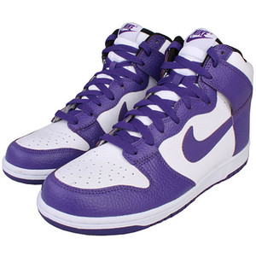
Launch: Guided Practice
Let’s try a few more! Identify the variables in each scenario and explain how they are related. Label the independent and dependent variables.
1) Stephanie is saving money to buy new sneakers. She plans to save $10 each week.
The amount of money DEPENDS ON the weeks going by!
Dependent Variable
Independent Variable
Nice work! Now, let’s write a rule to match this story.
What are the variables? (What is changing??)
Which variable depends on the other to change?
RULE:
m = 10w
“money saved is equal to $10 times the number of weeks”
Agenda
Notes:
(5 min) 23 minutes
In-Class Notes
Read over directions, then click to reveal the question. After you or a student reads the question, the teacher icon will appear to guide student thinking. This scaffolding will be provided for the first 2 questions; it is recommended you continue to encourage the same process for each question.
Give students time to identify the variables, then click again to reveal the highlighting.
Once next guiding question is revealed, poll students for answers– does money depend on weeks, or do the weeks depend on money? Which is the dependent variable, which is independent?
Click reveals answer, then prompts students to think about how to write a rule or expression for this story. Allow students to brainstorm this for a moment, alone or in a small group, then click to show answer.
Pause to acknowledge the patterns that occur when writing a rule—it’s easy to place the dependent variable all by itself on one side of the equal sign, then show what happens to the independent variable on the other side.

Slide 8
Launch: Guided Practice, continued
Identify the variables in each scenario and explain how they are related. Label the independent and dependent variables.
2) To train for track season, Alex is running 2 miles per day. He has run 10
miles already.
Miles DEPEND ON the days going by!
Dependent Variable
Independent Variable
Which variable depends on the other to change?
Write a rule to match this story.
What are the variables? (What is changing??)
RULE:
m = 2d + 10
“miles ran is equal to 2 times the number of days plus 10 he already ran”
Agenda
Notes:
(4 min) 27 minutes
In-Class Notes
Read over directions, then click to reveal the question. After you or a student reads the question, the teacher icon will appear to guide student thinking. This scaffolding will be provided; it is recommended you continue to encourage the same process for each question.
Give students time to identify the variables, then click again to reveal the highlighting.
Once next guiding question is revealed, poll students for answers– do miles depend on days, or do the days depend on miles? Which is the dependent variable, which is independent?
Click reveals answer, then prompts students to think about how to write a rule or expression for this story. Again, allow students to brainstorm this for a moment, alone or in a small group, then click to show answer.

Slide 9
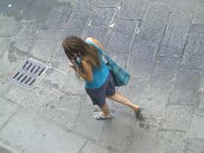
Launch: Guided Practice, continued
Identify the variables in each scenario and explain how they are related. Label the independent and dependent variables.
3) Maya is walking to her friend’s house. She walks at a rate of 6 km each hour.
The number of kilometers DEPENDS ON the hours she walks!
Dependent Variable
Independent Variable
You’ve got it!
Try the same procedure on your own.
RULE:
k = 6h
“kilometers walked is equal to 6 times the number of hours she walks”
Agenda
Notes:
(4 min) 31 minutes
In-Class Notes
Read over directions, then click to reveal the question. After you or a student reads the question, the teacher icon will appear, but this time without the prompts to scaffold. Remind students of the procedure only if needed: pick out the variables in the story, decide which one depends on the other to change, and write a rule to describe the relationship between the variables.
Give students time to identify each part of the process, and have volunteers show their work in the board. Then click to reveal answers. Accept and discuss any variations in the rules students write, such as being able to choose any variables to represent the words—for example, using “d” for distance instead of “k” for kms.
Since this is the first unscaffolded question, stop after to check in with students on their understanding of the process!

Slide 10
Launch: Observations
What do you notice about TIME as a variable in scenarios?
TIME tends to be the independent variable!
Seconds, minutes, hours, days, weeks, months, years…
In many real-life situations, things change as TIME passes! Ex: height, distance, speed, money earned, items sold, etc. all can change over time!
Agenda
Notes:
(3 min) 34 minutes
In-Class Notes
Take a moment to poll the students on the first observational question. If they need reminders, quickly scroll back to each guided practice slide so they can have another look.
The aim is for students to notice that TIME was the independent variable in all 3 of the guided practice questions.
Click to reveal this observation after your brief discussion
Allow students to make conjectures as to WHY this is the case—what is special about time? Poll them!
Click to reveal, discuss how this aligns with students’ thinking. Make sure everyone understands that time is a popular independent variable, because time often ‘causes’ change in other things!

Slide 11
Launch: Observations, continued
4) Miguel spends about 40 minutes doing homework for every class he is in.
Minutes spent on homework DEPEND ON the number of classes!
M = 40c
Dependent Variable
Independent Variable
NOPE,
not always!
Is TIME always an Independent variable?
Agenda
Notes:
(3 min) 37 minutes
In-Class Notes
This is an example where time is not the independent variable, to make a point that we always need to think about it carefully and consider which variable depends on the other based on the scenario!
Instruct students to follow the same procedures to identify the variables and relationship between them, then click to reveal answers.
For the sake of one more practice problem, have students come up with the expression as well, before moving on to the Explore classwork.

Slide 12
Explore
CLASSWORK: “Variable Relationships & Expressions for Scenarios”
Agenda
Notes:
(20 min) 57 minutes
In-Class Notes
Pass out the classwork: “Variable Relationships and Expressions for Scenarios”
Set parameters—I recommend allowing students to work in pairs/small groups to complete the assignment
Announce how much time you will be giving to students to complete the CW (about 20-25 minutes should suffice), then click the stopwatch to set the timer. If your class blocks are short and another day is needed, use discretion for if you will ask the students to complete the rest of this assignment as HW, and give the other HW supplied with this lesson the following day.
Circulate and confer with students as they work, but give very little help as possible to keep rigor high! Note any common misconceptions as you make your way around the room
When timer sounds, proceed to next slide to address common confusions and review any questions the students may need additional class discourse on.
Preparation Notes
Make copies of the classwork for distribution.

Slide 13
Summary
This is your time for you and your learning partner(s)
to share out…
• Questions about anything on the classwork
• Any confusions you had as you worked
• Patterns you may have noticed or idea you have now
• Problems you found especially easy or difficult
Agenda
Notes:
(10 min/as needed) 67 minutes
In-Class Notes
Use your normal routines around students sharing out their confusions for any of the problems on the CW, or about the concepts in general—have electronic CW ready to project onto the board as well.
Allow for as much time as your class needs, but try to allow 5-8 mins left in the class for the Exit Ticket.
Preparation Notes
Please have calling sticks ready to randomize how you will have groups share out this information. If possible, have most or every group share out to hold students responsible for reflecting on the process.

Slide 14
Assessment: EXIT TICKET!
In your own words, define Independent Variable and Dependent Variable.
On average Natalie can type 87 words for every minute. 2a) Identify the INDEPENDENT and DEPENDENT variable. 2b) Write a rule or expression to match the scenario.
Agenda
Notes:
(6 min) 73 minutes
In-Class Notes
Ask students to take out a blank piece of paper, or distribute the paper. Instruct them to write their name, date, and “exit ticket” at the top.
Remind students that Exit Tickets are to be done ‘solo’ –eyes on own papers only please
This should only take 5-8 minutes to complete—leave enough time (a minute or two) for students to receive the HW before the end of class!
Preparation Notes
Have an extension question provided in the lesson materials (or one of your own!) ready for students who breeze through this exit ticket quickly!

Slide 15
Practice
Please complete HW 6.EE.9, due tomorrow!
Agenda
Notes:
(2 min) 75 mins
In-Class Notes
Distribute the HW
Preparation Notes
Change due date if needed.

Slide 16
Dependent and Independent Variables – Day 2

Slide 17
Vocabulary
An independent variable is one that is not influenced by another variable.
The value of a dependent variable relies on the values of the independent variable.

Slide 18
Example
Frank earns $8 per hour mowing his neighbors' lawns.
The amount of money he earns m,
depends on how many hours he works h.
The more hours he works, the more money he earns.
Therefore the dependent variable is money m,
and the independent variable is hours h.
The amount of hours he works does not rely on the money he earns.

Slide 19
Try to guess the missing variable.
Dependent Variable | Independent Variable
Cell phone bill
How far you can drive
Your Nine Weeks grade
How much money you earn
Cost of a speeding ticket
Time it takes to drive somewhere
How much air conditioning you use
Total calories and fat
Opportunities for high-paying jobs
Results of a football game
With your group, try to think of at least three examples of independent and dependent variables?

Slide 20
4
The number of tickets I can buy depends on how much money I have.
A
True
B
False
Notes:
Answer: True

Slide 21
The number of tickets I can buy depends
on how much money I have.
5
So which value is the independent variable?
A
amount of money
B
number of tickets
Notes:
Answer: A

Slide 22
6
It costs $4.25 to rent a movie. The amount of money I spend depends on how many movies I rent.
So the dependent variable is the number of movies I rent.
A
True
B
False
Notes:
Answer: True

Slide 23
7
The older I get, the taller I am.
My height is the...
A
Independent Variable
B
Dependent Variable
Notes:
Answer: B

Slide 24
8
The more people I have at my party, the more brownies I need to bake. The number of people at my party is the...
A
Independent Variable
B
Dependent Variable
Notes:
Answer: A

Slide 25
Equations and Tables

Slide 26
The relationship between dependent and independent variables can be represented with a table.
Independent | Dependent
Input | Output
The independent variable is always in the left column, and the dependent variable is always in the right column.
The relationship between independent & dependent variables and input & output works like a machine.

Slide 27
The value of n is the input.
Given the value for n, find the output using the given rule.
Input
Output
n
2n
20
40
100

Slide 28
The manager of the department store raised the price $15 on each video game.
Original price
Price after mark up
$100
$55
$38
x
Notes:
Teacher’s instructions: The price after mark up is $15 more, so the expression which satisfies the situation is x +15.

Slide 29
A parent wants to figure out the differences in grade level of her two sons. The younger son is two years behind the older one in terms of grade level.
older son's
grade level
younger son's
grade level
6
10
2
g
Notes:
Teacher’s instructions: The expression is g - 2 because the younger child is two years less than the older child's grade level.

Slide 30
Tables can be used to represent equations.
The table below represents the equation
y = x + 3.
x | y
3 | 6
4 | 7
6 | 9
The output (y) depends on the input (x).
So x is the independent variable, on the left,
and y is the dependent variable, on the right.

Slide 31
This table represents the equation
t = n + 11
Find the values for t, given the values for n.
n
t
10
28
40

Slide 32
This table represents the equation
y = x - 60
Find the values for y, given the values for n.
x
y
80
120
180

Slide 33
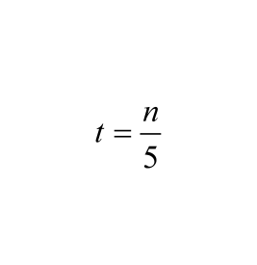
This table represents the equation
Find the values for t, given the values for n.
n
t
20
40
80

Slide 34
This table represents the equation
y = 2x
Find the values for y, given the values for x.
x
y
20
40
100

Slide 35
Equations and tables can also be used to represent real-life information mathematically.
Natalie is going ice skating.
The skating rink charges $6.25 per hour of skating.
We will let h represent the number of hours of skating and c represent the total cost.
Equation: c = 6.25 h
hours (h) | cost (c)
1 | $6.25
2 | $12.50
3 | $18.75

Slide 36
Mary's age is twice the age of Jack.
Can you think of an algebraic equation which
determines Mary's age (m), given Jack's age (j)?
Jack's Age
Mary's Age
12
14
24
a
Notes:
Teacher’s in.structions: Mary is "2 times" Jack's age. m = 2j

Slide 37
The manager of the department store raised the price $15 on each video game.
Can you find an equation that will satisfy the total cost of the video game (t) if given the original price (p)?
Original price (p)
Price after mark up (t)
$100
$55
$38
x
Notes:
Teacher’s instructions: The price after mark up is $15 more, so the equation which satisfies the situation is
t = p + 15.

Slide 38
9
Henry downloads songs into iTunes. The amount of time it takes him to download a song depends on the song's file size.
Which is the independent variable?
A
Download time
B
File size
Notes:
Answer: B

Slide 39
10
If it takes 50 seconds to download one megabyte, which equation represents this scenario ? Use the variable t for download time and s for file size.
A
s = 50t
B
t = 50s
C
50 - s = t
Notes:
Answer: B

Slide 40
11
Which table represents the equation t = 50s ?
A
B
s | t
200 | 4
100 | 2
50 | 1
s | t
4 | 200
5 | 250
6 | 300
C
D
s | t
200 | 150
100 | 50
50 | 1
s | t
1 | 51
2 | 52
3 | 53
Notes:
Answer: B

Slide 41
12
Find the missing value in this table.
It takes Jonathan 6 minutes to run a mile. Let t represent the number of minutes and d represent the number of miles.
(t) | (d)
6 | 1
18 | ?
Notes:
Answer: 3

Slide 42
13
Use the equation y = 5x to complete the table.
x | y
20 | ?
? | 150
50 | ?
A
?= 4 ?= 30 ?= 250
B
?= 4 ?= 30 ?= 10
C
?= 100 ?= 30 ?= 250
D
?= 100 ?= 3 ?= 10
Notes:
Answer: C

Slide 43
Graphing Equations

Slide 44
You have learned that equations and tables are two ways to represent real-life scenarios.
Equations and tables can also be graphed to represent a real-life scenario.
Example:
A cafeteria has an automatic waffle-making machine. The table shows the relationship between the time in hours (x) and the number of waffles the machine can make (y).
(x) | (y)
1 | 50
2 | 100
3 | 150
4 | 200
5 | 250

Slide 45
The equation for this scenario is
y = 50x
Each hour, 50 waffles are made.
(x) | (y)
1 | 50
2 | 100
3 | 150
4 | 200
5 | 250
The value of y depends on the value of x.
y is dependent x is independent
This scenario can be represented with a graph.
When graphing:
The independent variable is always across the x axis.
The dependent variable is always up the y axis.

Slide 46
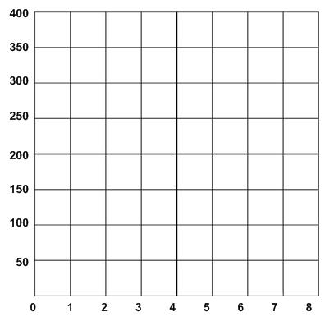
Once you have represented the equation in a function table, you can utilize the independent and dependent variable values as coordinates.
Plot the coordinates from the table below to graph the scenario.
Time (x) | Waffles Made (y)
1 | 50
2 | 100
3 | 150
4 | 200
5 | 250

Slide 47
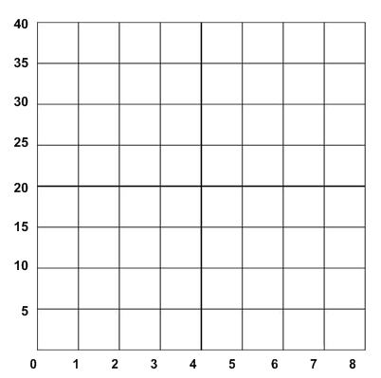
A bookstore is running a special and
is charging $5 for any childrens' book.
1. Write an equation to represent the scenario.
2. Complete the table to represent the scenario.
3. Graph the function.
# of Books (x) | Total Cost (y)
1

Slide 48
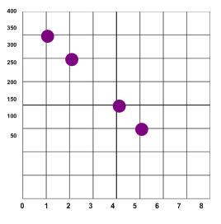
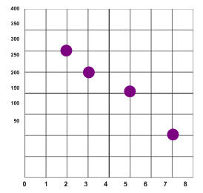
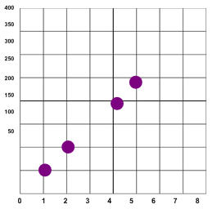
14
A plane descends at a rate of 50 feet per minute. Which graph represents this scenario?
A
B
C
Notes:
Answer: A

Slide 49
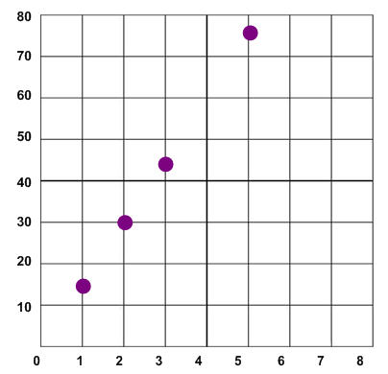
15
Which scenario does the graph represent?
A
Mia earns $12 per hour.
B
The river rose at a steady rate of 15 feet per hour.
C
The stock value decreased by $.50 per minute
D
The plane traveled 300 miles per hour.
Notes:
Answer: B

Slide 50
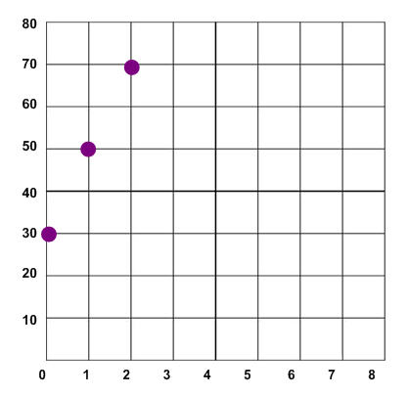
16
Which scenario does the graph represent?
A
Tia starts out with $30. Every hour Tia earns an additional $20.
B
Tia starts out with $50. Every minute she spends $5.
C
Tia runs a mile every 20 minutes.
Notes:
Answer: A

Slide 51
17
A dogwood tree grew at the rate of 4 feet per year. Which table represents the relationship between the height of the tree (h) and the number of years (t)?
A
B
t | h
t | h
t | h
1 | 4
2 | 5
3 | 6
t | h
1 | 4
3 | 12
5 | 20
C
D
t | h
5 | 1
10 | 2
15 | 3
t | h
4 | 1
8 | 2
12 | 3
Notes:
Answer: B

Slide 52
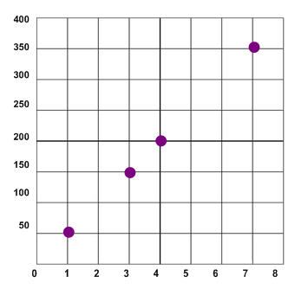
18
The table and graph represent which equation?
minutes (x) | 1 | 3 | 4 | 7
# of words typed (y) | 50 | 150 | 200 | 350
A
y = 50x
B
50y = x
C
y = x - 50
D
y = x + 50
Notes:
Answer: A

