Slide 1
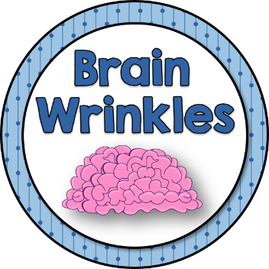
The European
Union
© 2014 Brain Wrinkles

Slide 2
The European Union
© 2014 Brain Wrinkles

Slide 3
The European Union
The purpose of the EU is for its members to work together for advantages that would be out of their reach if each were working alone.
The EU believes that when countries work together they are a more powerful force in the world because they involve:
more money,
more people,
and more land areas.
This helps make small countries more competitive in the world market.
© 2014 Brain Wrinkles

Slide 4
The US is much larger than separate European countries.
When the EU countries combine, they have more people and a larger economy, and they can compete in a global economy.
 | European Union | United States
Land Area (approx.) | 1,500,000 | 3,700,000
Population (approx.) | 500,000,000 | 305,000,000
Gross Domestic Product | $15.65 trillion | $15.29 trillion
GDP Per Capita | $34,500 | $49,000
© 2014 Brain Wrinkles

Slide 5
What’s the Big Deal?
The European Union does NOT handle all the government business for the members.
(It is a confederation.)
Each country still makes its own laws, has a military, and elects its leaders.
© 2014 Brain Wrinkles

Slide 6
Member Benefits
Members may use a common currency (euro) that makes trade easier.
EU works to improve trade, education, farming, & industry among its members.
1. No tariffs (taxes) among member countries – free trade zone
2. Citizens of one country can move freely to another country
3. Citizens can live and work in any other EU nation
4. Citizens can vote in local elections even if they aren’t citizens of the country
© 2014 Brain Wrinkles

Slide 7
The Euro
The euro is the currency of MOST EU countries.
Member countries can choose to give up their own currency and exchange it for euros.
For example, French francs and German marks have been replaced by the euro.
A common currency makes trade between the countries much easier and less expensive.
12 countries in the EU do not use the euro.
For example, the United Kingdom has decided to continue to use the British pound.
© 2014 Brain Wrinkles

Slide 8
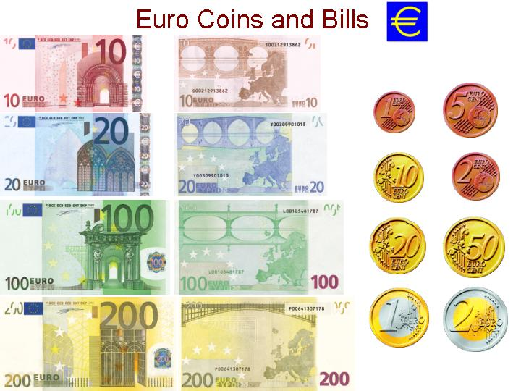
© 2014 Brain Wrinkles

Slide 9
EU Members 2014:
Austria | Belgium | Bulgaria | Croatia
Cyprus | Czech Republic | Denmark | Estonia
Finland | France | Germany | Greece
Hungary | Iceland | Italy | Latvia
Lithuania | Luxembourg | Malta | Netherlands
Poland | Portugal | Romania | Slovakia
Slovenia | Spain | Sweden | United Kingdom
© 2014 Brain Wrinkles

Slide 10
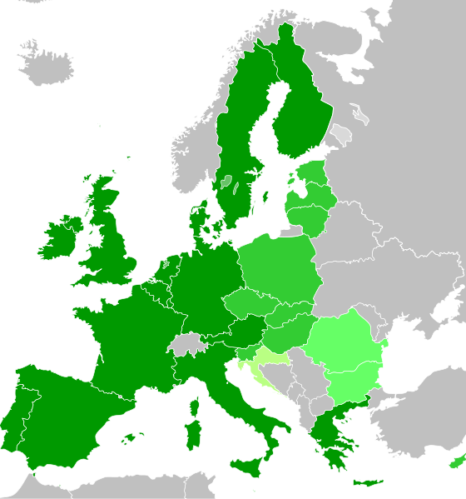
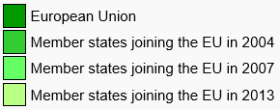
There are currently 28 members of the European Union. Croatia is the newest member; the country joined the EU in July 2013.
© 2014 Brain Wrinkles

Slide 11
Non-Members
There are several countries that are NOT EU members, including Turkey, Switzerland, Iceland, & Russia.
WHY?
Turkey’s culture (98% Muslim), stability, and location to the Middle East causes some EU members to not want Turkey to join.
Switzerland has one of the world’s highest standards of living and prefers its economy to not be regulated under the EU.
The EU has strict limits on the fishing industry, and Iceland does not want the EU’s control on its most important economic activity.
Russia prefers to be an independent world leader over its own resources and economy.
© 2014 Brain Wrinkles

Slide 12
To Join or Not?
Do you think it’s beneficial for countries to join the EU?
Let’s read an article and see if it will help you make your decision.
http://www.timeforkids.com/news/trouble-greece/18601
© 2014 Brain Wrinkles

