Slide 1
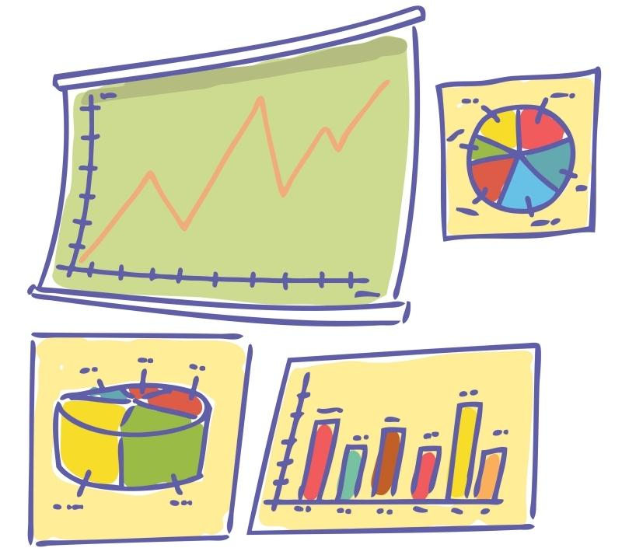
Statistics
Although you will encounter many fields of math (algebra, geometry, trigonometry, even calculus!) during your life, statistics is the field that you will likely encounter most often. In reality, we are exposed to statistics every single day!

Slide 2
Asking Statistical Questions!
Statistical questions:
How old are the students in my school?
How many pets are owned by each student in my class?
What is the height of each person in my class?
How many letters are in the name of each person in my class?
Non-statistical questions:
How old am I?
How many pets do I own?
What is my math test score?
What is my favorite type of cupcake?
What is my height?

Slide 3
Data
Facts and information collected together to try to learn something new!

Slide 4
Distribution of Data/Overall Shape
The shape that data makes when it is placed on a number line or graph.
The graph will often have a “cluster” of data in one area, a "gap" of data in another place, and sometimes an "outlier", or piece of data that is much larger or smaller than the other numbers.

Slide 5
Center of Data
The middle of the data expressed with a single number.
here are two great ways to do this...
1. Mean: The "mean" is the "average" you're used to, where you add up all the numbers and then divide by the number of numbers.
2. Median: The "median" is the "middle" value in the list of numbers. To find the median, your numbers have to be listed in numerical order, so you may have to rewrite your list first.

Slide 6
Spread/Variation
A way to look at how spread out the data is...
1. Range: The “range” is the difference between the largest and smallest number in the list.
2. Mean absolute deviation: An average of how far each data point in a set is from the mean of the set of data. The "Average" of the "Average" (see next slide)

Slide 7
Mean absolute deviation
An average of how far each data point in a set is from the mean.

Slide 8
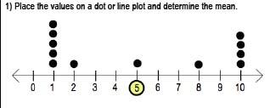
Alternate method for mean absolute deviation

Slide 9
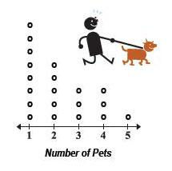
Dot Plot
A graph where each piece of data is shown as a dot above the number line.

Slide 10
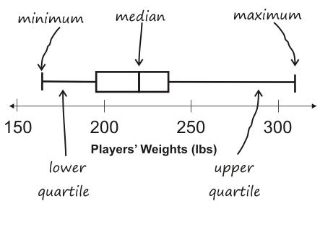
Box Plot
A graph that visually displays the data using median, quartiles and extremes on a number line!

Slide 11
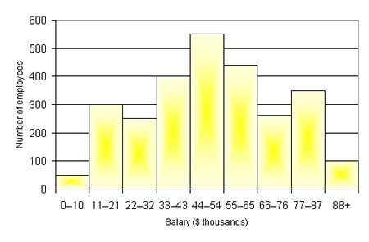
Histogram
A data display where the labels for the bars are in numeric intervals.

Slide 12
Population
The complete set of individuals from which data is collected.
Name the population:
Shaddox/Strong students’ favorite project of the year
Average height of 12 year olds
Math grades of middle school females in the HTH Village.

Slide 13
Sample
A portion, piece, or segment of the individuals from which data is collected... because sometimes you can't ask everyone!!!

