Slide 1
Introduction to Inequalities in the Real World

Slide 2
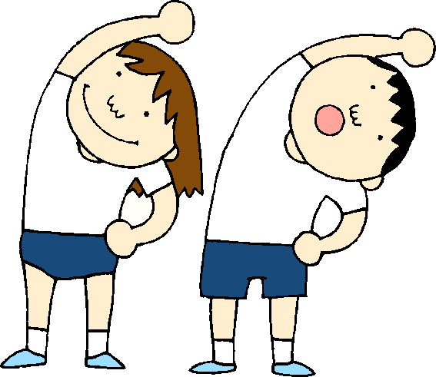
Warm Up
OBJECTIVE: SWBAT translate real-world situations into mathematical statements using inequalities and variables. Language Objective: Students will define and give examples of real-world situations that have infinitely many answers.
A set has the following values: {2, 4, 6}. Which of the values in this set make the inequality below true? Show your work!
2x + 6 > 12
Hint: Use substitution!
2x + 6 > 12
2(2) + 6 > 12
4 + 6 > 12
10 > 12
2x + 6 > 12
2(4) + 6 > 12
8 + 6 > 12
14 > 12
2x + 6 > 12
2(6) + 6 > 12
12+ 6 > 12
18 > 12
False!
True!
True!
The values 4 and 6 make the inequality true!
Agenda

Slide 3
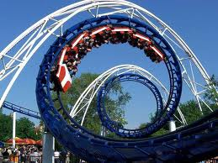
Launch
Let’s go for a ride:
Are you ready?!?!
Agenda

Slide 4
Launch Continued: Pair-Share
Mei and Erika are at Six Flags with their families. They see the following sign in front the Dropping Dragon Roller Coaster. Mei is 56 inches tall and Erika is 49 inches tall.
Your height must be greater than 50 inches to ride the Dropping Dragon!
Agenda

Slide 5
Launch Continued:
Who will be able to go on the ride? Why?
Who will NOT be able to go on the ride? Why not?
Miguel also wants to go on the Dropping Dragon. What is one height that he could be in order to ride the roller coaster?
Mei will be able to ride the Dropping Dragon
because she is taller than 50 inches.
Erika will be not able to ride the Dropping
Dragon because she is shorter than 50 inches.
Your height must be greater than 50 inches to ride the Dropping Dragon!
Agenda

Slide 6
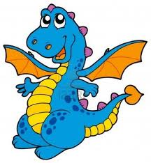
Launch Continued: Pair-Share
Mei’s little brother, Sai, wants to go on the Mini-Coaster ride. Sai is 34 inches tall. Mei sees the following sign in front of the ride.
Can Sai go on the Mini-Coaster? Why or why not?
Can Mei go on the ride with him? Why or why not?
Erika’s little brother, Nick, wants to go on the Mini-Coaster. What is one height that he could be to go on this ride?
Your height must be less than 50 inches tall to ride the Mini-Coaster!
Mei is 56 inches tall.
Agenda

Slide 7
Launch Continued: Pair-Share
Mei’s little brother, Sai, wants to go on the Mini-Coaster ride. Sai is 34 inches tall. Mei sees the following sign in front of the ride. Can Sai go on the Mini-Coaster? Why or why not?
Can Mei go on the ride with him? Why or why not?
Erika’s little brother, Nick, wants to go on the Mini-Coaster. What is one height that he could be to go on this ride?
Your height must be less than 50 inches tall to ride the Mini-Coaster!
Sai can go on the Mini-Coaster because he
is shorter than 50 inches.
Mei can NOT go on the Mini-Coaster because she
is taller than 50 inches.
Agenda

Slide 8
Launch Continued: Turn and Talk
Compare the two signs for the Dropping Dragon and the Mini-Coaster.
Explain 1 similarity to your partner
Explain 1 difference to your partner
Your height must be greater than 50 inches to ride the Dropping Dragon!
Your height must be less than 50 inches tall to ride the Mini-Coaster!
Agenda

Slide 9
Explore:
How can we represent this sign as a mathematic statement?
Your height must be greater than 50 inches to ride the Dropping Dragon!
Let’s Review:
What is a variable?
A variable is a symbol that Is used to represent an unknown number.
An example of a variable is the letter x or y.
In the sign above, what number is unknown?
The person’s height!
We can use x to represent the unknown height of any rider!
Agenda

Slide 10
Explore:
How can we represent this sign as a math statement?
x
>
Your must be
to ride the Dropping Dragon!
height
greater than
50 inches
What symbol connects x with 50 inches?
An equal sign?
Greater than can be represented using a symbol!
Agenda

Slide 11
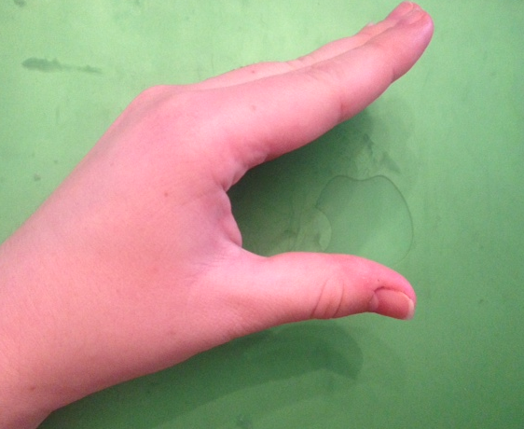
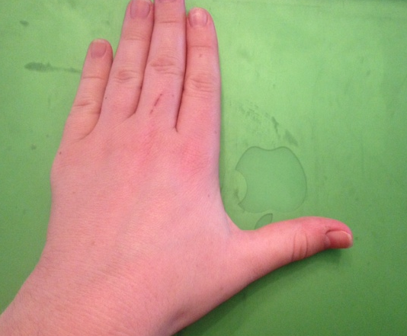
Explore: What is an inequality?
Greater than
Less than
>
<
The greater than and less than symbols are called inequalities!
An inequality is a symbol, like > or <, that states that two values are NOT equal.
What are the symbols for greater than and less than?
How can we remember which one is less than?
Take your left hand, hold it up and make and “L” , like the picture
Now, close your hand a little
Do you see a less than sign?
Agenda

Slide 12
Explore:
Let’s review!
How can we represent this sign as a mathematical statement?
x
>
Your must be
to ride the Dropping Dragon!
50 inches
height
greater than
Step 1: We find the unknown value.
50 inches
Step 2: We pick a variable.
Step 3: We find the number connected to
the variable.
Step 4: We use an inequality to
connect the variable and number.
Agenda

Slide 13
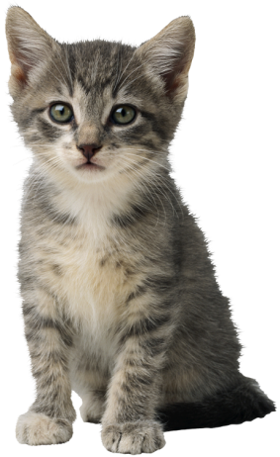
Explore: You try!
How can we represent this sign as a mathematical statement?
x
<
height
Your must
be
tall to ride the Mini-Coaster!
less than
50 inches
Review Question:
What heights (or values for x) will make that inequality statement above true?
Is there just 1 answer to this problem?
Agenda

Slide 14
Explore:
x > 50
For this inequality statement,
we have many, many solutions!
In fact, we have infinitely many solutions for an inequality statement like x > 50.
infinitely many solutions, means that we have never-ending answers that will make a math statement true.
Agenda

Slide 15
Summary:
A variable is a symbol that Is used to represent an ____________ number. A variable is represented by a letter like _____ or ______.
unknown
x
y
>
<
An inequality is a symbol, like ____ or ____, that states that two values are NOT equal.
infinitely many solutions , means that we have never-ending answers that will make a math statement _____.
true
Agenda

Slide 16
Practice:
Write an inequality statement using the variable x to represent each real-world situation below. Then, write 3 possible solutions to each inequality.
Water freezes at any temperature less than 0 degrees Celsius (°C).
x < 0 °C
3 possible solutions: -5 °C, -20 °C, -52 °C
(2) Kiera’s weekly allowance is greater than $10.
x > $10
(3) In his job as a lawyer, Cameron works more than 50 hours
per week.
x > 50 hours
Agenda

Slide 17
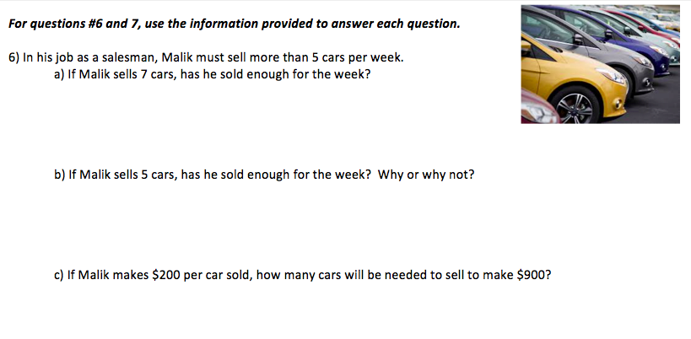
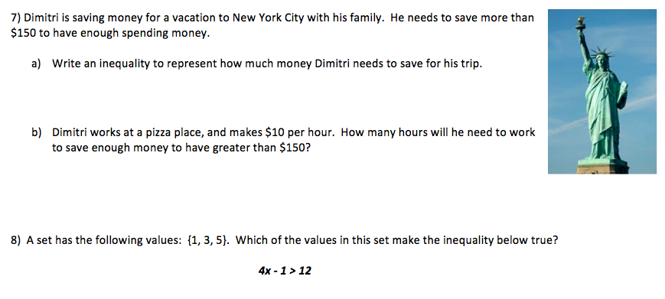
Practice - Classwork
Agenda

Slide 18
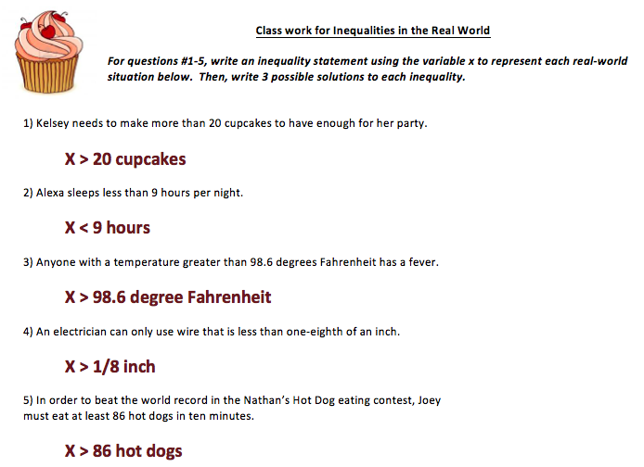
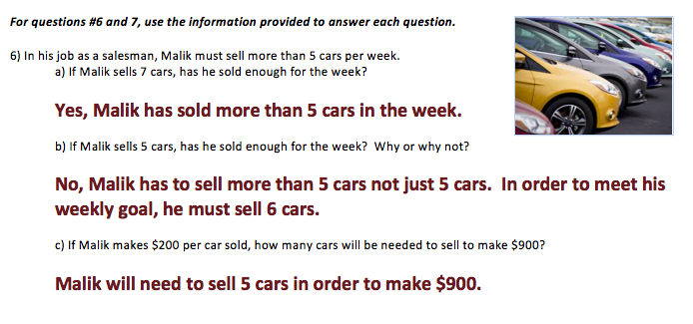
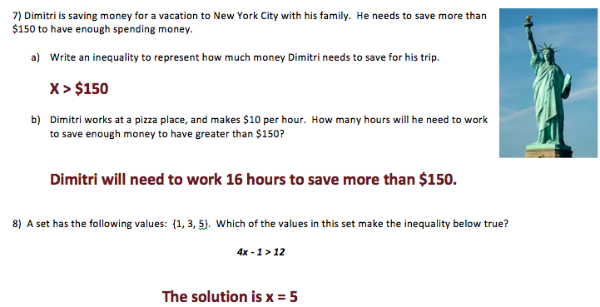
Practice – Classwork Answers
Agenda

