Slide 1
Rise of Nazism

Slide 2
After World War I,
a democratic
government called the
Weimar Republic
took hold in
Germany.

Slide 3
Unfortunately, this
government faced
huge problems.

Slide 4
Germany’s people and its
economy suffered heavily
after Germany was forced
to pay reparations to
countries devastated by
World War I.

Slide 5
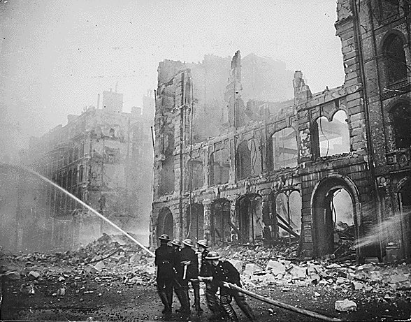

Slide 6
Millions of Germans could
not find jobs, there were
riots in the streets, and
Germans did not believe
their leaders could
improve the situation.

Slide 7
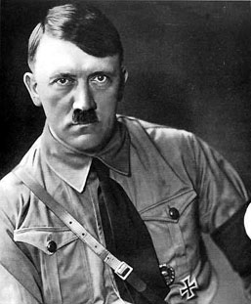
A political party named the
Nazi Party began to attract
the attention of dissatisfied
Germans, largely through
powerful speeches by its
leader, Adolf Hitler.

Slide 8
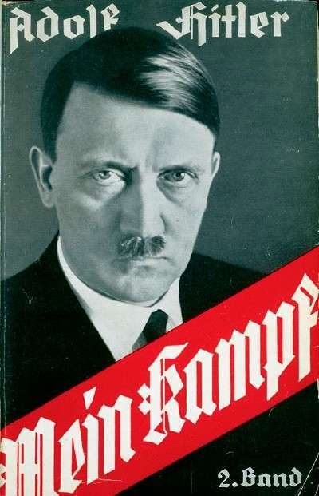
Hitler wrote a book called
Mein Kampf (My Struggle),
where he described his
ideas to strengthen
Germany.

Slide 9
His book describes his
belief that Aryans
(Germans) were the
“master race”, and his racist
feelings against Jews, Slavs,
gypsies, and blacks.

Slide 10
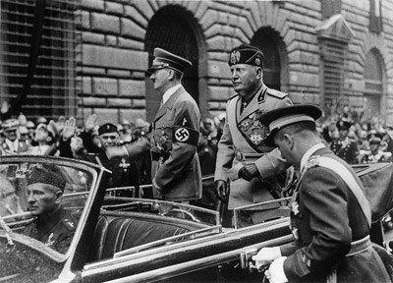
The Nazis believed in
fascism, where a strong
central government is
controlled by the military
and run by a dictator.

Slide 11
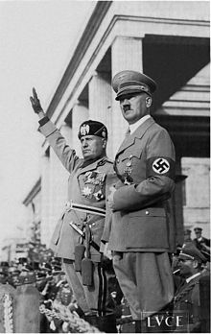
The Nazis grew in power because they:
Offered cures for Germany’s economic problems.
Appealed to German nationalism by calling for an
increase in armed forces and expansion of
Germany territory in violation of the Treaty of
Versailles.
United Germans against Jews by blaming Jews
for Germany’s problems.

Slide 12
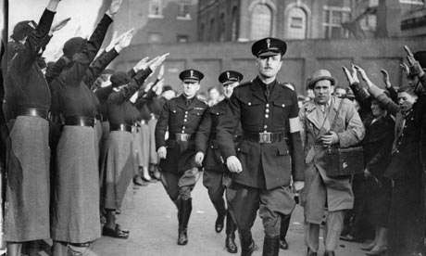
The Nazis grew in power because they:
Convinced Germans that they could protect them
from potential enemies like Russia.
Organized private, armed groups to terrorize
anyone who opposed them.
Few people spoke out against them inside or
outside Germany.

Slide 13
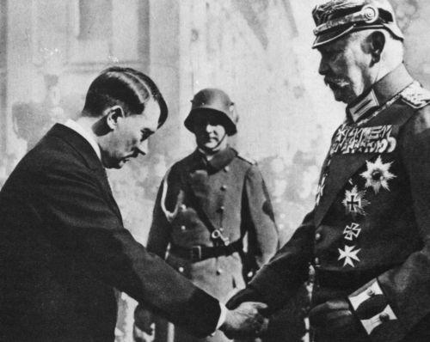
Hitler came to power in
1933 when the president
of the Weimar Republic
named him as chancellor.

Slide 14
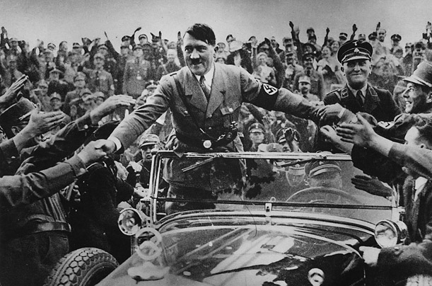
Hitler quickly destroyed
the democratic
government and
became a dictator.

Slide 15
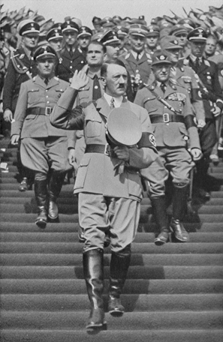
He and the Nazi Party
had achieved their
first goal:
to dominate Germany.

Slide 16
The ________________ was Germany’s government after WWI.
They faced huge problems including ______________ and
________________. Germany’s ________________ was
suffering since Germany had to pay _______________ after the
war. Soon, the _____________ led by _______________,
began to attract people to its message. This group grew in
power because they offered _______________ to Germany’s
economic problems, appealed to German _____________,
and offered ______________ from enemies like Russia. They
also had private _____________ that frightened anyone who
opposed them. _______________ became a dictator
in total control of Germany.

Slide 17
The ________________ was Germany’s government after WWI.
They faced huge problems including ______________ and
________________. Germany’s ________________ was
suffering since Germany had to pay _______________ after the
war. Soon, the _____________ led by _______________,
began to attract people to its message. This group grew in
power because they offered _______________ to Germany’s
economic problems, appealed to German _____________,
and offered ______________ from enemies like Russia. They
also had private _____________ that frightened anyone who
opposed them. _______________ became a dictator
in total control of Germany.
Weimar Republic
riots
unemployment
economy
reparations
Nazi Party
Adolf Hitler
solutions
nationalism
protection
armies
Adolf Hitler

