Slide 1
The
Cold War
Origins and Consequences

Slide 2
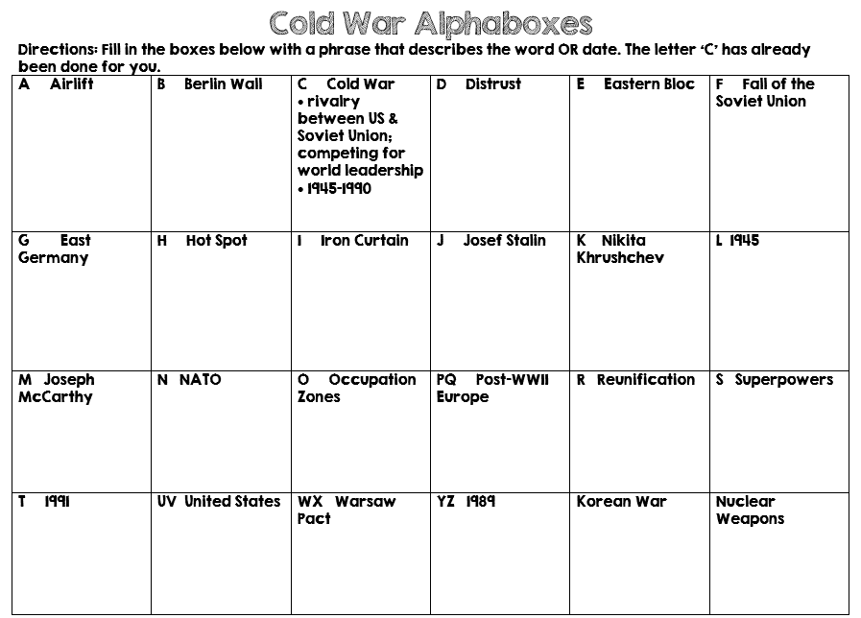

Slide 3
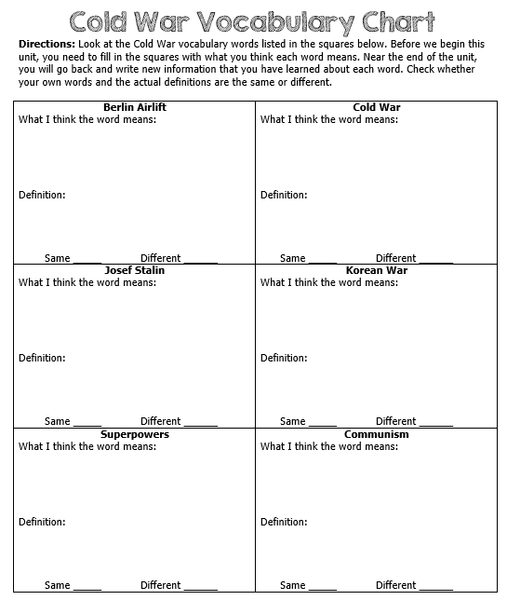

Slide 4
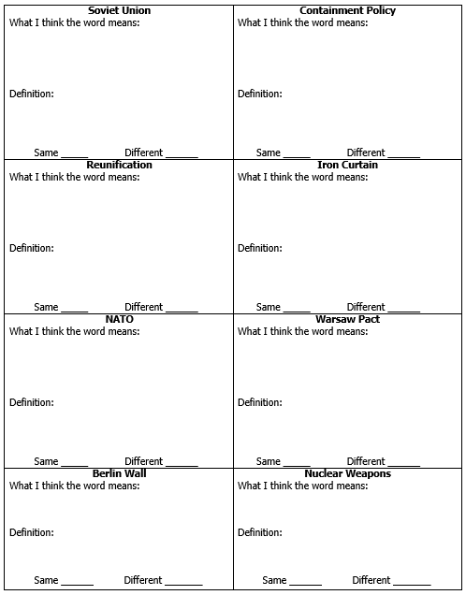

Slide 5
The
Cold War
Origins and Consequences

Slide 6
Josef Stalin
Stalin was a harsh dictator (absolute power); many lived in terror of him.
He sent millions of serfs to prison camps in Siberia for not giving up their farms to the communist government.
Much like Hitler, he also “got rid of” those who opposed his ideas.

Slide 7
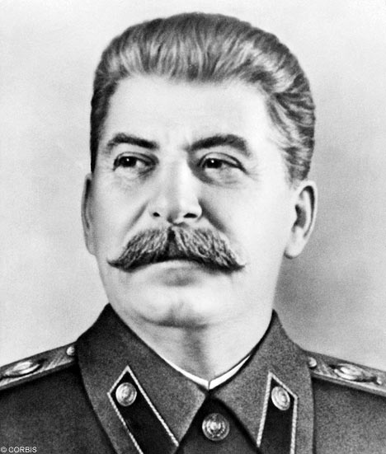

Slide 8
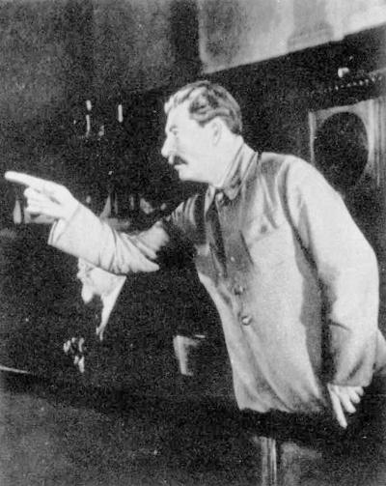
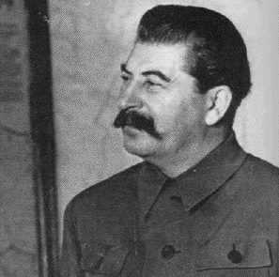

Slide 9
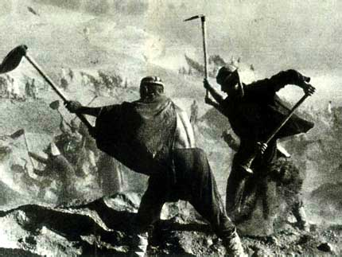
“Gulag”: large prison camp in Siberia.

Slide 10
Soviets In WWII
In 1939, Stalin signed an agreement with Germany—”no more fighting”.
In 1941, 3 million German soldiers attacked the Soviet Union; millions of Soviets died or were captured.
Harsh weather was on the Soviet’s side…
In 1945, Soviet troops captured Berlin, the capital of Germany.

Slide 11
End of WWII
After WWII, Soviets did not leave the Eastern European countries that they freed. Instead, they tried to make the countries become communist.
Western Europe and America were alarmed by Soviet advances in Eastern Europe.
Many Europeans and Americans believed that the communists were trying to take over the world!
In March 1946, Winston Churchill warns of the “Iron Curtain” of Soviet totalitarianism.

Slide 12
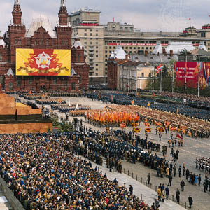

Slide 13
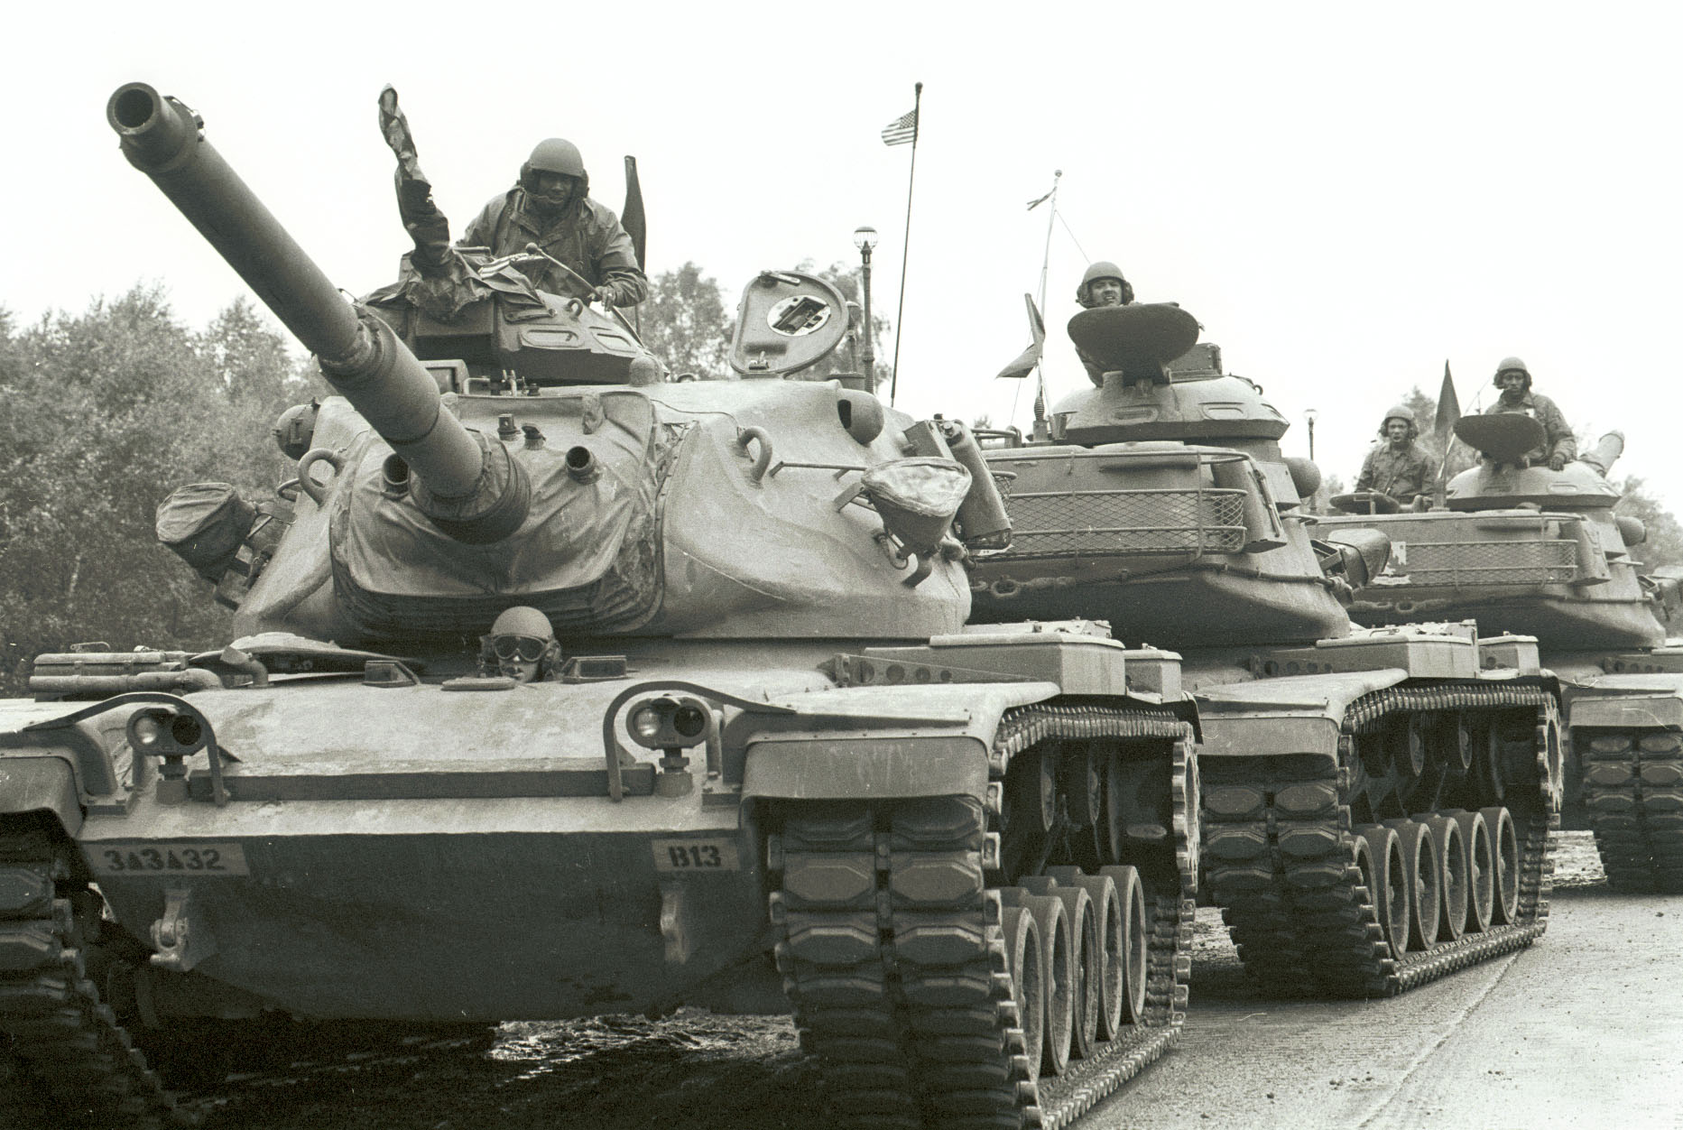

Slide 14
Eastern Bloc
Stalin wanted to keep political and economic control over Eastern Europe.
The Soviets managed to set up communist governments throughout Eastern Europe.
Stalin outlawed political parties or newspapers that opposed the communists.
The Soviets jailed or killed some political opponents.
The Soviets rigged elections to ensure the success of communists.

Slide 15
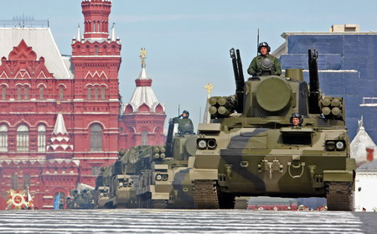

Slide 16
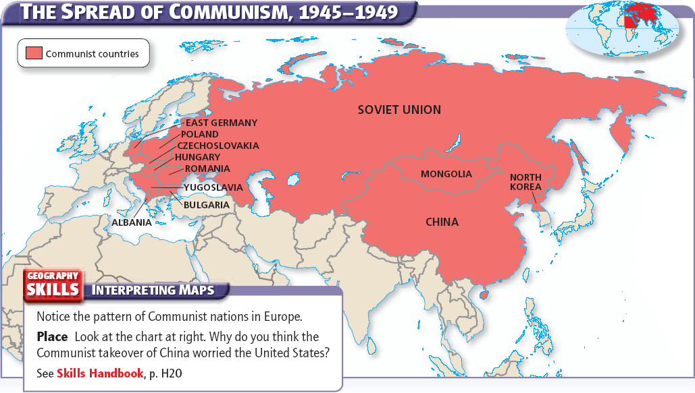

Slide 17
Iron Curtain
Winston Churchill attacked the Soviet Union for creating an “Iron Curtain”.
The term reflected Churchill’s belief that communism had created a sharp division in Europe.
Harry S. Truman urged his secretary of state to get tough with the Soviets.
Stalin believed that the Iron Curtain was necessary to protect the Soviet Union from western attacks.
He also used this as an excuse to rebuild the military.

Slide 18
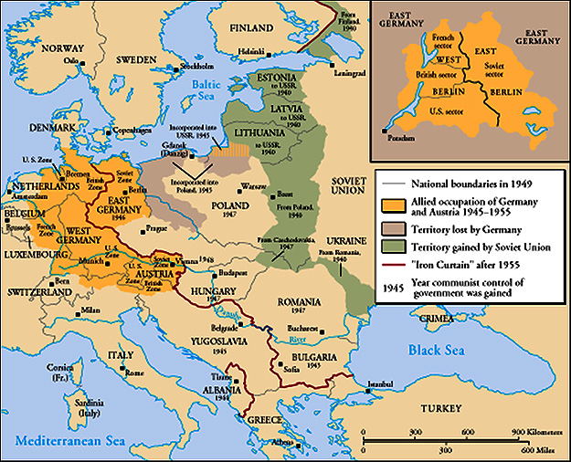
From Stettin in the Balkans, to Trieste in the Adriatic, an iron curtain has descended across the Continent. Behind that line lies the ancient capitals of Central and Eastern Europe.
Sir Winston Churchill, 1946

Slide 19
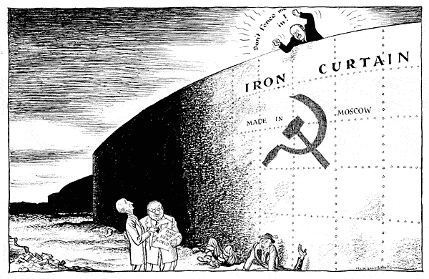

Slide 20
Opposing views
1945 was the beginning of a long period of distrust & misunderstanding between the Soviet Union and its former allies in the West (particularly the US).
Soviet Union believed that a powerful central government should control the economy as well as the government.
US believed that businesses should be privately owned.

Slide 21
SuperPowers
Both the United States and Russia were Superpowers.
Strong, wealthy countries with large populations and very strong militaries.
The U.S. and the Soviet Union were the two most powerful countries in the world—they had nuclear weapons.
There was a lot of tension between the U.S. and the Soviet Union.
Many feared the rivalry between Democracy and Communism would lead to a nuclear war.
They called this tension a “Cold War” because neither side ever fired a shot.
However, the threat of nuclear war left many feeling nervous.

Slide 22
Head to Head
As the Cold War continued, more countries allied with each side.
The US and USSR had the ability to influence world events and project worldwide power.
The countries were evenly matched…

Slide 23
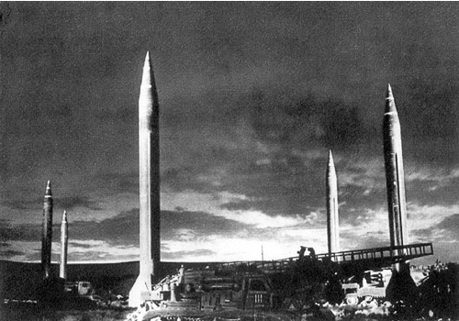

Slide 24
Soviet Union
The U.S.S.R. had a permanent seat on the UN Security Council.
It influenced other communist countries and dictatorships around the world.
It occupied the largest country in the world, 3rd largest population, & the 2nd largest economy.
It had military and space technology, a worldwide spy network (the KGB), & one of the largest stockpiles of nuclear weapons in the world.

Slide 25
United States
The US also had a permanent seat on the UN Security Council, as well as strong ties with Western Europe & Latin America.
4th most populated country
It had powerful military support from NATO, the largest navy in the world, bases all over the world, the CIA, and a large reserve of nuclear weapons.

Slide 26
Distrust
Each side thought the other was trying to rule the world.
Neither side would give up, and people lived in fear that another world war would erupt.
This time it could be a nuclear war, which could destroy the entire planet…
Countries began to form alliances to protect themselves.

Slide 27
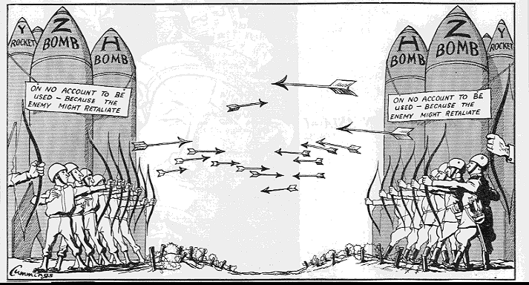

Slide 28
NATO
In 1949, Western European countries, Canada, & US formed the North Atlantic Treaty Organization (NATO).
Each nation in NATO believed the Soviet Union would not attack western Europe if the U.S. would launch nuclear war in return.

Slide 29
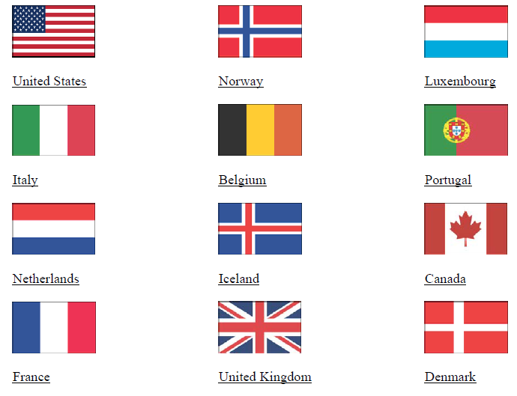

Slide 30
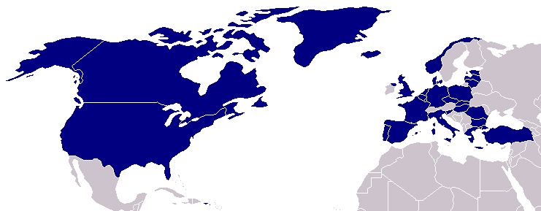

Slide 31
The Warsaw Pact
What was the Warsaw Pact?
An alliance between the Soviet Union and its communist satellite nations.
Why was it formed?
to counter NATO
an anti-Western military alliance
Why “Warsaw”?
Warsaw, Poland was the city where the treaty was signed
Satellite nation?
Satellite nations are nations that are dependent upon a stronger power.
The Soviet satellite nations were Bulgaria, Romania, Czechoslovakia, Hungary, Poland, and East Germany.

Slide 32
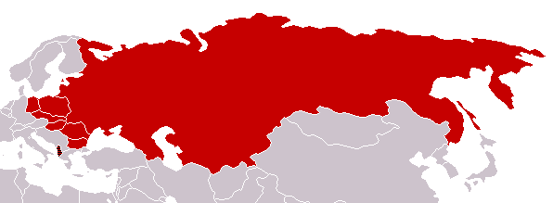

Slide 33
Division of Germany
At the end of WWII, the Allies divided Germany into 4 sections to keep it from regaining power.
US, Great Britain, France, & Soviet Union each controlled a section.
In 1948, the Western Allies wanted to reunite Germany, but the Soviets disagreed.
The Soviet section became “East Germany” and the reunited sections became “West Germany”.
Berlin was also divided into East & West.

Slide 34
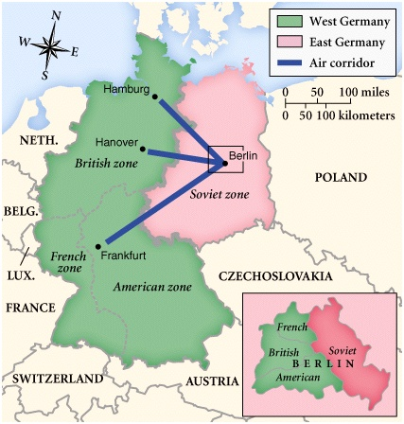

Slide 35
What About Berlin?
During the Cold war, there were many “hot spots” (areas of extreme tension).
The earliest hot spot was Berlin.
At the end of World War II, Germany was divided into four occupation zones:
American, British, French, and Soviet
The Soviets controlled the eastern part of Germany, the western countries controlled the western part of Germany.
The capital, Berlin, deep within Soviet-controlled territory, was also divided into four occupation zones.

Slide 36
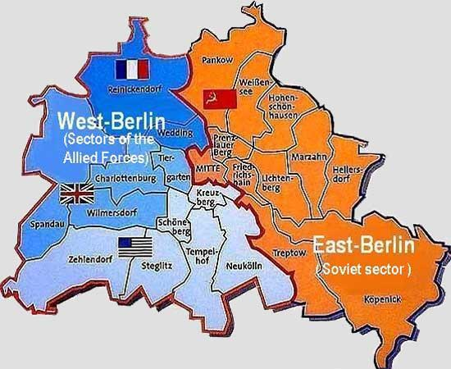

Slide 37
Blockaded Berlin
In June 1948, the Soviets blockaded all land and water traffic into western Berlin hoping to make Britain, France, and America leave the city.
(Remember Berlin was in East Germany which the USSR occupied.)
In response, the United States and Great Britain began an airlift…

Slide 38
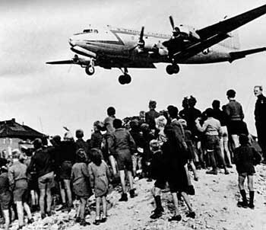

Slide 39
Berlin Airlift
What’s an airlift?
A system of carrying supplies into East Berlin by plane day and night. British and American pilots flew in tons of food, fuel, and raw materials.
How long did it last?
11 months

Slide 40
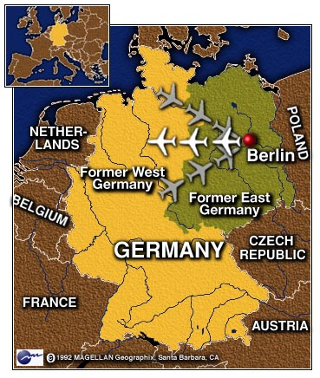

Slide 41
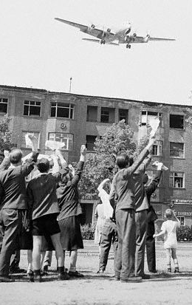
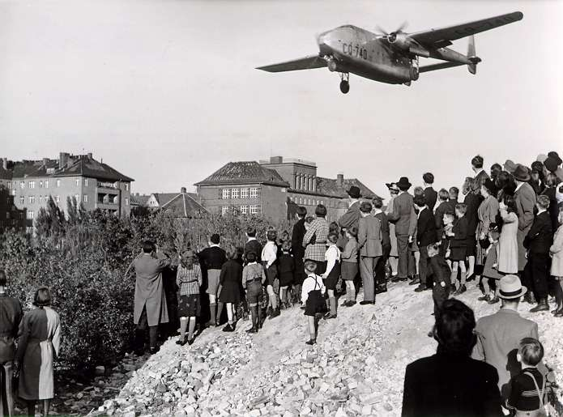

Slide 43
Now What?
The airlift is over—now what?
Germany officially becomes two countries with two governments.
Bonn becomes the capital of West Germany.
East Berlin becomes the capital of East Germany.
West Berlin remains a democratic stronghold, surrounded by communism.

Slide 44
Post-WWII Korea
After World War II, Japanese-occupied Korea was temporarily divided into northern and southern parts.
The Soviet Union controlled Korea north of the 38th parallel.
The United States would be in charge of Korea south of the 38th parallel.
The Soviet Union established a communist government in North Korea.
In South Korea, the United States promoted a democratic system.

Slide 45
Korean War Begins
In 1950, Kim Il Sung, the leader of North Korea, sent his powerful army into South Korea.
South Korea was where the United States had to take a stand against Communist aggression.
Truman ordered American naval and air forces to support Korean ground troops, and asked the United Nations to approve the use of force to stop the North Korean invasion.
The United Nations responded quickly, imposing military sanctions. The U.S. and 19 other nations committed troops to the area.
Despite initial heavy losses, the combined UN forces finally began to win.

Slide 46
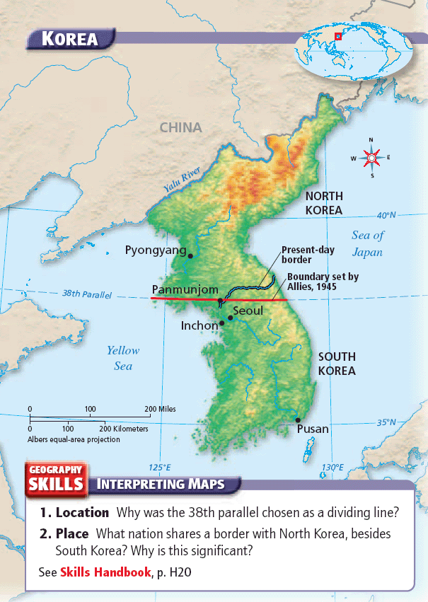
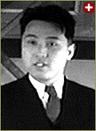
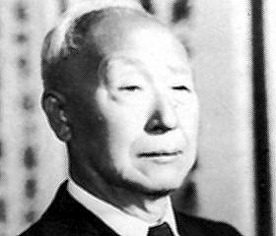
Kim Il-Sung
Syngman Rhee

Slide 47
Korean War
The situation changed when General Douglas MacArthur disobeyed orders to stay in South Korea.
Going beyond the 38th parallel into North Korea brought communist China’s well-trained and well-equipped army into the war.
When the fighting finally ended in 1953, no one was truly victorious.
The 38th parallel dividing line remained intact.

Slide 48
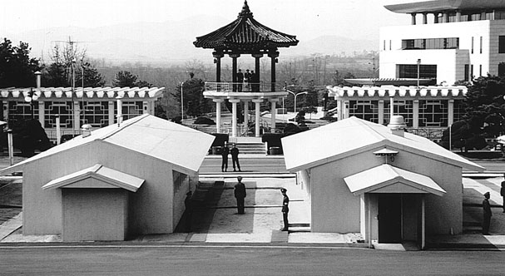

Slide 49
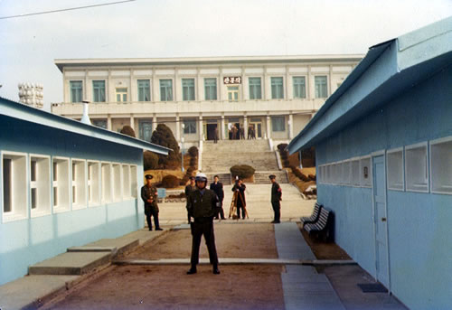

Slide 50
Who Won?
South Korea remained “free”, so containment had worked.
Korea was badly damaged, and many lives were lost.
They are still two separate countries today.
Reunification talks have begun, but progress is very, very slow.

Slide 51
Back in USA
Many Americans worried that communism would take over the United States and dominate the world.
Senator Joseph McCarthy spearheaded a communist hunt fueled by these fears throughout the U.S.
His television appearances infected the nation with an anticommunist hysteria that ruined numerous lives from politicians to actors and writers.

Slide 52
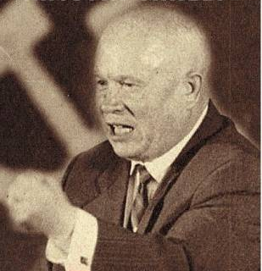
Premier Nikita Khrushchev
About the capitalist states, it doesn't depend on you whether we (Soviet Union) exist. If you don't like us, don't accept our invitations, and don't invite us to come to see you. Whether you like it our not, history is on our side. We will bury you. -- 1956

Slide 53
A New Leader
Nikita Khrushchev was born in 1894 to a miner in Ukraine. His grandfather was a serf.
He served as the First Secretary of the Communist Party of the Soviet Union from 1953-1964.
He initiated the space program that launched Sputnik I.
He had the idea of placing nuclear missiles in Cuba to restore the balance of power during the Cold War. This led to the Cuban Missile Crisis.
His announced goals were to overtake the United States in productivity and to help spread Communism throughout the world.
Khrushchev was overthrown in 1964. After seven years of house arrest, he died in Moscow in 1971.

Slide 54
Berlin Wall
Berliners hated living under communism.
Luckily, West Berlin and freedom were just across the street.
About 3 million people fled to West Berlin looking for political freedom and better lives.
The East German government wanted it to stop.
In August 1961, East Germany built a 103 mile wall between East and West Berlin.
Guarded by Soviet troops, it became a symbol of the split between western and eastern Europe.

Slide 55
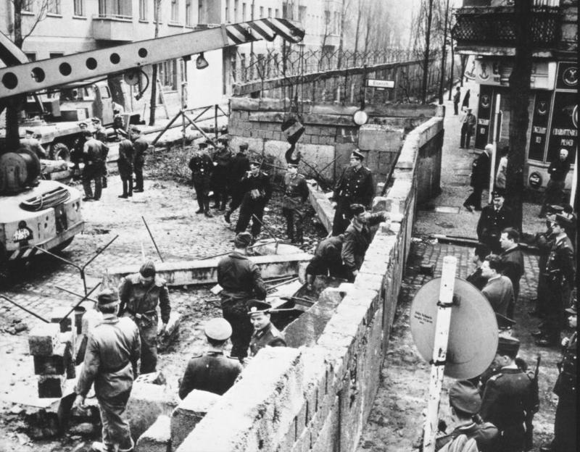

Slide 56
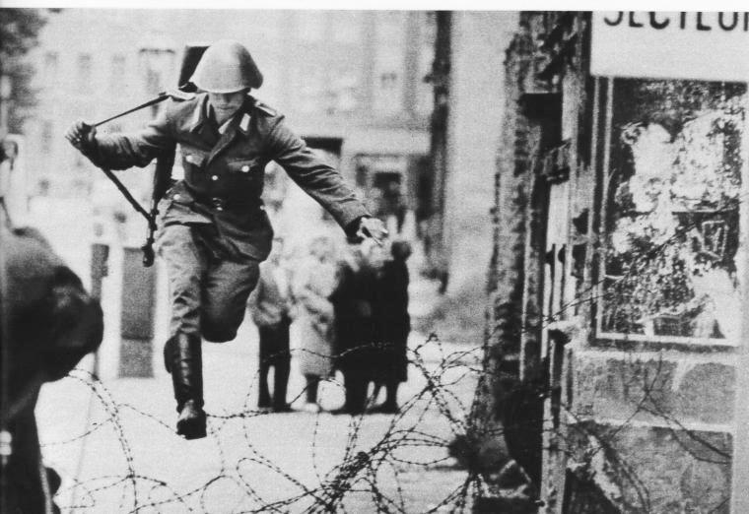

Slide 57
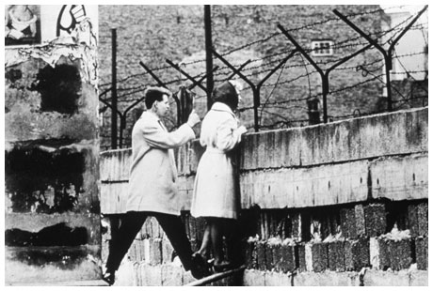

Slide 59
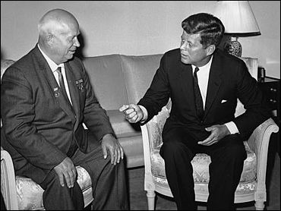
Paris, 1961
Khrushchev & JFK meet to discuss Berlin and nuclear proliferation. Khrushchev thinks that JFK is young, inexperienced, and can be pushed over.

Slide 60
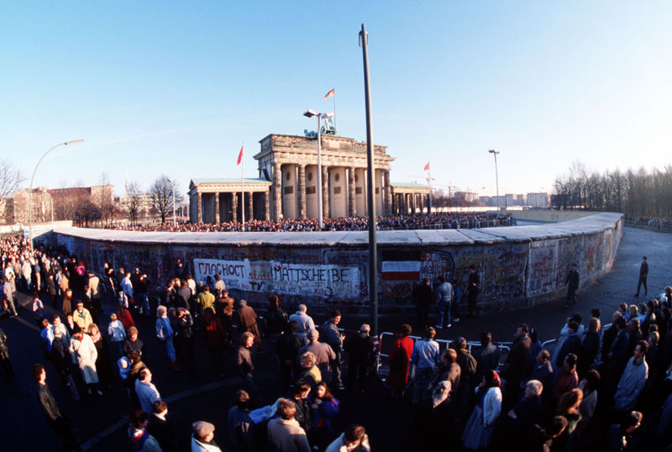

Slide 61
Losing Control
The economy did not grow; the government spent too much money on heavy industry.
This often caused food shortages.
By the 1980s, most Soviet people had lost faith in the communist system.
They had no personal freedoms.

Slide 62
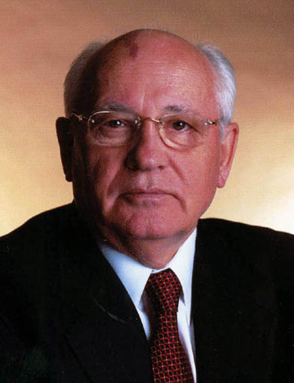
Losing Control
Soviet Union was spending tons of money putting down revolts, protecting its borders, and keeping up with the US in the arms race.
In 1985, the economy was so unstable that Mikhail Gorbachev, head of USSR, reduced government control of business and increased the freedoms for all citizens.

Slide 63
Berlin Wall Falls
Demonstrations by people prompted the government to remove border-crossing restrictions.
When the announcement was made, East and West Berliners climbed the wall and celebrated.
Citizens immediately began tearing down the wall.
Nov. 9th 1989: the Berlin Wall, a symbol of communism, was destroyed.
Shortly after the Berlin Wall fell, Germany was reunited as one country (October 3, 1990).

Slide 64
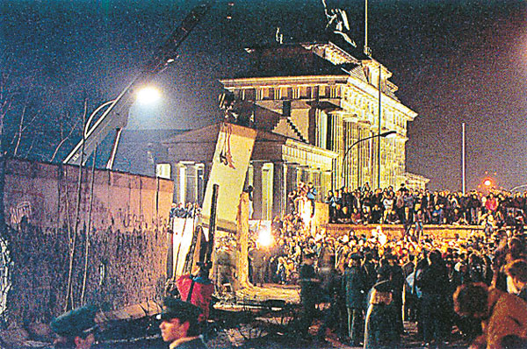

Slide 65
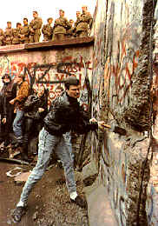

Slide 66
Reunification
Shortly after the Berlin Wall fell, Germans voted to make the countries of East Germany and West Germany was reunited as one country (October 3, 1990).
Today, Germany is a free democracy with a great economy.

Slide 67
Cold War Ends
After Germany was reunified, the Soviet republics that had once been separate countries began seeking their independence also.
In 1991, Soviet Union was no more and the Cold War finally ends.
Many countries were created; Russia was the largest.

