Slide 1
Latin American
Independence
Movement
Toussaint L’Ouverture, Simon Bolivar,
& Miguel Hidalgo

Slide 2
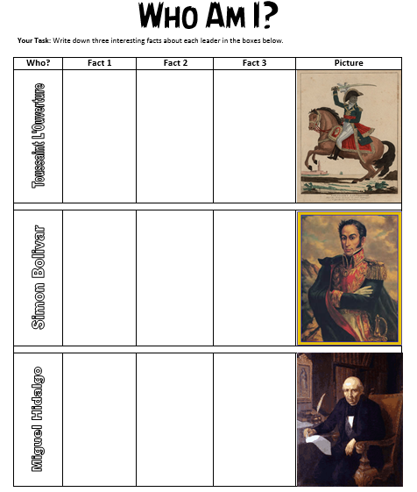

Slide 3
Spain Builds An Empire
Spain conquered most of the lands in the Americas (while Portugal conquered Brazil0.
It divided its empire into provinces.
The two most important provinces were New Spain and Peru.
Spain set up a class system; Native Americans were the lowest.

Slide 4
Treatment of Natives
The Native Americans were the least powerful class.
They were forced to work on plantations (haciendas) for European settlers.
They also worked in mines after silver was discovered (extremely dangerous).
Many died from overwork, malnutrition, or diseases.
The population decreased from 25 million in 1519 to less than 2 million in the late 1500s.

Slide 5
Emergence of Slavery
European diseases decimated Native American population.
European settlers still needed workers for plantations.
Colonists began importing African slaves to supplement Native American labor.
Aspects of Native American & African culture (languages, customs, beliefs, traditions) survived & blended together.

Slide 6
Blending of Ethnic Groups
Mestizos: people of mixed Native American and European ancestry
Criollo: had Spanish-born parents, but was born in Latin America
Mulattoes: people of mixed African and European ancestry

Slide 7
Triangular Trade
Ships leaving Europe first stopped in Africa; they traded European goods for captives taken in tribal wars or raids.
Ships then traveled to America; slaves were exchanged for sugar & other island products.
Ships returned home loaded with products from the Americas that grew very popular with Europeans.

Slide 8
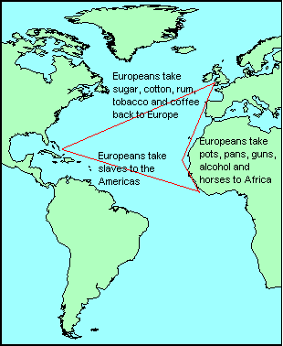

Slide 9
Slavery in Americas
An estimated 8-15 million Africans reached the Americas from the 16th to the 19th century.
The African slave population quickly began to outnumber the Europeans & the Native Americans.
Slave rebellions were common.

Slide 10
Toussaint
L'Ouverture

Slide 11
Toussaint L’Ouverture
He was a former slave in Haiti (freed in 1777).
In 1791, he led a huge slave revolt against the French in Hispaniola.
France was also fighting a war against Spanish forces in Hispaniola; they couldn’t deal with slave rebellions.
They promised that any slave who joined the French army & fought the Spanish would be freed.
In 1795, L’Ouverture’s army helped the French defeat the Spanish.

Slide 12
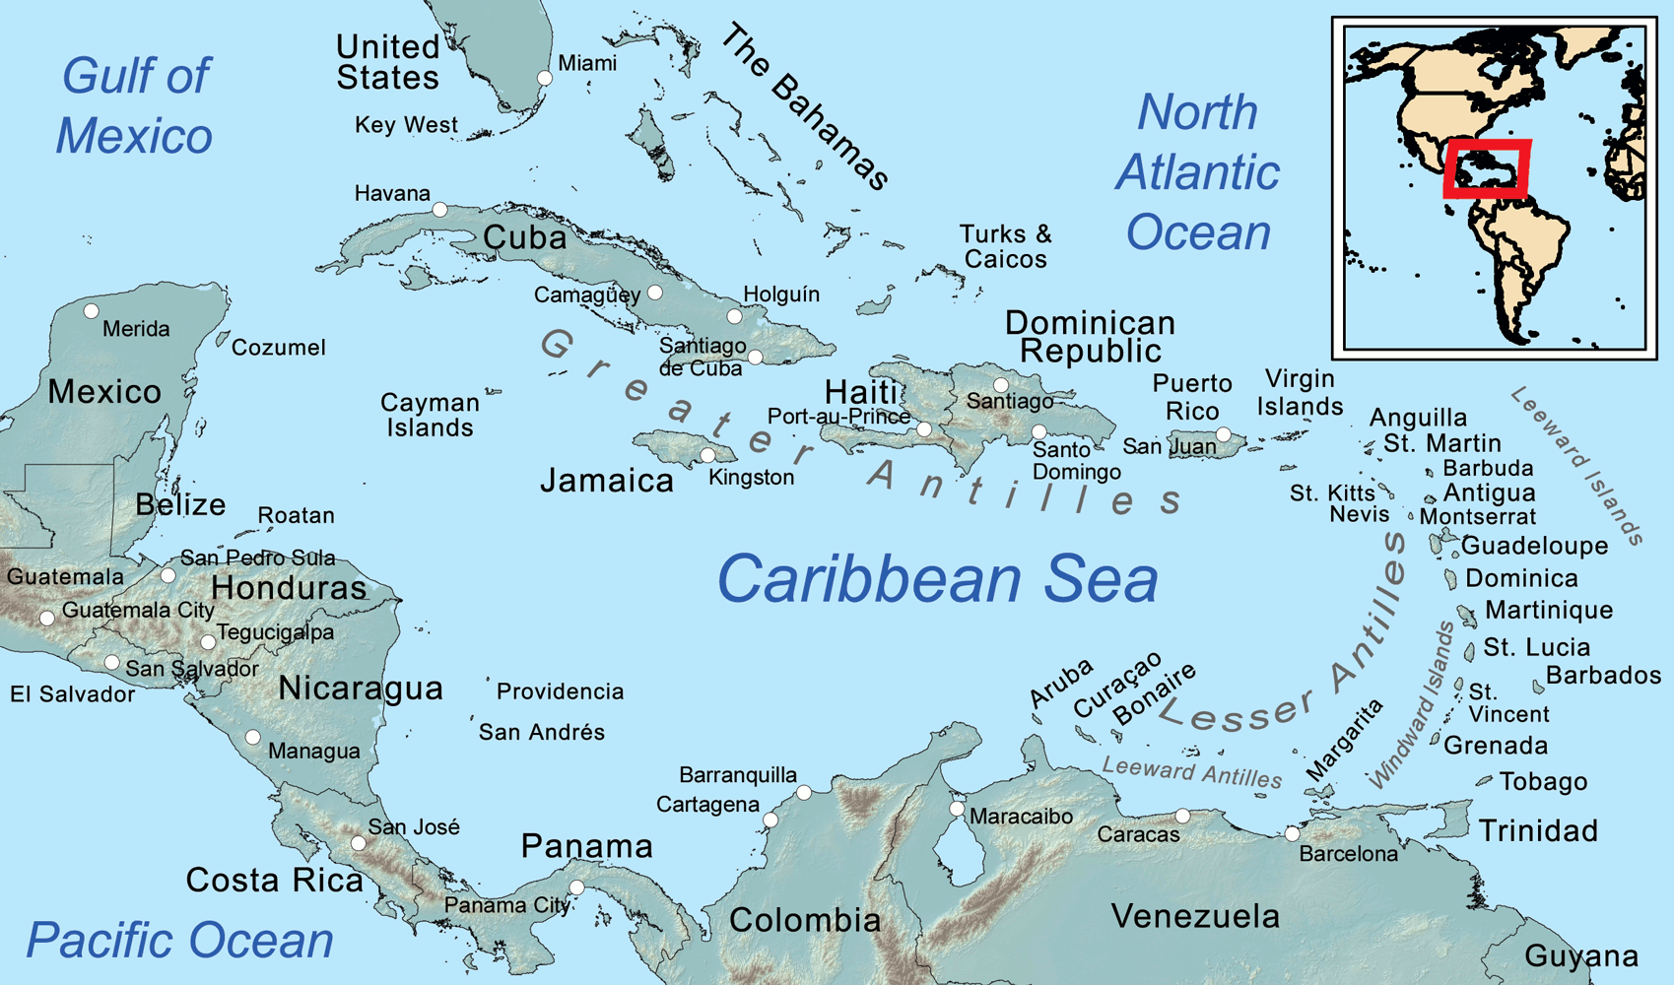

Slide 13
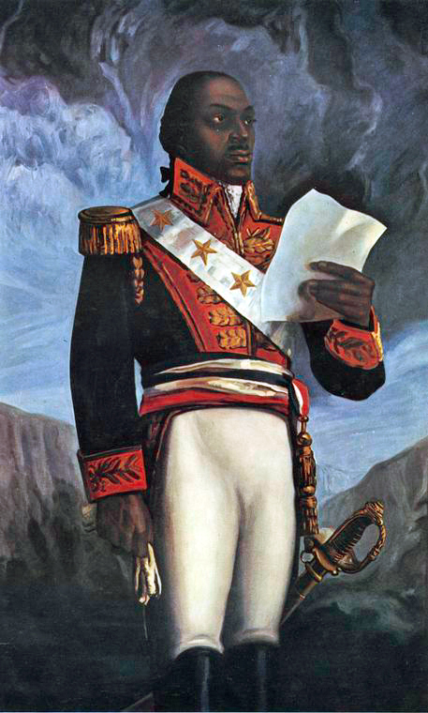

Slide 14
Toussaint L’Ouverture
In 1801, L’Ouverture led a huge army into a Spanish colony & freed all slaves there.
Six months later, he became “governor general of Haiti for life.”
In 1802, a large French army lands in Haiti.
They wanted to restore old French government & regain control of sugar trade.
L’Ouverture’s army fought the French & lost.
French arrested L’Ouverture and sent him to prison in France.
L’Ouverture died while in prison.

Slide 15
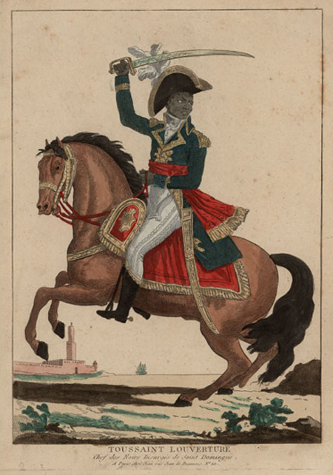

Slide 16
Haiti’s Independence
L’Ouverture’s army was outraged; it took up arms again against France.
In November 1803, they defeated the last of the French forces.
In 1804, they declared Haiti independent of French rule.
Haiti became the 1st country in Latin America to break free of European imperialism.

Slide 17
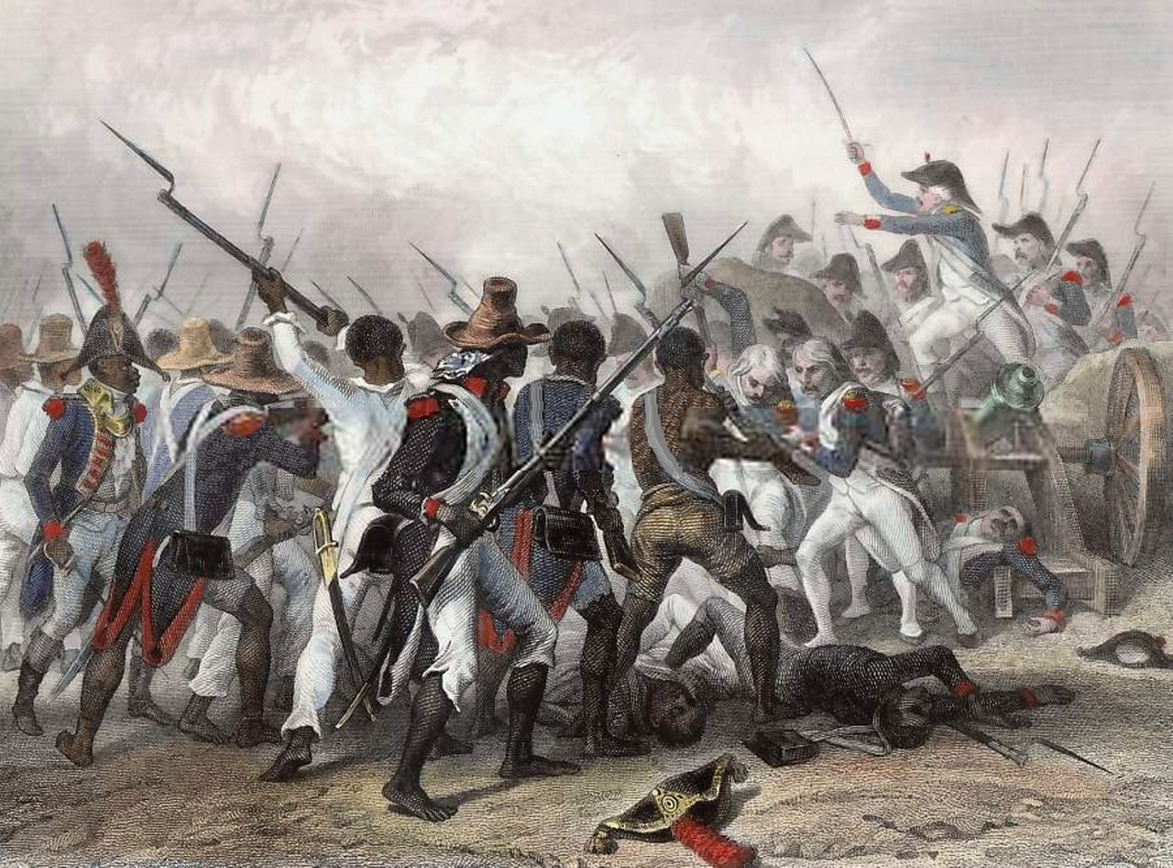

Slide 18
Simon
Bolivar

Slide 19
Simon Bolivar
Bolivar was a wealthy Venezuelan Criollo who spent many years traveling Europe.
While in Italy, he discovered his life’s purpose: to liberate his homeland from European control.
In 1810, Bolivar’s army kicks Spanish governor out of Venezuela
In 1811, a new constitution proclaimed Venezuela independent of Spanish rule.
Soon after, Spanish royalists defeated the new country’s army & Bolivar was forced to flee to New Granada (Colombia).

Slide 20
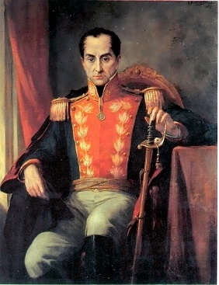

Slide 21
El Libertador
Bolivar organized a bigger army and marched back into Venezuela.
In 1813, Bolivar’s army won & took control of Venezuela’s capital, Caracas.
Bolivar was nicknamed El Libertador.

Slide 22
El Libertador
Bolivar organized a bigger army and marched back into Venezuela.
In 1813, Bolivar’s army won & took control of Venezuela’s capital, Caracas.
Bolivar was nicknamed El Libertador.
Over the next few years, Bolivar liberated New Granada (now Colombia), Ecuador, Panama, Peru, & Upper Peru (now Bolivia).

Slide 23
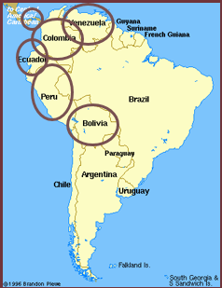

Slide 24
Miguel
Hidalgo

Slide 25
Miguel Hidalgo
Hidalgo was a Catholic priest in the town of Dolores.
He began the struggle for Mexico’s independence in 1810.
September 16th, 1810: “Cry of Dolores” was his call for revolution.
He rang church bells and shouted, “Long live our Lady of Guadalupe! Death to bad government! Death to the Spaniards!”.
An army of mestizos & Native Americans rallied behind Hidalgo.

Slide 26
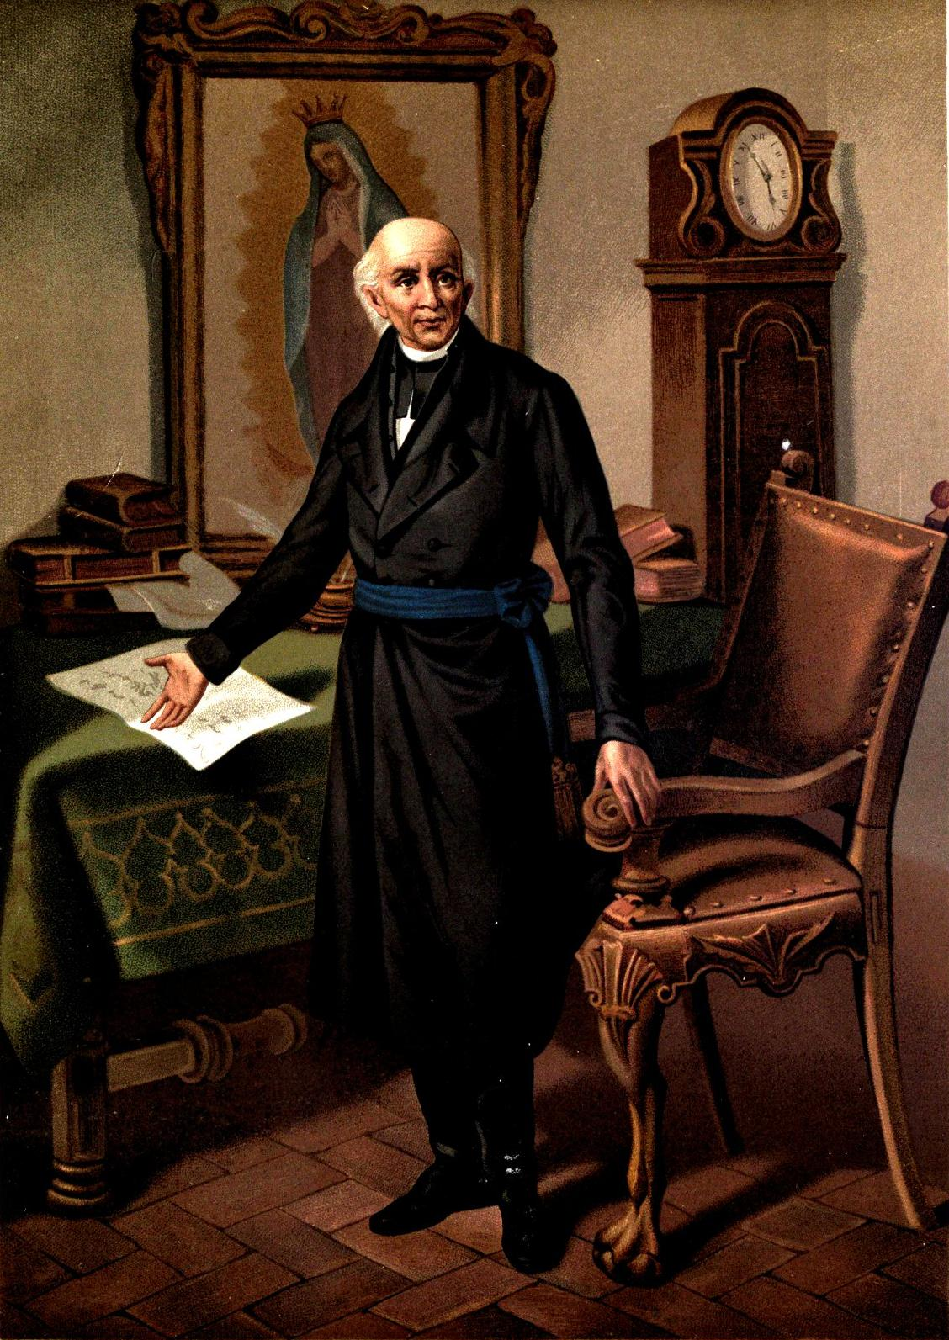

Slide 27
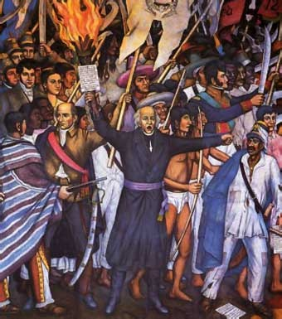

Slide 28
Mexico Continues to Fight
Over 80,000 people joined the fight, but the army was soon defeated by the Spanish.
Hidalgo was captured and executed in 1811.
Mexicans continued to fight for independence over the next decade.

Slide 29
Mexico’s Independence
In 1821, Mexico gained independence from Spain.
Mexico celebrates September 16th as it’s Independence Day.
The president rings a bell in Mexico city and repeats Hidalgo’s “Cry of Dolores.”

Slide 30
?
Hidalgo
Bolivar
L’Ouverture

Slide 31
Who Am I?
The country of Bolivia was named in my honor.

Slide 32
I Am…
Simon Bolivar

Slide 33
Who Am I?
I am known as the father of Mexican independence.

Slide 34
I Am…
Miguel Hidalgo

Slide 35
Who Am I?
I was able to end Spanish rule in much of South America.

Slide 36
I Am…
Simon Bolivar

Slide 37
Who Am I?
I am a wealthy Venezuelan who was educated in Spain.

Slide 38
I Am…
Simon Bolivar

Slide 39
Who Am I?
My job in Mexico was a priest.

Slide 40
I Am…
Miguel Hidalgo

Slide 41
Who Am I?
I was imprisoned in France.

Slide 42
I Am…
Toussaint L’Ouverture

Slide 43
Who Am I?
I helped citizens gain independence in Haiti.

Slide 44
I Am…
Toussaint L’Ouverture

Slide 45
Who Am I?
When I rang my church bell, it was the signal for the beginning of the revolution.

Slide 46
I Am…
Miguel Hidalgo

Slide 47
Who Am I?
Colombia, Ecuador, Panama, Peru, and Venezuela won their independence through my efforts.

Slide 48
I Am…
Simon Bolivar

Slide 49
Who Am I?
I am former slave who was self educated.

Slide 50
I Am…
Toussaint L’Ouverture

Slide 51
Who Am I?
I did not live to see my country gain independence. (2)

Slide 52
I Am…
Miguel Hidalgo & Toussaint L’Ouverture

Slide 53
Who Am I?
My nickname is “El Libertador”.

Slide 54
I Am…
Simon Bolivar

