Slide 1
NAFTA’s
Functions
North American Free Trade Agreement

Slide 2
What is NAFTA?
NAFTA stands for “North American Free Trade Agreement”.
It is an agreement between the countries of North America: Canada, United States, & Mexico.
NAFTA was signed in 1993 and went into effect on January 1st, 1994.
NAFTA was written to create a Free Trade Area in North America.
“Free Trade” means that countries may freely trade goods with each other without having to pay a tariff (tax) on those goods.
In other words, “free trade” means no trade barriers.

Slide 3
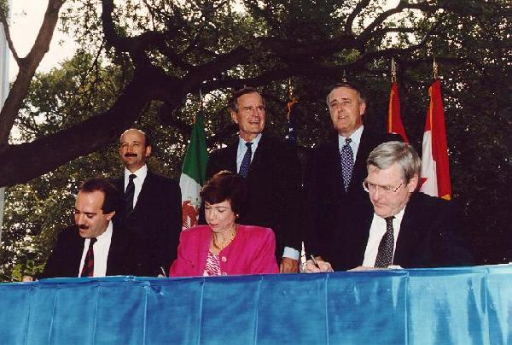
“It was on Oct. 7, 1992, under an old oak tree in downtown San Antonio that Mexican President Carlos Salinas, U.S. President George Herbert Walker Bush and Canadian Prime Minister Brian Mulroney signed the historic treaty that dropped trade barriers on the continent.”

Slide 4
Free Trade
The purpose of the agreement is to:
Allow free movement of goods and services among the countries.
Promote competition in the free trade areas.
Protect the property rights of people and businesses in each country.
Be able to resolve problems that arise among the countries.
Encourage cooperation among countries.
The agreement opened the door for free trade, ending tariffs on various goods and services, and implementing equality between Canada, USA, and Mexico.

Slide 5
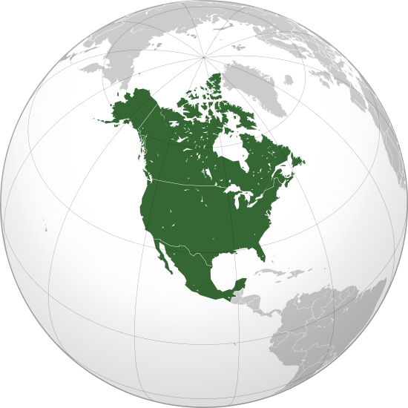
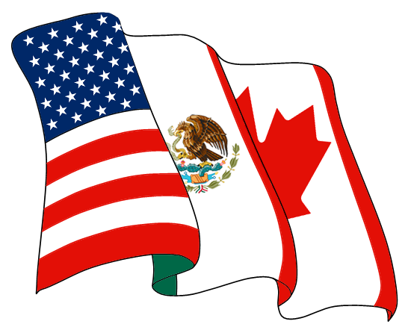

Slide 6
Pros
Free trade increases sales and profits for Mexico, Canada and the U.S.A., thus strengthening their economies.
Lack of tariffs has allowed Mexico to sell its goods in the USA and Canada at lower prices.
This makes Mexican products more competitive in these markets and increases Mexico’s profits as it tries to develop its economy.
Free trade is an opportunity for the U.S. to provide financial help to Mexico by making jobs available in factories located there.

Slide 7
Cons
Free trade has caused more U.S. job losses than gains, especially for higher-wage jobs.
People work for lower wages and there are fewer labor regulations in Mexico, so American factories have moved across the border.
Factories, called Maquiladoras, are built on the Mexican border and workers are hired there to make goods at a much lower wage than workers would be paid in the U.S.A.
Mexico does not have as strict environmental regulations like Canada & U.S., so when factories move across the border, they are contributing to North America’s pollution problem.
Some argue that our borders should be open like the EU does in Europe.
That makes some people angry because they feel the borders should be closed.

Slide 8
US Business Owners
American business owners have enjoyed many benefits from NAFTA:
They can move their factories to Mexico and ship the goods to the US with no tariffs.
They do not have to pay the workers in Mexico as much as in the United States.
There are not as many labor and environmental regulations for factories in Mexico.
They can sell their product for cheaper, but still make a good profit.
They have a greater area to sell their product in.

Slide 9
Mexican Business Owners
Most Mexican business owners have mixed feelings about NAFTA.
They like NAFTA because they can trade freely.
They can ship & sell their products across the continent without having to pay tariffs.
They have a greater area to sell their products in.
They do not like foreign owned factories because they would create competition.

Slide 10
Mexican Government Official
In the early 1990s, Mexico owed a lot of money to the World Bank, to private banks, and to other countries.
Government officials decided the only way out was to completely restructure Mexico’s economy and to focus on exporting.
They believed NAFTA would be good for the economy of Mexico.
They knew that the maquiladoras would provide jobs for Mexicans.

Slide 11
Mexican Factory Worker
Mexican factory workers have benefited from NAFTA because it has provided jobs in a country where there were not enough jobs.
Unfortunately, the wages are very low and the working conditions are rough.
Most workers barely make enough money to provide food for their families, even though they work very long hours.

Slide 12
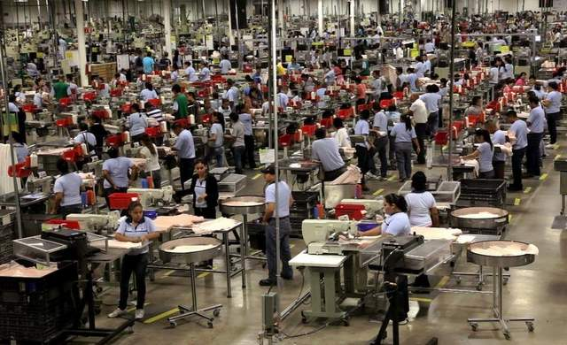
Employees work at an American-owned factory located in Mexico.

Slide 13
US Factory Worker
As a result of NAFTA, many U.S. manufacturers moved their operations south of the border where employees were cheaper and environmental standards lower.
Many American factory workers lost their jobs because of this.
Unemployment in the US rose after NAFTA went into effect.

Slide 14
“In a 1992 debate with President George Bush Sr. and presidential candidate Bill Clinton, independent candidate Ross Perot famously suggested NAFTA would create "a giant sucking sound" as jobs moved south of the border.”

Slide 15
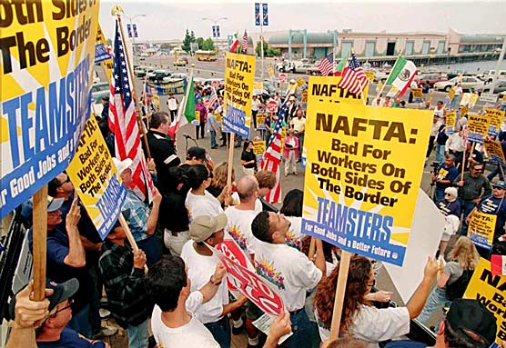
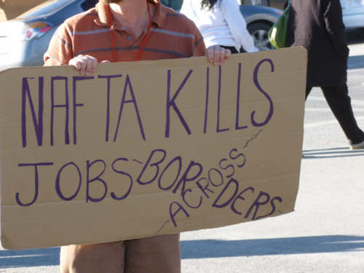

Slide 16
Environmentalists
Building factories creates pollution. An environmentalist would want to make sure the US, Canada, and Mexico all had laws to protect the environment. Because all three countries are neighbors, air pollution from one affects them all.
Unfortunately, NAFTA didn’t establish any multinational environmental regulations when it was signed 20 years ago.
It created the Commission for Environmental Cooperation, based in Canada.
It accepts complaints from citizens of the U.S., Mexico or Canada who believe their government is not enforcing environmental laws.
It takes a very long time for anything to be investigated and solved. One American-owned maquiladora continued polluted for 10 years after a complaint was filed!

Slide 17
American Consumers
American consumers have benefited from NAFTA.
Goods made in Mexico cost a lot less because labor is cheaper there.
Goods are also cheaper because there are no tariffs placed on imports.

Slide 18
20 Years Later…
NAFTA now links over 450 million people producing $17 trillion worth of goods and services.
It has met many of its goals:
It created jobs in the maquiladoras of Mexico and helped build up Mexico's middle class through jobs and cheaper consumer goods.
Trade between US, Mexico, & Canada has more than tripled since 1994.
Unfortunately, NAFTA still has its problems.
Small farmers in Mexico were put out of business by cheap U.S. agricultural exports.
They were forced to move to bigger cities, adding to poverty, pollution, overcrowding, and illegal immigration to the U.S.
The population of illegal immigrants in the U.S. in 1990 was 2 million, now it's around 11 million.
There is major pollution in the boomtowns that have grown up around the maquiladoras.

