Slide 1
Early Civilizations
of
Latin America
European Impact on the
Aztec & Inca Civilizations

Slide 2
The Inca

Slide 3
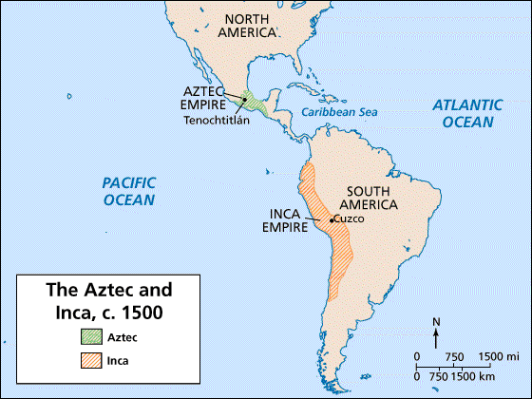

Slide 4
Rise of the Inca
In 1200 AD, Incas settled in Cuzco, a village in the Andes Mountains (now in Peru).
Most were farmers.
In 1438 AD, Pachacuti became ruler of the Incas and conquered more lands/people.
The empire stretched 2,500 miles and ruled 12 million people.
They used runners to spread news—at a rate of 250 miles a day!

Slide 5
Aztec Temple

Slide 6
Aztec Temple
Machu
Picchu

Slide 7
Cuzco
The jaguar was an important symbol to the Incans.
Cuzco (capital city) was built in the shape of a jaguar!

Slide 8
Aztec Temple

Slide 9
Accomplishments
They were excellent farmers, builders, and managers.
Roads and aqueducts:
Incans built more than 19,000 miles of roads (over mountains)!
They also built canals and aqueducts to carry water to dry areas.
aqueduct—pipe or channel designed to carry water to a distant source; irrigates dry land

Slide 10
Aztec Temple

Slide 11
Aqueduct

Slide 13
Accomplishments
Farming:
The Inca cut terraces into the Andes to create farmland.
They developed a large variety of foods.
They also discovered ways to store and preserve food.
The potato was a staple food (due to it being able to grow in the high altitudes of the Andes).
Other foods: tomatoes, maize, lima beans, peppers, grains

Slide 14
Aztec Temple
Terrace Farming

Slide 15
Aztec Temple
Terrace Farming

Slide 16
Architecture
Incan ruins are some of the most impressive works of architecture in the world.
They cut stone with such precisions that each block fit exactly with its neighbor.
The fit was so tight, even a thin knife wouldn’t fit in the cracks.

Slide 17
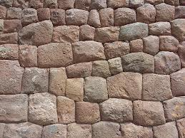

Slide 18
Aztec Temple

Slide 19
Aztec Temple

Slide 20
Record Keeping
The nobles conducted a census to count people so they could be taxed.
They did not have a written language.
They recorded information on knotted strings called quipus.
Each color represented a different item and knots of different sizes at different intervals stood for numbers.

Slide 21
Aztec Temple
Quipu

Slide 22
Religion
Like the Aztec, the Inca were also polytheistic.
The main god was the sun god.
Sacrifice was a big part of their religion—usually a white llama was used, but sometimes they sacrificed small children.
They also believed in reincarnation.

Slide 23
Sun God

Slide 24
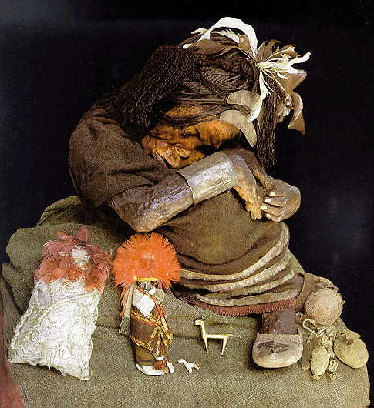
Incan Mummy
(Over 500 Years Old!)

