Slide 1
Early Civilizations
of
Latin America
European Impact on the
Aztec & Inca Civilizations

Slide 2
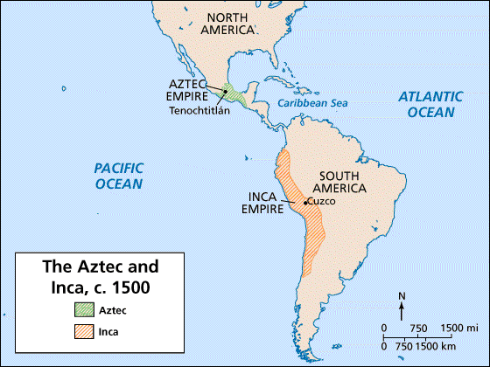

Slide 3
The Aztecs

Slide 4
Aztec Civilization
Aztecs arrived in the Valley of Mexico in 1100s (central Mexico, including present day Mexico City).
They wandered about looking for a home site until 1325.
Aztecs finally settled on an island in the middle of Lake Texcoco.
They built a magnificent city called Tenochtitlan (now Mexico City).

Slide 5
Aztec Temple

Slide 6
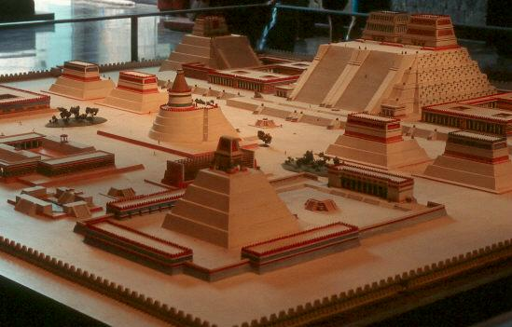
Diorama of Tenochtitlan

Slide 7
Tenochtitlan
This was the Aztec’s capital.
It was created in the center of a lake!
They built floating islands called “chinampas” by piling rich earth from the bottom of the lake onto rafts made of wood.
Roots of plants grew down to bottom, anchoring the rafts .

Slide 8
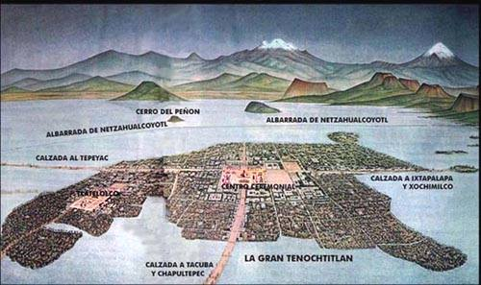
Tenochtitlan

Slide 9
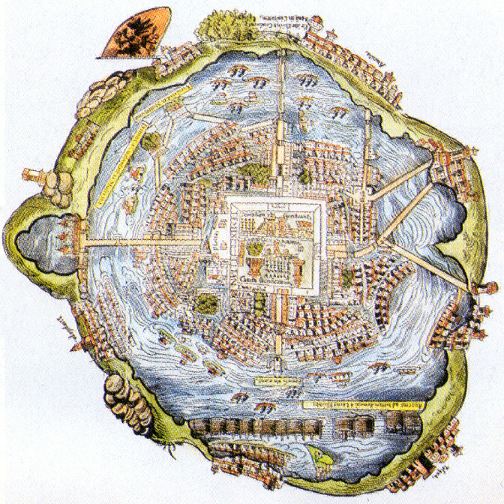

Slide 10
Chinampas

Slide 11
Expanding Empire
In the 1400s, Aztec warriors began conquering other people.
They made them pay taxes; noble Aztecs grew rich.
Aztecs had an emperor; the nobles and priests helped the emperor—all were very wealthy.
Not everyone was rich—most people were farmers.

Slide 12
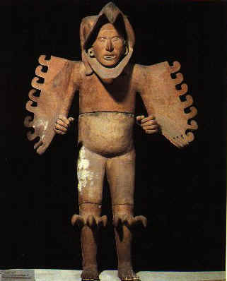
Eagle Warrior
Sculpture

Slide 13
Men’s Work
The Aztec were very involved in agriculture.
They used chinampas (man-made floating islands) to grow crops of vegetables, flowers, grasses, and medicinal plants.
They also hunted and fished.

Slide 14
Women’s Work
The Aztec women spent the day taking care of the children, cooking, knitting, and doing housework.

Slide 15
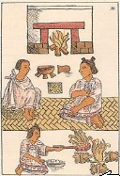
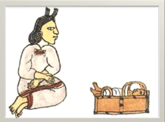
Women’s Work

Slide 16
Achievements
Doctors developed 1,000s of medicines from plants.
Astronomers predicted movements of the planets; designed an accurate calendar!
Priests kept extensive records using hieroglyphics.
Schooling - Boys studied either religion or military skills; girls learned cloth spinning and cooking.

Slide 17
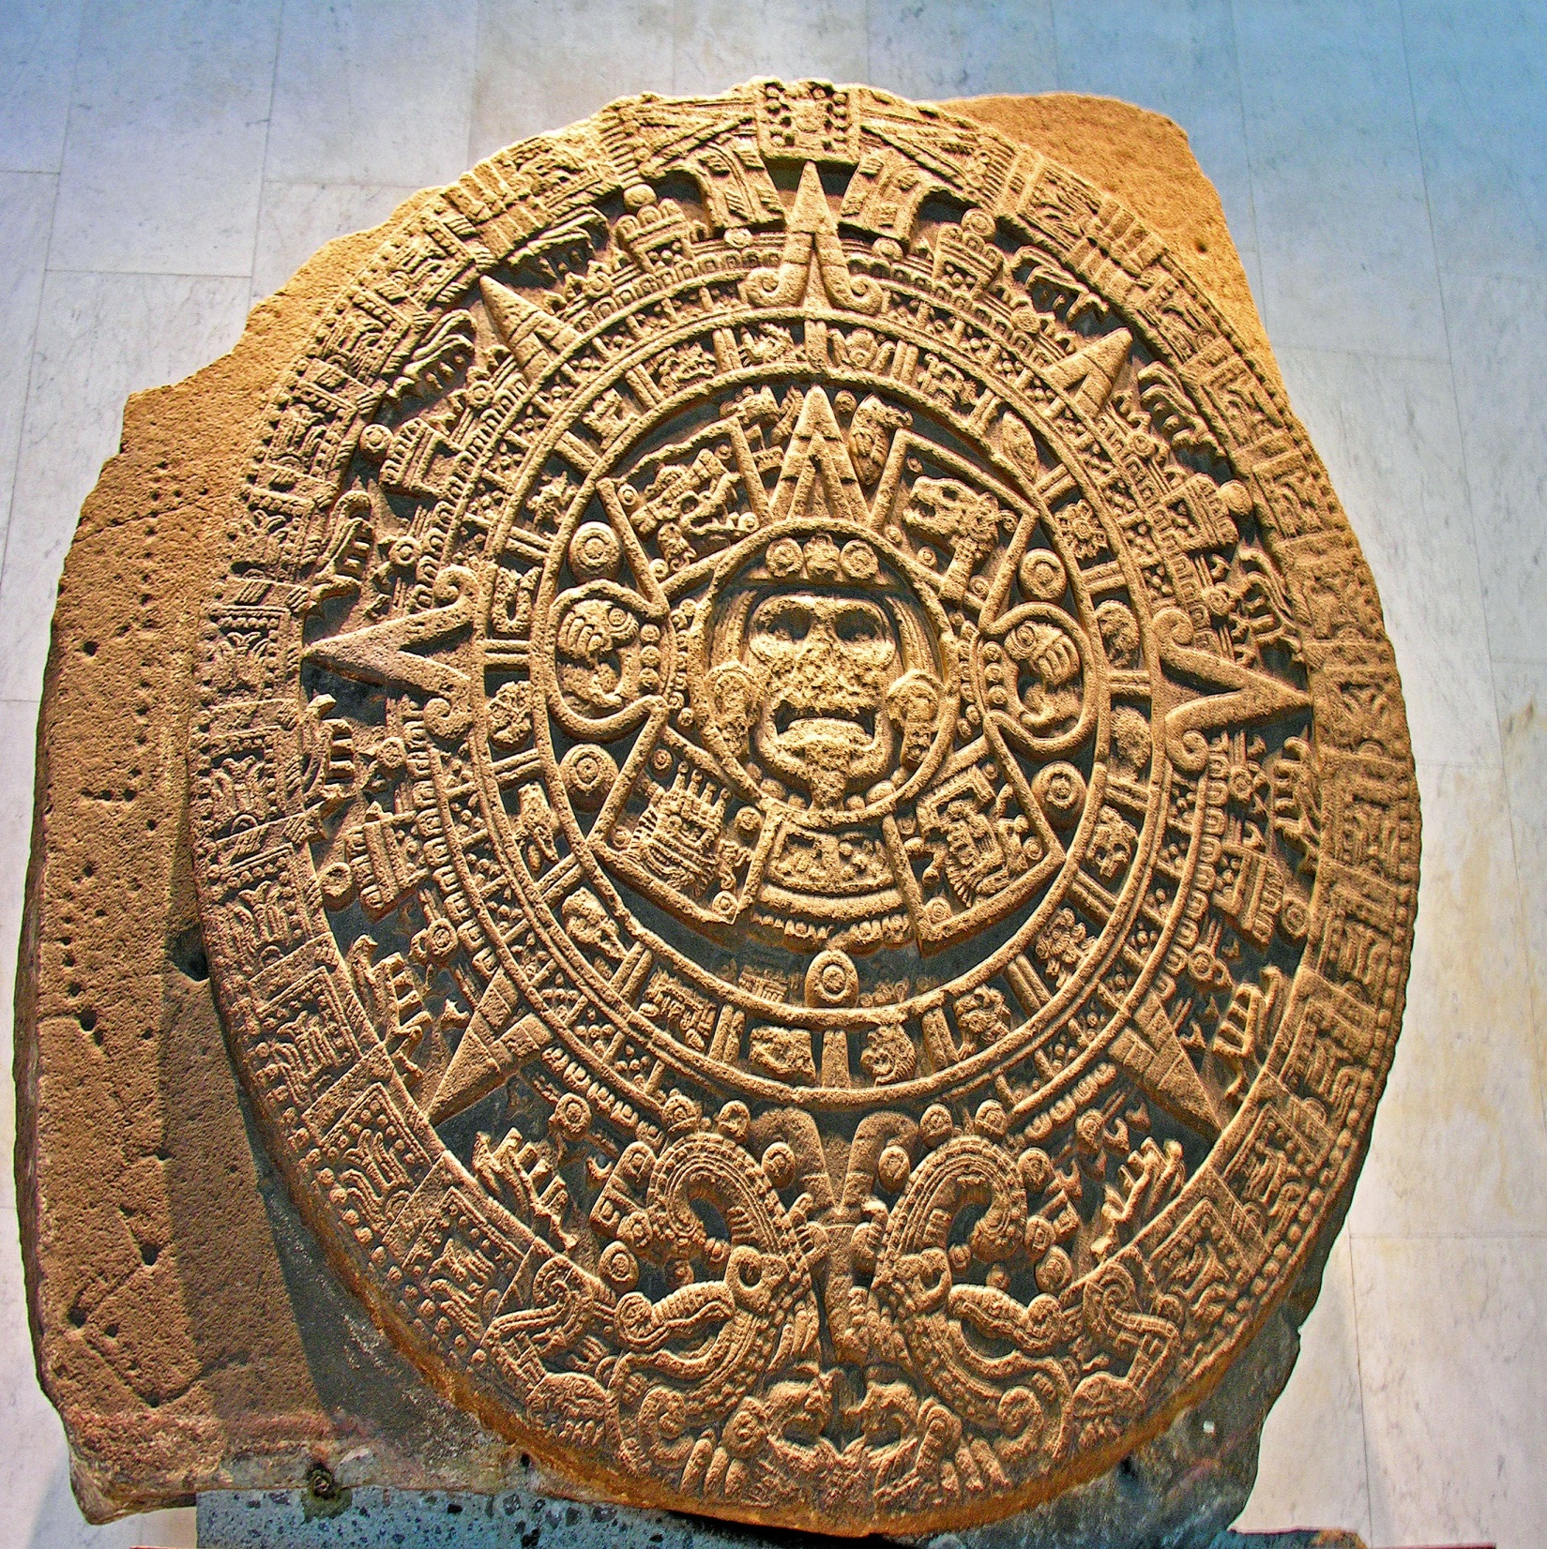
Aztec Sun Stone (Calendar)

Slide 18
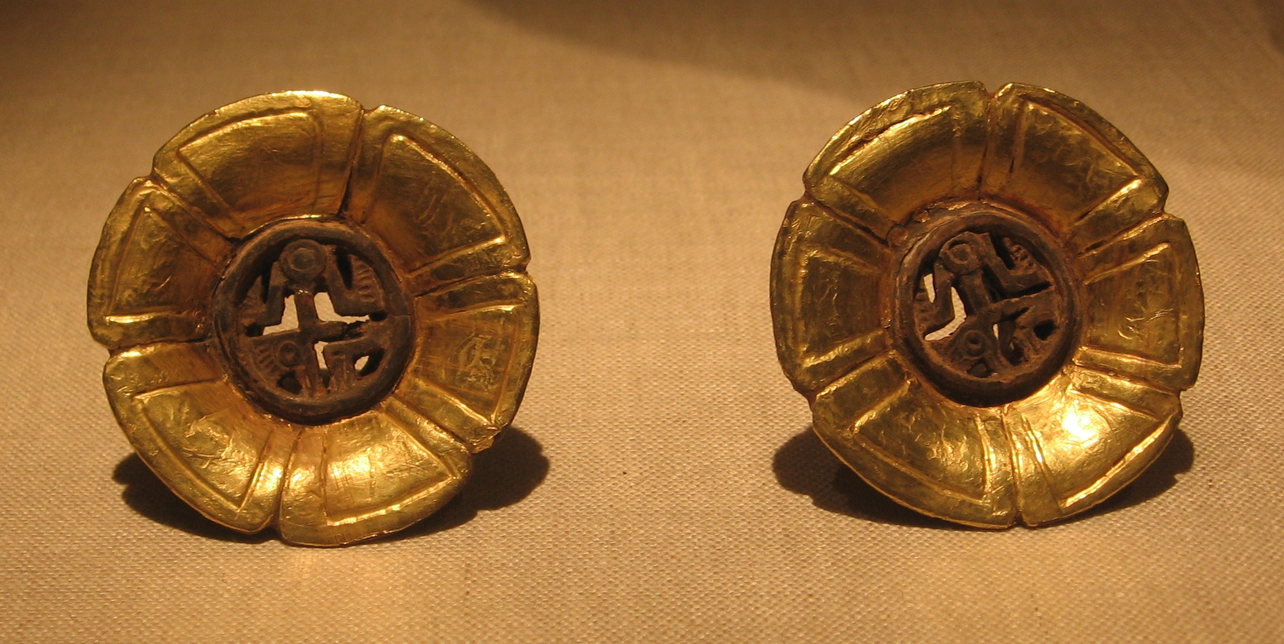
Aztec Golden “Ear Flares”

Slide 19
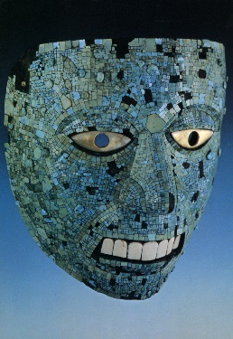
Mosaic Mask Inlaid
with Turquoise

Slide 20
Discipline
How did the Aztecs discipline children?
Some punishments included making them inhale smoke, holding them over fire in which spicy peppers where thrown, and puncturing their skin with thorns!
Maybe that’s what made the warriors so tough!

Slide 21
Aztec Discipline

Slide 22
Religion
Cities were religious centers; they worshipped their gods in pyramid-shaped temples.
Sacrifice was an important part of the religious ceremonies (meant to honor the gods).
Polytheistic (worshipped many gods): Sun, Death, Maize, Rulers, Rain, etc.

Slide 23
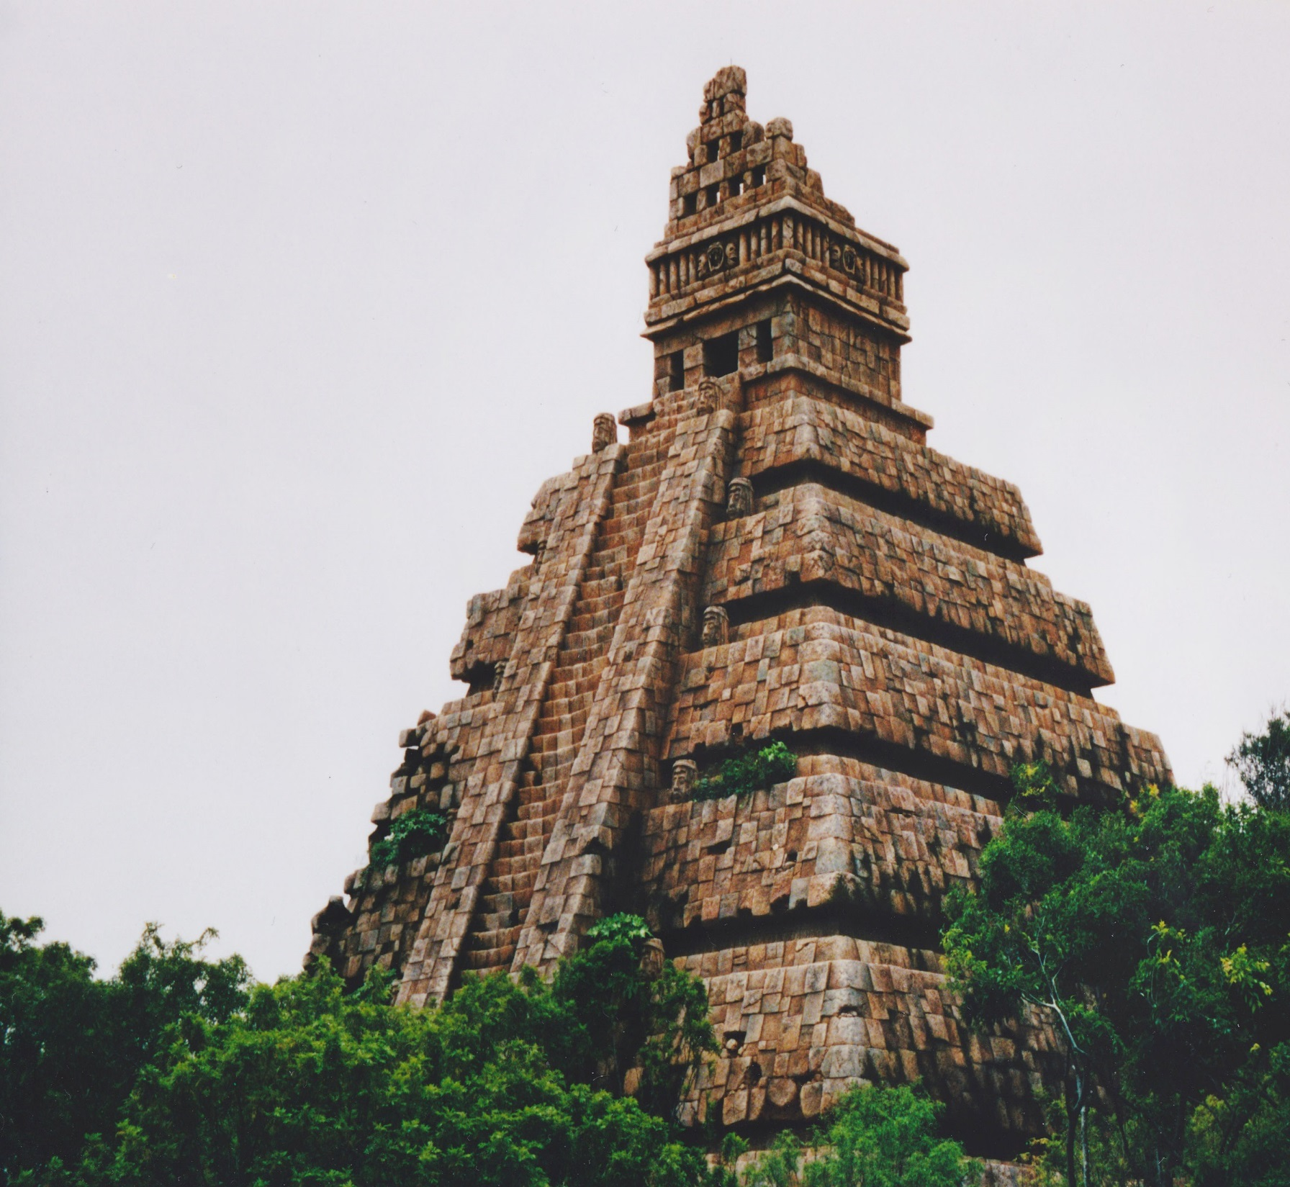
Aztec Temple

Slide 24
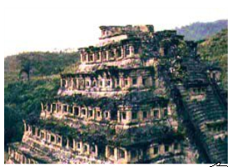
Temples
Instead of tearing down old temples, Aztec would just keep adding levels to the existing one.
This one was built over 6 times!
Rooms for sacrificing are at the top.

Slide 25
Aztec Temple

Slide 26
Religious Ceremonies
The bath was an important part of daily life--not only to be cleaned, but also to be religiously purified.
Most homes had a steam room attached to living quarters.
Other religious ceremonies included human sacrifices:
usually children or prisoners of war
felt that human hearts and blood strengthened the gods

Slide 27
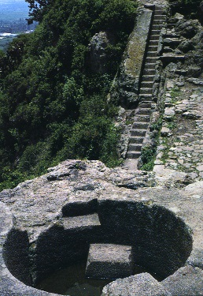
Aztec Bath

Slide 28
Aztec human sacrifice was on a greater scale than anywhere or any time in human history.

