Slide 1


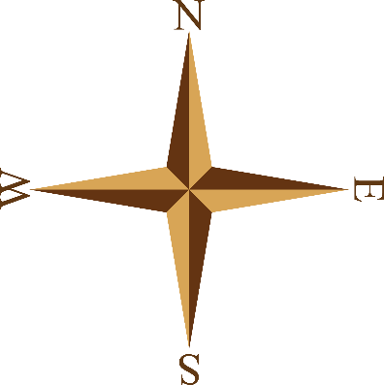

European
Exploration
& Colonization
Portugal, Spain, England, & France

Slide 2

The 3 G’s…
Why did Europeans go exploring?
GOLD
  New trade routes opened up opportunities for wealth.
GOD
  Missionaries wanted to spread Christianity.
GLORY
  Explorers were considered famous heroes; countries competed for colonies.

Slide 3
The Crusades (1095 – 1291)
The Crusades were military expeditions sent by the Catholic Church to capture the Holy Land from the Muslim Turks.
They were not successful, but did have a few positive results:
  Europeans learned to draw better maps and build better ships.
  Exposed Europeans to spices & goods from the East.

Slide 4
Trade Routes
In the 1400s, major trade routes from the East to Europe went through 2 Italian cities (Venice & Genoa).
Italian merchants marked up the prices on the goods & sold them throughout Europe.
Other European countries resented the huge profits made by Italians & began to look for other routes to the East…

Slide 5

Trade Routes
Europeans created new trade routes to bring products from Europe to India, China, & the Spice Islands.
This greatly contributed to the expansion of the empires of Portugal, Spain, England, and France.

Slide 6

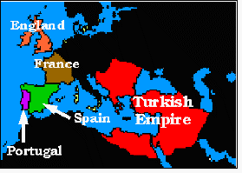

Slide 7
Portugal’s Empire
1n the 15th century , Portugal led the world in sea exploration and explored the western coast of Africa.
The Portuguese wanted to find a trade route around Africa to Asia because:
  They believed they could make a lot of money as traders if they could get Asian goods for a cheaper price.
  They also wanted to spread Christianity along Africa’s west coast.

Slide 8
Prince Henry the Navigator
He was the son of the Portuguese king.
He sent more than 50 expeditions down the west coast of Africa.
  He wanted to establish Portuguese colonies & break the Muslim hold on trade routes.
He also created a naval observatory that taught students navigation, astronomy, & cartography

Slide 9
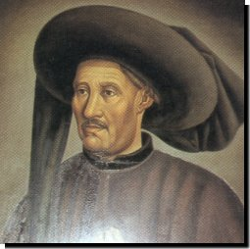
Prince Henry the Navigator

Slide 10
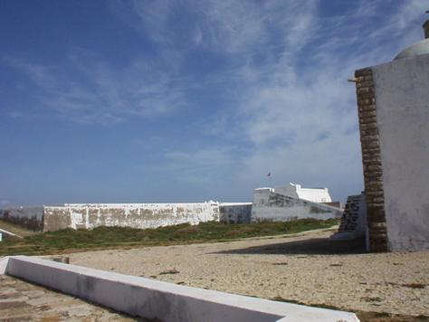
Institute of Sagres

Slide 11
Prince Henry the Navigator
He was unable to make much money trading gold, so he tried creating sugar cane plantations.
  Sugar cane was a very profitable crop, but required lots of labor.
Prince Henry imported slaves from Africa to work the fields.
  This was successful & was later copied in the New World.
  His actions encouraged a slave trade that lasted another 400 years…

Slide 12
Portugal’s Empire
For the next 300 years, Portuguese sailors continued to explore Africa where they established forts & trading posts.
  By 1571, a string of outposts connected Portugal to Africa, India, South Pacific Islands, & Japan
Portugal grew wealthy from these trade routes, but its most profitable colony was Brazil.

Slide 13
Spain’s Empire
Spanish explorers were searching for a trade route through or around North & South America to Asia.
  They wanted to find a quicker route to the gold & spices in Asia.

Slide 14
Christopher Columbus
In the 1490s, Columbus, an Italian, was given ships & sailors by the Spanish monarchy.
  They wanted him to try to find a quick route through the Atlantic Ocean to Asia.
He discovered the Bahamas, but thought he was in Asia.
Later, it was realized that he discovered 2 new continents!
Exploration of these areas brought great wealth to Spain.

Slide 15
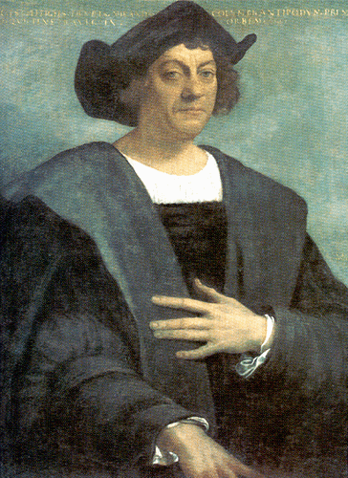
Christopher Columbus

Slide 16
Spain’s Empire
Spain had a huge empire that spanned the globe.
Spanish conquistadors conquered the Inca and Aztec civilizations in the 1500s (South America).
  They were looking for gold & spices.
  They used missionaries to convert natives to Christianity.
Spain claimed huge areas of North & South America & ruled over them for 300 years.

Slide 17
England’s Empire
In the past, England was one of three countries--England, Scotland, & Wales.
In the 1700s, the three united and became Great Britain.
The British empire was the largest in history.
  At its peak, Great Britain controlled: Canada, Australia, India, much of Africa, and numerous islands all over the world.

Slide 18
England’s Empire
North America came under British control in the 1700s.
  It lost the American colonies in 1776, but maintained control over Canada until the 20th century.
Great Britain colonized Australia in 1788.
  It was used as a penal (prison) colony to relieve overcrowded jails in England.

Slide 19
France’s Empire
France possessed colonies around the world from 1600 to 1900.
It also dominated much of the European continent.
  By 1812, France controlled much of Germany and Italy.

Slide 20
France’s Empire
France established other colonies in the 16th-17th centuries:
  --Islands in the Caribbean, the Indian Ocean, the South Pacific, the North Pacific, & the North Atlantic
France also maintained influence in Canada, South America, Southeast Asia, & Northwest Africa.

Slide 21
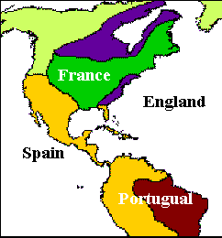

Slide 22
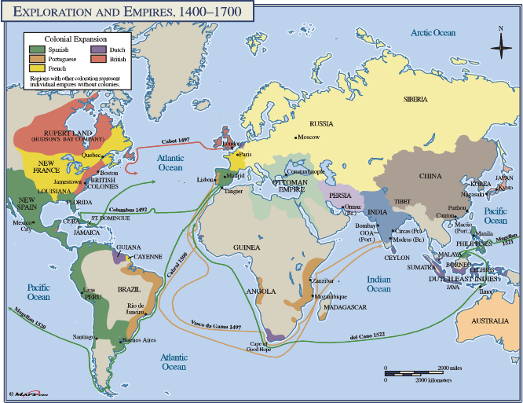

Slide 23
